Slide 1

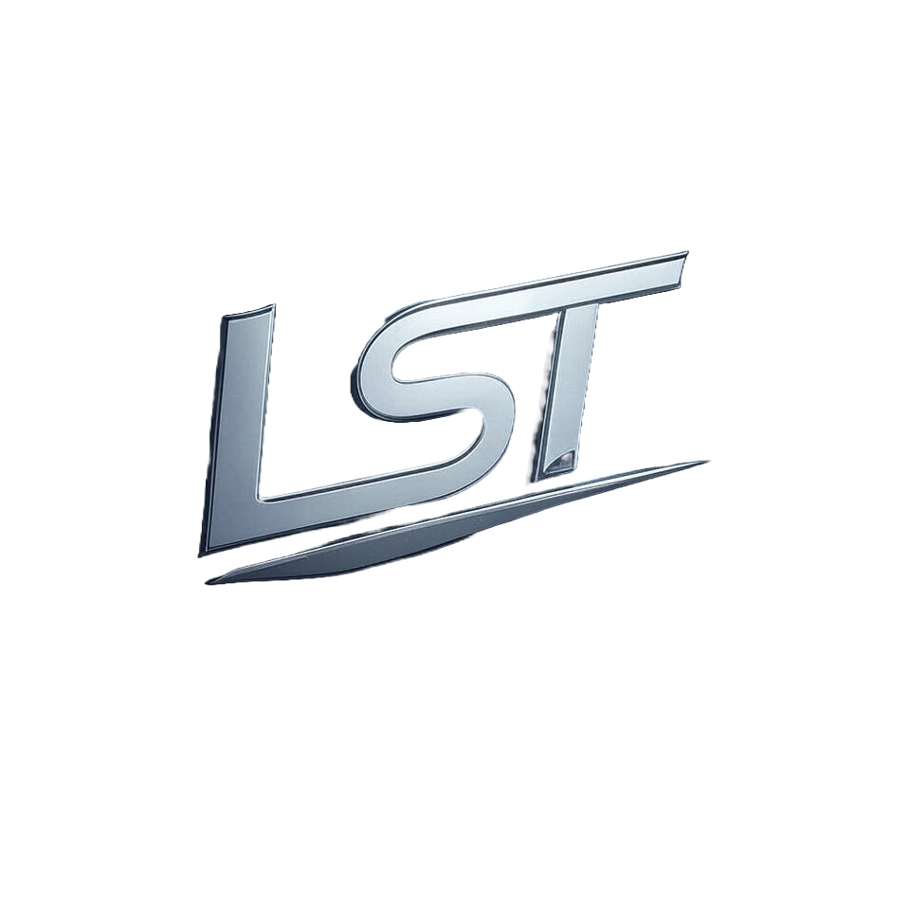
Ethereum Due Diligence Report

Slide 2
Table of Contents
1. Legal and Regulatory Compliance

Slide 3
1. Legal and Regulatory Compliance

Slide 4
Has the project obtained all necessary licenses and registrations?
Zerion's involvement with Ethereum and its development of smart contracts indicates their expertise within this blockchain ecosystem; however, there is no explicit confirmation in the provided context that Zerion has obtained all necessary licenses for operating specifically as an entity related to Ethereum. While it can be inferred from other parts of the text—such as obtaining a MICAR license expected to reduce regulatory hurdles and clarifications by French NCA on registration processes—that Zerion may have taken steps toward compliance with relevant regulations, there is no direct evidence confirming that they hold all necessary licenses specifically for their activities related to Ethereum. Their governance structure suggests an organizational commitment towards transparency which could imply adherence to certain legal requirements; however, without explicit confirmation of licensing details specific to the use and operation on the Ethereum platform by Zerion itself as a distinct entity or service provider within this ecosystem (e.g., operating under EtherionLab's name), we cannot conclusively state that all necessary licenses have been obtained for their activities related directly with Ethereum.

