Slide 1

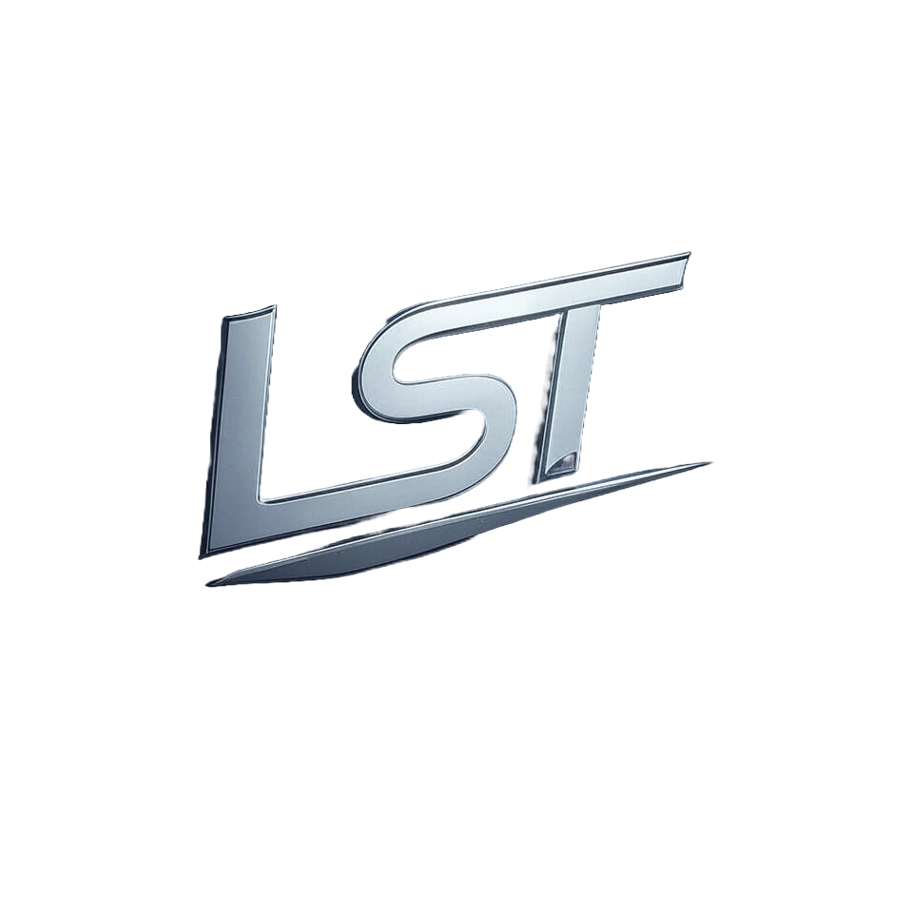
Ripple Due Diligence Report

Slide 2
Table of Contents
1. Legal and Regulatory Compliance

Slide 3
1. Legal and Regulatory Compliance

Slide 4
What is the legal structure of the entity behind the digital asset?
Ripple's legal structure is that of Ripple Labs Inc., which was founded as OpenCoin, Inc. in 2012 by Chris Larsen and Jed McCaleb before rebranding to its current name in 2015. As a private company incorporated under Delaware law (likely due to the state's favorable corporate laws), it operates with certain protections for shareholders while also adhering strictly to regulatory requirements set forth both at state level, such as those imposed through incorporation into Delaware's legal system and federal regulations. Ripple Labs Inc.'s status is not publicly disclosed in terms of its specific internal governance structure or shareholder details; however, the company's compliance efforts are evident from obtaining approvals like that by New York State Department of Financial Services (DFS) for operating a payment remittance service. The company has also received regulatory approval and licenses to operate as an authorized money transmitter under various jurisdictions including Singapore's Monetary Authority. (Continued on next slide...)

Slide 5
(Continued) What is the legal structure of the entity behind the digital asset?
These recognitions indicate Ripple Labs Inc.'s commitment towards maintaining compliance with international financial regulations, which is crucial given the nature of its operations in cross-border payments using blockchain technology for facilitating transactions that are typically subject to stringent oversight by regulatory bodies. In summary: Ripple operates as a private Delaware corporation under the name Ripple Labs Inc., following strict adherence and obtaining necessary approvals from various jurisdictions.

