Slide 1

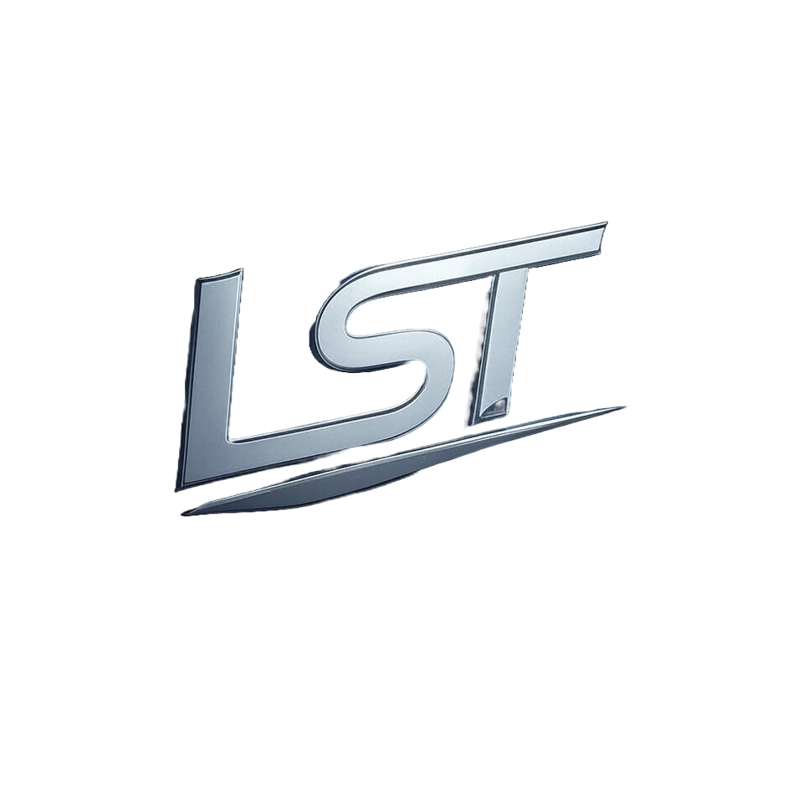
Cosmos Due Diligence Report

Slide 2
Table of Contents
4. Team and Governance

Slide 3
4. Team and Governance

Slide 4
How are governance proposals submitted, voted on, and executed?
In Cosmos' governance framework: **Proposal Submission:** Proposals are submitted by validators or delegates (token holders who delegate their voting power). These proposals take form as smart contracts deployed onto Ethereum's blockchain. The Maker Protocol utilizes MKR tokens for this purpose, with each proposal detailing the proposed change and its implementation strategy. **Voting Process:** - **Single-action vs Delegating Proposals:** Cosmos employs two types of governance mechanisms—single-action (SAPC) which is used when a one-time decision suffices; delegating proposals (DPC), where continuous voting on complex decisions occurs. SAPCs are simpler, allowing for immediate execution upon approval. DPCs involve ongoing votes by delegates who hold MKR tokens and have delegated their governance power to others. - **Voting Power:** The weight of a vote is proportional to the number of MKR tokens held or controlled through delegation within Cosmos' ecosystem. Delegates can change which validators they delegate voting rights to, allowing for dynamic shifts in influence during ongoing DPCs. (Continued on next slide...)

Slide 5
(Continued) How are governance proposals submitted, voted on, and executed?
This flexibility ensures that active participants with vested interests have their say. **Execution:** - **Proposal Execution:** Upon approval (meeting a predefined quorum and substantial majority), the smart contract representing approved proposals is executed on Ethereum. The execution process updates internal governance variables within Cosmos, reflecting new rules or changes as specified by successful DPCs. This may involve software upgrades to accommodate constitutional amendments. **Governance Dynamics:** - **Internal Governance Variables:** Changes proposed through voting directly affect these variables that govern the Maker Protocol's operational parameters and consensus mechanisms. These updates are crucial for maintaining system integrity, adapting governance structures in response to evolving needs or identified vulnerabilities within Cosmos' ecosystem. In essence, Cosmos employs a sophisticated yet flexible approach towards decentralized decision-making by leveraging Ethereum-based smart contracts (MKR tokens) as its primary tool of engagement—ensuring transparency and active participation from the community through both SAPCs for immediate decisions and DPCs for ongoing governance matters.

