Slide 1
Blockchain Solutions for Emerging Economies
Revolutionizing Transactions and Trade

Slide 2
Introduction to ABJCoin
ABJCoin is Nigeria's blockchain solution for global payment transactions.
It aims to revolutionize the Nigerian economy and financial sectors.
Notes:
ABJCoin is built on blockchain technology, ensuring secure and transparent transactions.

Slide 3
ABJCoin's Potential Impact

Slide 4
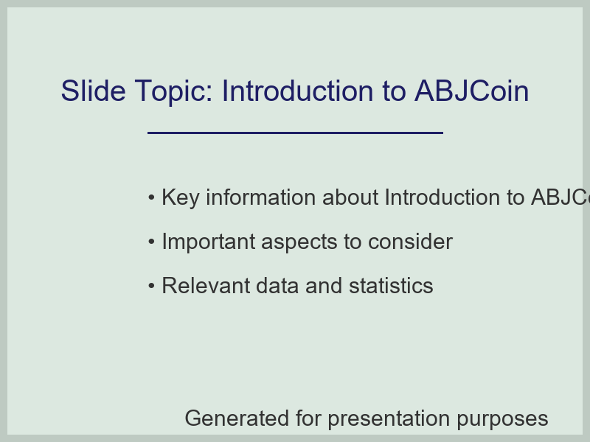
Introduction to ABJCoin

Slide 5
The Problem with Traditional Payment Systems
High transaction fees and long processing times hinder financial inclusion.
Traditional systems are often insecure and prone to fraud.
Notes:
ABJCoin's blockchain-based solution addresses these issues.

Slide 6
Transaction Fees Comparison

Slide 7
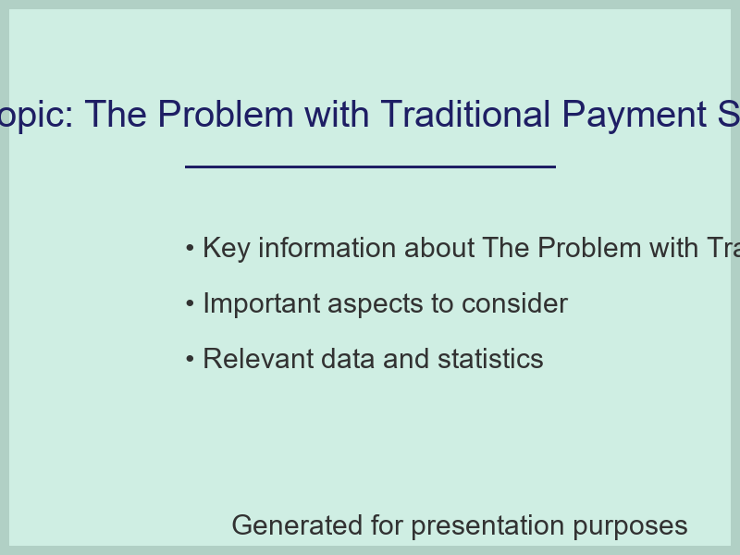
The Problem with Traditional Payment Systems

Slide 8
ABJCoin's Features and Benefits
Decentralized and secure transaction processing.
Fast and low-cost transactions.
Notes:
ABJCoin's features make it an attractive alternative to traditional payment systems.

Slide 9
ABJCoin's Market Share

Slide 10
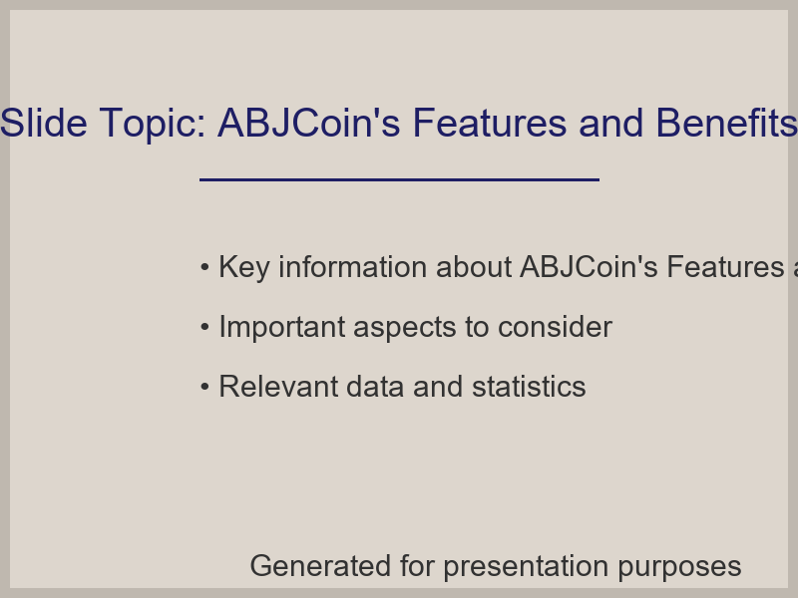
ABJCoin's Features and Benefits

