Slide 1
Blockchain Technology and Smart Contracts
Secure and Scalable Solutions

Slide 2
Introduction to Blockchain
Blockchain is a distributed ledger technology
It enables secure and transparent data storage and transfer
Notes:
Blockchain is the underlying technology behind cryptocurrencies like Bitcoin and Ethereum

Slide 3
Blockchain Adoption Rate

Slide 4
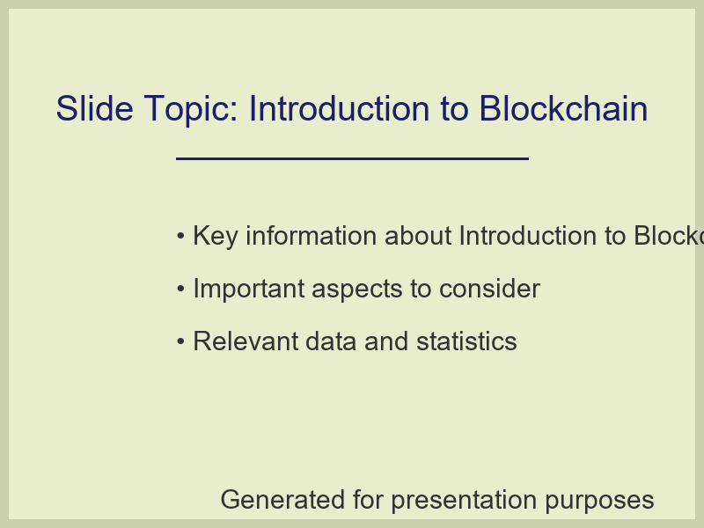
Introduction to Blockchain

Slide 5
Smart Contracts
Smart contracts are self-executing contracts with the terms of the agreement written directly into lines of code
They automate the enforcement and execution of contractual obligations
Notes:
Smart contracts have the potential to revolutionize various industries by increasing efficiency and reducing costs

Slide 6
Smart Contract Usage

Slide 7
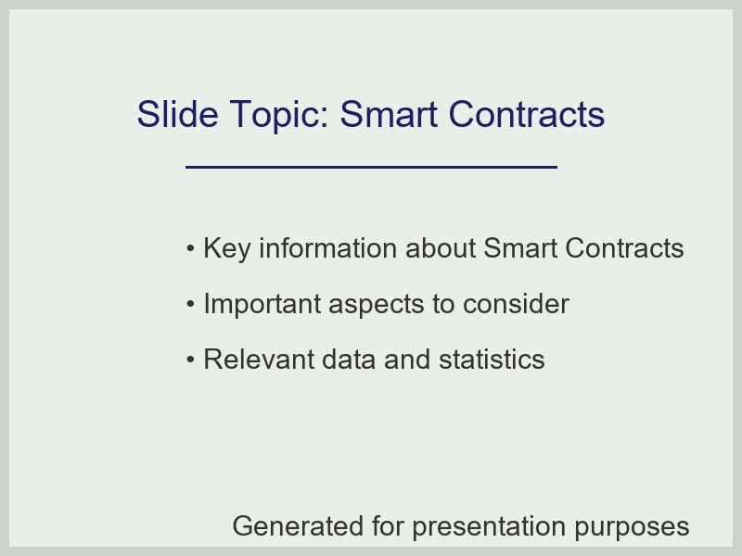
Smart Contracts

Slide 8
Blockchain Security
Blockchain technology provides a secure way to store and transfer data
It uses advanced cryptography and a decentralized network to prevent tampering and unauthorized access
Notes:
The security of blockchain technology is one of its most significant advantages

Slide 9
Blockchain Security Measures

Slide 10
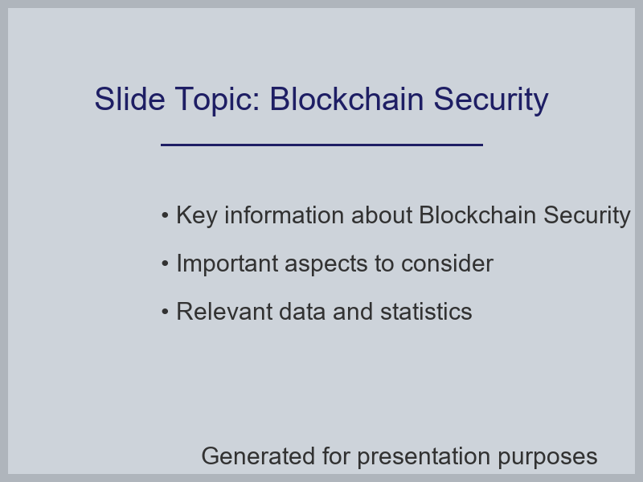
Blockchain Security

