Slide 1
Main Risk in Crypto
Understanding the risks associated with cryptocurrency investments

Slide 2
Risk of Regulatory Changes
Changes in regulations can impact the value of cryptocurrencies
Governments and regulatory bodies can impose restrictions on cryptocurrency use
Notes:
Regulatory changes can have a significant impact on the cryptocurrency market

Slide 3
Regulatory Risk

Slide 4
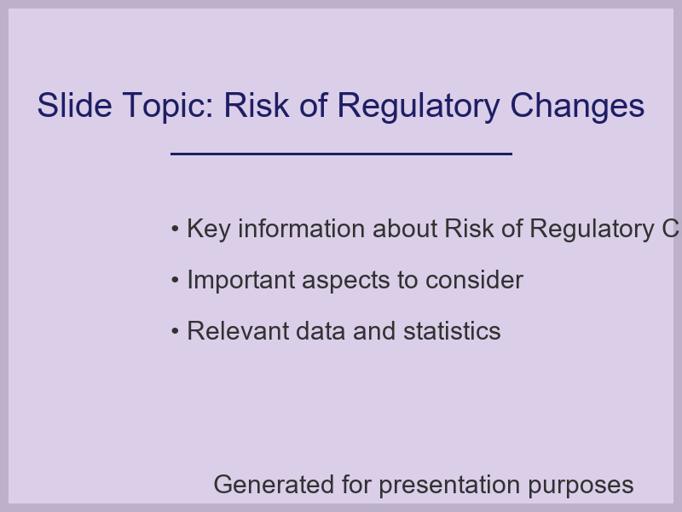
Risk of Regulatory Changes

Slide 5
Risk of Security Breaches
Cryptocurrency exchanges and wallets can be vulnerable to hacking
Security breaches can result in significant financial losses
Notes:
Security breaches are a major risk in the cryptocurrency space

Slide 6
Security Breach Risk

Slide 7
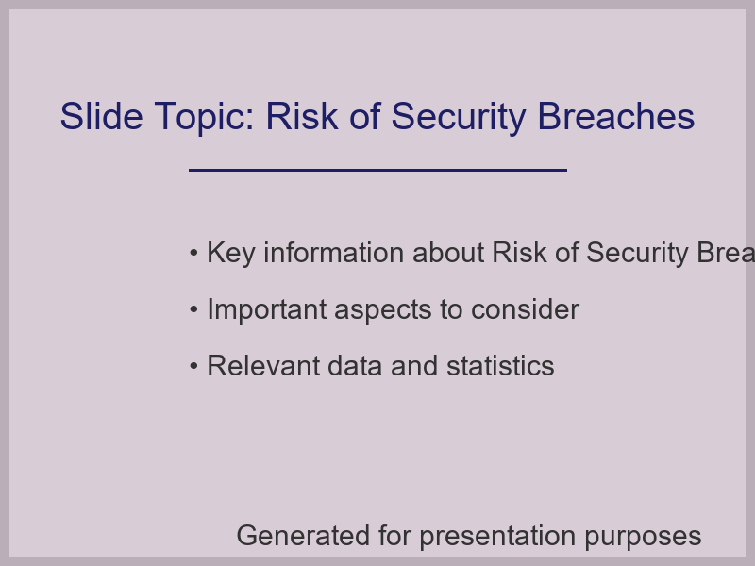
Risk of Security Breaches

Slide 8
Risk of Market Volatility
Cryptocurrency markets can be highly volatile
Market fluctuations can result in significant financial losses
Notes:
Market volatility is a significant risk in cryptocurrency investments

Slide 9
Market Volatility Risk

Slide 10

Risk of Market Volatility

