Slide 1

Co mmerc ial Due Diligenc e
Po werPo int Temp late
Co mple te PowerP oint template for high- quality, compre hens ive due
dilige nc e re po rts and investment theses

Slide 2

Objec tiv es of thi s template
The Due Diligence template includes a fully s tructured due diligence report complete with ready -to-us e s lides, as well as
framewo rks , to ols, real-life examples, and best practic es to help you:
Conduct a due diligence of a target company using a bes t-practice hypothesis-driven approach, ensuring a holistic assessment of the
attractiveness of the target’s market, strength of the company, and feasibility of business plan
Analyze the target’s financial position and financial statements
Analyze the market attractiveness and dynamics
Create an overview of the target’s competitive advantage and market positioning
Discuss and evaluate the commercial attra ctivene s s of the target
Create and present a co mplete commercial due diligence report as part of your larger M&A process
Get inspiration from real-life case exa mples on how other due diligence re p orts look like
2

Slide 3

The Due Diligenc e template is a s upporting to ol for you to use as p art of yo ur
broader M&A proces s
Phas e 1
Phas e 2
Phas e 3
Phas e 4
Phas e 5
P os t-merger
M&A Strategy
Target Identific atio n
Due Diligence
Trans action
Exec utio n
In tegratio n
1. M&A objectives
1. Target identification
1. Due diligence project plan
1. S tructure of deal
1. Post-merger strategy and
high-level plan
2. O rganiz ing for M&A
3. G uiding principles
4. Target screening criteria
2. Data collection and
high-level assessment
2. Due diligence hypothesis
framework and approach
2. Negotiation strategy
3. S igning and clos ing
2. Day 1 readiness
3. 100-day plan
3. Target shortlisting
3. C omme rcial, financial,
operations , IT,
4. Indicative valuation and
financial analysis
manage me nt, legal and
environmental due
diligence
4. Synergy realization and
detailed integration plans
5. Target approval for due
diligence phase
5. Implementation and
mo nito ring
4. Financial modelling
and business case
6. Initiation of contact and
letter of intent
5. Synergy assessment
6. S ummary of s trate gic
re comme nda tions
7. Next steps
3

Slide 4

The Due Diligenc e template focus es on the c o mmercial part of a due diligence
proces s (a CDD)
A
B
C
D
E
F
G
Comme rcial
Operational
Financial
Legal
IT and tec h
Environmental
Mana gemen t
• Market size,
gro wth, tre nds ,
and competitors
• O pe rational
• A djus tme nts to
P&L and balance
sheet (incl. tax)
• IP rights
• Technology
• Compliance and
• Key employee
assessment and
re mune ra tion
packages
efficiency
• C ontra cts
• Insurance
pla tfo rms
reporting of ESG
• S upplier
• Tech roadmap
• Customer and
opportunities
and dependency
• Financial
• ERP systems
and CAPEX
value propos ition
performance
• Financials,
s trate gy, and
plan
• R&D and pipeline
• Budget accuracy
and level of
inve s tme nts
re po rting
Fo cus of this
template
4

Slide 5
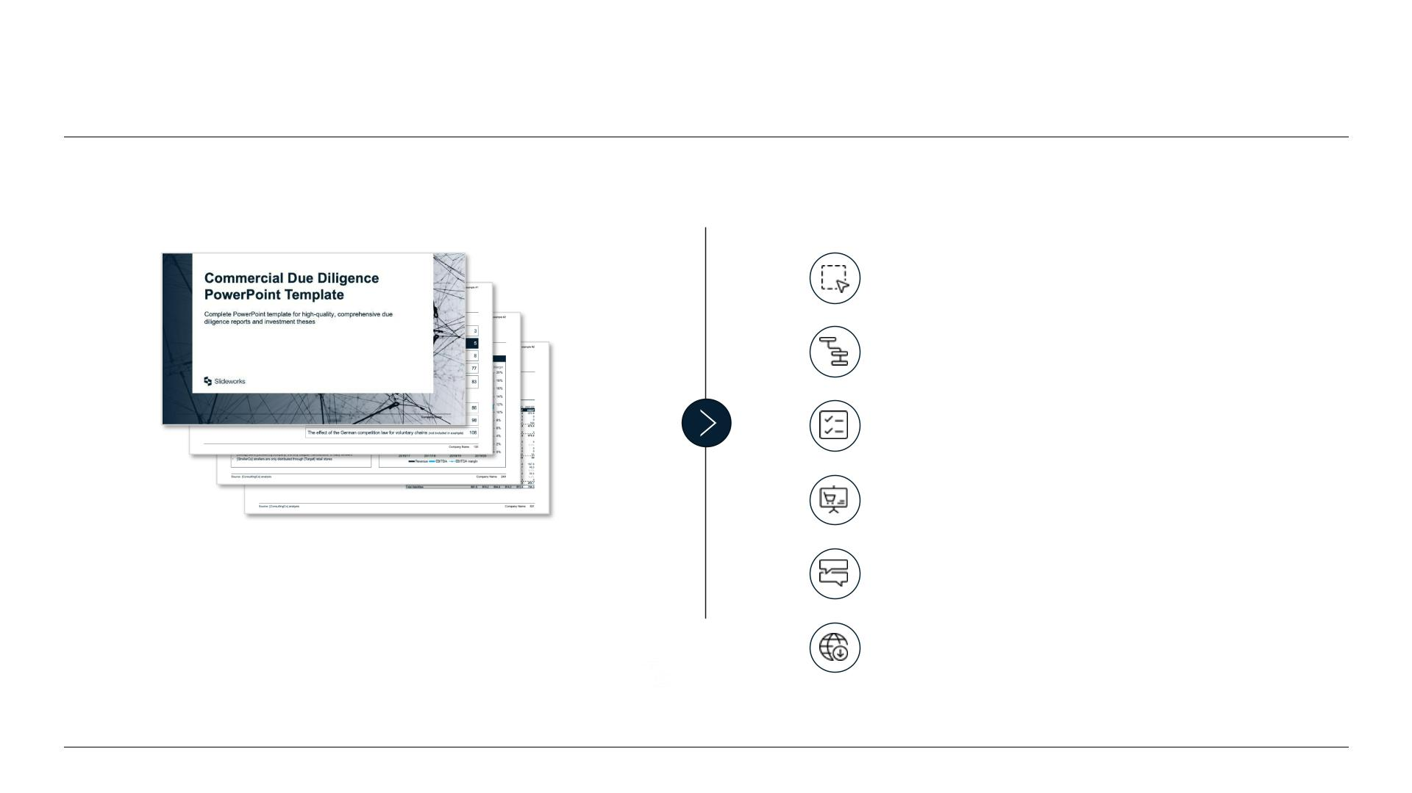
Th is te mp late inc ludes ev ery thing you need to c reate your own high -
qu al ity, well-s truc tured due diligence pres entation
Inc luded with this to o lkit:
Fully editable slides with best-practice
la youts
C omplete storyline based on proven
and tested due diligence re p orts
Best-practice hands-on guide and
helpful checklist
Three real-life case exa mples for
inspiration and guidance
329
6
Free support from our senior ex-
McKinse y, BCG and Bain consultants
PowerP oint slides
Excel file s
Free access to future update s
5

Slide 6
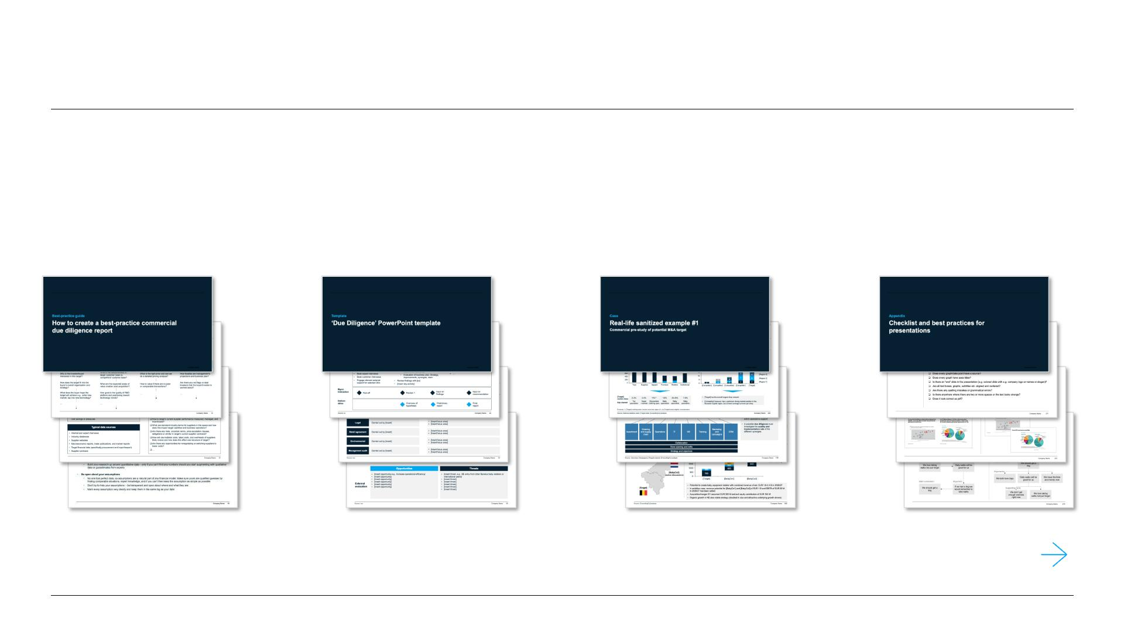
The Due Diligence (CDD) te mp late is s tructured in four main pa rts
Part 1
Part 2
Part 3
Part 4
Best practice guide on
cre a ting CDDs
S tructure d co mme rcia l
due dilige nc e template
Thre e full- le ngth,
real- life C DDs
Cons ulting che cklist
and tips and tric ks
See more de tails of each section in following pages
6

Slide 7
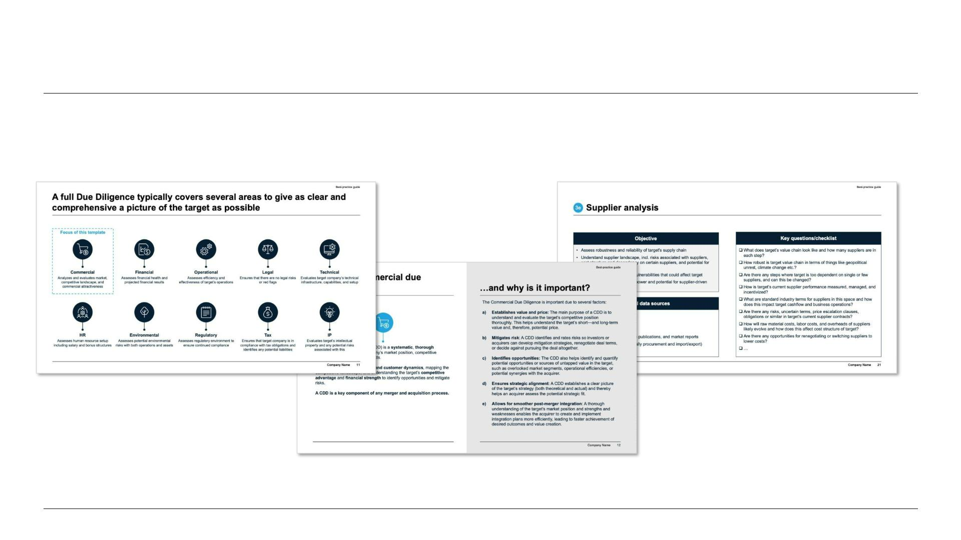
Part 1: Get a tried- and- tes ted bes t-practice guide on s truc turing an
effec tiv e co mmerc ial due dilig enc e pres entatio n
7

Slide 8
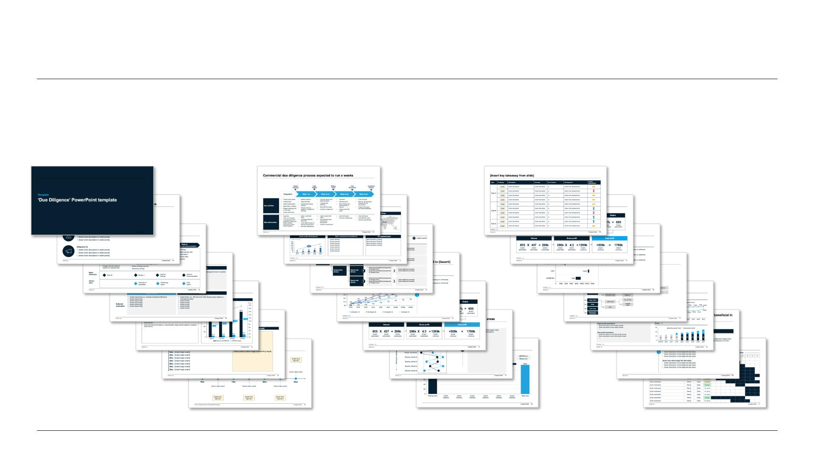
Part 2: The full c o mmercial due diligence temp late with s tructured
s ections and multiple vers io ns of s lides for you to choos e from
89 fully editable template s lides in a complete and s tructured sto ryline with action titles , ready -to-us e graphs ,
s ugges ted formatting and mo re:
8

Slide 9
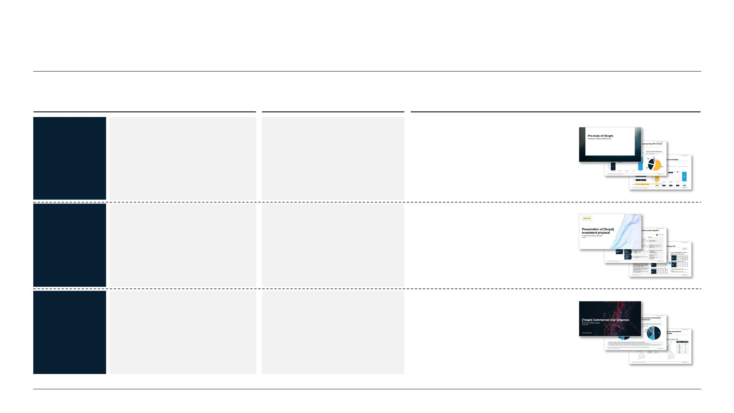
Part 3: Thre e dif ferent s anitized cas e s tudies to show you wha t a due
diligence rep o rt can look like in real - life cas es
Case
Main purpos e
Typ es of analysis included
• Target development and pos ition
Buyer- s ide commercial due
diligence of G erman- based
wholesale and retail chain to
assess potential attractiveness
• Q ualitative and quantitative ma rke t
Real-life cas e
example #1
Commercial pre-study of
potential M&A target
dynamics and competitive landscape
• P ossible market expansion strategies
for target
• Quantitative and qualitative
market development
Real-life cas e
example #2
Investment proposal prepared
for Belgian baby equipment
provider to potential buyers
• Business case with base case
S ell- side investment proposal
and ambition case
• Detailed financial analysis and
valuation method
Outside-in assessment of UK-
based consumer foodservice
provider’s market and
• Competitive lands cape and ta rge t
Real-life cas e
example #3
Market and competitor analysis
as part of a commercial due
diligence
positioning
• Quantitative market development
• Potential impact on target
co mpe titive landscape
9

Slide 10
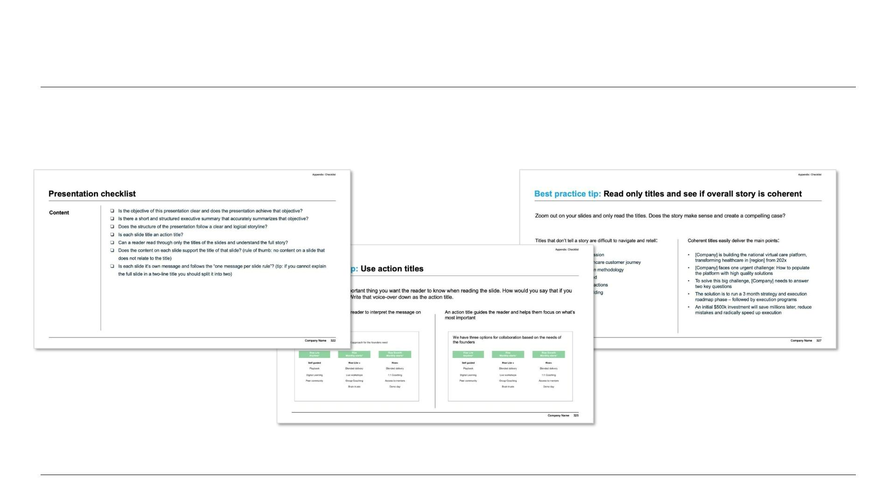
Part 4: A helpful chec klis t and management cons ulting tip s and tricks to
take your pres entation to the next level
10

Slide 11
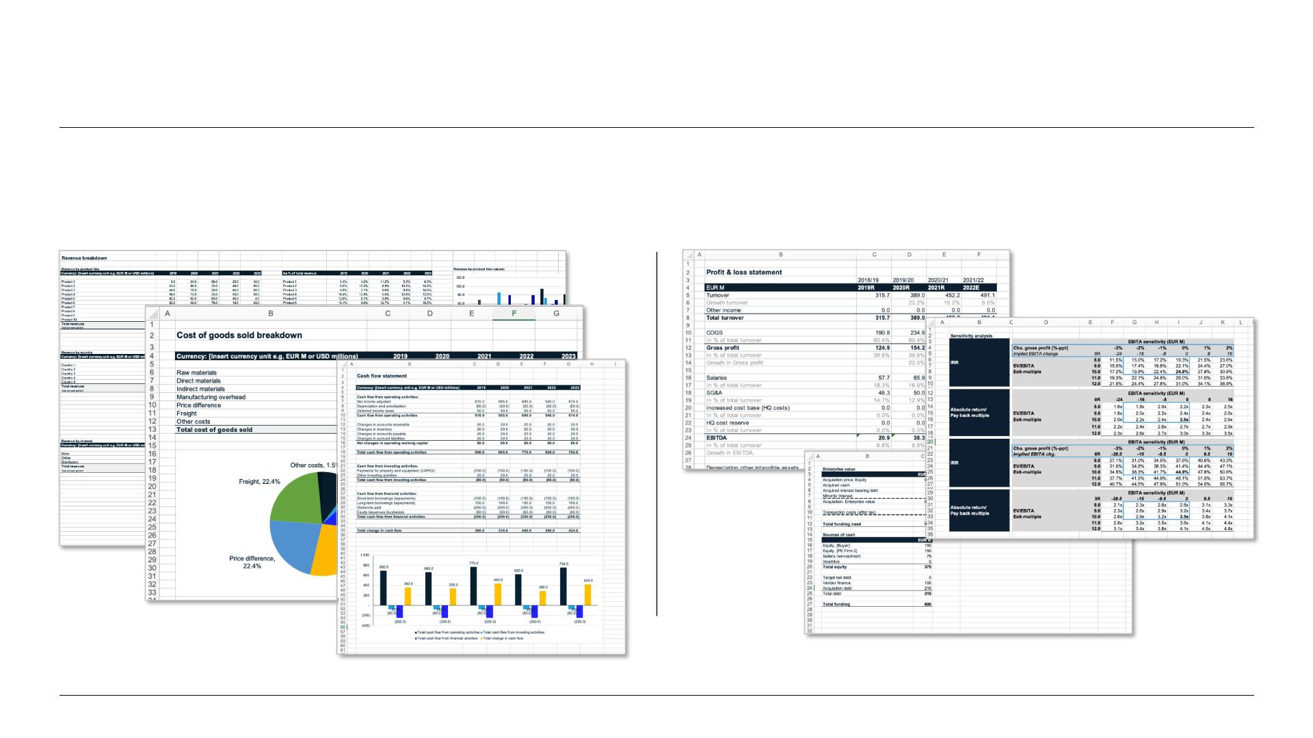
In additio n, the template includes s everal fully editable Ex cel s heets to
s upport your due diligence, as wel l as the files fro m one cas e ex ample
Ready-to-use financial templates…
…and all files from one case example
11

Slide 12

Money back gu arantee
We want you to be s a tis fied, so all eligible
templates purchas ed on Slideworks can be
re funde d within 30 day s of purchas e.
For whatever reason, if you are unhappy
with a te mplate , you can request a re fund .
S imply email us atinfo @ s lideworks .io and
we will start the process.
Most refunds are returne d via the origina l
payment method.
Note that we retain the right to only refund a customer’s first
purchas e. Please see our terms and co nditio ns for detailed
info rma tio n.
12

Slide 13


