Slide 1

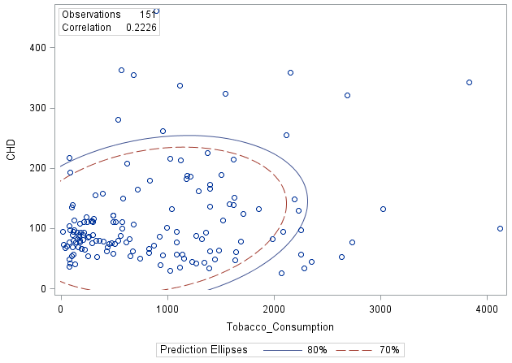
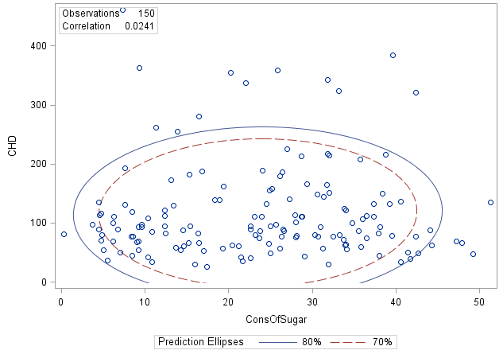
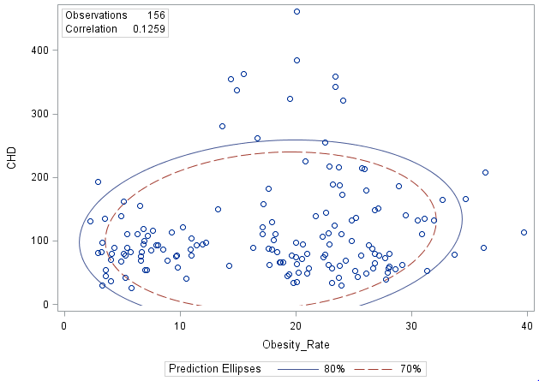
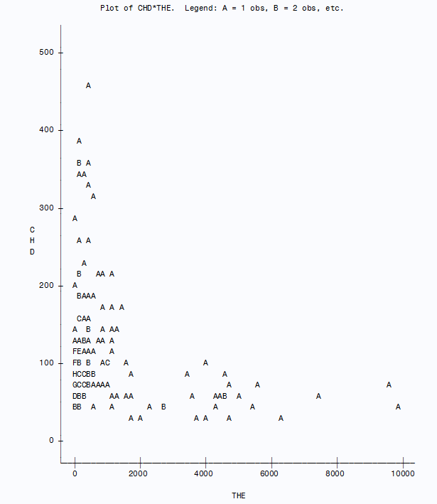
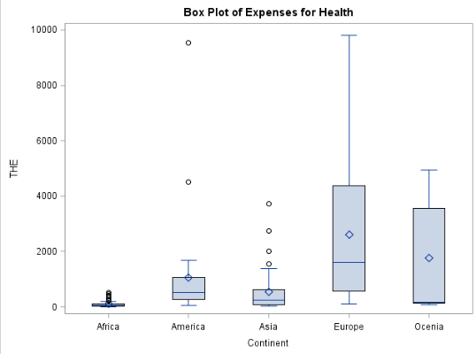
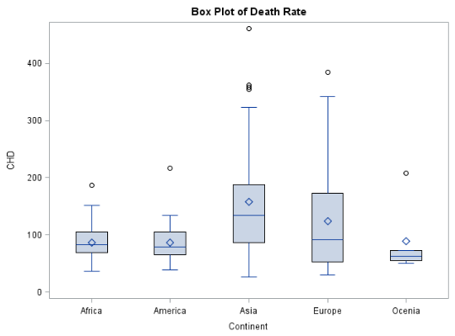
CORONARY HEART DISEASE Bennur Kaya, Beste Karaçay, Merve Erşahin Department of Statistics, Middle East Technical University
Also, these two box plots shows us the expenses for health of continents and the death rate because of CHD according to continents. It can be concluded that when health expenses increase, death rate decreases.
The second question is to test which variable increases the death rate because of CHD more.
INTRODUCTION
Coronary heart disease (CHD) refers to a narrowing of the coronary arteries, the blood vessels that supply oxygen and blood to the heart.
Research suggests that CHD starts when certain factors damage the inner layers of the coronary arteries. The problem to be investigated is how these factors affect this disease.
Our dataset consists of 3 categorical and 7 numerical variables.
Our aims are;
To see whether there is a relation between CHD (death rate because of Coronory Heart Disease) and expenses for health according to continents.
There is no exactly one reason for the disease and we want to check which one of the variables causes more risk.
2.Multiple Regression Analysis
Country | Continent | CHD | CHD LEVEL | Life Exp. | Inactivity | Cons. Of Sugar | Obesity_Rate | Tobacco Cons. | THE
Malta | Europe | 87.92 | Low | 82 | 71.90 | 44.1 | 26.6 | 1266.14 | 3471
Swaziland | Africa | 62.63 | Very Low | 57 | 69.00 | 20.4 | 17.7 | 427.08 | 233
Saudi Arabia | Asia | 165.67 | Very High | 75 | 68.80 | 29.4 | 34.7 | 1395.14 | 1194
Argentina | America | 93.87 | High | 76 | 68.30 | 38.1 | 26.3 | 1359.4 | 998
From the scatter plots, it can be concluded that tobacco consumption, obesity rate and consumption of sugar have weak correlation with death rate because of CHD.
Table 1. Summary of data.
*CHD=Death Rate because of Coronary Heart Disease
*THE=Expenses for Health
*Life Exp.= Life Expectancy
Statistical Analysis
1. Relationship between expenses for health and death rate because of CHD
CHD=98.460+0.0189*TobaccoCons+1.403*Obesity-1.073*ConsOfSugar
According to model, it is seen that tobacco consumption and obesity have positive effect on death rate because of CHD. That means, if obesity increases 1 unit, death rate due to coronary heart disease increases 1.40 unit.
Although tobacco consumption has the highest correlation, it doesn’t have the highest effect.
Conclusion
According to analysis results, expenses for health of continents have an effect on death rate due to coronary heart disease. If health expenses increase, death rate decreases. Moreover, unlike obesity and tobacco consumption, sugar consumption has a negative effect on CHD.
Future Study
To obtain more satisfying results, you can find other factors that might have an effect on CHD such as genetic factors, high levels of cholesterol or happiness.
To improve the data, number of missing values can be decreased.
Graph 1. Scatter plot of CHD and expenses for health.
A= 1 obs., B= 2 obs. etc.
Here, in this scatter plot, it can be seen that there is a negative relationship between the rate of death due to CHD and the health expenses.
REFERENCES
Coronary Heart Disease Death Rate per 100,000 (2014). Retrieved from http://www.worldlifeexpectancy.com/cause-of-death/coronary-heart-disease/by-country/
List of countries by cigarette consumption per capita (2018). Retrieved from http://www.wiki-zero.com/index.php?q=aHR0cHM6Ly9lbi53aWtpcGVkaWEub3JnL3dpa2kvTGlzdF9vZl9jb3VudHJpZXNfYnlfY2lnYXJldHRlX2NvbnN1bXB0aW9uX3Blcl9jYXBpdGE
List of countries by total health expenditure per capita (2015). Retrieved from http://www.wiki-zero.com/index.php?q=aHR0cHM6Ly9lbi53aWtpcGVkaWEub3JnL3dpa2kvTGlzdF9vZl9jb3VudHJpZXNfYnlfdG90YWxfaGVhbHRoX2V4cGVuZGl0dXJlX3Blcl9jYXBpdGE
REPORT: OBESITY RATES BY COUNTRY (2017). Retrieved from https://renewbariatrics.com/obesity-rank-by-countries/
Sugar Consumption Per Capita by Country (2011). Retrieved from http://www.helgilibrary.com/indicators/sugar-consumption-per-capita/
Graph 2. Box Plot of Continents and Expenses for Health
Graph 3. Box Plot of Continents and Death Rate because of CHD

