Slide 1
MICRO PROJECT

Slide 2
INDEX
TOPIC
INTRODUCTION
DESIGN
IMPLEMENTATION
a) program script
b)output
TEAM MEMBERS

Slide 3
TOPIC
DISPLAY DISK PARTITION AND RELATED INFORMATION

Slide 4
INTRODUCTION
DISK partition or disk slicing is the creation of one or more regions on secondary storage , so that each region can be managed separately. These region are called partitions.
It is typically the first step of preparing a newly installed disk , before any file system is created.
The disk stores the information about the partitions location and sizes in an area known as the partition table that the operating system reads before any other part of the disk.
Each partition then appears to the operating system as a distinct logical disk that uses part of the actual disk.
This program is used to display disk partition and other information which helps the common people to understand complex information about their disk.
Partitioning allows the use of different file systems to be installed for different kinds of files. Separating user data from system data can prevent the system partition from becoming full and rendering the system unusable.
Partition can also make backing up easier.
A disadvantage is that it can be difficult to properly size resulting in having one partition with much free space and another nearly totally allocated.

Slide 5
DESIGN
The design of this program was done with python programming language .
The graphical user interface was rendered with the help of the GUI toolkit Qt which integrates python.
The system module os was used to derive the disk partition and its relevant details.
The details of disk partition are acquired by the use of system command fdisk.
These details are passed to the PyQt in string type and is displayed in a textbox layout predefined in the program.
Although the initial command and purpose of this program is to veiw disk partitions and its relevant information and it’s relevant information , the textbox indicating the command is editable and any system command can be passed to get relevant information.

Slide 6
IMPLEMENTATION

Slide 7
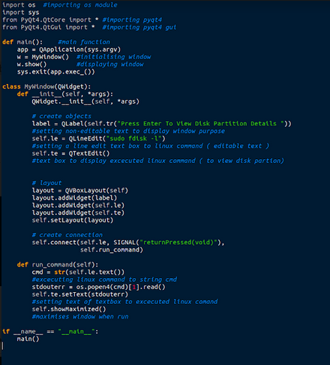
PROGRAM SCRIPT

Slide 8
OUTPUT

Slide 9
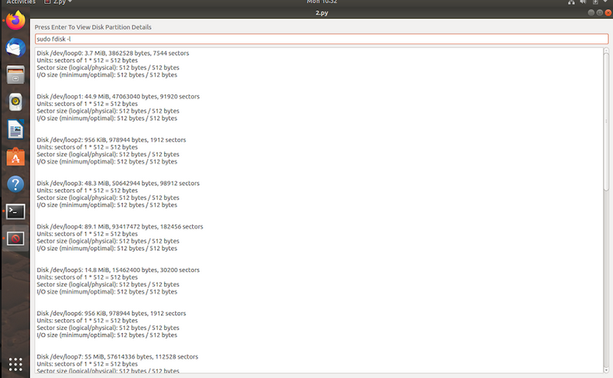

Slide 10
MEMBERS
BENNET BENNY
BHAGYA BABU
BHARAT M MANOJ
BINU THOMAS

