Slide 1
Lecture 8 Announcements
Assignment 2
Program due on Friday
Assignment 1 – stats
SLOC = Source Line Of Code, KLOC, MLOC
~ a java language statement, ends with a “;”
SLOC counters are freely available
checkstyle-cs, a free Eclipse plug-in
http://sourceforge.net/projects/metrics/
CodePro AnalytiX
Topics for today will include:
Exceptions
Stream IO covered in lab this week

Slide 2
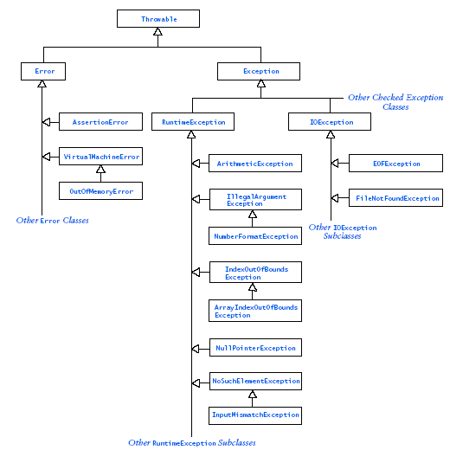

Exception
Class
Hierarchy

Slide 3
Exceptions - terminology
exception: An object representing a run-time error.
Other languages don't have this concept; they represent errors by returning error codes (null, -1, false, etc.).
throw: To cause an exception to occur.
The JVM can do it, and so can you
catch: To handle an exception.
If an exception is thrown and no code catches it, the program's execution will stop and an error trace will be printed.
If the exception is caught, the program can continue running.

Slide 4
Code that throws exceptions
dividing by zero:
int x = 0;
System.out.println(1 / x); // ArithmeticException
trying to dereference a null variable:
Point p = null;
p.translate(2, -3); // NullPointerException
trying to interpret input in the wrong way:
int err = Integer.parseInt("hi");
// NumberFormatException
reading from a non-existent file:
Scanner in = new Scanner(new File("notHere.txt"));
// FileNotFoundException

Slide 5
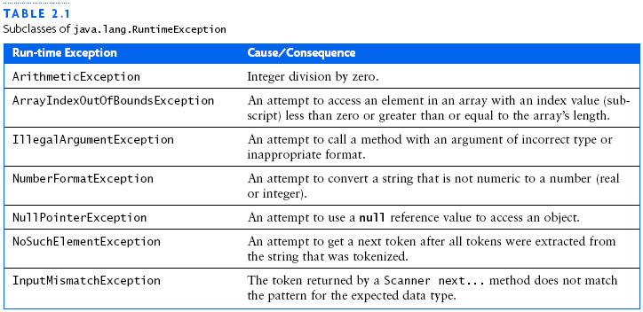
Some Exceptions Handled by JVM

Slide 6
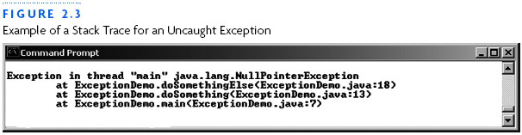
Uncaught Exceptions (default)
When an exception occurs that is not caught by your program, the program stops and the JVM displays an error message and a stack trace
The stack trace shows the sequence of method calls, starting at the method that threw the exception and ending back at main

Slide 7
Why Should You Use Exceptions?
Necessary for reliable, fault tolerant, robust software systems
Often 75%+ code dedicated to reliability
20% of interface errors are errors in handling exceptions
We want to manage run time errors in an orderly fashion so as to create fault tolerant software systems
Advanced error handling can be done that allows for resumption of execution after correcting for an error
Capability to return error information should not be limited to just the return type of an operation.

Slide 8
How to Handle Runtime Errors?
It is possible to detect and handle errors of various types.
Problem: this complicates the code and makes it harder to understand.
the error detection and error handling code may have little or nothing to do with what the real code is trying to do (“happy path”).
A tradeoff must be made between ensuring correct behavior under all possible circumstances and clarity of the code

Slide 9
Error Handling Options
What to do when handling run-time errors
Preclude/prevent
Guarantee they do not happen
Report
Up to someone else in the calling chain to do something
Retry
Works when fault is transient
Repair in situ
Fix the problem or compensate for the problem
Ignore
Results are satisfactory even with the exception

Slide 10
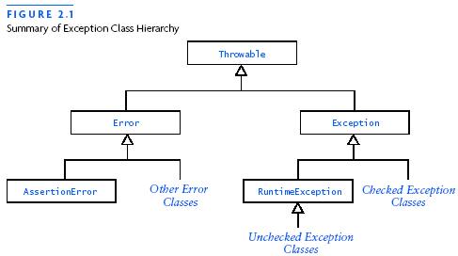
The Class Throwable
Throwable is the superclass of all exceptions & errors
All exception classes inherit the methods of Throwable
Object

Slide 11
Throwable methods
All exception objects have these methods:
try
{
readFile();
}
catch (IOException e)
{
System.out.println("I/O error: " + e.getMessage());
}
Method | Description
public String getMessage() | text describing the error
public String toString() | exception's type and description
getCause(), getStackTrace(), printStackTrace() | other methods

Slide 12
Errors and Exceptions
The class Error and its subclasses represent errors due to serious external conditions; they are unchecked by the compiler
Example: OutOfMemoryError
You cannot foresee or guard against them
While you can attempt to handle them, it is generally not a good idea as you will probably be unsuccessful
Except for AssertionError
The class Exception and its subclasses can be handled by your program
RuntimeException and its subclasses are unchecked by the compiler
All others must be either:
explicitly caught or
explicitly mentioned as thrown by the
method
Object

Slide 13
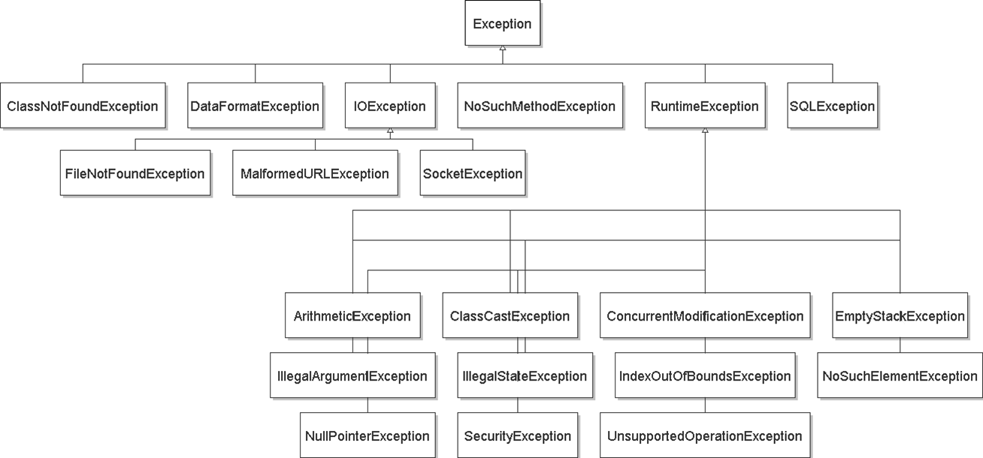
Exception inheritance
All exceptions extend from a common superclass Exception
Your custom
exception

Slide 14
Our Goals
To learn how to catch and handle exceptions within our programs, so that our programs don’t just crash
To know when and where to catch an exception
To learn how to throw exceptions
To be able to design your own custom exception classes
To understand the difference between checked and unchecked exceptions

Slide 15
Why Use Exceptions?
Separate normal from abnormal processing
Normal processing often quite straightforward
E.g, what to do if a method’s precondition is violated (something which must be true before the method starts)
Abnormal processing often quite tangled
Causes nesting
Obscures normal processing
We want to separate error handling code from regular code flow
So that frequent and repetitive testing of return values, and propagation of error return values, is not required.
Using exceptions may be more efficient because the normal execution path does not need to test for error conditions.
We can group Error Types and Error Differentiation

Slide 16
Examples
Nested tangle
if (condition1) then
do something1
if (condition 2) then
do something2
if (condition3) then
do something3
else exception3
else exception2
else exception1
With exceptions
Do something1;
Do something2;
Do something3;
Handle Exceptions:
ex1: exception1
ex2: exception2
ex3: exception3

Slide 17
Why Exceptions - Details
We may want to propagate Errors Up the Call Stack
The point at which an error occurs is rarely a suitable place to handle it, particularly in library code, but by the time an error code has been propagated to a place where it can be handled, too much contextual information has been lost.
Exceptions bridge this gap - they allow specific error information to be carried from the point where its available to a point where it can be utilized
using exception objects that contain the information

Slide 18
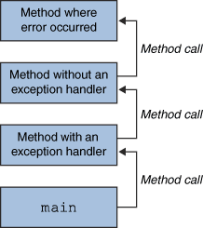
Throwing and catching
At any time, your program has an active call stack of methods.
When an exception is thrown, the JVM looks up the call stack until it finds a method with a matching catch block for that exception type
If one is found, control jumps back to that method.
If none is found, the program crashes.
Exceptions allow non-local error handling.
A method many levels up the stack can handle a deep error.

Slide 19
Exception Handling Mechanics
JAVA has built-in exception handling features for certain exception object types
Exception object - is created when the error occurs and contains information about it
Exception handling is accomplished by the keywords: try, catch, throw, throws, and finally
Exceptions and Exception Types
Claiming Exceptions
Throwing Exceptions
Catching Exceptions
Rethrowing Exceptions
The finally Clause

Slide 20
The try-catch Sequence
The try-catch sequence resembles an if-then-else or switch set of statements
try
{
// Execute the following statements until an
// exception is thrown or block completes successfully
...
// Skip all the catch blocks if no exceptions were thrown
}
catch (ExceptionTypeA ex)
{
// Execute this catch block if an exception of type
// ExceptionTypeA was thrown in the try block
…
}
catch (ExceptionTypeB ex)
{
// Execute this catch block if an exception of type
// ExceptionTypeB was thrown in the try block
…
}
// as many additional catch blocks as you might need
finally
{ // executed in any case
}

Slide 21
Exceptions Control Flow/1
Statements in try block are executed
If no exceptions occur, catch clauses are skipped
If an exception is thrown (either by you or the JVM) then the normal flow of control of the program halts
Instead of executing the regular next statement the Java Runtime System starts to search for a matching catch block
If a catch block of matching parameter type is found, execution jumps to the catch clause for that type of exception

Slide 22
Exception Control Flow/2
If there is no matching catch clause, then the program terminates
The code in the finally block is executed either after the try block is exited or after a catch clause is exited (optional)
If exception of another type occurs, it is thrown until it is caught by another try-catch block

Slide 23
Catching Exceptions
catch(IOException exceptionOb)
{block}
IOException exceptionOb behaves like a method parameter
exceptionOb contains reference to the exception object that was thrown and matched
catch clause can analyze object to find out more details, e.g.
exceptionOb.printStackTrace(): printout the chain of method calls that led to exception

Slide 24
The try-catch Sequence (cont.)
try
{
// Execute the following statements until an
// exception is thrown or block completes OK
...
// Skip the catch blocks if no exceptions were thrown
}
catch (ExceptionTypeA ex)
{
// Execute this catch block if an exception of type
// ExceptionTypeA was thrown in the try block
...
}
catch (ExceptionTypeB ex)
{
// Execute this catch block if an exception of type
// ExceptionTypeB was thrown in the try block
...
}
PITFALL!
Unreachable catch block
ExceptionTypeB should not be a subclass of ExceptionTypeA. If is was, its exceptions would be caught be the first catch clause and its catch clause would be unreachable.
Solution: reverse the order
ExceptionTypeA
ExceptionTypeB

Slide 25
Catching with inheritance
try
{ statement(s);
}
catch (FileNotFoundException fnfe)
{ code to handle the file not found exception
}
catch (IOException ioe)
{ code to handle any other I/O exception
}
catch (Exception e)
{ code to handle any other exception
}
a SocketException would match the second block
an ArithmeticException would match the third block
Catch classes should go from more specific to more general

Slide 26
The finally clause
Executed when try block is exited in any of three ways:
After last statement of try block
After last statement of a catch clause, if this try block caught an exception
When an exception was thrown in try block and was not caught

Slide 27
The finally clause
Exception normally terminates the current method
Danger: Can skip over essential code
Must execute reader.close() even if exception happens
Use finally clause for code that must be executed "no matter what"
FileReader reader = new FileReader(filename); BufferedReader in = new BufferedReader(reader); String s = in.readLine( );
. . . reader.close(); // May never get here

Slide 28
The finally clause
try { FileReader reader = new FileReader(filename);
BufferedReader in = new BufferedReader(reader); String s = in.readLine( ); } finally { reader.close(); // if an exception occurs, finally clause // is also executed before exception is // passed to its handler }

Slide 29
Catching Exceptions - Bulletproofing
try // block of code to be monitored for exceptions
{ int a, b;
String s;
s = in.next( ); // Scanner method returns next token
b = Integer.parseInt (s);
a = 356 / b;
} // what are all the things that could go wrong here??
catch (ArithmeticException e1) //catch arithmetic run time errors
{ System.out.println (“divide by zero attempted”);
}
catch (NumberFormatException e2)
{ //catch invalid conversions of a string to a numeric format
System.out.println (“invalid number in string”);
}
catch (IOException e3)
{ //catch IO exceptions that occur on input
System.out.println (“failed input operation”);
}
finally //do this block regardless
{ . . . }
int c = a + b;
How do I retry
the block of code
monitored?

Slide 30
User input is a common source of exceptions
public static int getNumberOfKids(Scanner scan)//uses a Scanner
{
int nextInt = 0; // next int value
boolean validInt = false; // flag for valid input
while(!validInt)
{
try
{
System.out.println("Enter number of children: ");
nextInt = scan.nextInt();
validInt = true;
}
catch (InputMismatchException ex)
{
scan.nextLine(); // clear buffer
System.out.println("Bad data-enter an integer");
}
}
return nextInt;
}

Slide 31
You Throwing Exceptions
It is not necessary to catch all exceptions
If you don't know how to handle an exception, don't catch it; let the JVM catch it
You can also throw them yourself,e.g. in BankAccount
public void deposit(double amount)
{ if(amount < 0)
{throw new IllegalArguementException();}
balance = balance + amount;
}
What happens if amount is negative?
Execution stops, and JVM looks for the nearest enclosing try block for an appropriate catch clause. If found, execution continues there. If not, the next enclosing try is examined, etc. If not found then the default handler halts the program.
Enclosure includes nesting, and method calls

Slide 32
You Throwing Exceptions
Alternative way to throw a IllegalArgumentException:
Note: All Exception classes have 2 constructors: ( ), and (String)
// for an illegal parameter value IllegalArgumentException myException = new IllegalArgumentException("Amount exceeds balance"); throw myException;
No need to store exception object in a variable unless you need it later:
throw new IllegalArgumentException("Amount exceeds balance");

Slide 33
Example
public class BankAccount { public void withdraw(double amount) { if (amount > balance) { IllegalArgumentException exception1 = new IllegalArgumentException
("Amount exceeds balance"); throw exception1; //where is it caught?? } balance = balance - amount; } . . . }

Slide 34
Designing Your Own Exceptions
You can design your own exception types – they are subclasses of Exception or RuntimeException
Ex, in BankAccount withdraw() method
if (amount > balance) { throw new InsufficientFundsException( "withdrawal of " + amount + " exceeds balance of “ + balance); }
How do you define a new exception type of your own?

Slide 35
Designing Your Own Exceptions
It is an unchecked exception
You extend RuntimeException or one of its subclasses
Supply two constructors
Default constructor
A constructor that accepts a message as a String describing reason for exception

Slide 36
Designing Your Own Exceptions
public class InsufficientFundsException extends RuntimeException { public InsufficientFundsException() {. . . } public InsufficientFundsException(String message) { super(message); //call superclass constructor
. . . } }

Slide 37
Writing an exception class
Tip: Throw exceptions appropriate to the abstraction.
// Thrown when the user tries to play after the game is over.
public class GameOverException extends RuntimeException
{ private String winner;
public GameOverException(String message, String winner)
{ super(message);
this.winner = winner;
}
public String getWinner()
{ return winner;}
}
// in Game class...
if (!inProgress())
{
throw new GameOverException("Game already ended", winner);
. . .
}

Slide 38
Checked (by the compiler) and Unchecked Exceptions
Unchecked Exceptions:
Extend the class RuntimeException or Error
programmer's error (logic errors, etc.) and preventable if coded right
Examples of runtime exceptions:
NumberFormatException IllegalArgumentException NullPointerException
ArithmeticException
ArrayIndexOutOfBoundsException

Slide 39
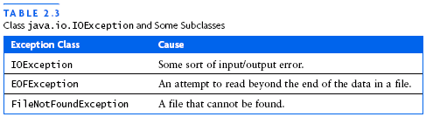
Checked and Unchecked Exceptions
Checked Exceptions (by the compiler)
Due to external circumstances that the programmer cannot prevent, but that can be expected anyway
If they do occur must be dealt with in some way - other than the program terminating
The compiler checks that you don't ignore them
Occur principally when programming with IO files and streams

Slide 40
Checked Exceptions
Two choices:
Handle the exception
Tell compiler that you want method to be terminated when the exception occurs
Use throws specifier on the method header so method can throw a checked exception
The example indicates the checked exceptions that this method can throw
public void read(String filename)
throws FileNotFoundException, IOException { FileReader reader = new FileReader(filename); BufferedReader in = new BufferedReader(reader); . . . }

Slide 41
Checked exceptions suck!
Tip: Avoid unnecessary use of checked exceptions.
Checked exceptions are (arguably) a wart in the Java language.
It should be the client's decision whether or not to catch exceptions.
When writing your own exception classes, extend RuntimeException so that it doesn't need to be caught unless the client wants to do so.
Some cases still require throwing checked exceptions (e.g. I/O)
public void play() throws Exception { // no
public void play() throws RuntimeException { // better
public void play() throws MP3Exception { // best
public class MP3Exception extends RuntimeException { ... }

Slide 42
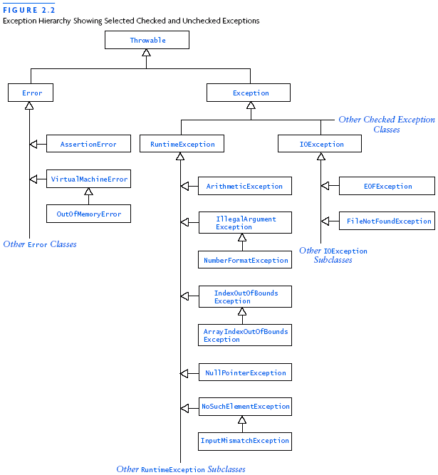
Checked Exceptions
Checked exceptions
are here
The compiler checks to see if:
You handled it with a “catch” or
You specified a “throws” clause on the method header

Slide 43
Checked Exceptions in Code
Program to count the # of chars in a file
If we have code that tries to build a FileReader object then we must deal with the possibility of an exception
The code contains a syntax error. "unreported exception java.io.FileNotFoundException; must be caught or declared to be thrown."
import java.io.FileReader;
public class Tester
{ // this method counts the # of characters in the given file
public int countChars(String fileName)
{ FileReader r = new FileReader(fileName);
int total = 0;
while( r.ready()) //true if file is ready
{ r.read(); //get next char as int or -1
total++;
}
r.close();
return total;
}
}

Slide 44
Checked Exceptions the “Easy” Way
import java.io.FileReader;
public class Tester
{ // this method counts the # of characters in the given file
public int countChars(String fileName)
throws FileNotFoundException, IOException
{ FileReader r = new FileReader(fileName);
int total = 0;
while( r.ready()) //true if file is ready
{ r.read(); //get next char as int or -1
total++;
}
r.close();
return total;
}
}
Now its up to the method(s) that call countChars() to deal with those exceptions

Slide 45
Handling Checked Exceptions
In the code on the previous slide there are in fact 4 statements that can generate checked exceptions. The calls to the:
The FileReader constructor
the ready method
the read method
the close method
To deal with these exceptions we can handle the exceptions within the method itself

Slide 46
Handle the exceptions locally
public int countChars(String fileName)
{ int total = 0;
try
{ FileReader r = new FileReader(fileName);
while( r.ready())
{ r.read();
total++;
}
r.close();
}
catch(FileNotFoundException e)
{ System.out.println("File named " + fileName + "not found. " + e);
total = -1;
}
catch(IOException e)
{ System.out.println("IOException occured " +
"while counting chars. " + e);
total = -1;
}
return total;
}

Slide 47
Nested try catch blocks – clunky!
public int countChars(String fileName)
{ int total = 0;
FileReader r = null;
try
{ r = new FileReader(fileName); }
catch(FileNotFoundException e)
{ System.out.println("File named "
+ fileName + "not found. " + e);
total = -1;
}
try
{ while( r.ready())
{ try
{ r.read(); }
catch(IOException e)
{ System.out.println("IOException "
+ "occurred while counting " + "chars. " + e);
total = -1;
}
total++;
}
}
catch(IOException e)
{ System.out.println("IOException occurred while counting chars. " + e);
total = -1; }
try
{ r.close();
}
catch(IOException e)
{ System.out.println("IOException occurred while counting chars. " + e);
total = -1; }
return total;
}

