Slide 1

Lobito Corridor Spatial Analysis:
A Configurable Decision Framework
https://worldbank.github.io/AGO_corridor_analysis/docs/chapters/summary.html
Benny Istanto – bistanto@worldbank.org

Slide 2
Lobito Corridor Spatial Analysis:
A Configurable Decision Framework
Key Message
This is a modular, scenario-based tool – not a fixed recommendation. Results can be tailored to align with Angola's strategic priorities.
Equity-Heavy Scenario
Balanced (Current)
Growth-Heavy Scenario
Higher weight on poverty & food insecurity
Focus on rural poor, even if access gains are smaller
Balances need (poverty) and opportunity (access, population)
Top 10% threshold with rural focus
Higher weight on travel time & cropland
Focus on productive hinterlands & economic flows
This presentation shows results from the Balanced scenario. Different scenarios will produce different priority areas and recommendations.

Slide 3
Current Scenario: Balanced Configuration
All numbers in this presentation are based on the following parameter settings. These can be adjusted to test different policy priorities.
Priority Selection
Equity Overlay Weights
Top 10% of cells by composite score
Rural focus: Require rural classification
Min cropland: 5% threshold
Poverty (W_POV): 15%
Food insecurity (W_FOOD): 10%
Travel time (W_MTT): 10%
Wealth index (W_RWI): 15%
Components Used
✓ Travel time to markets
✓ Population density
✓ Drought exposure
○ Nighttime lights (excluded for rural focus)
What Can Change?
Thresholds, weights, component mix, urban/rural split, and clustering parameters – all adjustable based on strategic priorities.
Source: config.py lines 538-595. Parameters can be re-run overnight to test alternative scenarios.

Slide 4
5 Strategic Questions This Framework Answers
Where do the strongest priority clusters emerge?
Where do multiple constraints stack with enough population to justify investment?
Are we focusing where needs and opportunities coincide?
Which municipalities balance high poverty with high potential for access improvements?
How many people benefit within 30/60/120 minutes?
Which sites reach the most beneficiaries quickly vs unlock remote hinterlands?
Are we stacking with other investments or creating islands?
Where can we coordinate with Government, World Bank and other partners?
How does movement along the corridor reinforce priorities?
Which segments carry the most interaction between priority areas?
Five research questions came from the team, via email 19 Sep 2025

Slide 5
Q1: Where do priority clusters emerge?
Under current configuration: Top 10% threshold, rural focus
Benguela: 4 clusters, 432 km², 3,134 people (0.1% of province), 217 km² cropland
Huambo: 2 clusters, 53 km², 31,776 people (1.1% of province), 35 km² cropland
Bie: 1 cluster, 27 km², 18,307 people (0.9% of province), 11 km² cropland
Moxico: 0 clusters
Moxico Leste: 0 clusters
Key Finding
Moxico and Moxico Leste Challenge
Huambo shows highest concentration: 1.1% of population in just 53 km² of priority clusters – indicates strong potential for targeted investment.
Zero clusters means no areas cross current threshold. Options: (1) Lower threshold to 15%, (2) Adjust weights for Moxico and Moxico Leste context, or (3) Accept lower priority.
Source: Table S1 from summary.md. Changing TOP_PCT_CELLS from 10% to 15% would add Moxico clusters.

Slide 6
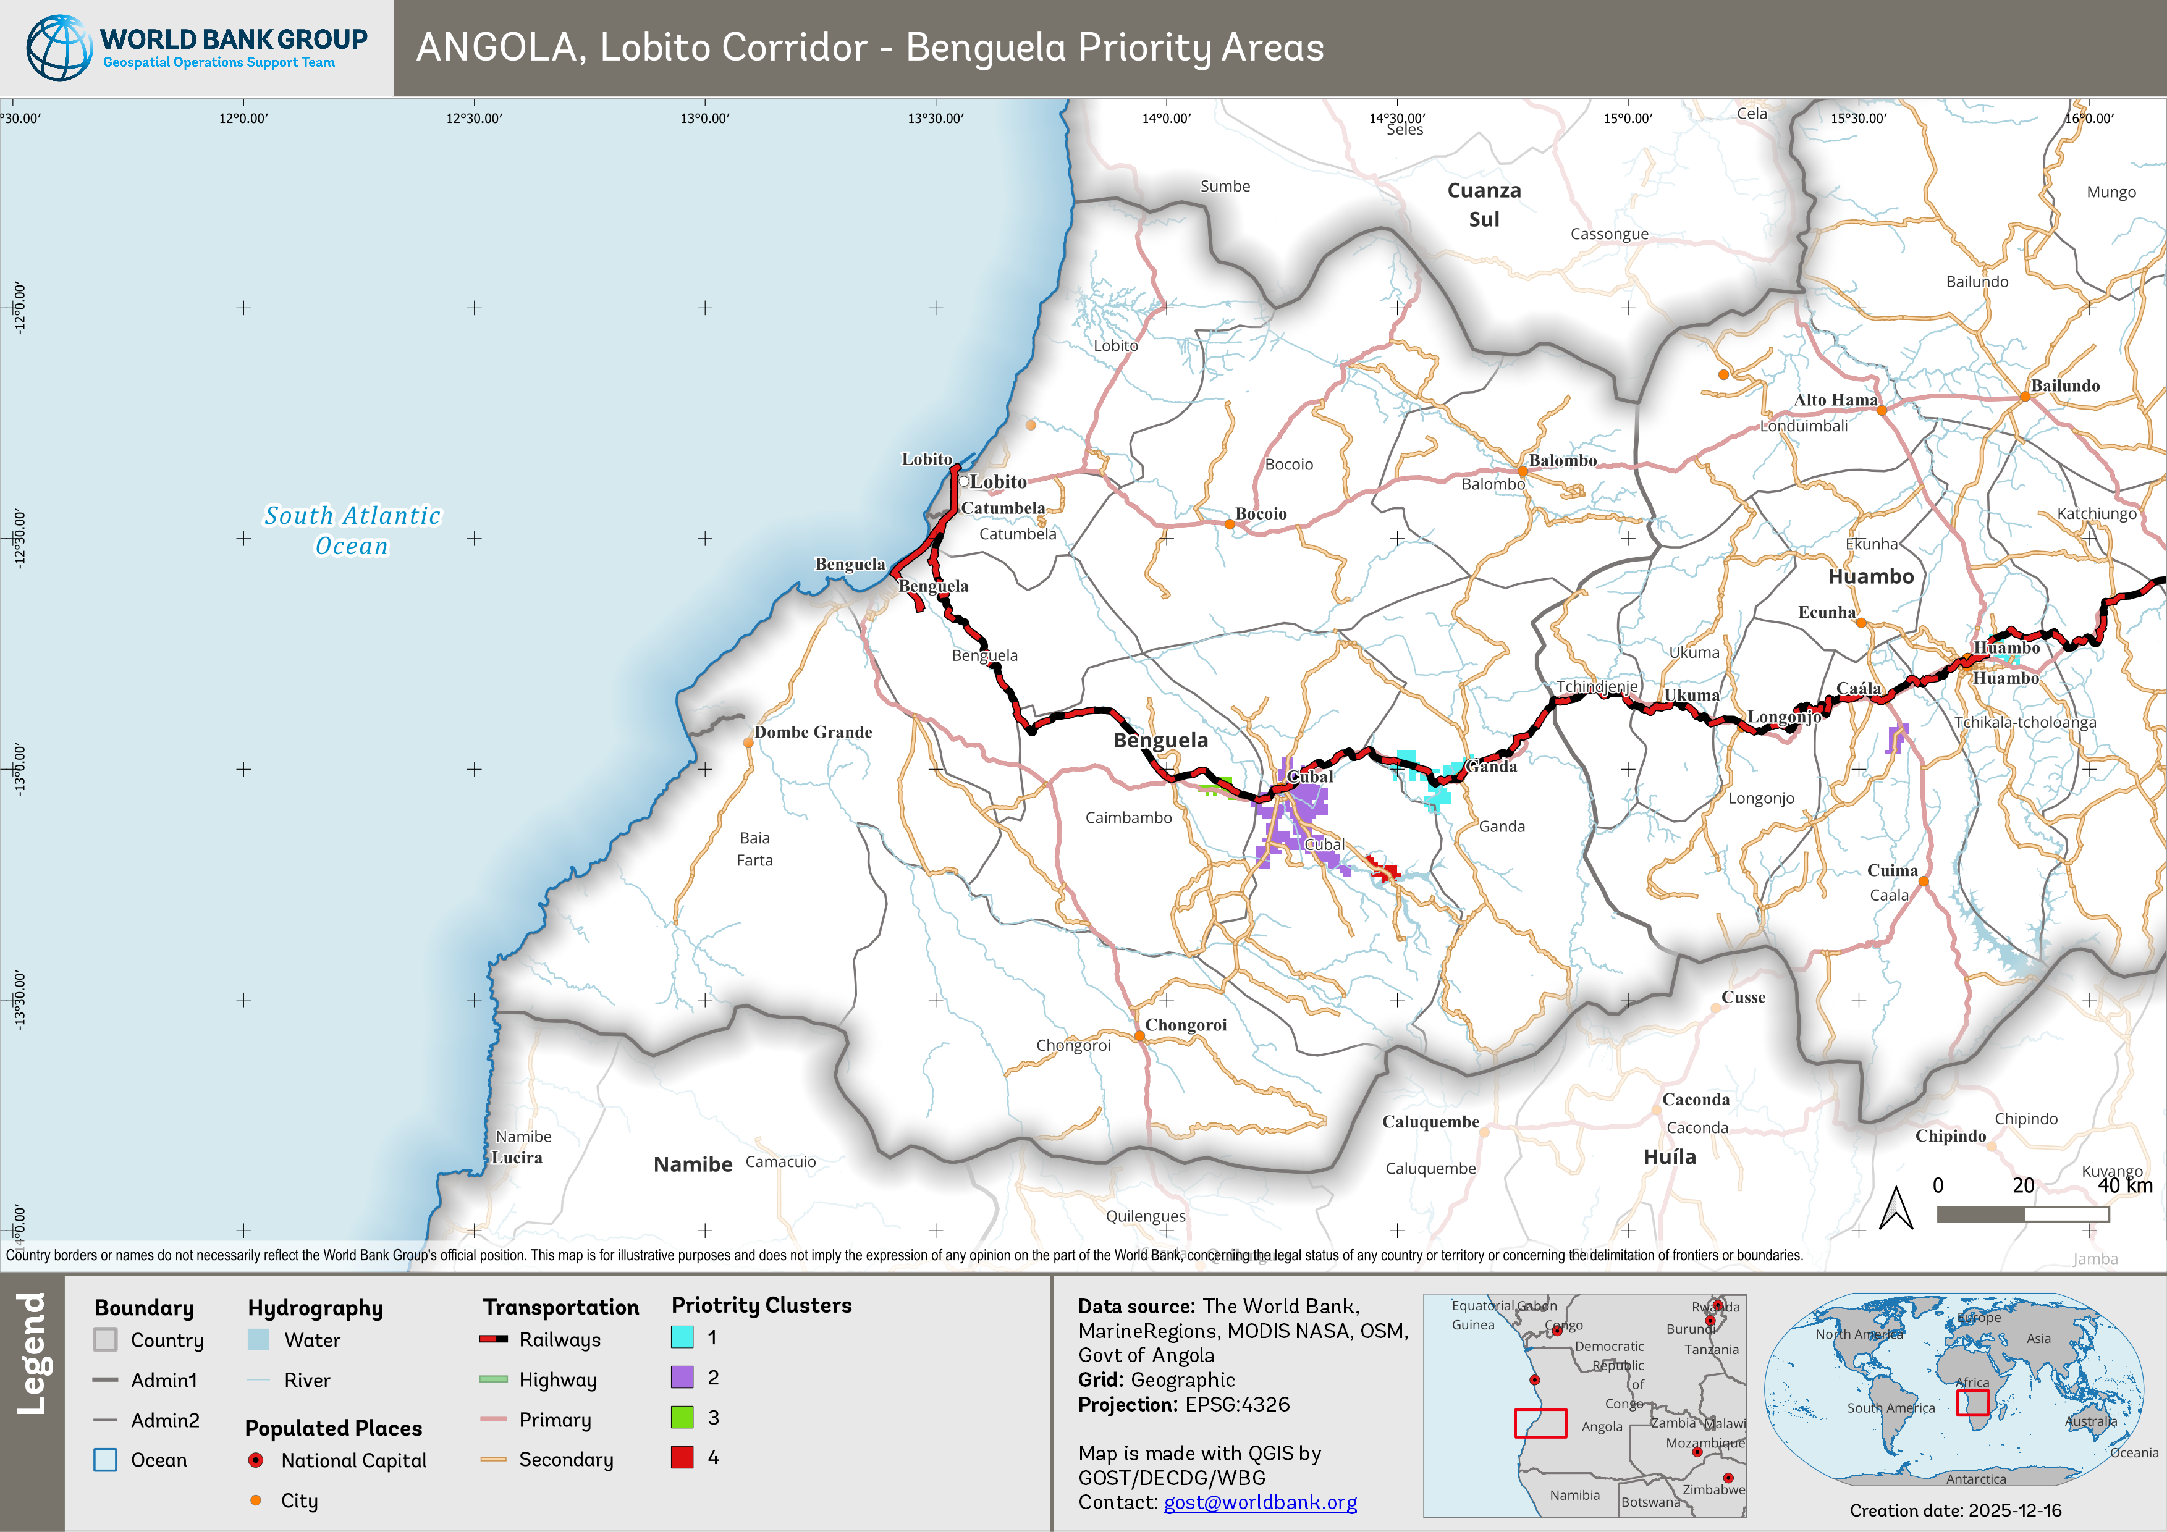
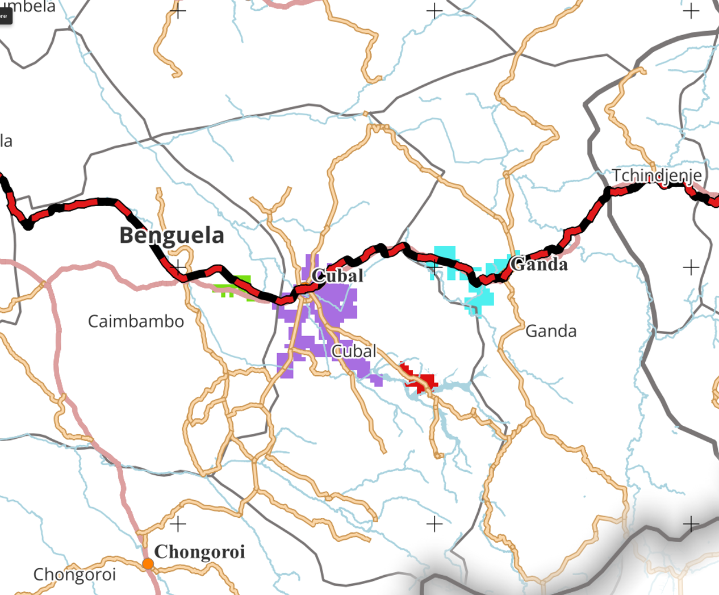
Q1: Where do priority clusters emerge?
Under current configuration: Top 10% threshold, rural focus

Slide 7
Q2: Are we focusing where needs and opportunities coincide?
Under current equity weights: W_POV=15%, W_FOOD=10%, W_MTT=10%, W_RWI=15%
Top 5 Municipalities - Huambo
Equity Quadrant Analysis
Ekunha, Score: 0.71
Huambo, Score: 0.70
Caála, Score: 0.67
Bailundo, Score: 0.62
Katchiungo, Score: 0.61
High Score & High Poverty, 3 municipalities (27.3%), 18% of rural poor: Good alignment – invest here
High Score & Low Poverty, 3 municipalities (27.3%), 18% of rural poor: Growth opportunities
Low Score & High Poverty, 3 municipalities (27.3%), 14% of rural poor: At-risk of under-prioritization
Low Score & Low Poverty, 2 municipalities (18.2%), 50% of rural poor: Lower urgency
Key Finding
Scenario Sensitivity
Top municipalities combine high rural poverty (65-70%), large priority mask share (12-18%), and good catchment (40-46% within 60 min).
Rankings shift with: (1) Higher poverty weight → rural-poor rise, (2) Higher access weight → better-connected rise, (3) Include urban → different set.
Source: Table S2 from summary.md. 36% in "High score & high poverty" quadrant indicates good equity targeting under current scenario.

Slide 8
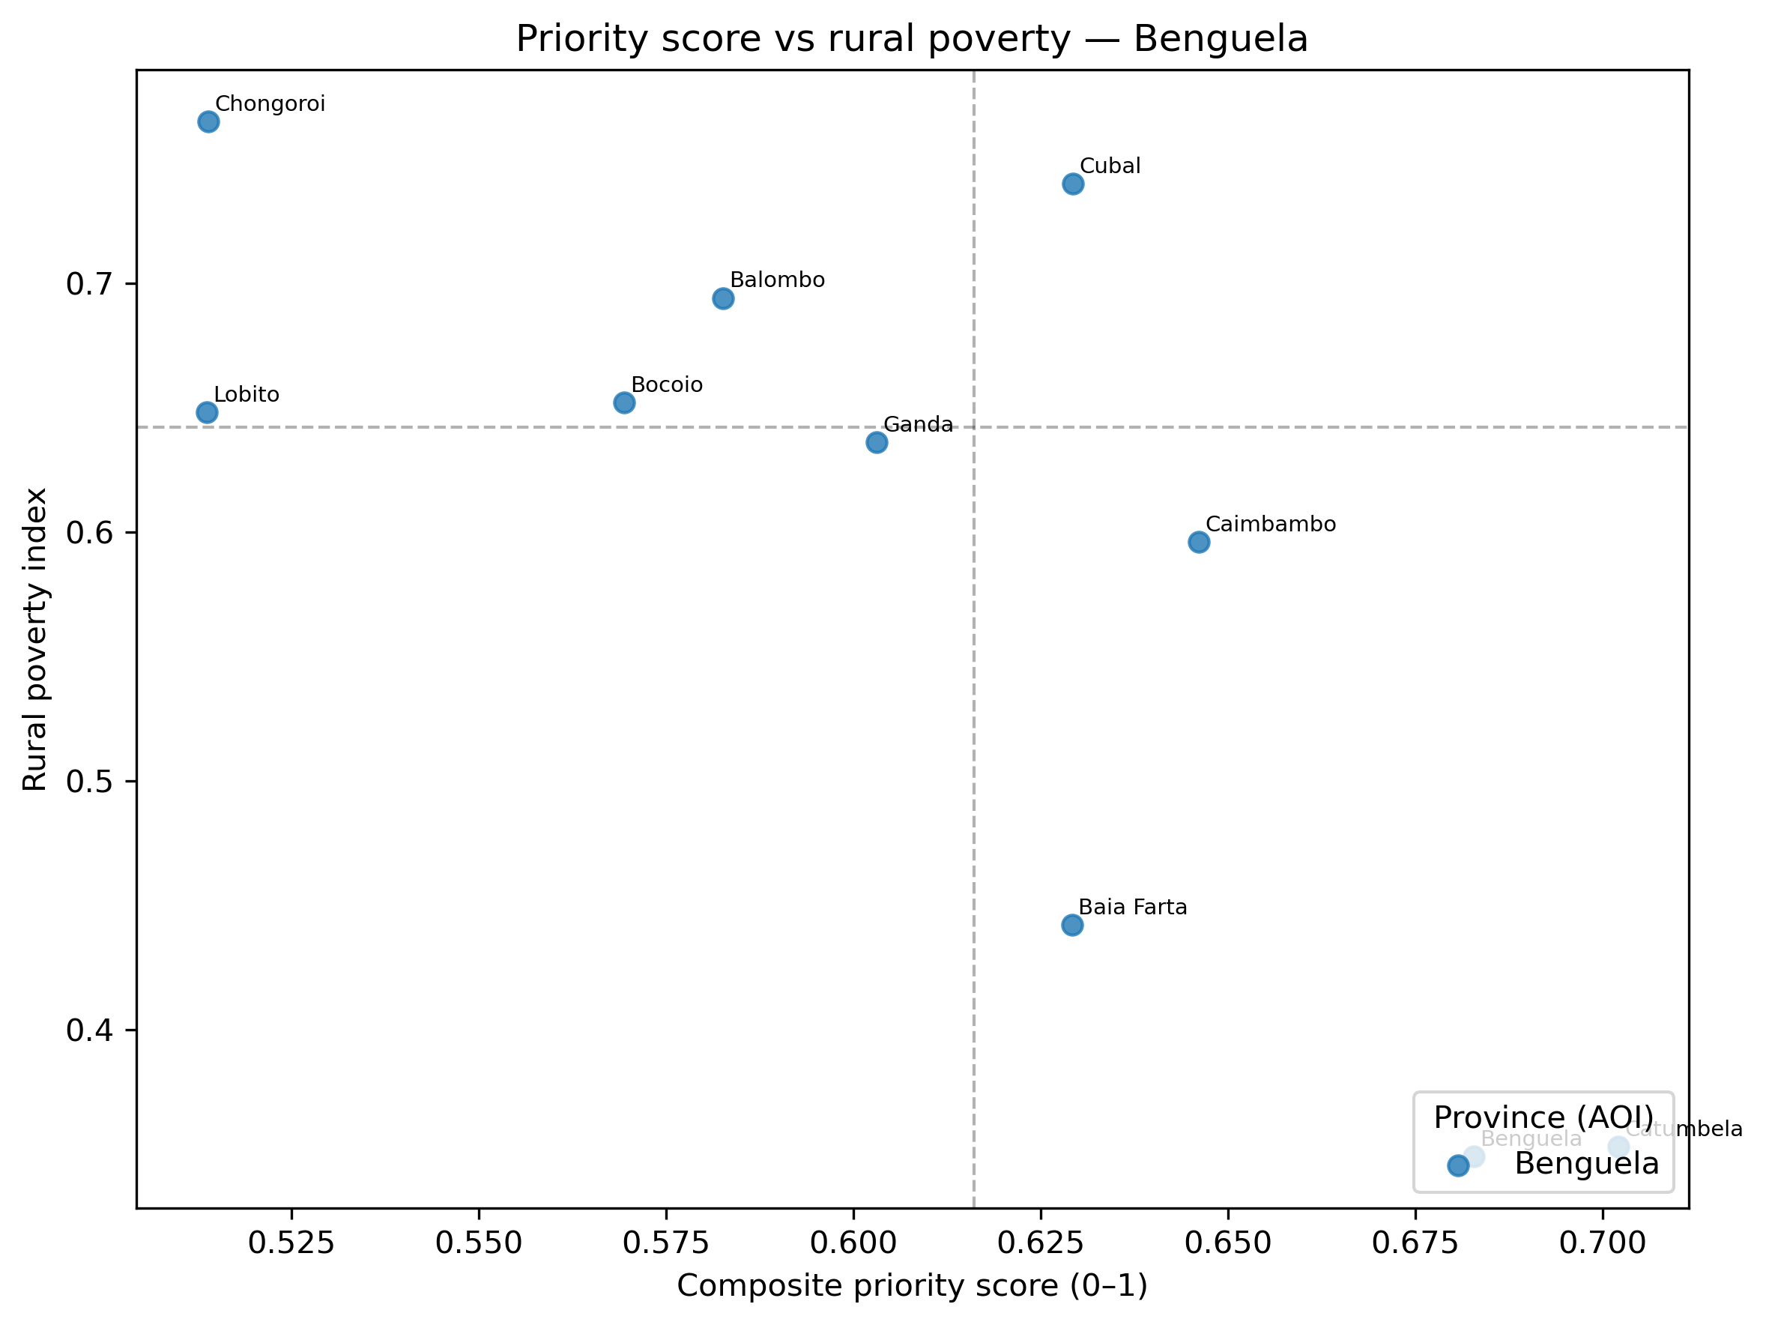
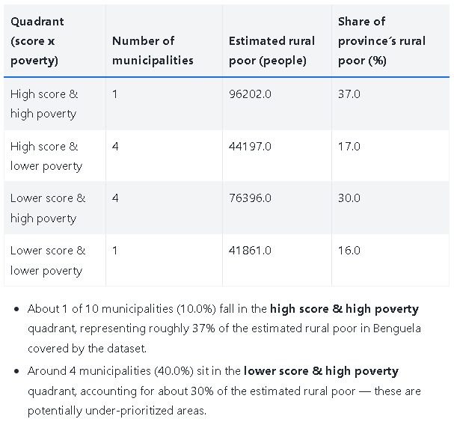
Q2: Are we focusing where needs and opportunities coincide?
Under current equity weights: W_POV=15%, W_FOOD=10%, W_MTT=10%, W_RWI=15%

Slide 9
Q3: How many people benefit within 30/60/120 minutes?
Top Sites by 30/60/120-min Population (Huambo)
Quick Wins (30-60 min)
Site ID | Municipality | 30-min | 60-min | 120-min
Site 1 | Caála | 24.3% | 45.6% | 67.9%
Site 2 | Caála | 34.7% | 45.2% | 68.8%
Site 20 | Tchindjenje | 14.7% | 44.6% | 68.2%
Site 5 | Tchikala-tcholoanga | 32.2% | 43.5% | 67.4%
Site 6 | Tchikala-tcholoanga | 19.9% | 42.7% | 64.4%
Caála sites (Sites 1 & 2) reach 45-46% of province population within 60 minutes – strongest immediate impact potential for market access and service delivery.
Remote Coverage (120 min)
All top 5 sites reach 64-69% of province population within 120 minutes – demonstrates solid network coverage for longer-distance agricultural supply chains and periodic services.
Strategic Trade-off
Investment choice: (1) Concentrate in Caála – Sites 1 & 2 reach 45% quickly with 30-min coverage of 24-35%, OR (2) Distribute across 3 municipalities - Adding Tchindjenje and Tchikala-tcholoanga sites improves geographic spread but with lower individual catchment percentages. Catchment tool can model combined coverage scenarios.
Source: Table S3 from summary.md. Thresholds (30/60/120 min) are configurable – can test 15/45/90 min or other combinations.

Slide 10
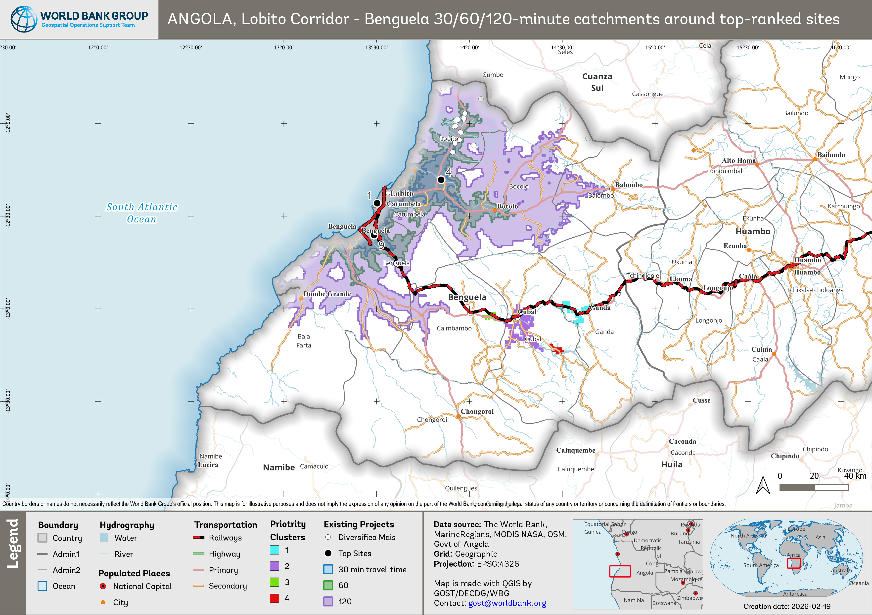
Q3: How many people benefit within 30/60/120 minutes?

Slide 11
Q4: Are we stacking with other investments?
Project Density Around Clusters
High-Opportunity Nodes
Count of projects within 30 km of priority clusters (where available):
Clusters with many nearby projects → good bundling potential
Huambo clusters: Strong WB project density (Cluster 1: 23 projects, Cluster 2: 14 projects) - no Government or Other projects recorded
Benguela clusters: 26 project location data available for synergy analysis, but the location are far away from 4 identified priority clusters
Isolated Clusters
High need but few investments → risk of fragmentation
Bridge Opportunities
Areas that could connect separate project islands
Coordination Opportunity
Where WB and Government projects cluster within 30 km of priority areas, there's strong potential for: (1) Joint planning sessions, (2) Shared infrastructure (roads, electricity), (3) Coordinated service delivery. The tool can identify these overlap zones for each province.
Source: Table S4 from summary.md. Radii (5/10/30 km) are configurable – currently using 30 km as 10 km is too sparse in rural areas.

Slide 12
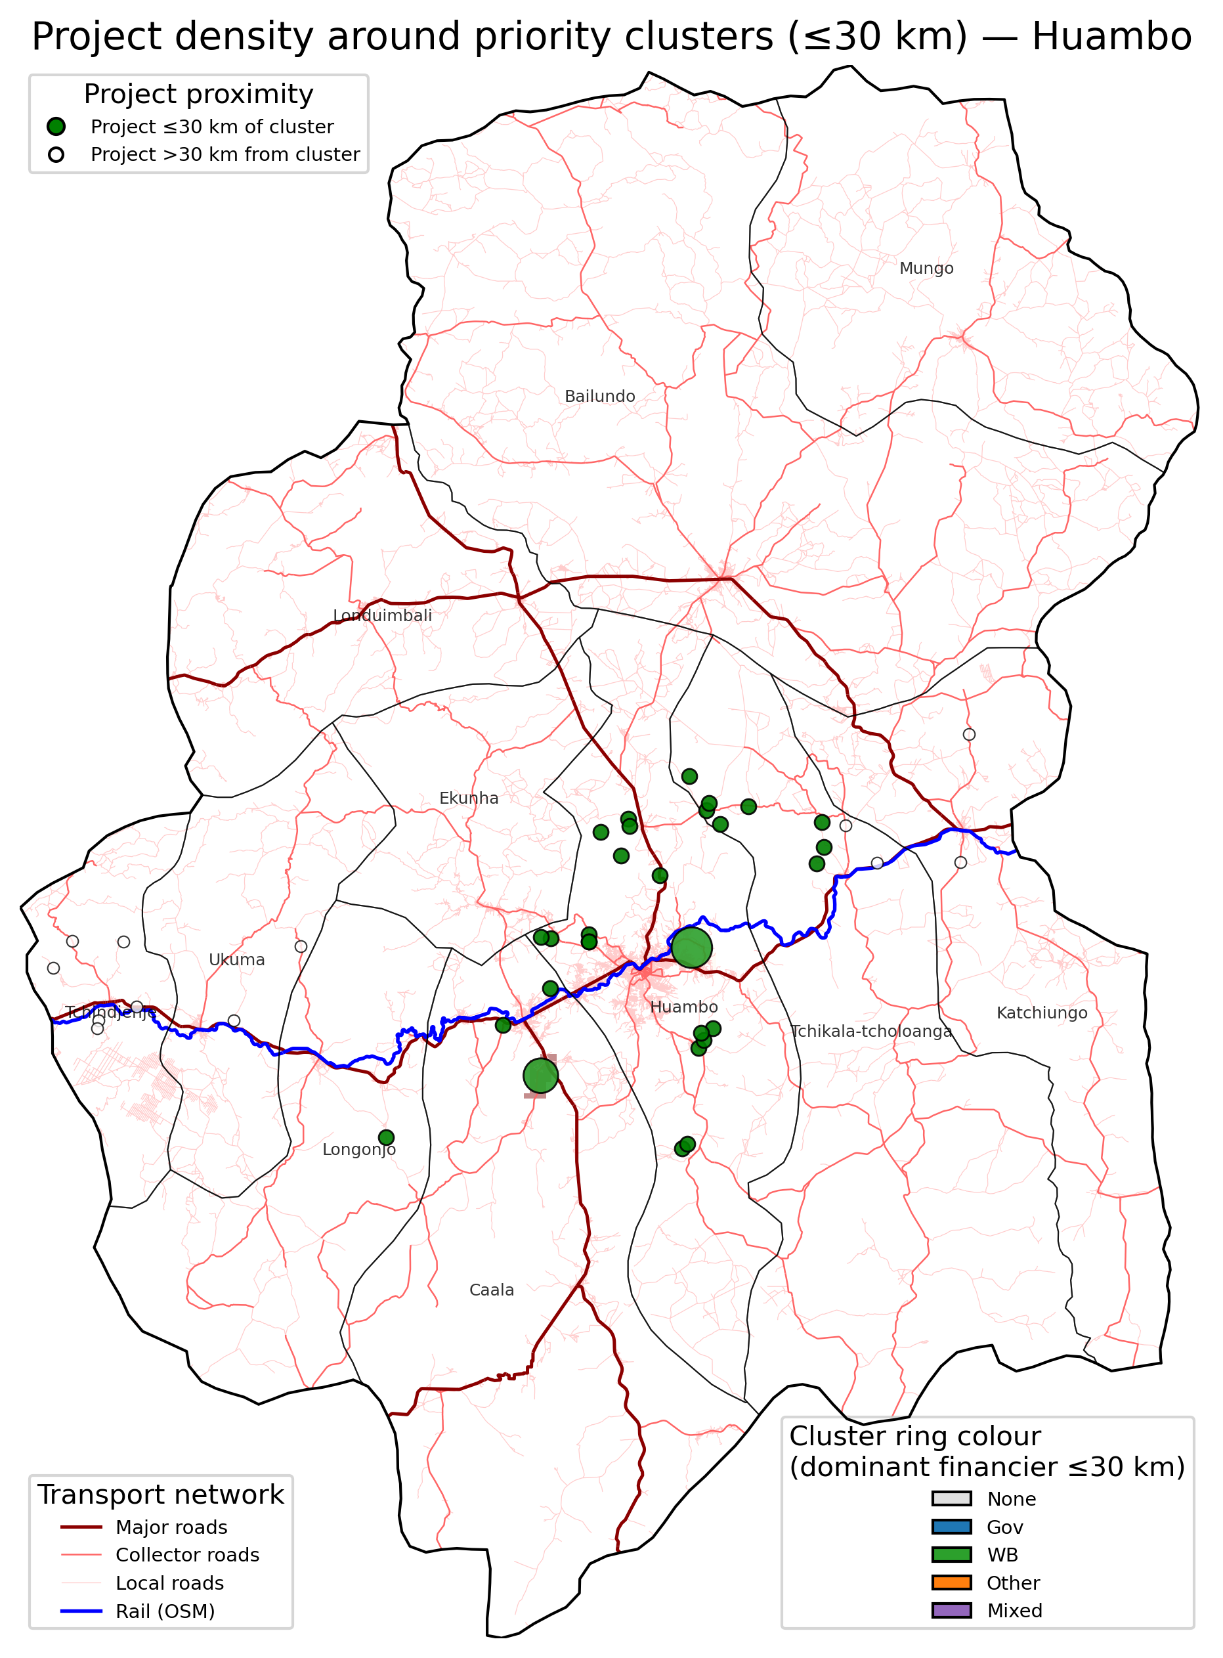
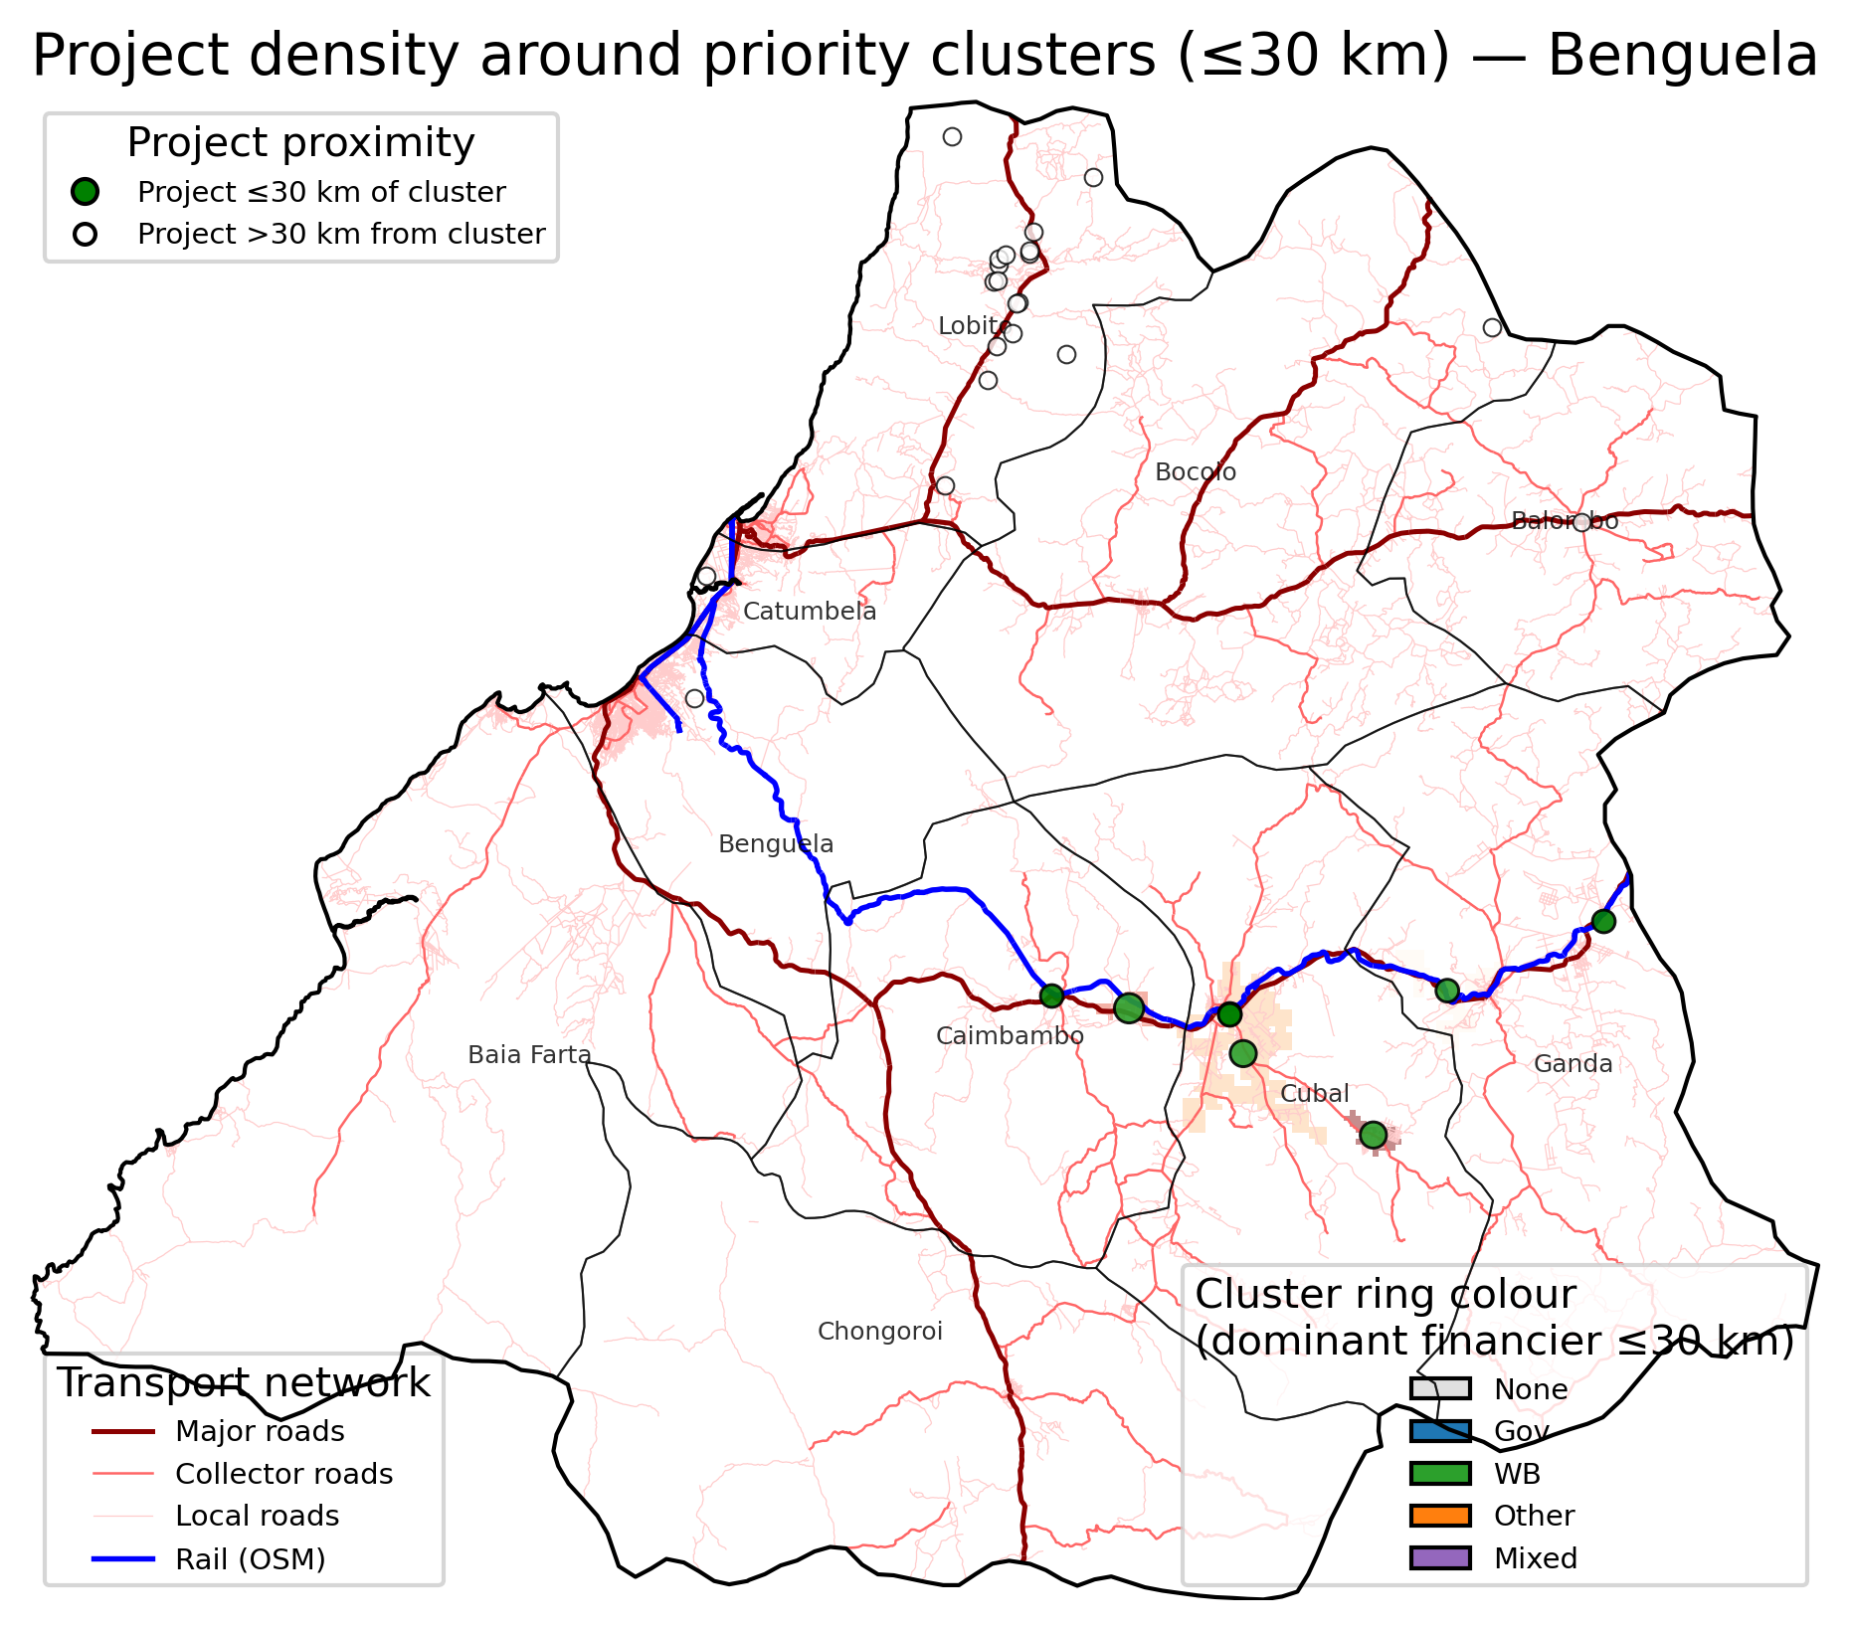
Q4: Are we stacking with other investments?

Slide 13
Q5: How does movement along the corridor reinforce priorities?
Top Origin-Destination (OD) Pairs (Huambo)
Key Finding
Caála ↔ Huambo: 97,939 flow, 56 km (✓ Both in priority mask)
Bailundo ↔ Huambo: 55,540 flow, 97 km
Huambo ↔ Tchikala: 49,511 flow, 36 km
Huambo ↔ Katchiungo: 41,294 flow, 57 km
Ekunha ↔ Huambo: 33,431 flow, 46 km
Caála-Huambo shows highest modelled flow (97,939) – both ends are in priority mask. This corridor segment deserves investment priority for both access and economic flow.
Gravity Model Assumptions
Flows based on population × distance decay. Currently using: OD_LAMBDA=0.015, RWI tilt enabled (RWI_WEIGHT=0.25). Can adjust to test different flow assumptions.
Strategic Insight
High-flow OD pairs that connect priority areas (like Caála-Huambo) should be prioritized for road/rail upgrades. These investments serve dual purposes: (1) improve access to priority clusters, AND (2) facilitate economic interaction between productive centers.
Source: Table S5 from summary.md. "Priority?" column indicates if both municipalities are in top priority mask – now trackable via priority_in_mask flag.

Slide 14
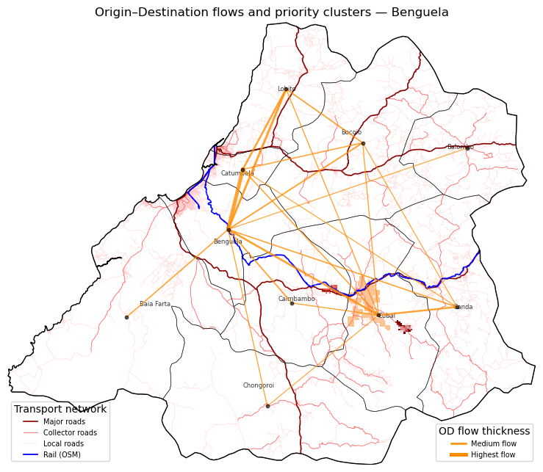
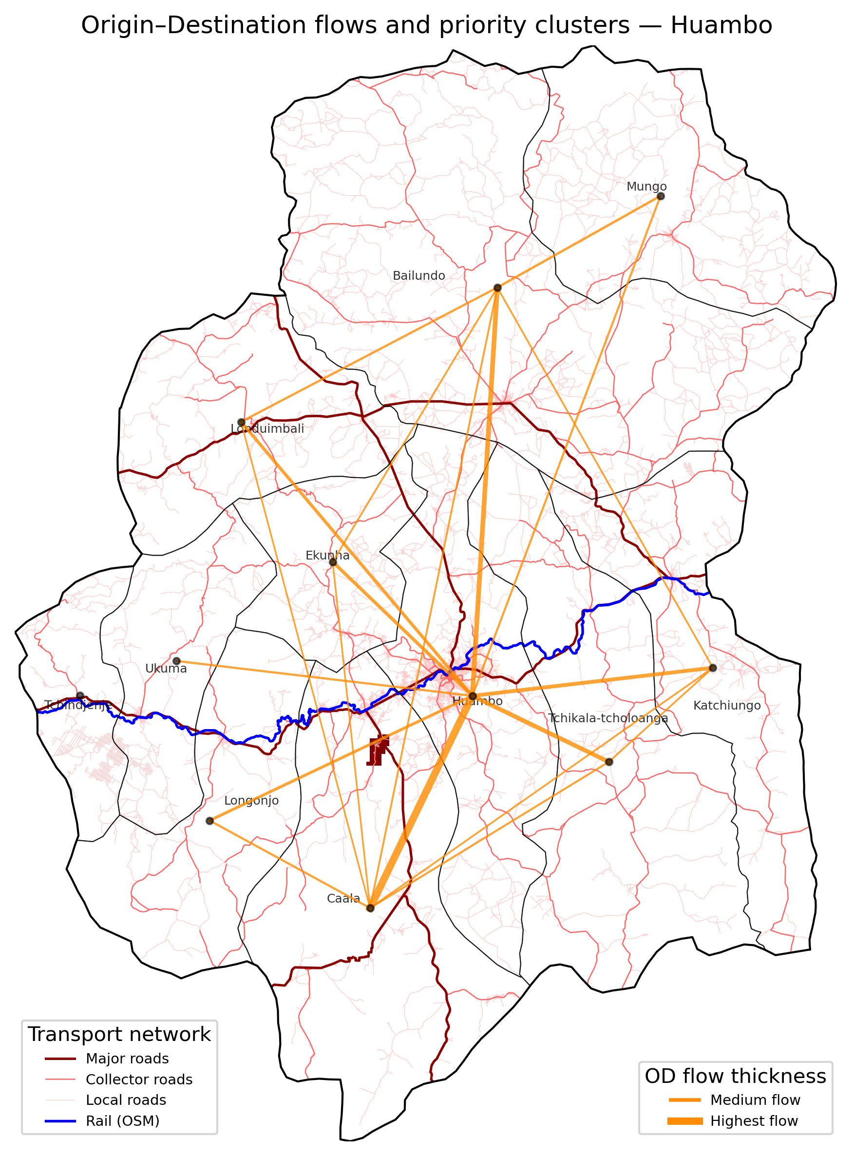
Q5: How does movement along the corridor reinforce priorities?

Slide 15
How Results Change Across Scenarios
Illustrative comparison: How would Huambo results differ under 3 scenarios?
Equity-Heavy
Balanced (Current)
Growth-Heavy
3-4 clusters
Top: Ekunha (highest poverty)
Pop in clusters: 1.2-1.4%
Avg poverty: 72-75%
Urban: No
2 clusters
Top: Ekunha
Pop in clusters: 1.1%
Avg poverty: 68-70%
Urban: No
1-2 clusters
Top: Huambo city (best access)
Pop in clusters: 0.8-1.0%
Avg poverty: 60-65%
Urban: Possible
Implementation Note
Decision Point
Any scenario can be run overnight by adjusting config.py parameters. Technical team needs 4-6 hours to reprocess all provinces.
Which scenario best aligns with Angola's corridor strategy? We can run 2-3 scenarios in parallel to compare trade-offs before final investment decisions.
Illustrative projections based on parameter sensitivity. Actual scenario runs would provide precise numbers for all 5 provinces.

Slide 16
Extended Analytics: Going Deeper
Four additional analytical layers, each designed to sharpen investment decisions.
1 EQUITY
2 NET NEW BENEFICIARIES
Benefit Incidence & Concentration Index
Marginal Catchment Analysis
• Ranks municipalities poorest → richest
• Plots cumulative benefit share vs. population share
• Single metric (CI): positive = pro-poor, negative = pro-rich
• Helps verify the priority surface actually serves the neediest
• For each project site: how many people are newly reached?
• Removes overlap between sites (no double-counting)
• Identifies sites with highest unique contribution
• Prevents over-investment in already-served areas
3 ROAD BOTTLENECKS
4 WHAT-IF SIMULATOR
OD-Flow × Flood Risk Overlay
Intervention Impact Modelling
• Models corridor movement (gravity OD between municipalities)
• Traces flow lines through the road grid
• Intersects with 100-year flood risk mask
• Ranks road cells by: how much disruption if this segment fails?
• Upgrades flood-risk road cells to 45 km/h (secondary standard)
• Recomputes travel time from all project sites
• Counts population gaining 5, 10, 15, 30, 60+ minutes
• Key metric: people newly within 60 min of a project site
All four layers are fully automated (Steps 09, 12, 14, 16) and produce downloadable tables and maps.

Slide 17
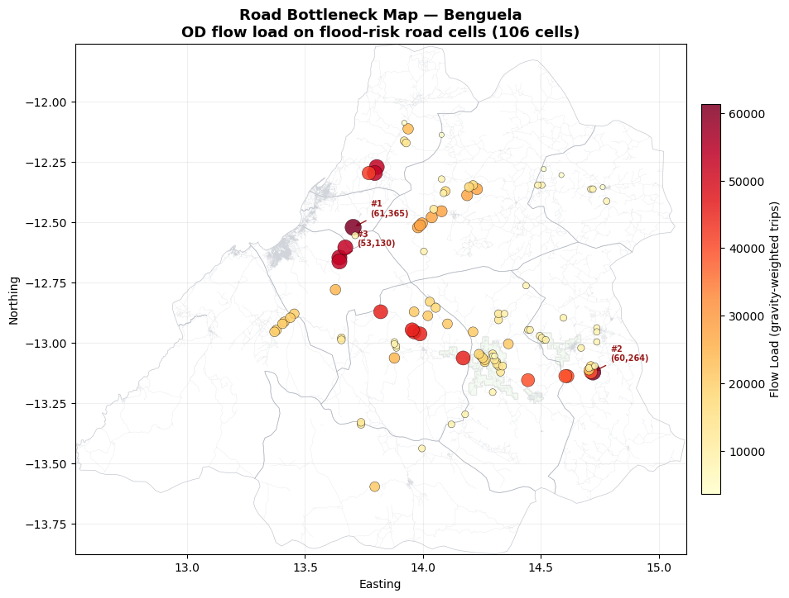
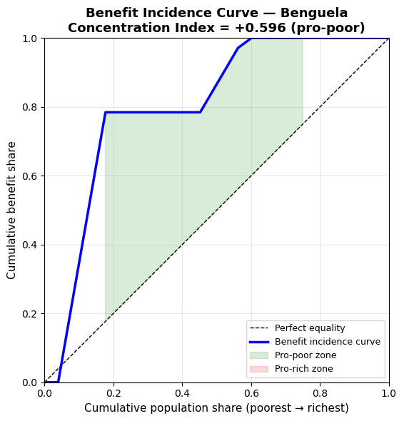
Extended Analytics: Going Deeper

Slide 18
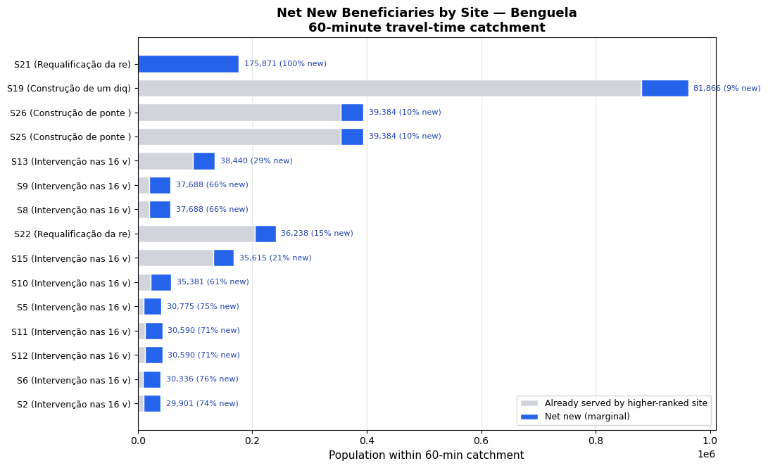
Extended Analytics: Going Deeper

Slide 19
What-If: Upgrading Flood-Vulnerable Roads
Simulation: upgrade all flood-risk road cells to secondary-road standard (45 km/h). How does travel time change across the province?
How the Simulation Works
What Decision Makers Should Look For
1. Baseline Compute travel times from all project sites using today's road network
2. Identify Find road cells sitting in the 100-year flood zone (Step 04)
3. Upgrade Set those cells to 45 km/h (secondary road standard)
4. Recompute Calculate new travel times on the improved network
5. Compare Subtract: how many minutes saved per grid cell?
Newly within 60 min People who previously had NO reasonable access to project sites and now do. The single most actionable metric for investment justification.
Large gains at low thresholds Many people gaining 5-10 minutes = widespread but modest improvement. Typical of upgrading a few key segments on a busy route.
Small gains at high thresholds Fewer people gaining 30-60+ minutes = transformative for remote communities. Often more important for equity objectives.
Corridor dashboard Step 15 aggregates these metrics across all provinces into a single comparison table for cross-province prioritisation.
Note: This is a cost-distance simulation, not a traffic assignment model. It shows potential accessibility gains, not predicted traffic volumes. Results should be validated with field engineering assessments before committing budget.
Outputs: sim_impact_summary.csv (population by threshold), sim_travel_delta.tif (minutes-saved raster). Full results in the Jupyter Book, Chapter 8c.

Slide 20
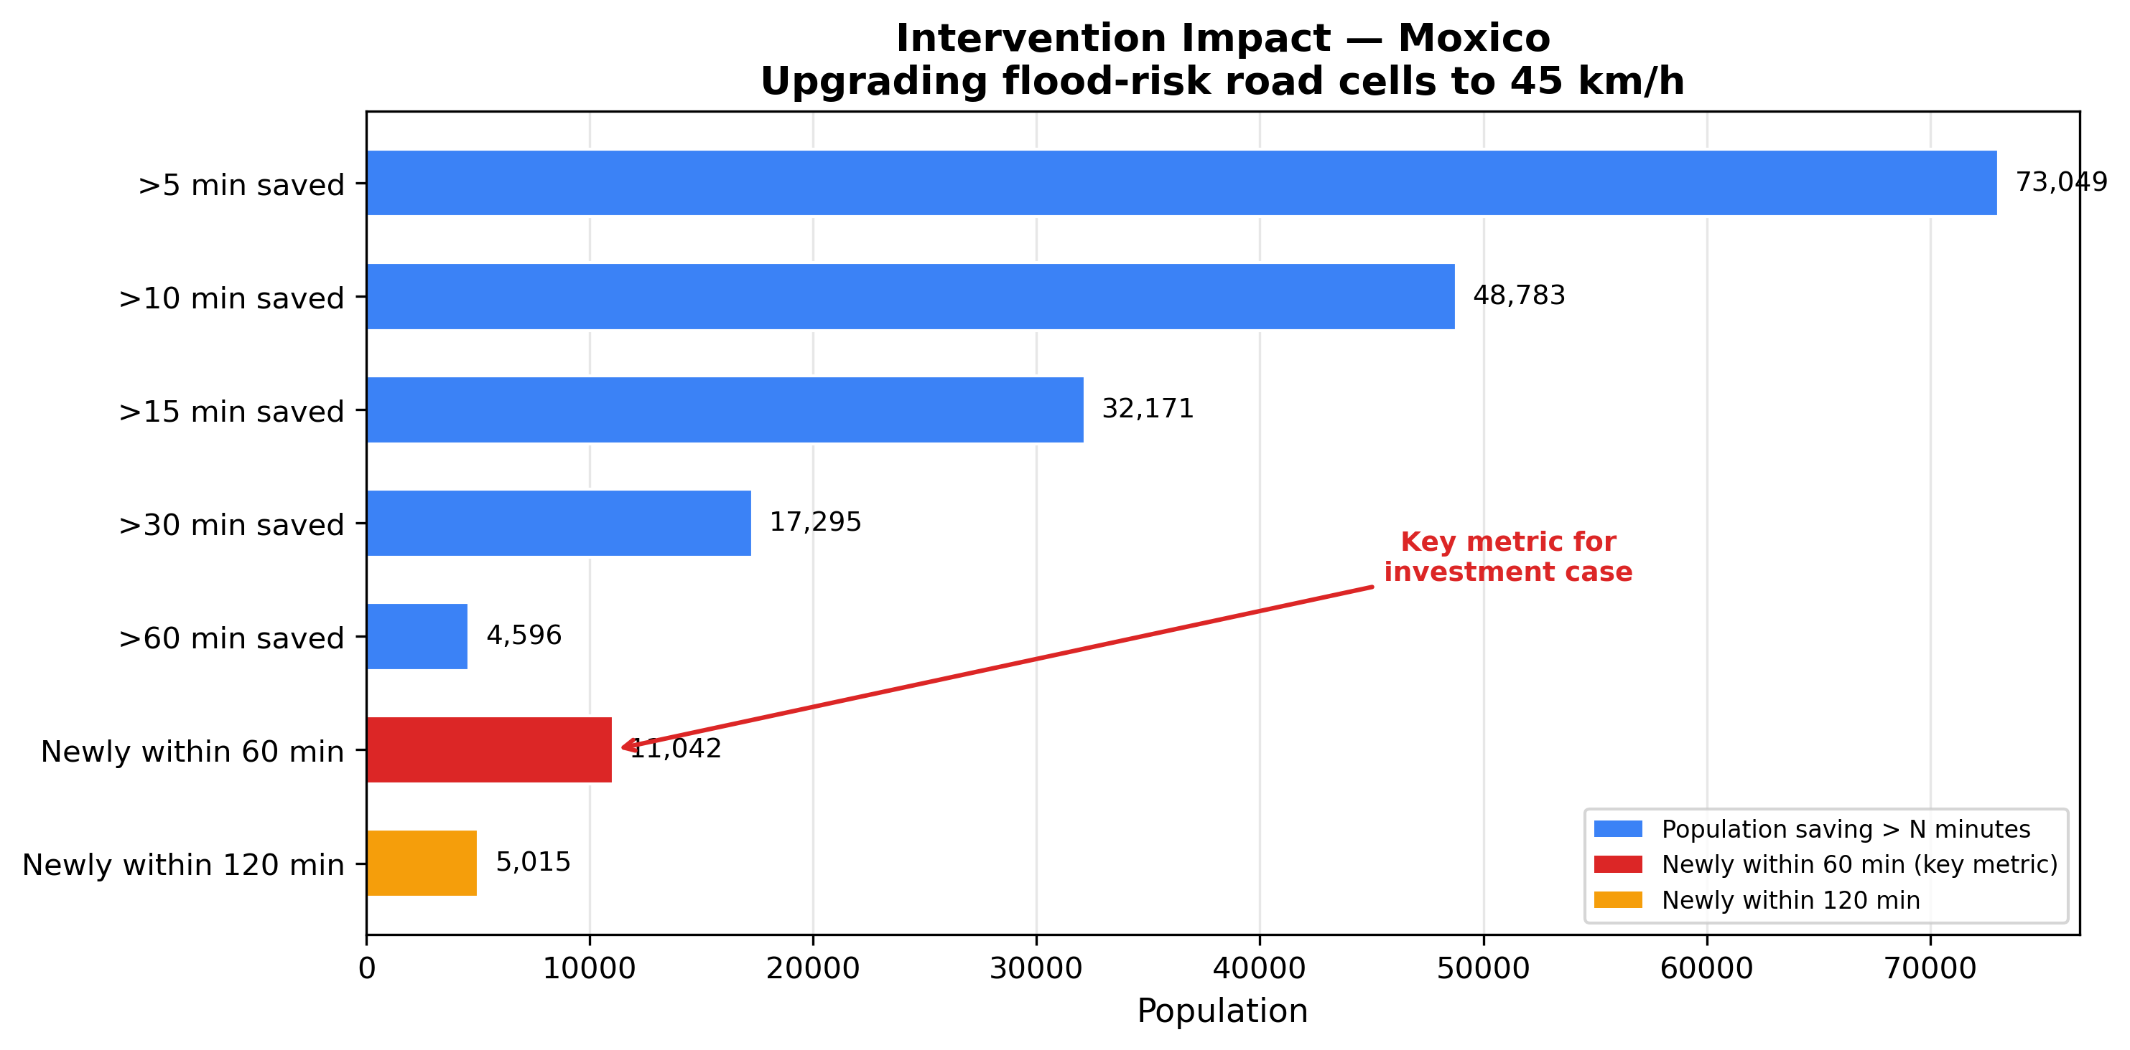
What-If: Upgrading Flood-Vulnerable Roads
Simulation: upgrade all flood-risk road cells to secondary-road standard (45 km/h). How does travel time change across the province?

Slide 21
Recommendations & Next Steps
Immediate (1-2 weeks) ?
Validate Balanced scenario alignment with country priorities
Decide on Moxico / Moxico Leste: accept zero clusters OR adjust threshold
Review equity results: CI shows whether priorities are pro-poor
Review bottleneck ranking: which road segments to protect first?
Medium-term (1-2 months)
Longer-term (3-6 months)
Run 2-3 comparison scenarios (equity-heavy, growth-heavy)
Use intervention simulator to build investment cases
Co-design with transport, agriculture, energy teams
Enrich project metadata by sector and status
Integrate observed data (traffic counts, production, trade)
Add remaining provinces to corridor dashboard
Template replication for other Angola corridors
Discussion: Which scenario should we prioritize?
Framework provides transparent, repeatable, and flexible prioritisation for corridor investment coordination.

