Slide 1
Final project presentation
Benny Y. Pratama
JC Data Science Batch 1

Slide 2
Outlines
Objectives
Data Analysis
Data Preprocessing
Prediction and Evaluation

Slide 3
OBJECTIVES

Slide 4
Objectives – What’s cooking?
To predict the origin of a recipe based on the ingredients provided.
Source : Kaggle (https://www.kaggle.com/c/whats-cooking-kernels-only, provided by Yummly - https://www.yummly.com/)

Slide 5
Data analysis

Slide 6
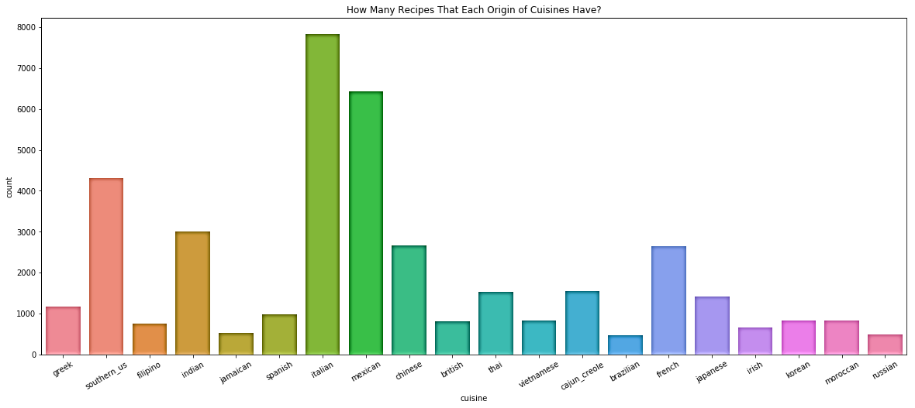
Data analysis – overall recipe

Slide 7
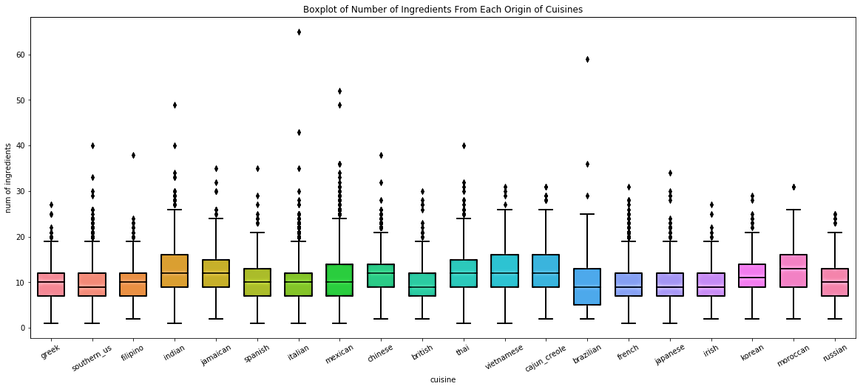
Data analysis – boxplot

Slide 8
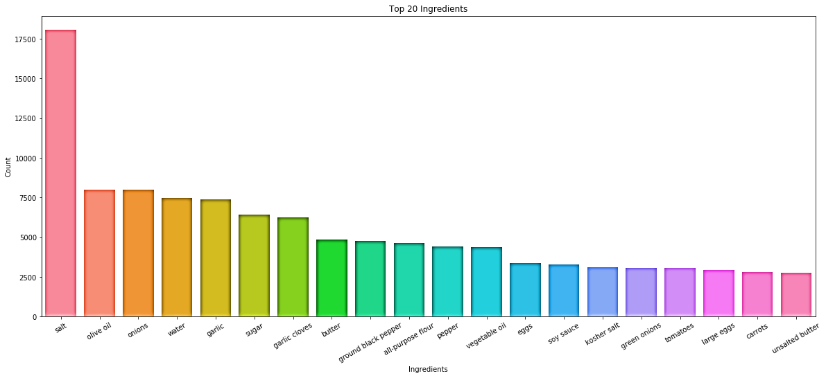
Data analysis – top 20 ingredients

Slide 9
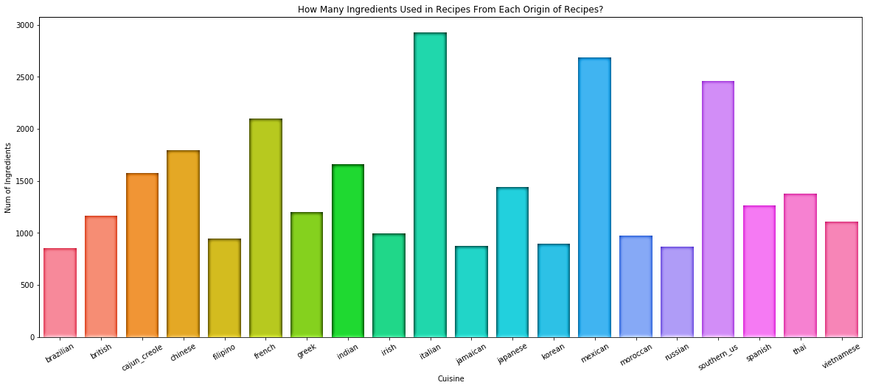
Data analysis - How Many Ingredients Used in Recipes From Each Origin of Recipes?

Slide 10
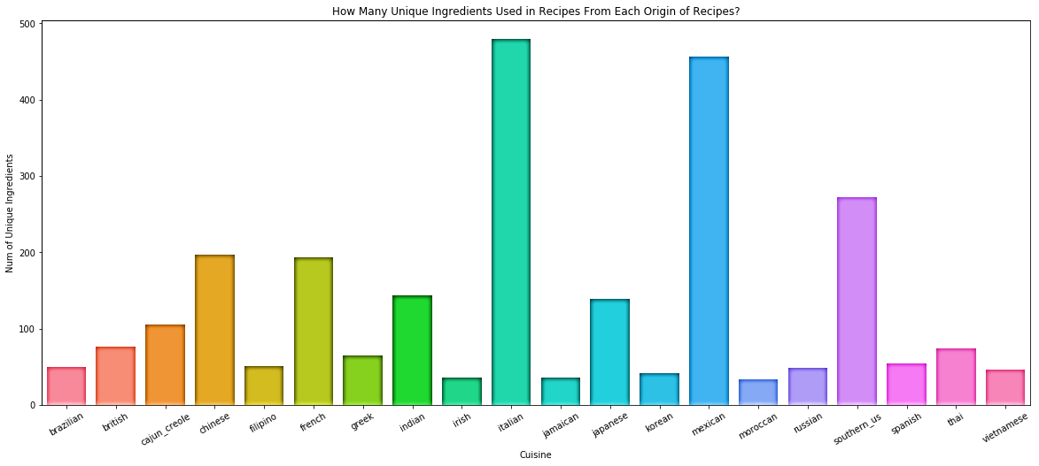
Data analysis - How Many unique Ingredients Used in Recipes From Each Origin of Recipes?

Slide 11
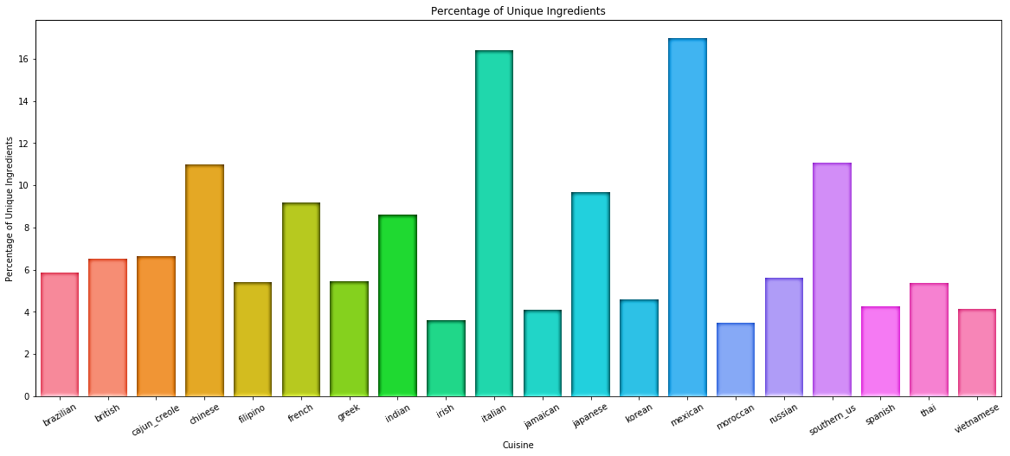
Data analysis - Percentage of Unique Ingredients

Slide 12
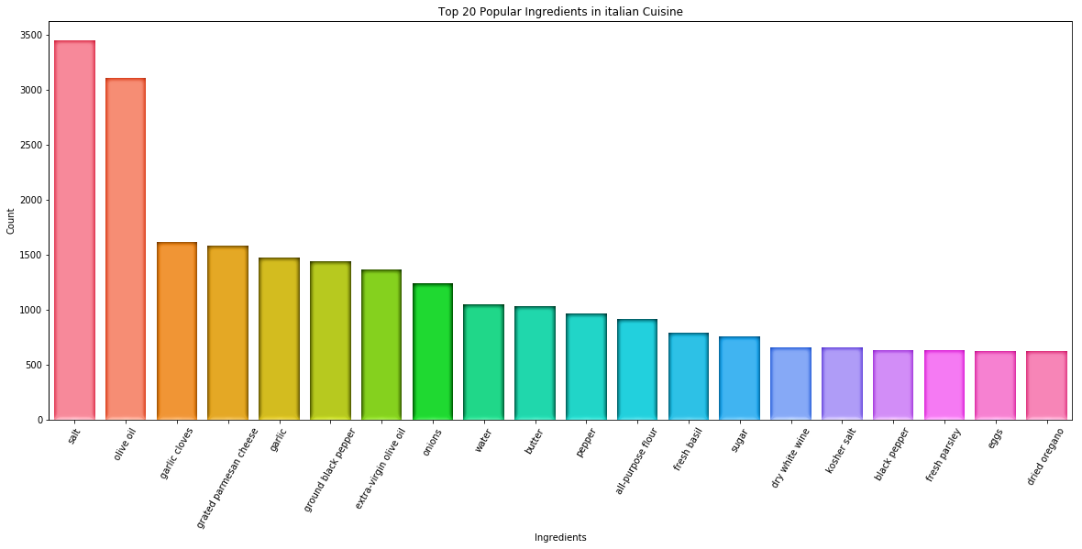
Data analysis – TOP 20 OF INGREDIENTS FROM SOME ORIGIN OF RECIPES (ITALY)

Slide 13
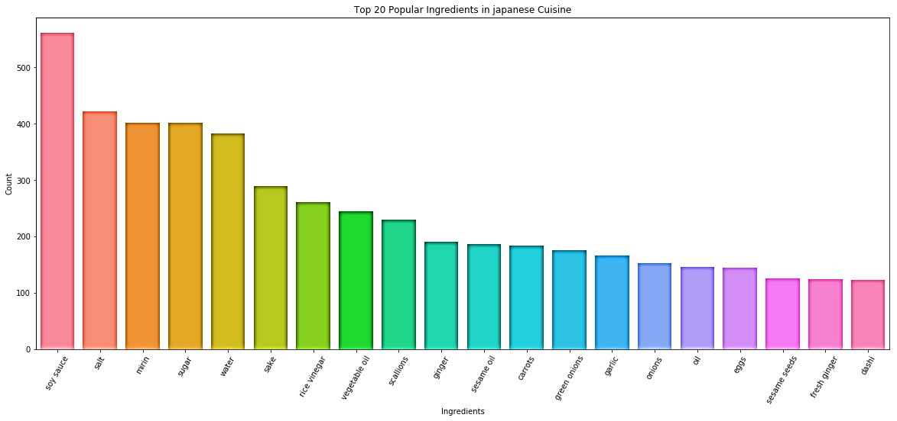
Data analysis – TOP 20 OF INGREDIENTS FROM SOME ORIGIN OF RECIPES (japan)

Slide 14
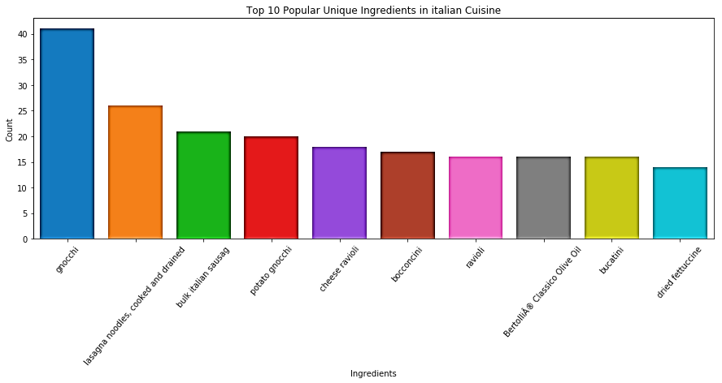
Data analysis – TOP 20 OF UNIQUE INGREDIENTS FROM SOME ORIGIN OF RECIPES (italy)

Slide 15
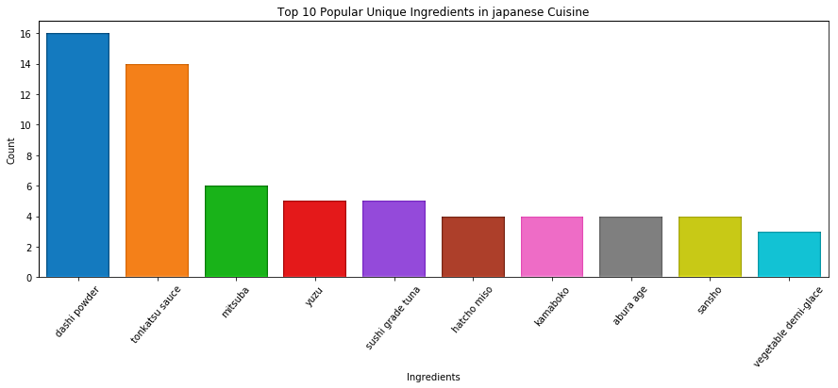
Data analysis – TOP 20 OF UNIQUE INGREDIENTS FROM SOME ORIGIN OF RECIPES (JAPAN)

Slide 16
DATA PREPROCESSING

Slide 17
DATA PREPROCESSING - STEPS
Tokenization data
Split data into training data and testing data
Implement Doc2Vec model for word embedding
Train model using training data
Set training data and testing data as learning vector

Slide 18
DOC2vec in a glance
An improvement to Word2Vec
Generally used to find relation among words
Implement CBOW, Skip-Gram, PV-DM, and PV-DBOW algorithms
Source : https://medium.com/scaleabout/a-gentle-introduction-to-doc2vec-db3e8c0cce5e

Slide 19
PREDICTION AND EVALUATION

Slide 20
MODEL
Implement LinearSVC model
It is commonly used for predicting text data

Slide 21
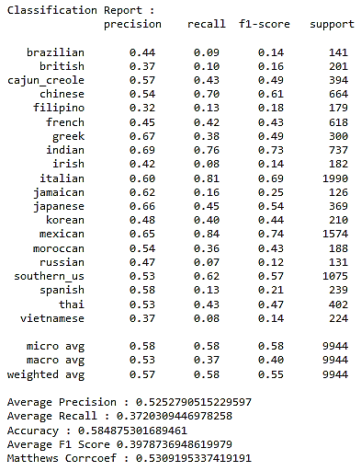
MOMENT OF TRUTH

