Slide 1

Windows 8.1 L&L – More than Just a Pretty Start Button
Ben Tsui & Jeremy Bibby

Slide 2
Lunch and Learn
Introduction
What’s new in Windows 8.1
What’s new in Xaml
What’s new in .NET
New App Store Changes
Visual Studio features
Azure Mobile Services
Performance Enhancements
Simplified Device Connectivity
Bing as a Platform

Slide 3
Introduction
Faster cadence across all product lines
Tighter customer feedback loop
Performance and usability improvements
New Form factor devices
All about Touch, Touch, Touch
Integrate the senses: ears, eyes, mouth
Notes:
Fast cadence for windows -> Windows 8.1 is only 8 months after last year’s build and incorporates a lot of changes. Same deal for Visual Studio, Bing, C#, C++, etc.
Microsoft incorporating feedback via adoption of Nuget, increasing open source presence, etc. Also a lot more visibility into what’s in the pipeline.
Performance improvements across the board through increased co-operation between windows team and DX team for things like better text rendering etc.
New form factors like small tablet
Touch – not giving up on Windows 8 modern UI, just making the desktop and modern experience work together better
Senses – better support for peripherals like 3d printers, wireless displays via WifiDirect, ability to code against custom devices

Slide 4
What’s new in Windows 8.1 - Highlights
New Search API’s with Bing
Build great search experience into your apps
Several XAML performance updates
New WebView and DX control with no airspace issues
New Controls
WinRT HTTP API:
OS Level caching used in all apps
Pre-fetch content built in
New Developer Tools
Notes:
HTTP Cache – Same cache between all apps, IE, etc., same sort of APIs as old windows one
Projection – useful for POS apps – customer facing display and a employee facing display
Contacts – ability to allow a user to easily interact with any given contact, helps cross-app scenarios and is more like Windows Phone model.

Slide 5
What’s new in Windows 8.1
Devices
POS: Point of Service device support for Magnetic Swipe Readers and Barcode Scanners
Improved USB HID support for custom hardware
RT Bluetooth API for interfacing with Bluetooth devices
New features in Mobility Services in Azure
Easier integration for Push notifications, tiles, background tasks
For a list of new features reference:
http://msdn.microsoft.com/en-us/library/windows/apps/bg182410.aspx
Notes:
HTTP Cache – Same cache between all apps, IE, etc., same sort of APIs as old windows one
Projection – useful for POS apps – customer facing display and a employee facing display
Contacts – ability to allow a user to easily interact with any given contact, helps cross-app scenarios and is more like Windows Phone model.

Slide 6


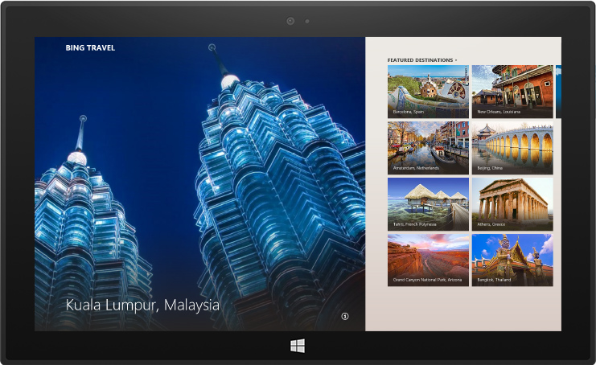

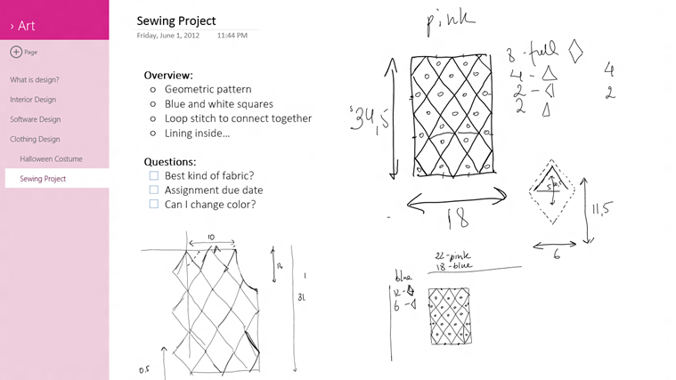

What’s New in Xaml – New Controls
Datepicker
Simplified flyout
Command Bar
Media Player Control
WebView
Hub
DX Swap Chain
Notes:
Datepicker – full support for all locations, time rules, etc.
Flyout – better support for window boundaries, placement, etc.
Command Bar – app bar but with slots for primary, secondary buttons – is able to eloquently scale down so that it shows icons with text, then just icons, then just primary icons as the size decreases.
Media Player – an OOTB media player control with standard player controls – not designed to be customized but deals with sizing etc.
DX Swapchain – ability to host directX content anywhere within your visual tree (used in big name apps like Maps, Freshpaint, OneNote, etc.)
Webview
now possible to host this anywhere in your visual tree without worrying about Airspace issues
Can easily host local files
Exposes nav events (started, completed, error) so that you can use it more effectively

Slide 7
What’s New in Xaml Continued ..
Performance
Deferred loading of keyed resources
Simplified OOTB control templates
Xaml binary compilation
Binding Performance Improvements
Text Rendering
Binding
More from WPF – Fallback, UpdateSourceTrigger, BindingExpression
ThemeBinding for runtime theme changes
Notes:
Deferred loading
all static resources are deferred for smaller memory footprint and faster loading. This prevents all themes from being loaded into memory like they are in Win8.0
Simplified OOTB
95%+ of people weren’t using all of the features in rich controls like the gridview, so now you have to opt in for some of the selection etc. which reduces the depth of the visual tree for each element from 5+ levels down to 1 or 2.
Binary Xaml
Compiling provides 25%+ better loading performance
Similar to old WPF Xaml binaries
Binding improvements
40% better performance with no code changes
Text
3x better text rendering performance
Support for coloured fonts – first font will be Segoe Emoji
Office team looking into turning ribbon icons into coloured fonts

Slide 8
What’s new in .NET
64 bit edit and continue
Async improvements
Better error reporting
Large Object Heap (LOH) compaction
Entity Framework connection resiliency
Nuget
Notes:
Async
Full call stack for web,desktop, modern apps
Task list to see all running tasks irrespective of source
Errors
C++ errors from the OS are now captured in the System.Exception
EF
Deals with retry logic, dropped connections, etc.
LOH
New setting to compact LOH
With great power comes great responsibility – quite slow
Nuget
Official nugget feed with relased, supported packaes
Prerelease components too with feedback being collected by the teams implementing it

Slide 9
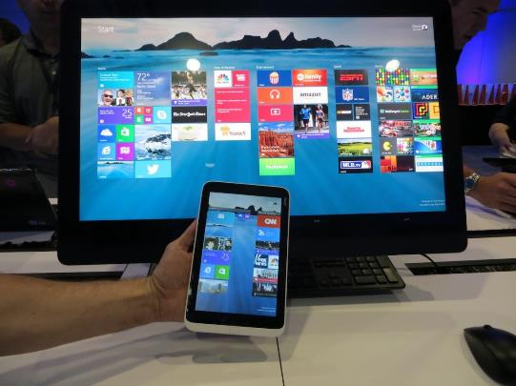
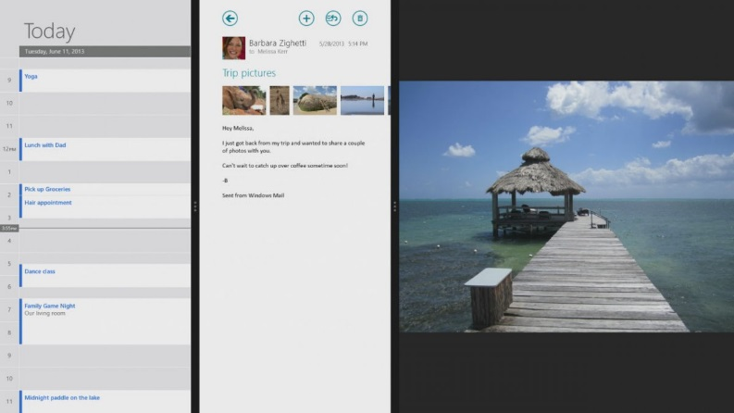
Modern UI Changes
New form factors and DPIs
Small tablets
High DPI tablets (surface w/ 2560x1440)
Multitasking changes
Multiple windows
500 pixel minimum width
No snap view requirement
Notes:
New surface as shown in VS device sim is higher res then retina (275ppi)
Multitasking
Now possible to dock as many windows as you want
Impossible to do some of the programmatic snapping operations now though
500 pixel
All apps need to be 100% functional down to 500 pixels wide
Orientation, fill etc. in xaml are obsolete, now you should base your states on screen ratio like responsive design
Snap view
No longer a requirement to support snap view to get into the store
You can opt into snap view if your app provides value in this mode.
Snap view now variable size – 320px up to 500px – letterboxed for now but when you upgrade, you get to layout the space appropriately

Slide 10













































New App Store Changes
In 8 months since the original store launch
Hundreds of millions of app downloads
New UI Design for the store
Updates to applications are done automatically, no longer a notification badge on the store tile
More cross categorization and cross selling of apps.
Crash data now available from the certification process
Detailed feedback for failure conditions

Slide 11
New App Store Changes
Enhanced analytics view for ratings and reviews
Consumables and repeat purchase process improved
App bundles and app resource bundles can be packaged separately and managed by the store
Average review time 2.2 days
Support for M-rated games
Update to Windows 8.1 is free and will occur through the store. If interested you can get it from the store by going to http://preview.windows.com and following the instructions

Slide 12
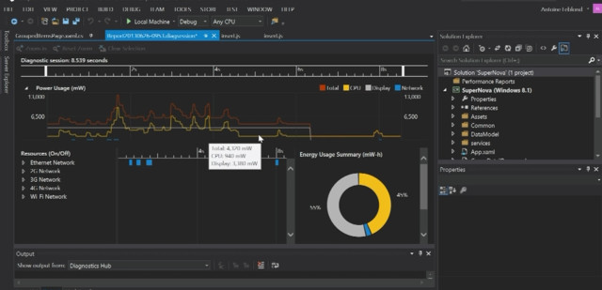
New to Visual Studio
New Visual Studio features:
Performance Tools
Coded UI Testing
Xaml
StaticResource autocomplete
Xaml Goto Definition
Notes:
Performance meter allows you to gauge the energy usage of your app using Wireless, 3g, 4g, etc. broken down by component (GPU,CPU,Video) Also tools to much more accurately determine Xaml performance and bottlenecks

Slide 13
Azure Mobile Services
New
GA 99.9% SLA
Free 20MB DB
Scheduler
Integrated Source Control
Android SDK, iOS SDK
HTML + JS SDK
Wp7.x support

Slide 14
Performance Enhancements
XAML Control lazy load
WebGL
MPEG Dash
New WebView

Slide 15



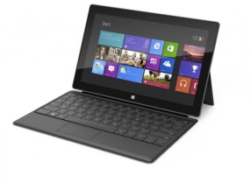



Simplified Device Connectivity
New 8.1 WinRT API to access peripherals
Several new pre-packaged Device Scenario API:
Finger prints
Geo Fence
Bar Codes
Smart Cards
3D Printers

Slide 16
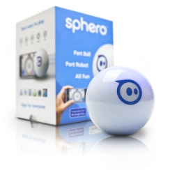

Simplified Device Connectivity
Available Device Protocol API:
HID
USB
Bluetooth RFCOMM
Bluetooth Smart
WiFi Direct

Slide 17

Bing as a Platform
New 2D and 3D maps – 8.1 will use Bing maps on Win8 – not an Active X control
2D maps will include new features:
Driving directions
Geocoding API
Windows 8 Available now: Managed WinJS, C#, C++
Windows 8.1 Beta

Slide 18

Bing as a Platform
3D Maps:
Integrated Street Side
API Designed for easily porting from Bing maps
Ability to drop custom 3D models into the map
New 3D models
Release date TBD

Slide 19
Bing as a Platform…
Text To Speech – TTS
Supports 15 languages
Windows 8.1 only
Speech Recognition
Converts Speech to Text
Supports en-us only
Windows 8.1 GA
OCR and Translation
Supports 8 languages
Available in Windows 8 and 8.1 Beta

Slide 20
Schedule of Events
Lunch and Learn
Blogs:
Introduction to Windows 8.1
Building apps with Bluetooth devices
Getting connected to Azure Mobile Service
Authentication – the forgotten child
Using USB Devices in a Store App
The New WinRT HTTP Client
Bing as an API
Designing apps for any Screen
Enhancing your Win 8.1 Application with DirectX
Testing your WinRT apps with Unit Tests and Coded UI
New Controls in Windows 8.1
Native Memory and why it matters for a .NET developer

Slide 21
…Schedule of Events
Labs
Controlling Bluetooth devices in a Windows Store App
An Introduction into Azure Mobile Services
Authentication and your Windows app
Controlling USB Devices in a Windows Store App
HTTP Client and the connected app
Creating Responsive Windows 8.1 applications
An introduction to DirectX within your Windows Store App
Coded UI testing for Caliburn Micro Windows Store Apps
High Performance List-based apps in WinRT 8.1

