Slide 1
Baseline: Expert Markers vs Accessory Features
Compare the 50 paper-ready markers with features re-selected from the accessory genome
Antibiotic-aware Adaptive Feature Fusion for Salmonella Antimicrobial Resistance Prediction

Slide 2
Context
Compare the 50 paper-ready markers with features re-selected from the accessory genome. This is experiment 1 of 26 in a study of antibiotic-aware adaptive feature fusion for Salmonella antimicrobial resistance prediction.

Slide 3
Objective
• Establish a strong baseline for Salmonella AMR prediction
• Check whether accessory-derived features can match expert markers

Slide 4
Data & Method
• 50 paper-ready markers per drug as baseline
• Chi-squared re-selection on the accessory matrix (train only)
• Logistic Regression / Random Forest across 5 antibiotics

Slide 5
Evaluation Metrics
• F1 score (primary metric for imbalanced data)
• Balanced accuracy and AUPRC
• Feature selection and thresholding on training data only
• Reliability checks where applicable: statistical test, lineage-aware split, negative control

Slide 6
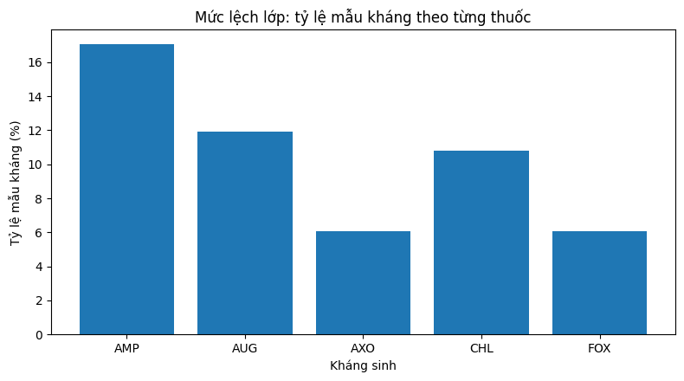
Results (1/3)
Result figure from notebook 01_baseline

Slide 7
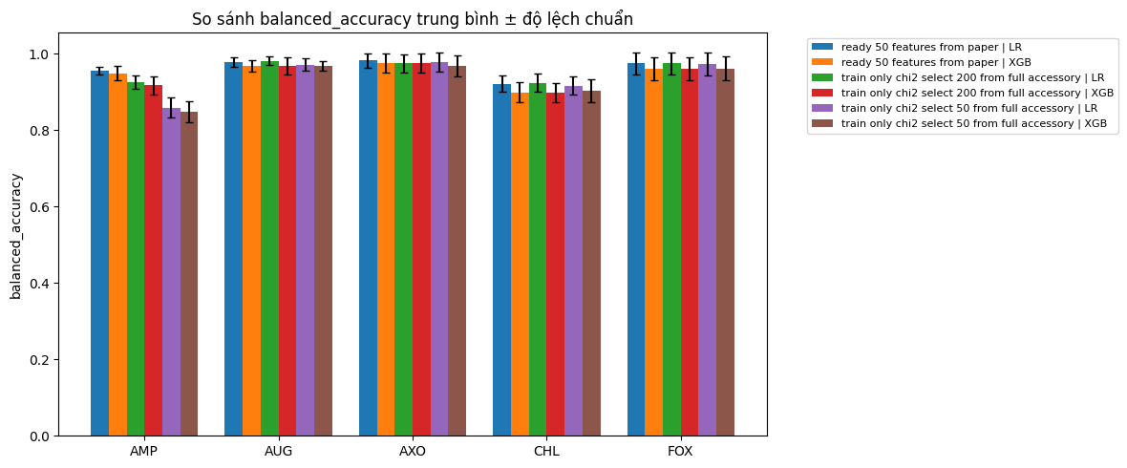
Results (2/3)
Result figure from notebook 01_baseline

Slide 8
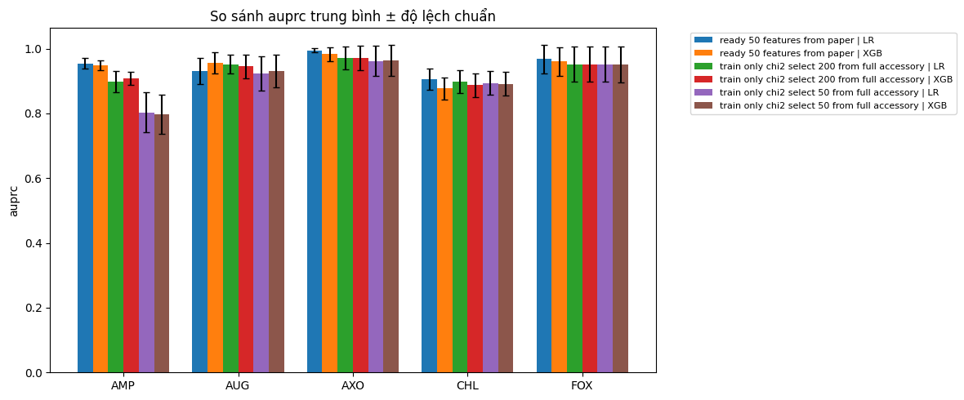
Results (3/3)
Result figure from notebook 01_baseline

Slide 9
Key Findings
• Paper-ready 50 markers are already very strong
• Re-selected accessory features reach comparable performance
• Motivates deeper study of the accessory genome

Slide 10
Notes
Exploratory baseline; its finding motivates the accessory-focused study.

Slide 11
Conclusion
Paper-ready 50 markers are already very strong

