Slide 1
Stability Selection of Features
Measure how stable selected features are across many data splits
Antibiotic-aware Adaptive Feature Fusion for Salmonella Antimicrobial Resistance Prediction

Slide 2
Context
Measure how stable selected features are across many data splits. This is experiment 2 of 26 in a study of antibiotic-aware adaptive feature fusion for Salmonella antimicrobial resistance prediction.

Slide 3
Objective
• Assess robustness of feature selection
• Identify consistently selected features

Slide 4
Data & Method
• Repeat selection over many train/test splits
• Count selection frequency and Jaccard overlap

Slide 5
Evaluation Metrics
• F1 score (primary metric for imbalanced data)
• Balanced accuracy and AUPRC
• Feature selection and thresholding on training data only
• Reliability checks where applicable: statistical test, lineage-aware split, negative control

Slide 6
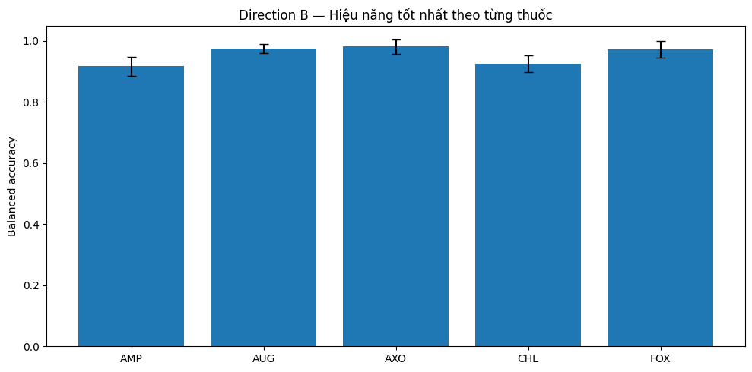
Results (1/3)
Result figure from notebook 02_stability

Slide 7
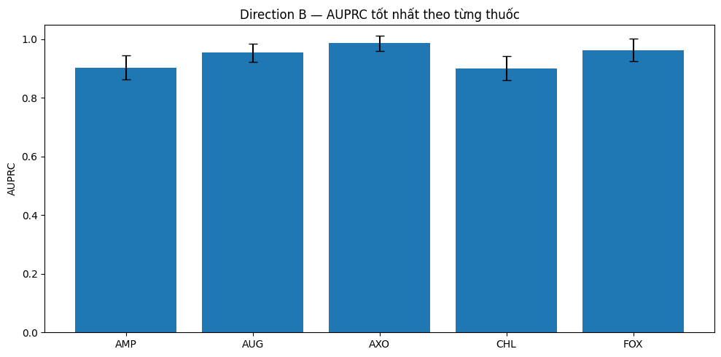
Results (2/3)
Result figure from notebook 02_stability

Slide 8
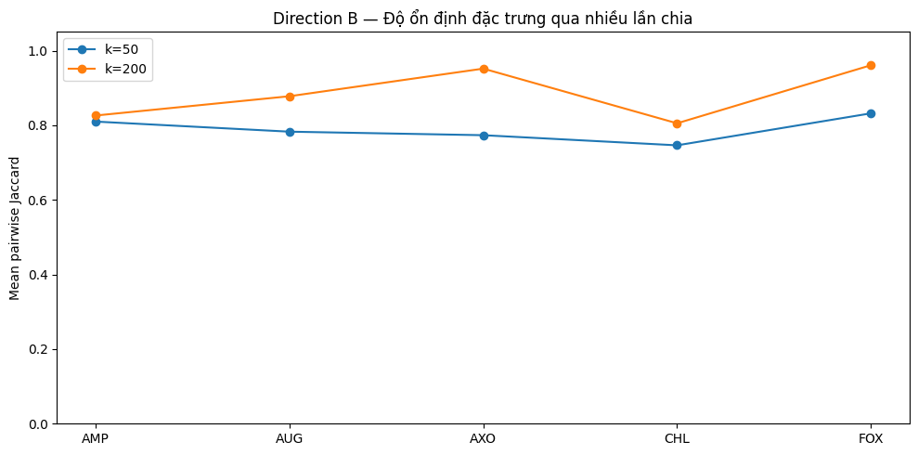
Results (3/3)
Result figure from notebook 02_stability

Slide 9
Key Findings
• k=200 is generally more stable than k=50
• AXO/FOX show the highest selection overlap

Slide 10
Notes
Exploratory; stability informs the feature selection used later.

Slide 11
Conclusion
k=200 is generally more stable than k=50

