Slide 1
Signal Source: Accessory Genome vs Core SNP
Which genome representation predicts resistance better
Antibiotic-aware Adaptive Feature Fusion for Salmonella Antimicrobial Resistance Prediction

Slide 2
Context
Which genome representation predicts resistance better. This is experiment 3 of 26 in a study of antibiotic-aware adaptive feature fusion for Salmonella antimicrobial resistance prediction.

Slide 3
Objective
• Compare accessory genes, core SNPs and their combination
• Identify the dominant predictive signal

Slide 4
Data & Method
• Chi-squared top-k on each representation (train only)
• Logistic Regression, 10 repeated splits

Slide 5
Evaluation Metrics
• F1 score (primary metric for imbalanced data)
• Balanced accuracy and AUPRC
• Feature selection and thresholding on training data only
• Reliability checks where applicable: statistical test, lineage-aware split, negative control

Slide 6
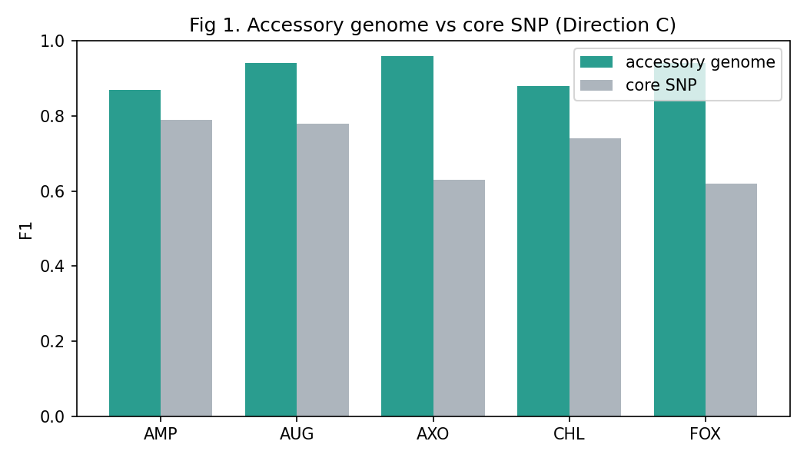
Results (1/3)
Result figure from notebook 03_signal_source

Slide 7
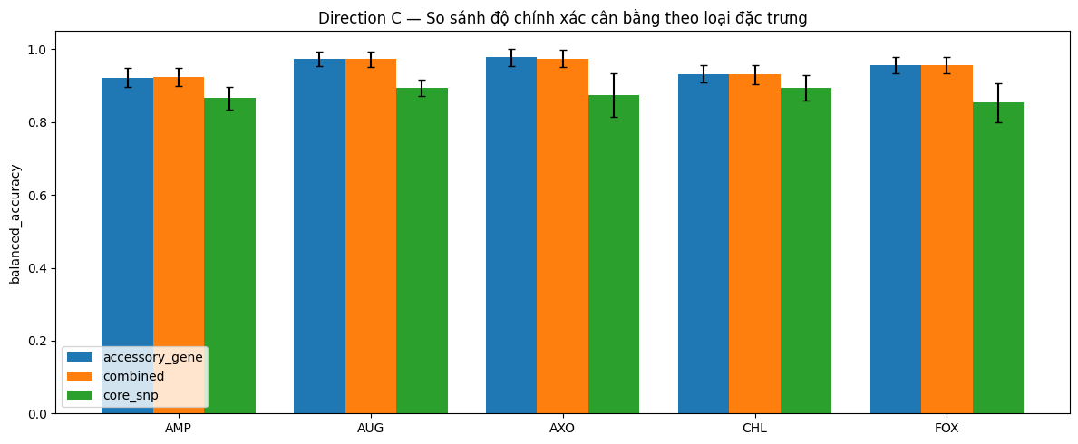
Results (2/3)
Result figure from notebook 03_signal_source

Slide 8
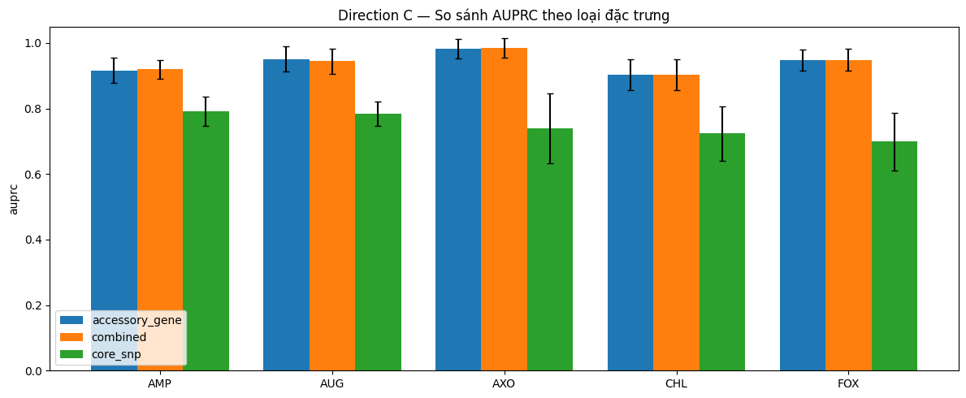
Results (3/3)
Result figure from notebook 03_signal_source

Slide 9
Key Findings
• Accessory beats core SNP on all 5 drugs (F1 gap 0.08-0.32)
• Combined is almost equal to accessory alone
• Core SNPs add little predictive signal

Slide 10
Notes
Key result: establishes the accessory genome as the main predictive signal.

Slide 11
Conclusion
Accessory beats core SNP on all 5 drugs (F1 gap 0.08-0.32)

