Slide 1
Temporal Split Evaluation
Train on older years, test on a newer year
Antibiotic-aware Adaptive Feature Fusion for Salmonella Antimicrobial Resistance Prediction

Slide 2
Context
Train on older years, test on a newer year. This is experiment 4 of 26 in a study of antibiotic-aware adaptive feature fusion for Salmonella antimicrobial resistance prediction.

Slide 3
Objective
• Test realistic difficulty beyond random splits
• Detect temporal distribution shift

Slide 4
Data & Method
• Train years <=2017, test 2018
• Compare against random split on the same subset

Slide 5
Evaluation Metrics
• F1 score (primary metric for imbalanced data)
• Balanced accuracy and AUPRC
• Feature selection and thresholding on training data only
• Reliability checks where applicable: statistical test, lineage-aware split, negative control

Slide 6
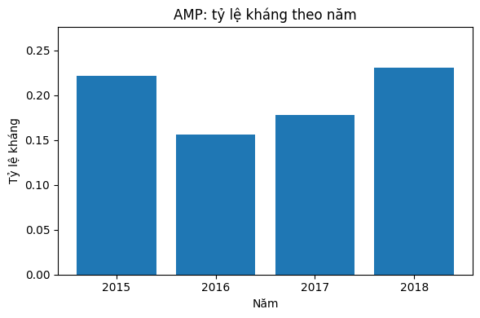
Results (1/3)
Result figure from notebook 04_temporal

Slide 7
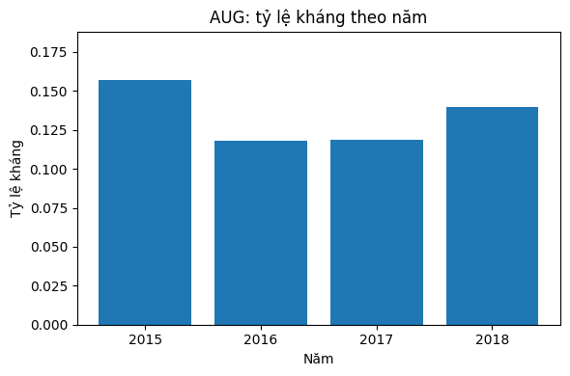
Results (2/3)
Result figure from notebook 04_temporal

Slide 8
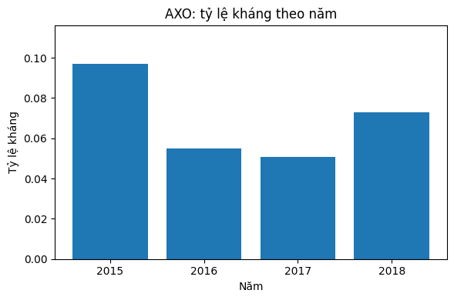
Results (3/3)
Result figure from notebook 04_temporal

Slide 9
Key Findings
• Modest performance drop under temporal split
• Small test set limits strong conclusions

Slide 10
Notes
Robustness check; the small 2018 test set is a caveat.

Slide 11
Conclusion
Modest performance drop under temporal split

