Slide 1
Biological Interpretation of Features
Interpret the most important and stable features biologically
Antibiotic-aware Adaptive Feature Fusion for Salmonella Antimicrobial Resistance Prediction

Slide 2
Context
Interpret the most important and stable features biologically. This is experiment 5 of 26 in a study of antibiotic-aware adaptive feature fusion for Salmonella antimicrobial resistance prediction.

Slide 3
Objective
• Link predictive features to biology
• Assess annotation quality

Slide 4
Data & Method
• Keyword / annotation matching of top features

Slide 5
Evaluation Metrics
• F1 score (primary metric for imbalanced data)
• Balanced accuracy and AUPRC
• Feature selection and thresholding on training data only
• Reliability checks where applicable: statistical test, lineage-aware split, negative control

Slide 6
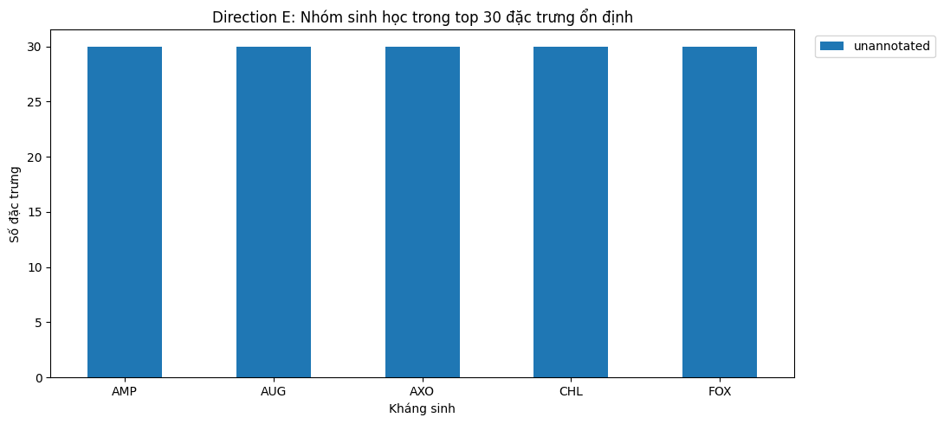
Results (1/3)
Result figure from notebook 05_bio_interp

Slide 7
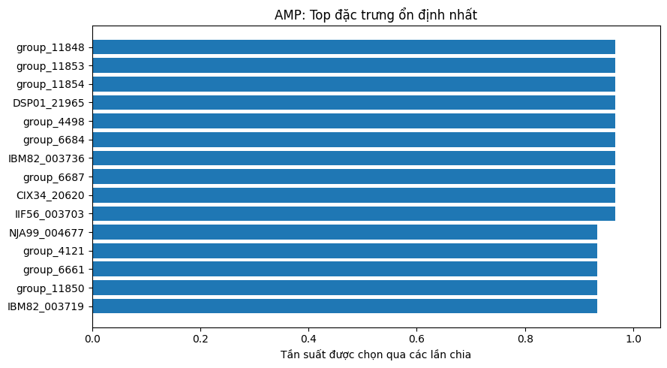
Results (2/3)
Result figure from notebook 05_bio_interp

Slide 8
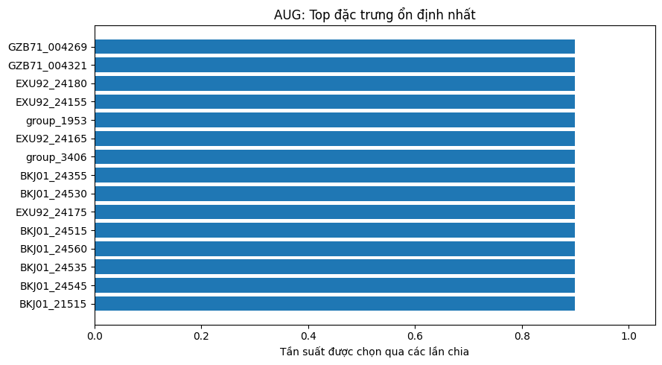
Results (3/3)
Result figure from notebook 05_bio_interp

Slide 9
Key Findings
• Some known AMR genes appear among top features
• Annotation coverage remains weak

Slide 10
Notes
Preliminary interpretation; deeper annotation is done in experiment 22.

Slide 11
Conclusion
Some known AMR genes appear among top features

