Slide 1
Handling Class Imbalance
Strategies for the rare resistant class
Antibiotic-aware Adaptive Feature Fusion for Salmonella Antimicrobial Resistance Prediction

Slide 2
Context
Strategies for the rare resistant class. This is experiment 6 of 26 in a study of antibiotic-aware adaptive feature fusion for Salmonella antimicrobial resistance prediction.

Slide 3
Objective
• Improve detection of rare resistant samples

Slide 4
Data & Method
• Class weighting, threshold tuning, oversampling, XGBoost weighted

Slide 5
Evaluation Metrics
• F1 score (primary metric for imbalanced data)
• Balanced accuracy and AUPRC
• Feature selection and thresholding on training data only
• Reliability checks where applicable: statistical test, lineage-aware split, negative control

Slide 6
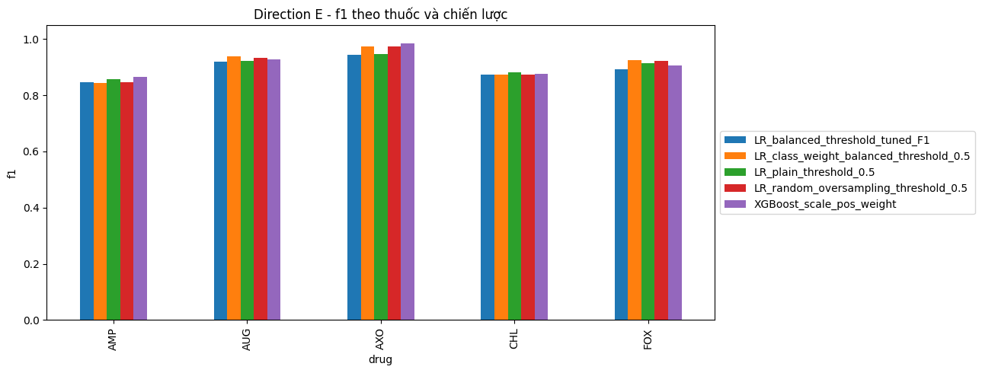
Results (1/3)
Result figure from notebook 06_imbalance

Slide 7
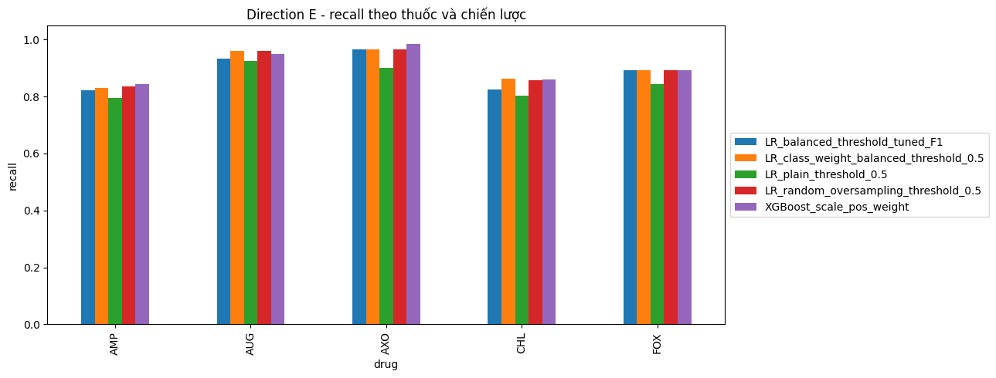
Results (2/3)
Result figure from notebook 06_imbalance

Slide 8
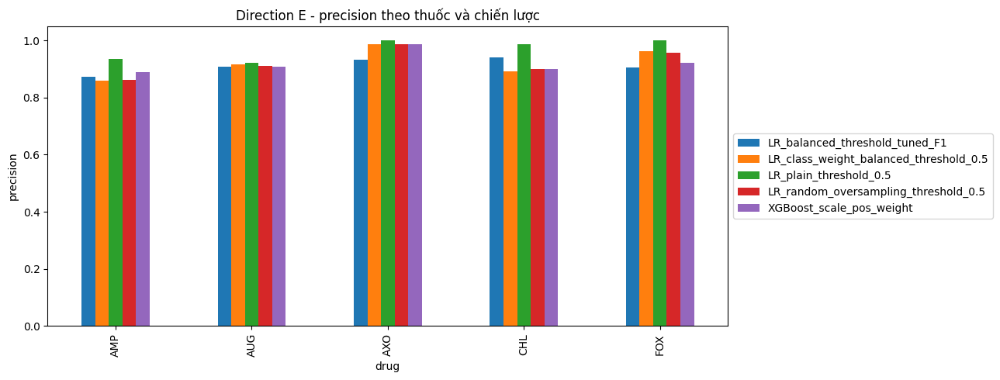
Results (3/3)
Result figure from notebook 06_imbalance

Slide 9
Key Findings
• Balancing raises recall at some precision cost
• Prioritize F1, balanced accuracy and AUPRC

Slide 10
Notes
The metric choice (F1/AUPRC) is used throughout the whole study.

Slide 11
Conclusion
Balancing raises recall at some precision cost

