Slide 1
Phylogeny-informed Prediction
Use an IQ-TREE phylogeny built from core SNPs
Antibiotic-aware Adaptive Feature Fusion for Salmonella Antimicrobial Resistance Prediction

Slide 2
Context
Use an IQ-TREE phylogeny built from core SNPs. This is experiment 7 of 26 in a study of antibiotic-aware adaptive feature fusion for Salmonella antimicrobial resistance prediction.

Slide 3
Objective
• Test whether phylogenetic structure helps prediction

Slide 4
Data & Method
• Build tree from core SNPs, derive phylogeny-aware features

Slide 5
Evaluation Metrics
• F1 score (primary metric for imbalanced data)
• Balanced accuracy and AUPRC
• Feature selection and thresholding on training data only
• Reliability checks where applicable: statistical test, lineage-aware split, negative control

Slide 6
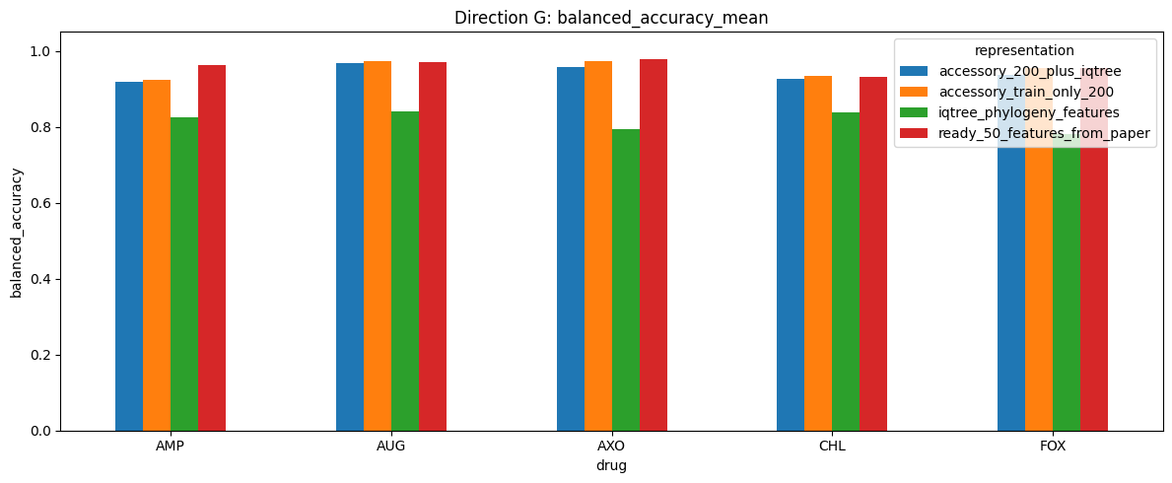
Results (1/3)
Result figure from notebook 07_phylogeny

Slide 7
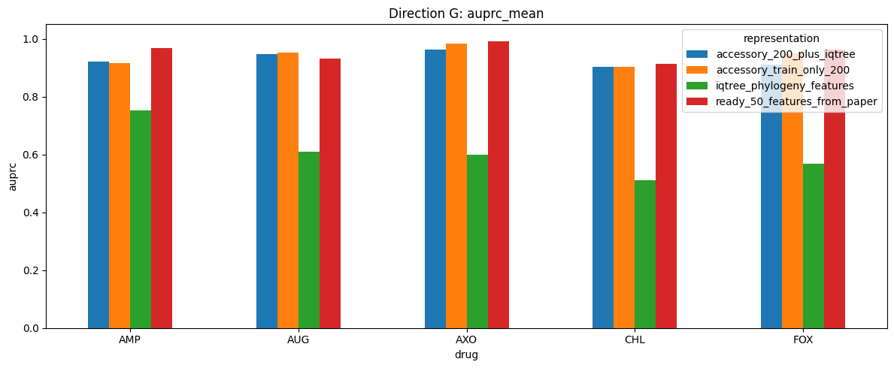
Results (2/3)
Result figure from notebook 07_phylogeny

Slide 8
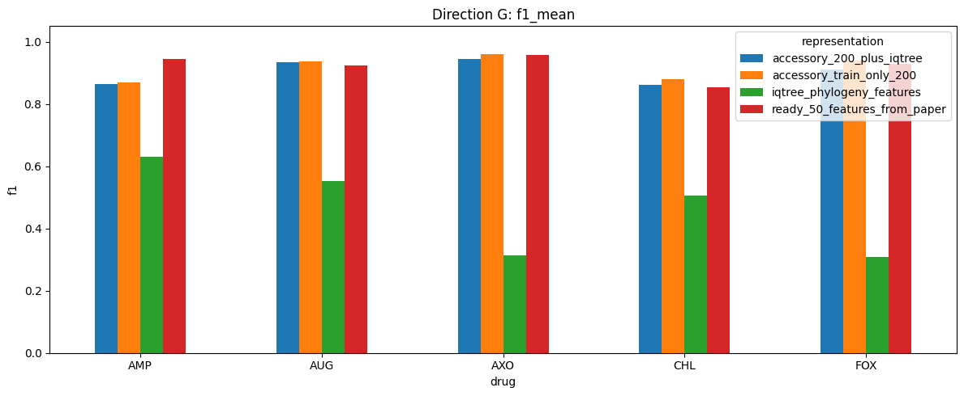
Results (3/3)
Result figure from notebook 07_phylogeny

Slide 9
Key Findings
• No clear improvement
• Treated as an auxiliary analysis

Slide 10
Notes
Auxiliary analysis; phylogeny is not the main axis of the study.

Slide 11
Conclusion
No clear improvement

