Slide 1
Functional Feature Augmentation
Add domain / functional-like features
Antibiotic-aware Adaptive Feature Fusion for Salmonella Antimicrobial Resistance Prediction

Slide 2
Context
Add domain / functional-like features. This is experiment 8 of 26 in a study of antibiotic-aware adaptive feature fusion for Salmonella antimicrobial resistance prediction.

Slide 3
Objective
• Enrich features with functional gene groups

Slide 4
Data & Method
• Keyword functional groups (beta-lactamase, efflux, ...)

Slide 5
Evaluation Metrics
• F1 score (primary metric for imbalanced data)
• Balanced accuracy and AUPRC
• Feature selection and thresholding on training data only
• Reliability checks where applicable: statistical test, lineage-aware split, negative control

Slide 6
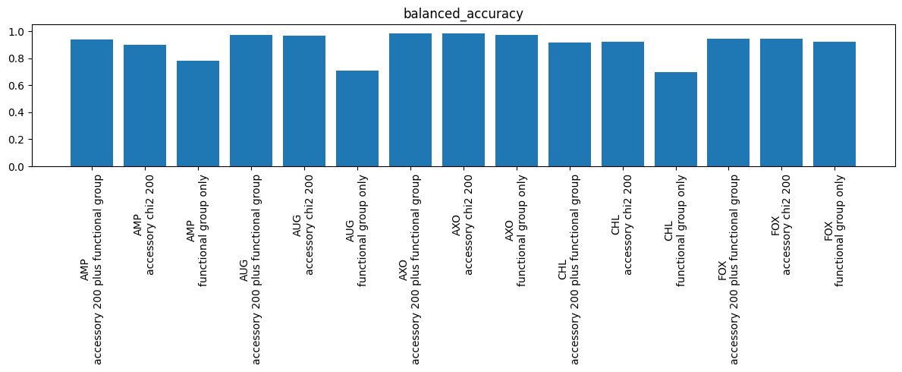
Results (1/3)
Result figure from notebook 08_functional

Slide 7
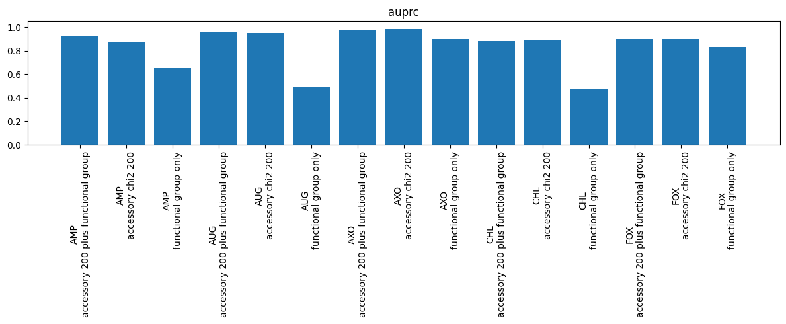
Results (2/3)
Result figure from notebook 08_functional

Slide 8
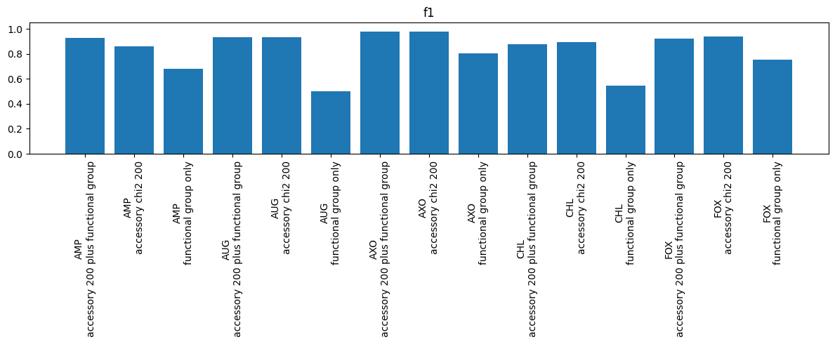
Results (3/3)
Result figure from notebook 08_functional

Slide 9
Key Findings
• Helps some drugs (AMP/AUG/AXO)
• Not sufficient as a standalone module

Slide 10
Notes
Candidate module feeding the adaptive fusion in experiment 14.

Slide 11
Conclusion
Helps some drugs (AMP/AUG/AXO)

