Slide 1
Network-guided Features
Features from a gene co-occurrence network
Antibiotic-aware Adaptive Feature Fusion for Salmonella Antimicrobial Resistance Prediction

Slide 2
Context
Features from a gene co-occurrence network. This is experiment 9 of 26 in a study of antibiotic-aware adaptive feature fusion for Salmonella antimicrobial resistance prediction.

Slide 3
Objective
• Exploit gene co-occurrence structure

Slide 4
Data & Method
• Co-occurrence graph; attempted STRING mapping

Slide 5
Evaluation Metrics
• F1 score (primary metric for imbalanced data)
• Balanced accuracy and AUPRC
• Feature selection and thresholding on training data only
• Reliability checks where applicable: statistical test, lineage-aware split, negative control

Slide 6
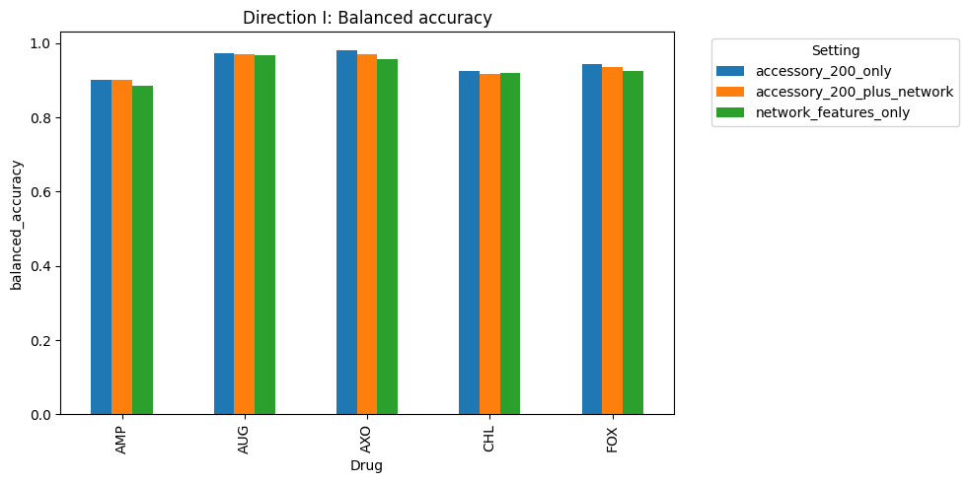
Results (1/3)
Result figure from notebook 09_network

Slide 7
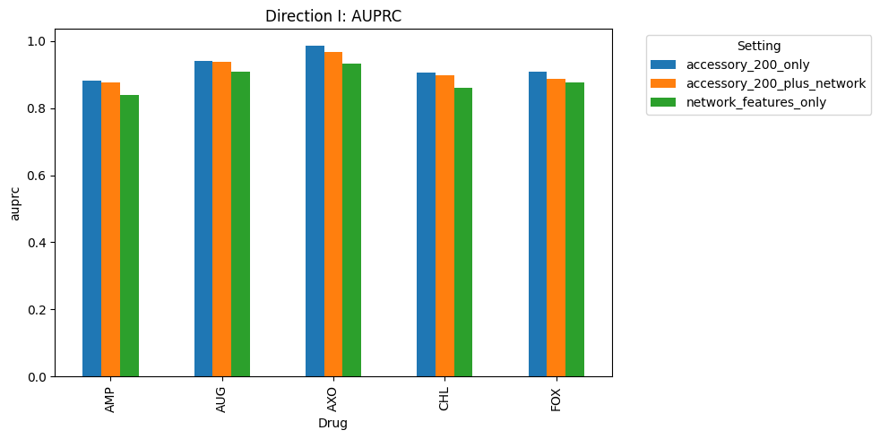
Results (2/3)
Result figure from notebook 09_network

Slide 8
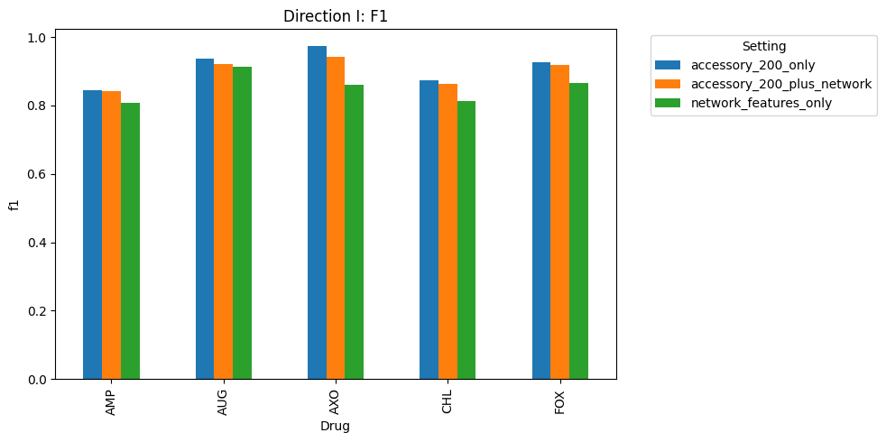
Results (3/3)
Result figure from notebook 09_network

Slide 9
Key Findings
• Small gains only
• STRING identifiers hard to match

Slide 10
Notes
Candidate module; limited by gene identifier mismatch.

Slide 11
Conclusion
Small gains only

