Slide 1
Ensemble Feature Selection
Combine several selectors into one ranking
Antibiotic-aware Adaptive Feature Fusion for Salmonella Antimicrobial Resistance Prediction

Slide 2
Context
Combine several selectors into one ranking. This is experiment 10 of 26 in a study of antibiotic-aware adaptive feature fusion for Salmonella antimicrobial resistance prediction.

Slide 3
Objective
• Select robust features from many criteria

Slide 4
Data & Method
• Chi-squared + L1-logistic + RF importance, averaged rank

Slide 5
Evaluation Metrics
• F1 score (primary metric for imbalanced data)
• Balanced accuracy and AUPRC
• Feature selection and thresholding on training data only
• Reliability checks where applicable: statistical test, lineage-aware split, negative control

Slide 6
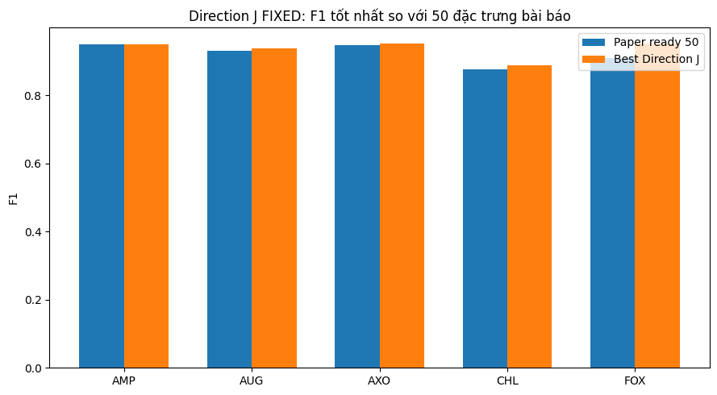
Results (1/3)
Result figure from notebook 10_ensemble_select

Slide 7
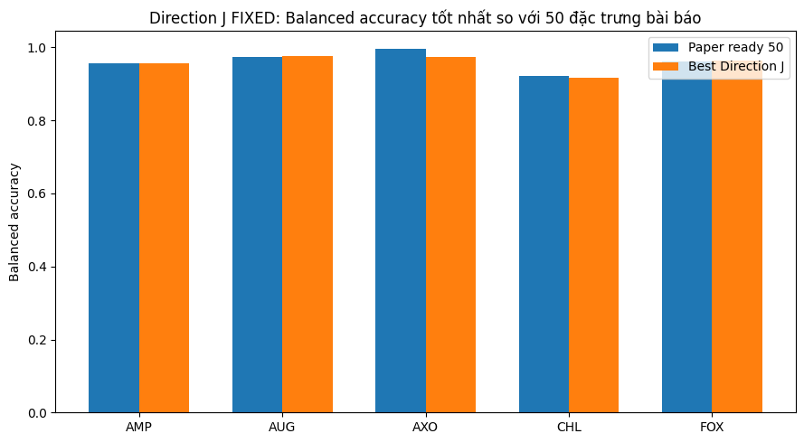
Results (2/3)
Result figure from notebook 10_ensemble_select

Slide 8
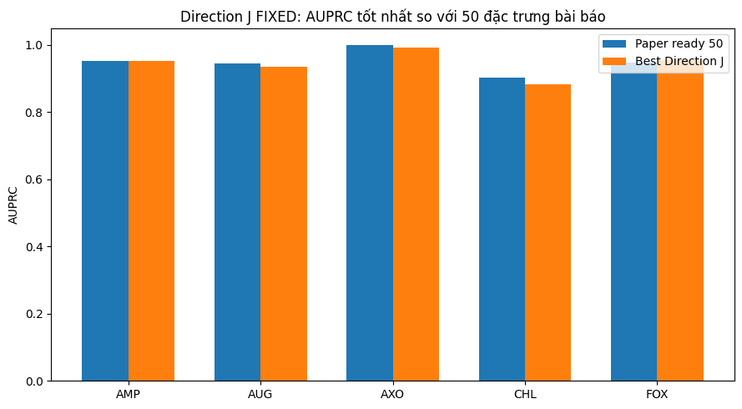
Results (3/3)
Result figure from notebook 10_ensemble_select

Slide 9
Key Findings
• Improves F1 for several drugs
• Most clearly for FOX

Slide 10
Notes
Candidate module; strongest for FOX.

Slide 11
Conclusion
Improves F1 for several drugs

