Slide 1
Adaptive Feature Fusion (Direction O)
Select the best module and model per antibiotic
Antibiotic-aware Adaptive Feature Fusion for Salmonella Antimicrobial Resistance Prediction

Slide 2
Context
Select the best module and model per antibiotic. This is experiment 14 of 26 in a study of antibiotic-aware adaptive feature fusion for Salmonella antimicrobial resistance prediction.

Slide 3
Objective
• Test antibiotic-specific configuration

Slide 4
Data & Method
• Many modules x models, 10 repeats, best per drug

Slide 5
Evaluation Metrics
• F1 score (primary metric for imbalanced data)
• Balanced accuracy and AUPRC
• Feature selection and thresholding on training data only
• Reliability checks where applicable: statistical test, lineage-aware split, negative control

Slide 6
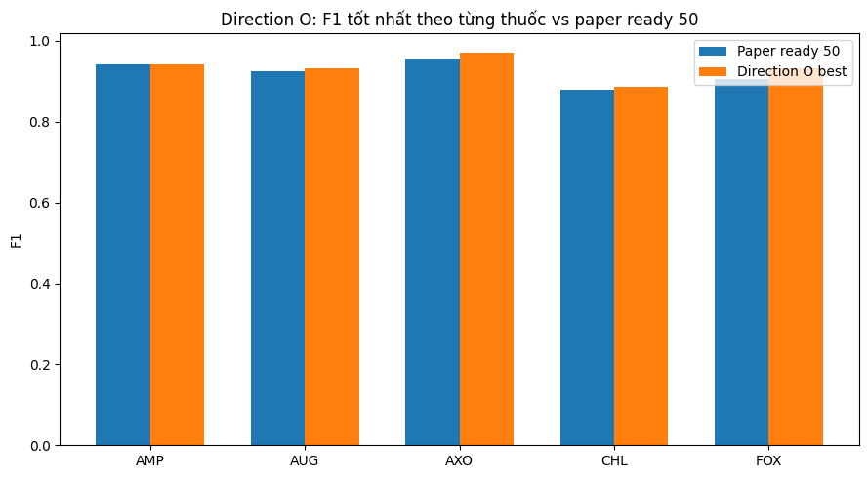
Results (1/3)
Result figure from notebook 14_adaptive_fusion

Slide 7
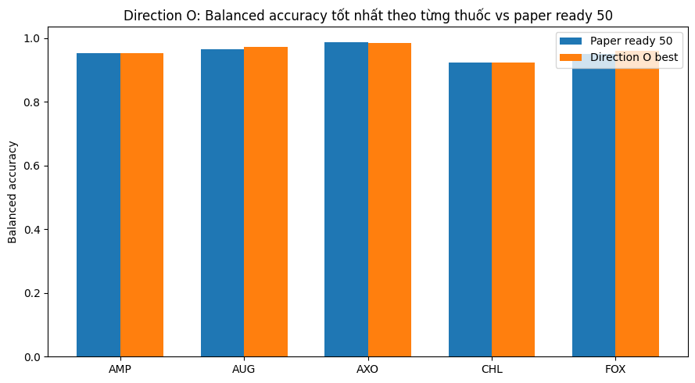
Results (2/3)
Result figure from notebook 14_adaptive_fusion

Slide 8
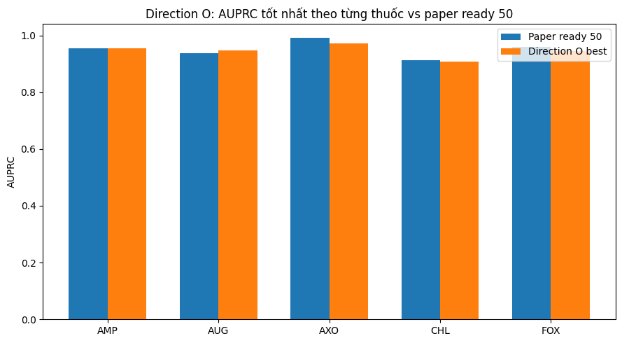
Results (3/3)
Result figure from notebook 14_adaptive_fusion

Slide 9
Key Findings
• Each drug prefers a different module
• Small F1 deltas (+0.000 to +0.027)
• Descriptive support for adaptive fusion

Slide 10
Notes
Central framework; later shown to only reach parity by experiments 20-21.

Slide 11
Conclusion
Each drug prefers a different module

