Slide 1
Antibiotic-aware Analysis
Add chemical and drug-class information
Antibiotic-aware Adaptive Feature Fusion for Salmonella Antimicrobial Resistance Prediction

Slide 2
Context
Add chemical and drug-class information. This is experiment 15 of 26 in a study of antibiotic-aware adaptive feature fusion for Salmonella antimicrobial resistance prediction.

Slide 3
Objective
• Incorporate drug knowledge into prediction

Slide 4
Data & Method
• PubChem descriptors, drug-class flags, optional genome-drug model

Slide 5
Evaluation Metrics
• F1 score (primary metric for imbalanced data)
• Balanced accuracy and AUPRC
• Feature selection and thresholding on training data only
• Reliability checks where applicable: statistical test, lineage-aware split, negative control

Slide 6
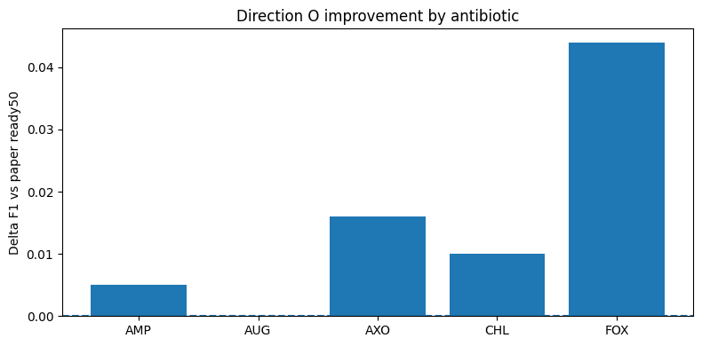
Results (1/2)
Result figure from notebook 15_antibiotic_aware

Slide 7
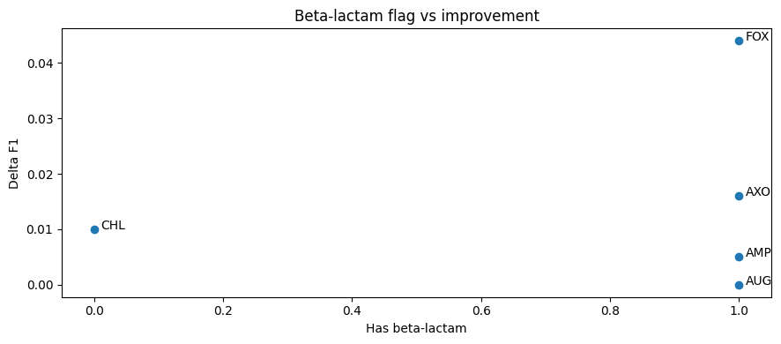
Results (2/2)
Result figure from notebook 15_antibiotic_aware

Slide 8
Key Findings
• Chemical/class info is useful combined with genome features

Slide 9
Notes
Antibiotic metadata analysis supporting new-drug generalization (16).

Slide 10
Conclusion
Chemical/class info is useful combined with genome features

