Slide 1
New-drug Generalization (Leave-one-drug-out)
Simulate prediction for an unseen drug
Antibiotic-aware Adaptive Feature Fusion for Salmonella Antimicrobial Resistance Prediction

Slide 2
Context
Simulate prediction for an unseen drug. This is experiment 16 of 26 in a study of antibiotic-aware adaptive feature fusion for Salmonella antimicrobial resistance prediction.

Slide 3
Objective
• Test generalization to a held-out antibiotic

Slide 4
Data & Method
• Sample-drug pairs; hold out one drug at a time

Slide 5
Evaluation Metrics
• F1 score (primary metric for imbalanced data)
• Balanced accuracy and AUPRC
• Feature selection and thresholding on training data only
• Reliability checks where applicable: statistical test, lineage-aware split, negative control

Slide 6
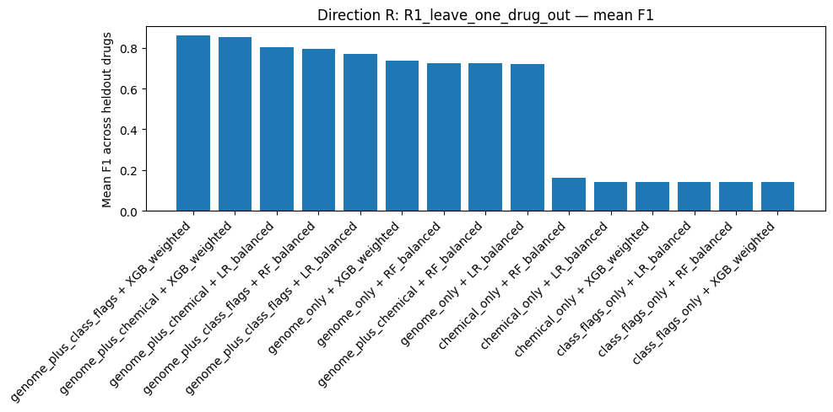
Results (1/2)
Result figure from notebook 16_new_drug

Slide 7
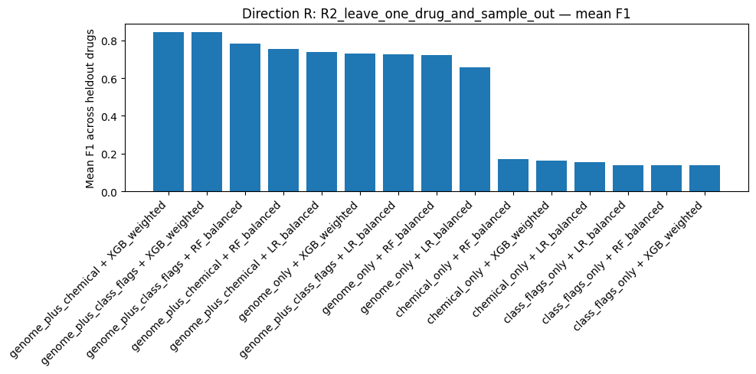
Results (2/2)
Result figure from notebook 16_new_drug

Slide 8
Key Findings
• Genome + chemical mean F1 0.844 vs genome-only 0.729
• Drug metadata helps only when combined with genome

Slide 9
Notes
New-drug simulation; note that the same genomes appear across drugs.

Slide 10
Conclusion
Genome + chemical mean F1 0.844 vs genome-only 0.729

