Slide 1
External Validation: Tetracycline
First external proof using BV-BRC annotations
Antibiotic-aware Adaptive Feature Fusion for Salmonella Antimicrobial Resistance Prediction

Slide 2
Context
First external proof using BV-BRC annotations. This is experiment 17 of 26 in a study of antibiotic-aware adaptive feature fusion for Salmonella antimicrobial resistance prediction.

Slide 3
Objective
• Validate on an external tetracycline dataset

Slide 4
Data & Method
• BV-BRC genome annotation features; Logistic Regression

Slide 5
Evaluation Metrics
• F1 score (primary metric for imbalanced data)
• Balanced accuracy and AUPRC
• Feature selection and thresholding on training data only
• Reliability checks where applicable: statistical test, lineage-aware split, negative control

Slide 6
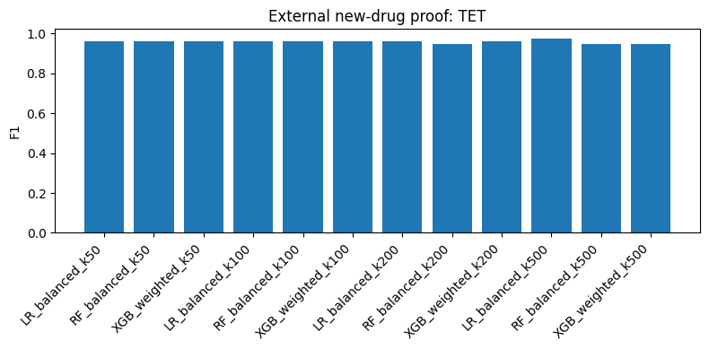
Results (1/1)
Result figure from notebook 17_external_tet

Slide 7
Key Findings
• High F1 (~0.97) on a small balanced test
• Top features are tetracycline-related

Slide 8
Notes
First external proof; the small balanced test is a caveat.

Slide 9
Conclusion
High F1 (~0.97) on a small balanced test

