Slide 1
External Multi-drug Validation
Extend to CIP, STR, GEN, NAL
Antibiotic-aware Adaptive Feature Fusion for Salmonella Antimicrobial Resistance Prediction

Slide 2
Context
Extend to CIP, STR, GEN, NAL. This is experiment 18 of 26 in a study of antibiotic-aware adaptive feature fusion for Salmonella antimicrobial resistance prediction.

Slide 3
Objective
• Validate across multiple external antibiotics

Slide 4
Data & Method
• Balanced subsets, repeated split, negative control

Slide 5
Evaluation Metrics
• F1 score (primary metric for imbalanced data)
• Balanced accuracy and AUPRC
• Feature selection and thresholding on training data only
• Reliability checks where applicable: statistical test, lineage-aware split, negative control

Slide 6
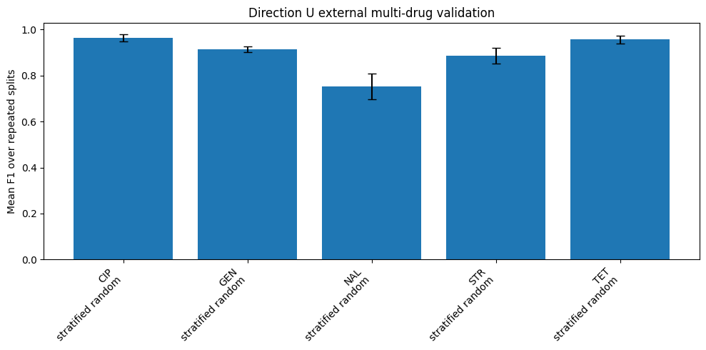
Results (1/2)
Result figure from notebook 18_external_multi

Slide 7
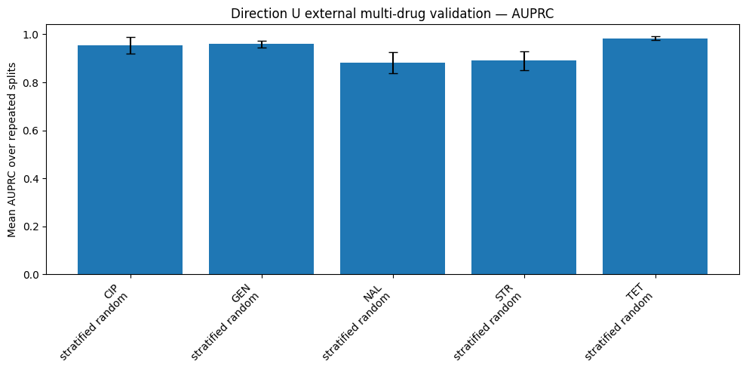
Results (2/2)
Result figure from notebook 18_external_multi

Slide 8
Key Findings
• High F1 but group-aware split was skipped
• CIP/NAL show weak mechanism keywords

Slide 9
Notes
Group-aware split was skipped here; corrected in experiment 25.

Slide 10
Conclusion
High F1 but group-aware split was skipped

