Slide 1
Robust External Validation
Cluster-aware split and quinolone-aware features
Antibiotic-aware Adaptive Feature Fusion for Salmonella Antimicrobial Resistance Prediction

Slide 2
Context
Cluster-aware split and quinolone-aware features. This is experiment 19 of 26 in a study of antibiotic-aware adaptive feature fusion for Salmonella antimicrobial resistance prediction.

Slide 3
Objective
• Harden external validation against leakage

Slide 4
Data & Method
• Jaccard clusters, negative control, similarity diagnostic

Slide 5
Evaluation Metrics
• F1 score (primary metric for imbalanced data)
• Balanced accuracy and AUPRC
• Feature selection and thresholding on training data only
• Reliability checks where applicable: statistical test, lineage-aware split, negative control

Slide 6
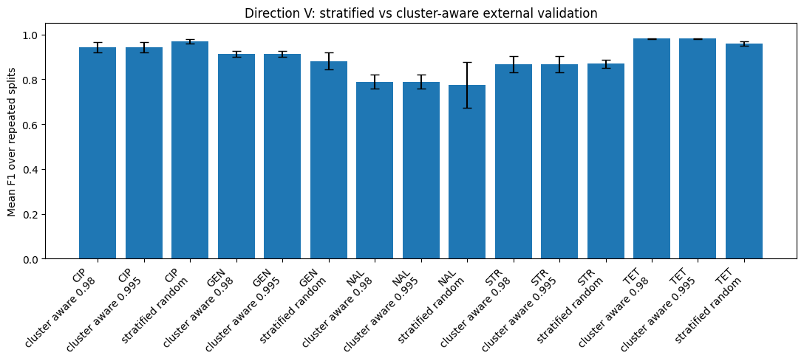
Results (1/3)
Result figure from notebook 19_external_robust

Slide 7
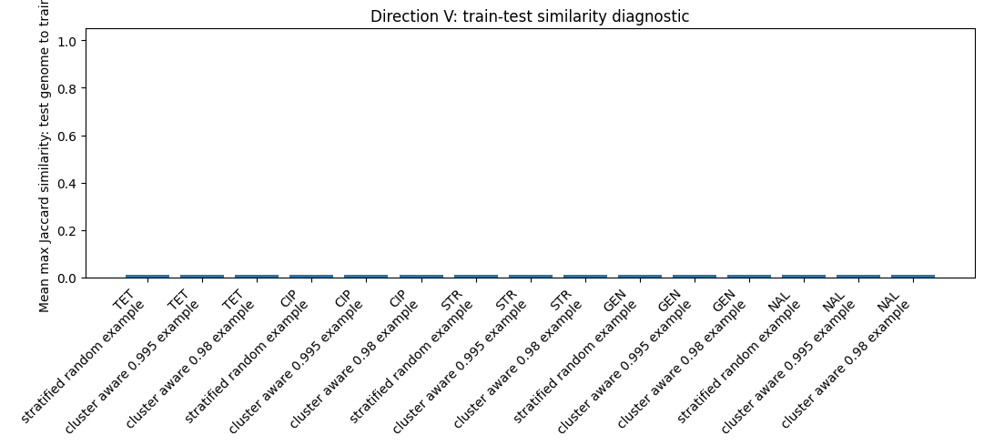
Results (2/3)
Result figure from notebook 19_external_robust

Slide 8
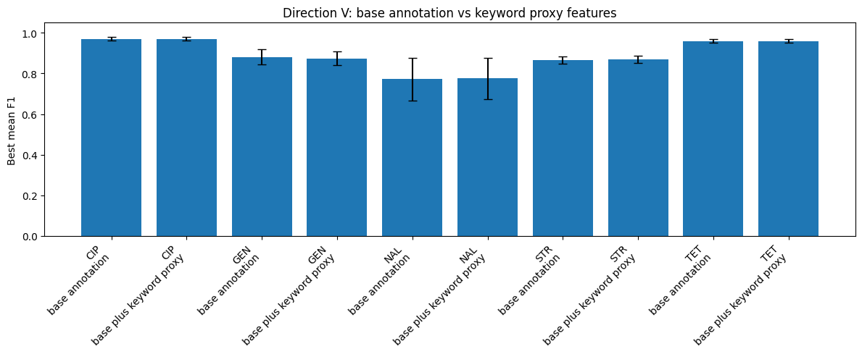
Results (3/3)
Result figure from notebook 19_external_robust

Slide 9
Key Findings
• Cluster-aware split degenerates to random
• Negative control is clean

Slide 10
Notes
Cluster-aware split degenerated; corrected with core SNP/MLST (24-25).

Slide 11
Conclusion
Cluster-aware split degenerates to random

