Slide 1
Statistical Testing (Simple Modules)
Is the adaptive advantage statistically significant?
Antibiotic-aware Adaptive Feature Fusion for Salmonella Antimicrobial Resistance Prediction

Slide 2
Context
Is the adaptive advantage statistically significant?. This is experiment 20 of 26 in a study of antibiotic-aware adaptive feature fusion for Salmonella antimicrobial resistance prediction.

Slide 3
Objective
• Test adaptive modules vs the expert baseline

Slide 4
Data & Method
• Repeated CV + Nadeau-Bengio t-test + Holm correction
• Lineage-aware split and negative control

Slide 5
Evaluation Metrics
• F1 score (primary metric for imbalanced data)
• Balanced accuracy and AUPRC
• Feature selection and thresholding on training data only
• Reliability checks where applicable: statistical test, lineage-aware split, negative control

Slide 6
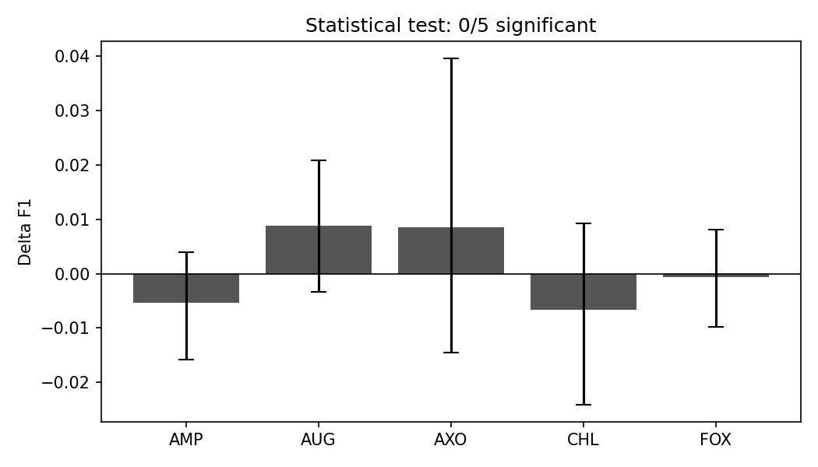
Results (1/1)
Result figure from notebook 20_stat_test

Slide 7
Key Findings
• 0/5 antibiotics significant after correction
• Adaptive fusion is on par with the baseline
• Negative control ~0.5 (no trivial leakage)

Slide 8
Notes
Reliability result: adaptive fusion equals the baseline (not significant).

Slide 9
Conclusion
0/5 antibiotics significant after correction

