Slide 1
Statistical Testing (All Direction O Modules)
Test the full advanced module set
Antibiotic-aware Adaptive Feature Fusion for Salmonella Antimicrobial Resistance Prediction

Slide 2
Context
Test the full advanced module set. This is experiment 21 of 26 in a study of antibiotic-aware adaptive feature fusion for Salmonella antimicrobial resistance prediction.

Slide 3
Objective
• Check whether advanced modules beat the baseline

Slide 4
Data & Method
• Same statistical harness on ensemble/graph/embedding modules

Slide 5
Evaluation Metrics
• F1 score (primary metric for imbalanced data)
• Balanced accuracy and AUPRC
• Feature selection and thresholding on training data only
• Reliability checks where applicable: statistical test, lineage-aware split, negative control

Slide 6
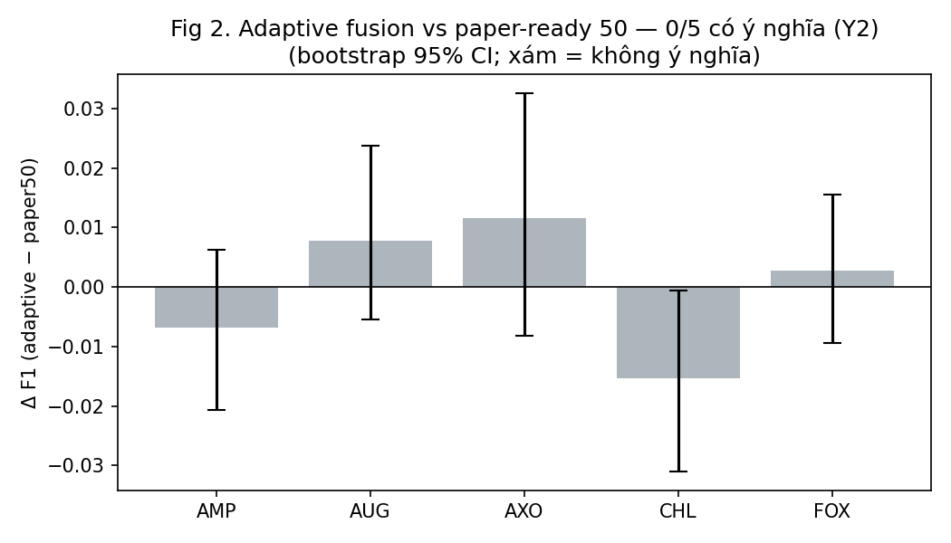
Results (1/1)
Result figure from notebook 21_stat_test_fusion

Slide 7
Key Findings
• Still 0/5 significant
• Confirms winner's curse in Direction O

Slide 8
Notes
Confirms the winner's curse in Direction O.

Slide 9
Conclusion
Still 0/5 significant

