Slide 1
Biological Annotation of Top Features
Do top features map to real resistance genes?
Antibiotic-aware Adaptive Feature Fusion for Salmonella Antimicrobial Resistance Prediction

Slide 2
Context
Do top features map to real resistance genes?. This is experiment 22 of 26 in a study of antibiotic-aware adaptive feature fusion for Salmonella antimicrobial resistance prediction.

Slide 3
Objective
• Interpret top features via a CARD/ResFinder catalog

Slide 4
Data & Method
• Stability selection + AMR gene-family matching

Slide 5
Evaluation Metrics
• F1 score (primary metric for imbalanced data)
• Balanced accuracy and AUPRC
• Feature selection and thresholding on training data only
• Reliability checks where applicable: statistical test, lineage-aware split, negative control

Slide 6
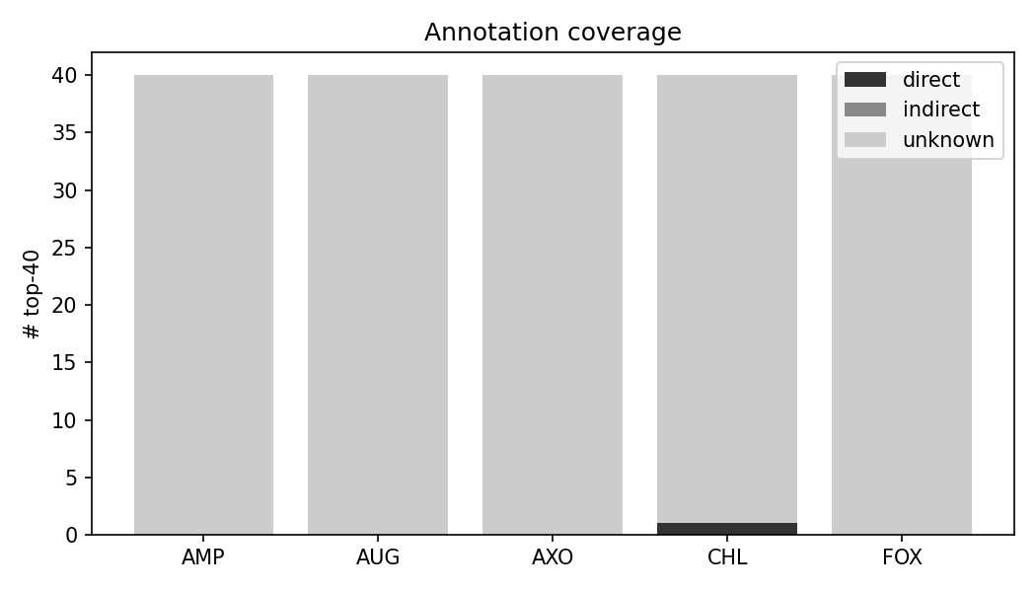
Results (1/1)
Result figure from notebook 22_annotation

Slide 7
Key Findings
• Paper-50 contains real genes (floR, sul1)
• Top accessory features only 0-2.5% annotatable
• Sequence-based tools needed for full coverage

Slide 8
Notes
Annotation coverage is weak; sequence-based tools are recommended.

Slide 9
Conclusion
Paper-50 contains real genes (floR, sul1)

