Slide 1
Probability Calibration and Screening Utility
Is the model deployable?
Antibiotic-aware Adaptive Feature Fusion for Salmonella Antimicrobial Resistance Prediction

Slide 2
Context
Is the model deployable?. This is experiment 23 of 26 in a study of antibiotic-aware adaptive feature fusion for Salmonella antimicrobial resistance prediction.

Slide 3
Objective
• Assess probability quality and clinical usefulness

Slide 4
Data & Method
• Out-of-fold probabilities, isotonic calibration, decision curve

Slide 5
Evaluation Metrics
• F1 score (primary metric for imbalanced data)
• Balanced accuracy and AUPRC
• Feature selection and thresholding on training data only
• Reliability checks where applicable: statistical test, lineage-aware split, negative control

Slide 6
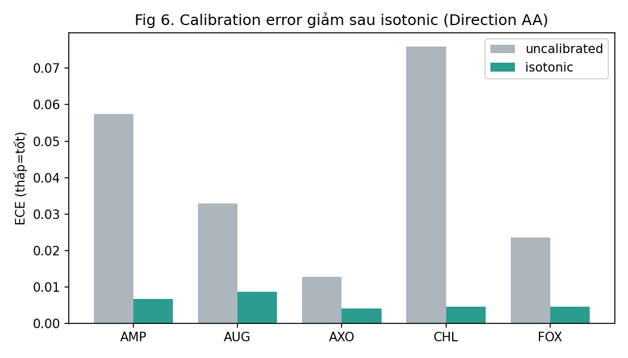
Results (1/1)
Result figure from notebook 23_calibration

Slide 7
Key Findings
• ECE reduced to ~0.005-0.01 after isotonic
• NPV 0.98-0.998; low alert rate
• Positive net benefit vs treat-all/none

Slide 8
Notes
Deployability evidence; still a screening aid, not a replacement for testing.

Slide 9
Conclusion
ECE reduced to ~0.005-0.01 after isotonic

