Slide 1
Lineage-aware Validation (Core SNP)
Control for population structure
Antibiotic-aware Adaptive Feature Fusion for Salmonella Antimicrobial Resistance Prediction

Slide 2
Context
Control for population structure. This is experiment 24 of 26 in a study of antibiotic-aware adaptive feature fusion for Salmonella antimicrobial resistance prediction.

Slide 3
Objective
• Detect population-structure confounding

Slide 4
Data & Method
• Core SNP distance clusters, leave-lineage-out, feature dropout

Slide 5
Evaluation Metrics
• F1 score (primary metric for imbalanced data)
• Balanced accuracy and AUPRC
• Feature selection and thresholding on training data only
• Reliability checks where applicable: statistical test, lineage-aware split, negative control

Slide 6
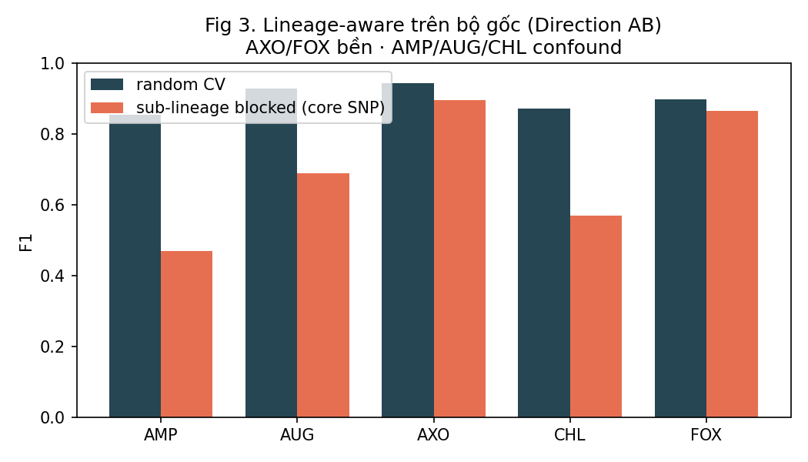
Results (1/1)
Result figure from notebook 24_lineage

Slide 7
Key Findings
• ~97% of genomes form one clonal lineage
• AXO/FOX robust; AMP/AUG/CHL confounded
• AXO/FOX rely on a few top markers

Slide 8
Notes
Central validity result: quantifies population-structure confounding.

Slide 9
Conclusion
~97% of genomes form one clonal lineage

