Slide 1
External Validation with MLST Group-aware Split
Fix balanced-subset and group-split flaws
Antibiotic-aware Adaptive Feature Fusion for Salmonella Antimicrobial Resistance Prediction

Slide 2
Context
Fix balanced-subset and group-split flaws. This is experiment 25 of 26 in a study of antibiotic-aware adaptive feature fusion for Salmonella antimicrobial resistance prediction.

Slide 3
Objective
• Evaluate external drugs at true prevalence, controlling lineage

Slide 4
Data & Method
• Self-fetch BV-BRC labels/features/MLST; group-aware CV

Slide 5
Evaluation Metrics
• F1 score (primary metric for imbalanced data)
• Balanced accuracy and AUPRC
• Feature selection and thresholding on training data only
• Reliability checks where applicable: statistical test, lineage-aware split, negative control

Slide 6
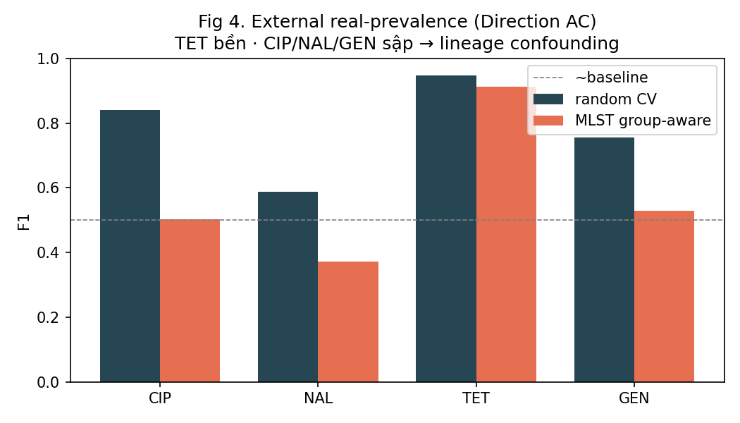
Results (1/1)
Result figure from notebook 25_external_mlst

Slide 7
Key Findings
• TET stays robust (F1 0.91)
• CIP/NAL/GEN collapse to ~0.5 (lineage confounding)
• Balanced subsets inflated earlier scores

Slide 8
Notes
Corrects earlier external over-optimism using true prevalence and MLST.

Slide 9
Conclusion
TET stays robust (F1 0.91)

