Slide 1
A table side chat on thinking about your NGS data statistically
NGS2013

Slide 2
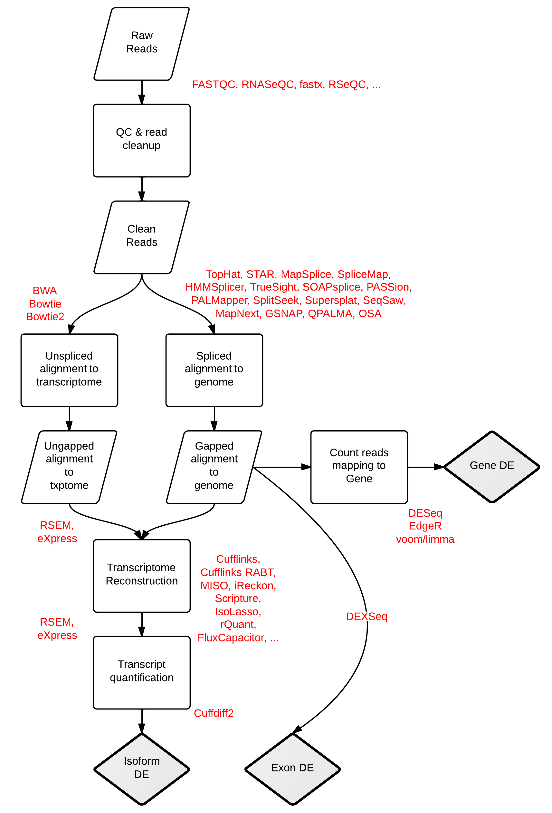
RNA-seq Workflows and Tools. Stephen Turner. Figshare. http://dx.doi.org/10.6084/m9.figshare.662782

Slide 3
Goals
I am not planning on trying to provide any sort of overview of statistical methods for genomic data. Instead I am going to provide a few short ideas to think about.
Statistics (like bioinformatics) is a rapidly developing area, in particular with respect to genomics. Rarely is it clear what the “right way” to analyze your data is.
Instead I hope to aid you in using some common sense when thinking about your experiments for using high throughput sequencing.

Slide 4
Useful references
Paul L. Auer and R.W. Doerge 2010. Statistical Design and Analysis of RNA-Seq Data. Genetics. 10.1534/genetics.110.114983
PMID: 20439781
Bullard, J. H., Purdom, E., Hansen, K. D., & Dudoit, S. (2010). Evaluation of statistical methods for normalization and differential expression in mRNA-Seq experiments BMC Bioinformatics, 11, 94. doi:10.1186/1471-2105-11-94

Slide 5
Designing your experiment before you start.
Sampling
Replication
Blocking
Randomization
Over all we are going to be thinking about how to avoid Confounding sources of variation in the data.
All of these are larger topics that are part of Experimental Design.

Slide 6
Sampling
Sampling design is all about making sure that when you “pick” (sample) observations, you do so in a random and unbiased manner.
Proper sampling aims to control for unknown sources of variation that influence the outcome of your experiments.
This seems reasonable, and often intuitive to most experimental biologists, but it can be very insidious.
Whiteboard…
Sampling
Replication
Blocking
Randomization

Slide 7
Sampling
Sampling
Replication
Blocking
Randomization

Slide 8
Replication
Imagine you have an experiment with one factor (sex), with two treatment levels ( males and females).
You want to look for sex specific differences in the brains of your critters based on transcriptional profiling, so you decide to use RNA-seq.
Perhaps you have a limited budget so you decide to run one sample of male brains, and one sample of female brains, each in one lane of a flow cell.
What (useful) information can you get out of this?
Not much (but there may be some). Why?
Sampling
Replication
Blocking
Randomization

Slide 9
Replication
Why?
No replication. How will you know if the differences you observe are due to differences in males and females, random (biological) differences between individuals, or technical variation due to RNA extraction, processing or running the samples on different lanes.
All of these sources of variation are confounded, and there are no particularly good ways of separating them out.
But there are lots of sources of variation, so how do we account for these?
Sampling
Replication
Blocking
Randomization

Slide 10
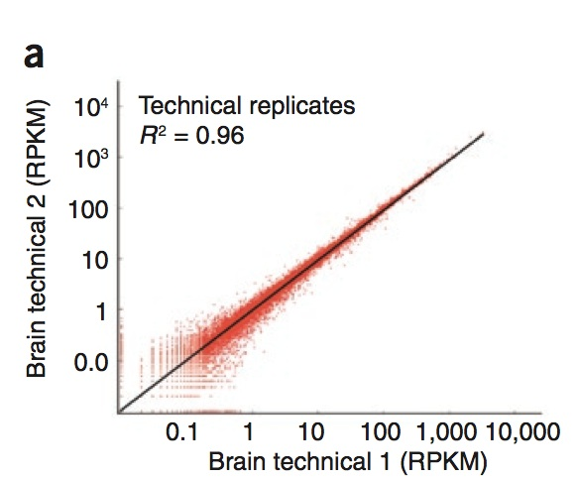
Replication
To date, several studies have suggested that “technical” replicates for RNA-seq show very little variation/ high correlation.
Sampling
Replication
Blocking
Randomization
Mortazavi et al. 2008
How might such a statement be misleading about variation?

Slide 11
Replication
This study looked at a single source of technical variation.
Running exactly the same sample on two different lanes on a flow cell.
This completely ignores other sources of “technical variation”
variation due to RNA purification
variation due to fragmentation, labeling, etc..
lane to lane variation
flow cell to flow cell variation
All of these may be important (although unlikely interesting) sources of variation…
However…..
Sampling
Replication
Blocking
Randomization

Slide 12
Replication
Many studies have ignored the BIOLOGICAL SOURCES of VARIATION between replicates. In most cases biological variation between samples (from the same treatment) are generally far more variable than technical sources of variation.
While it would be nice to be able to partition various sources of technical variation (such as labeling, RNA extraction), it often too expensive to perform such a design (see white board).
IF you have limited resources, it is generally far better to have biological replication (independent biological samples for a given treatment) than technical replication.
Does these lead to confounded sources of variation?
Sampling
Replication
Blocking
Randomization

Slide 13
Blocking
Blocks in experimental design represent some factor (usually something not of major interest) that can strongly influence your outcomes. More importantly it is a factor which you can use to group other factors that you are interested in.
For instance in agriculture there is often plot to plot variation. You may not be interested in the plot themselves but in the variety of crops you are growing.
But what would happen if you grew all of strain 1 on plot 1 and all of strain 2 on plot 2?
Whiteboard.
These plots would represent blocking levels
Sampling
Replication
Blocking
Randomization

Slide 14
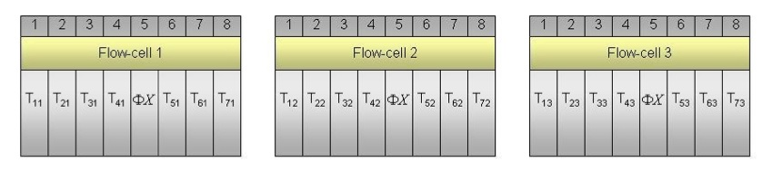
Blocking
Sampling
Replication
Blocking
Randomization
In genomic studies the major blocking levels are often the slide/chip for microarrays (i.e. two samples /slide for 2 color arrays, 16 arrays/slide for Illumina arrays).
For GAII/HiSeq RNA-seq data the major blocking effect is the flow cell itself, or lanes within the flow cell.
Auer and Doerge 2010

Slide 15
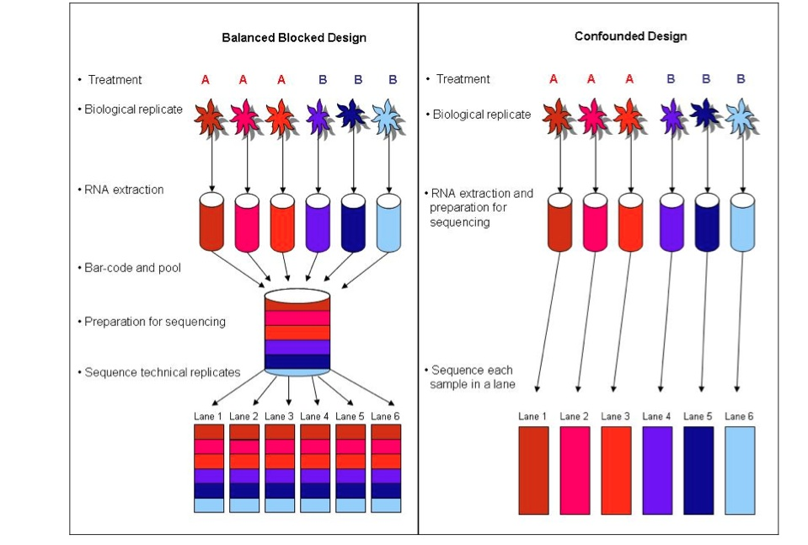
Blocking
Incorporating lanes as a blocking effect
Sampling
Replication
Blocking
Randomization
Auer and Doerge 2010

Slide 16
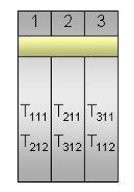
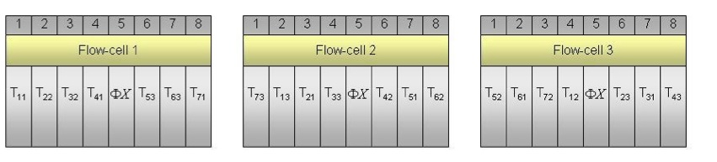
Blocking designs
Balanced Incomplete Blocking
Design (BIBD)
Sampling
Replication
Blocking
Randomization
Let’s dissect these subscripts.
Balanced for treatments across flow cells.. Randomized for location
Auer and Doerge 2010

Slide 17
You have designed and run the experiment… now what?
First a couple of quotes from a great statistician:
An approximate answer to the right problem is worth a good deal more than an exact answer to an approximate problem.
John Tukey
Numerical quantities focus on expected values, graphical summaries on unexpected values.
John Tukey

Slide 18
RNA-seq Workflows and Tools. Stephen Turner. Figshare. http://dx.doi.org/10.6084/m9.figshare.662782

Slide 19
Visually examine your data at every step of the analysis!!!!!
By far the single most important thing you should be thinking about with your data, at every stage of the analysis (raw, filtered, aligned, normalized, modeled) is how to present the data graphically.
Plots are a very good way to pick out if something wacky is going on with your data.
Even if your data is of the highest quality, different software can produce very different results (in unattended ways). Plenty of Bugs and features.

Slide 20
R

Slide 21
Exploratory Data Analysis
What is EDA?
An approach to data analysis, largely using graphical techniques to help refine hypotheses and aid in the model building process.
Some advocates suggest it can be used for hypothesis generation (we will discuss when and where this might be sensible).

Slide 22
Objectives of EDA
Propose/refine models to explain the observed patterns of the data.
Assess assumptions on which statistical modeling is based
Provide a context for further data collection.
Help in determining the appropriate form of statistical modeling (LS, MLE< Bayesian, resampling…).

Slide 23
Useful online tutorial on EDA
http://www.itl.nist.gov/div898/handbook/eda/eda.htm

Slide 24
EDA
EDA emphasizes “robust” and non-parametric approaches to examining the data.

Slide 25
Critiques of EDA
“Data-Dredging”. Using it as “free lunch” with respect to a posteriori hypothesis testing.
Observing patterns that are not real.
“ Under torture, the data readily yields false confessions”
(MainDonald & Braun 2003)

Slide 26
suggestions
Bolker (2007) suggests an honest approach: prior to examining your data you write down a list of the patterns you are looking for so that you can distinguish between:
1) Patterns you were initially looking for
2) Unanticipated patterns that answer the same question in different ways.
3) Novel (but likely spurious) patterns.

Slide 27
Cross-validation
Subset your data (cross-validation):
The other useful approach is to use a random subset of all of your data (No more than 40% of it) for data exploration, and then you can perform the model fitting based on the entire data set (or better yet the remaining 60%).
Of course, this only works if you have enough data to do so!

Slide 28
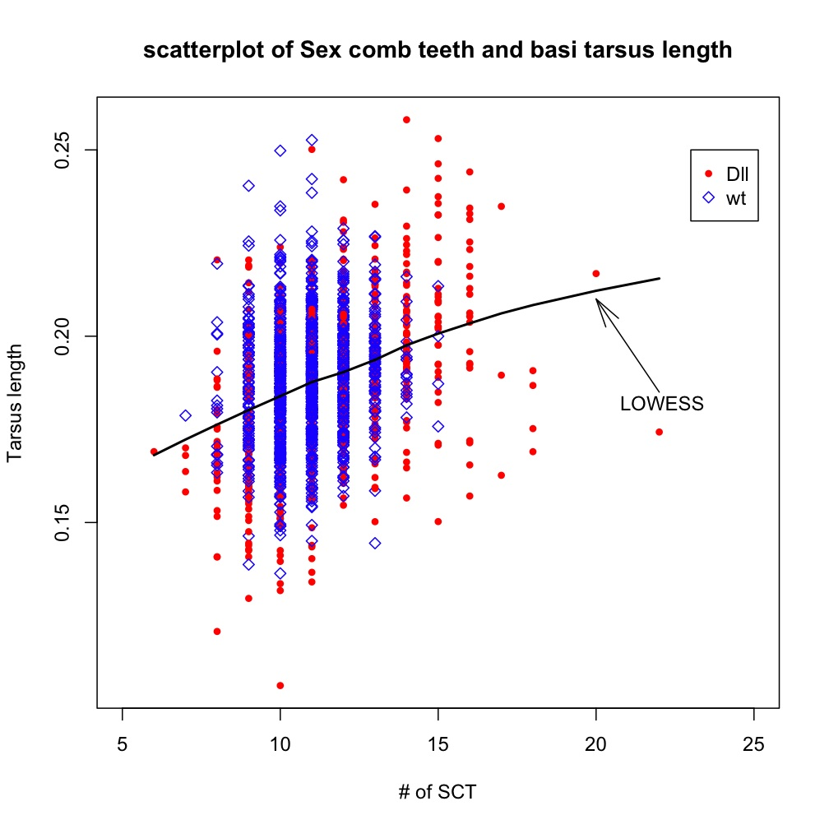
Bi-variate scatterplot with loess. Is this data dredging?

Slide 29
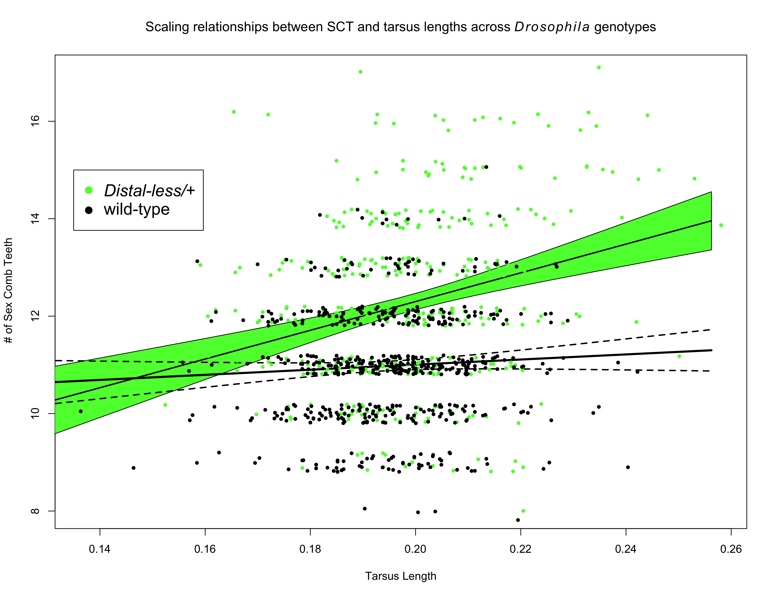
This would not be considered EDA.. Why not?

Slide 30
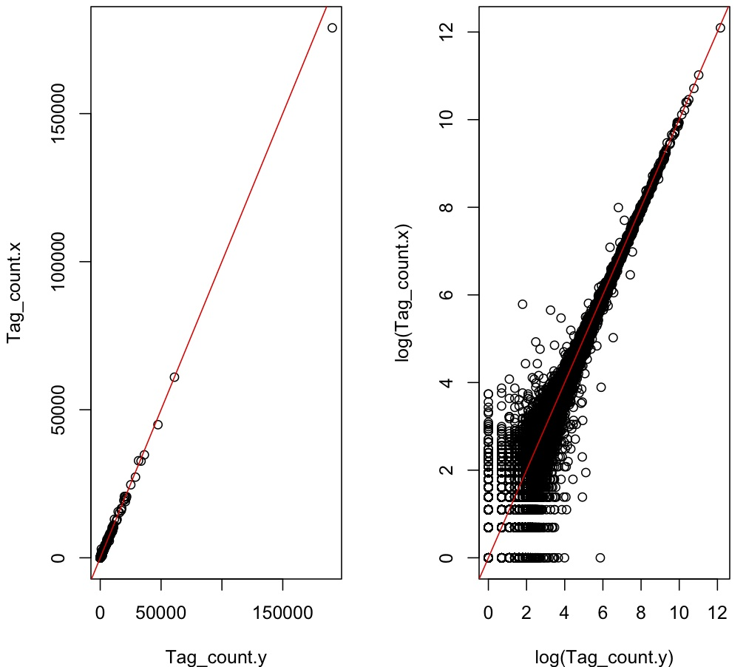
Some examples: Digital Gene Expression (Sequence tags) for RNA quantification
A comparison of two lanes of DGE sequence tags.
What’s the difference between these plots?

Slide 31
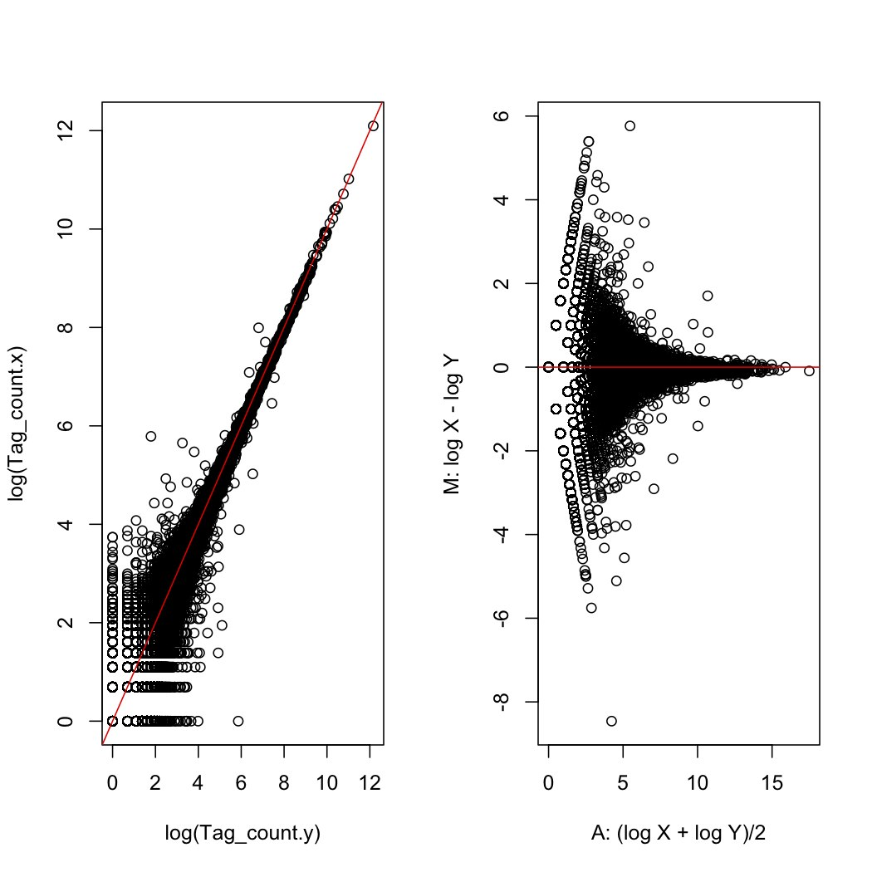
Some examples: Digital Gene Expression (Sequence tags) for RNA quantification
A comparison of two lanes of DGE sequence tags.
MA plot
What’s the difference between these plots?

Slide 32
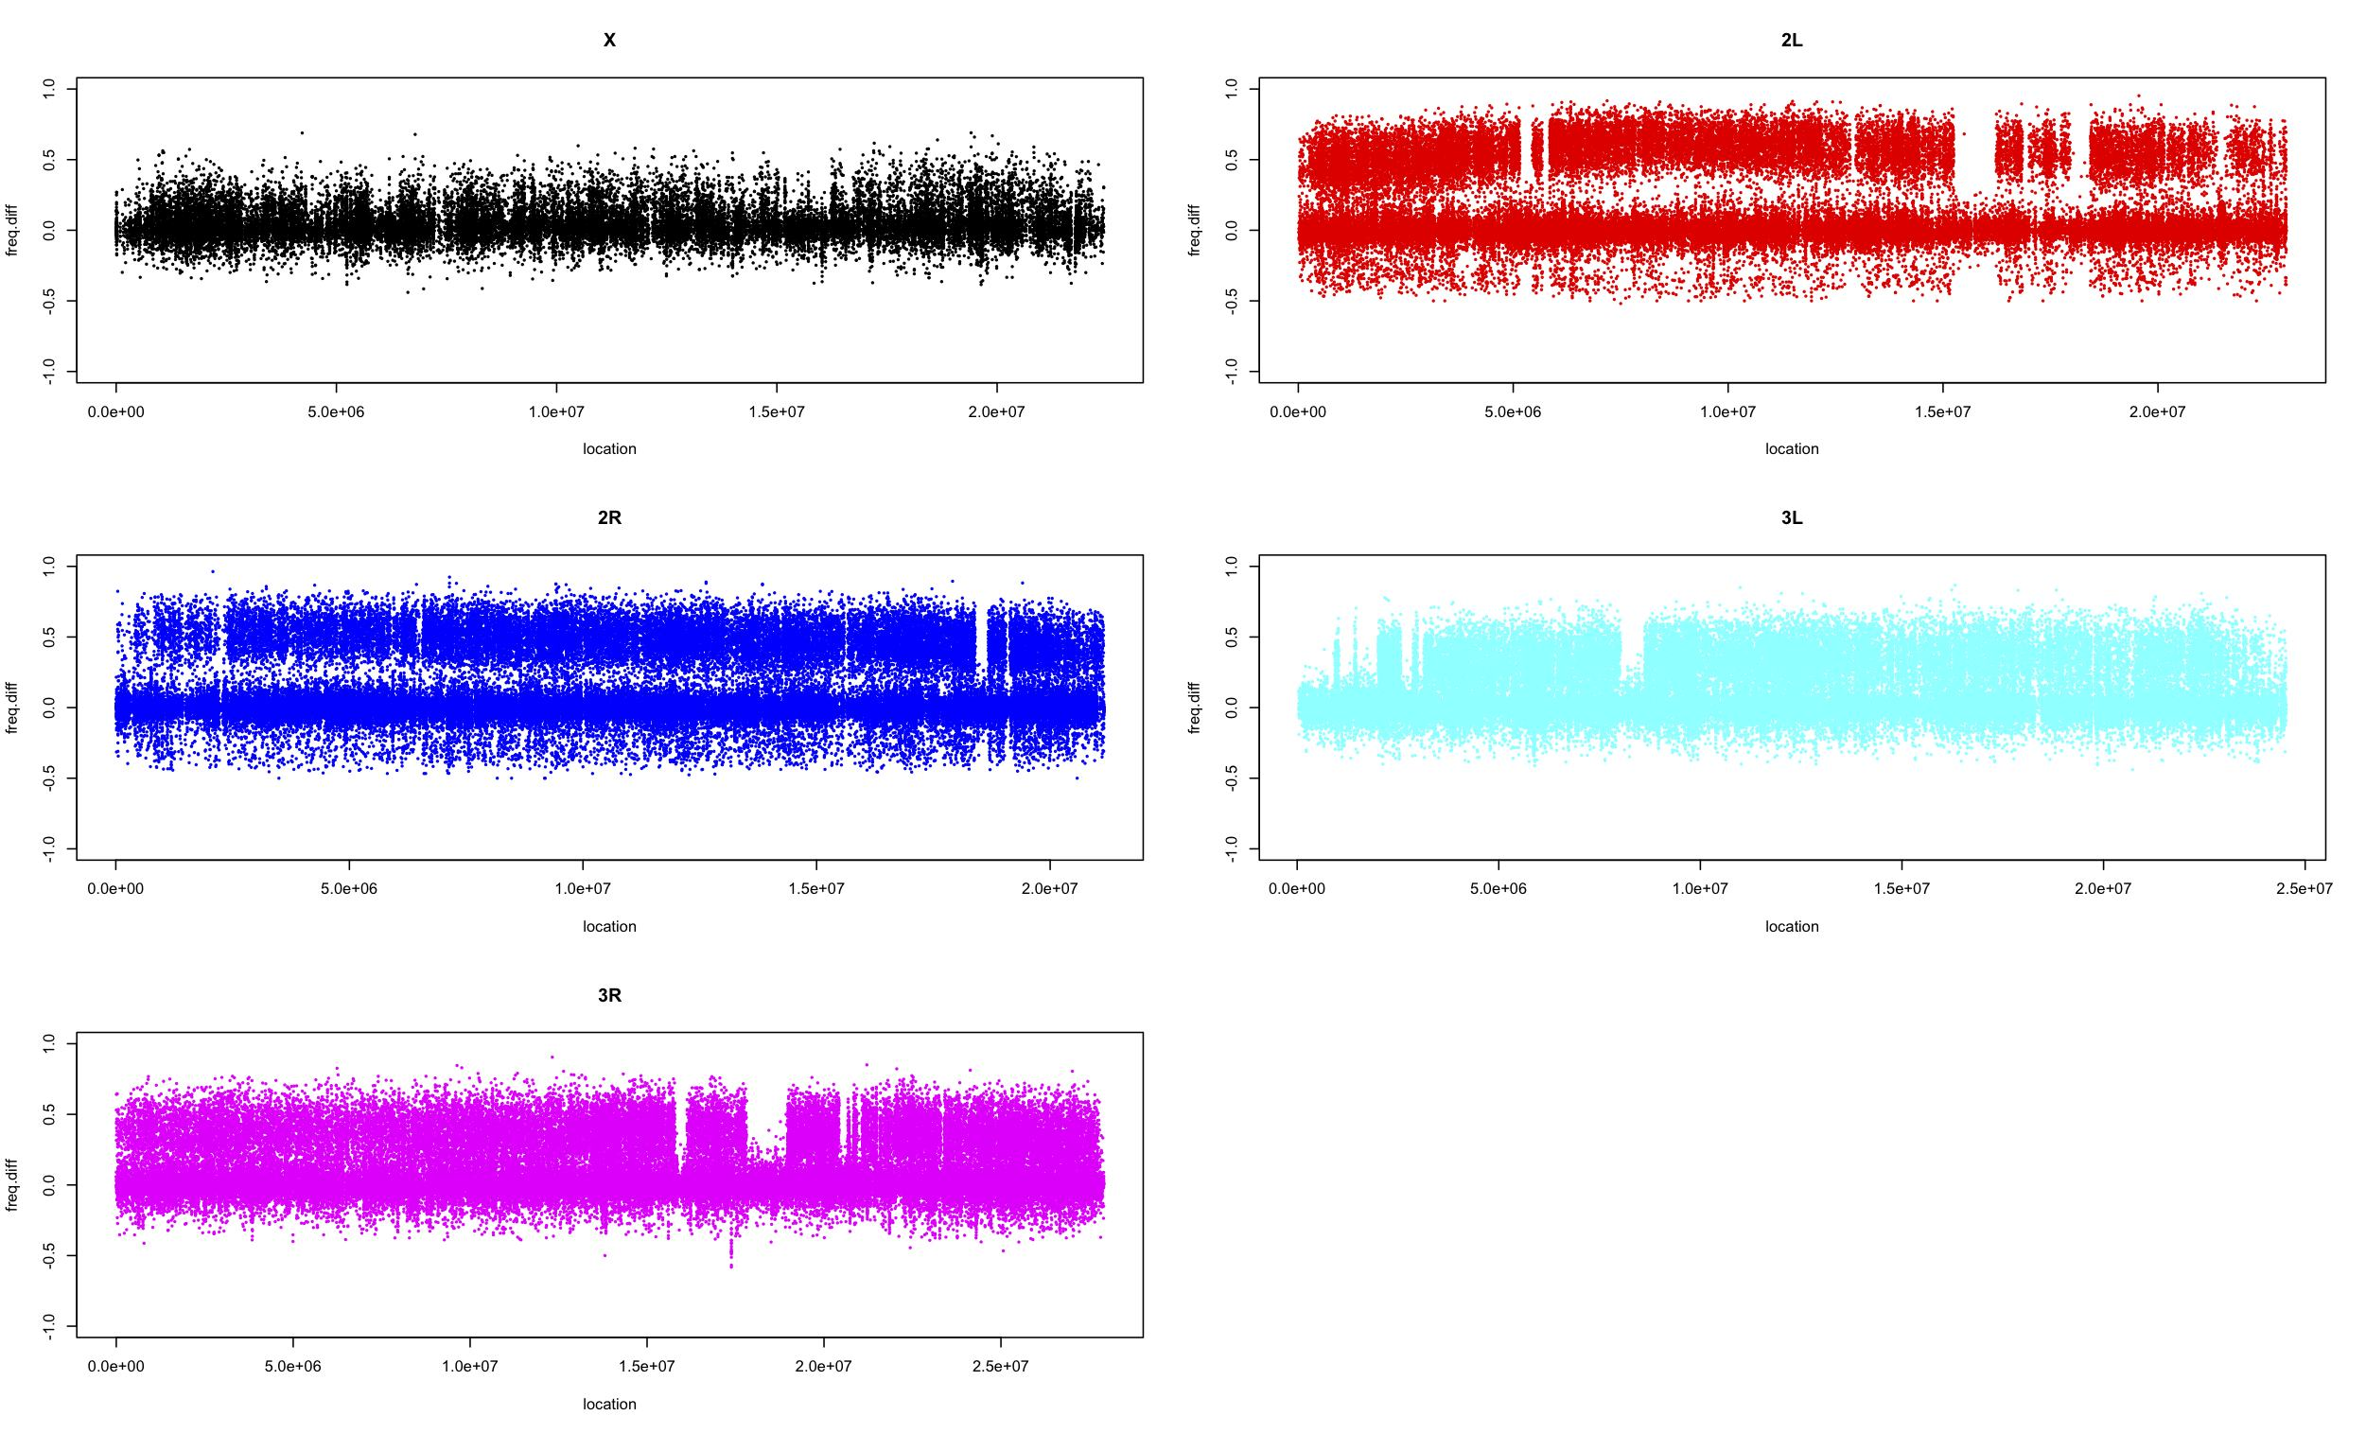
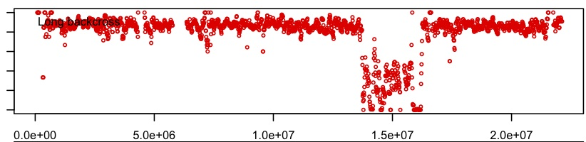
Whole genome analysis can be messy, how do we deal with this.
Every SNP
Sliding window& binning

Slide 33
Genome level Correlations are not a good measure of repeatability
One BIG mistake people make with BIG genomics data sets is treat each gene (or genomic interval) as an independent data point. In particular for correlation analysis.
This is almost never the case…
chalkboard.

Slide 34
Nookaew et al 2102 NAR

Slide 35
What does this tell us?
These cells are biological replicates (diagonals)
These cells are for different software
Nookaew et al 2102 NAR

Slide 36
Differentially expressed genes based on software for quantification
Differentially expressed genes based on software for mapping
Nookaew et al 2102 NAR

Slide 37
One right way?
At this point it is safest to assume that there is no one single “right way” to analyze your NGS data (for RNAseq or anything else).
While a number of studies have demonstrated that several pipelines give similar results, it is best to try several approaches.
Even fitting what seems like the “same” model can give different results from different software.
Let’s discuss why.

Slide 38
Is performing your analysis multiple ways enough?
Just because you create multiple forks in your analysis (different read mappers, different tools for quantification), does not mean you are out of the woods.
Always generate lots of plots to help you visualize your data in as many ways as possible.

Slide 39
Simulating your analysis
One other important tool (that is very straightforward) is to use simple simulation or resampling approaches to “rig” the analysis.
White board.

Slide 40
Readings for Monday and Tuesday
Vijay, N., Poelstra, J. W., Künstner, A., & Wolf, J. B. W. (2012). Challenges and strategies in transcriptome assembly and differential gene expression quantification. A comprehensive in silico assessment of RNA-seq experiments. Molecular Ecology. doi:10.1111/mec.12014
Garber, M., Grabherr, M. G., Guttman, M., & Trapnell, C. (2011). Computational methods for transcriptome annotation and quantification using RNA-seq. Nature Methods, 8(6), 469–477. doi:10.1038/nmeth.1613
Nookaew, I., Papini, M., Pornputtapong, N., Scalcinati, G., Fagerberg, L., Uhlén, M., & Nielsen, J. (2012). A comprehensive comparison of RNA-Seq-based transcriptome analysis from reads to differential gene expression and cross-comparison with microarrays: a case study in Saccharomyces cerevisiae. Nucleic Acids Research, 40(20), 10084–10097. doi:10.1093/nar/gks804

