Slide 1
RNAseq

Slide 2
RNA-Seq Alignment
RNA-seq reads
Illumina sequencing
mRNA
35bp - 150bp
single or paired-end
reads
transcriptome
Notes:
So what do we do with these reads. They were all transcribed from the genome, so we can try to locate their origin in the genome. We do this with a method that was developed jointly between UNC and U. Kentucky called MapSplice

Slide 3
Sequencing and Alignment
RNA-seq reads
Illumina sequencing
mRNA
35bp - 150bp
single or paired-end
reads
transcriptome
MapSplice
RNA-seq alignments
Reference
Genome
Exon 1
Exon 2
Exon 3
5’
3’
Wang K., et al., MapSplice: Accurate Mapping of RNA-seq Reads for Splice Junction Discovery, Nucleic Acids Research, 2010.
Hu Y., et al., A Probabilistic Framework for Aligning Paired-end RNA-seq Data, Bioinformatics, 2010
Notes:
Reads that arise entirely from an exon should be easy to locate uniquely in the genome, but because of splicing, we will also see reads that cross exon boundaries which corresponds to a gapped or spliced alignment. There will be many ways to locate a read if we allow it so be split into pieces across the genome. The novelty of MapSplice is that it considers possible alignments for all the reads and leverages repeated occurrences of different gapped alignments to distinguish true splices from spurious splices

Slide 4
MapSplice Features
Aligns to reference genome without dependence on annotations
Finds canonical and non-canonical spliced alignments
SNP and indel tolerance relative to the reference genome
Aligns arbitrarily long reads with multiple splices
Aligns reads over arbitrarily long gaps (e.g. fusion transcripts that result from genomic translocations)
Can detect exons as small as 8bp (assuming sufficient read coverage)
Two-stage alignment
Classify “true” junctions using candidate alignments for all reads
Realign reads using only true junctions
Positive independent evaluations in comparative studies
MapSplice consistently outperforms other methods in measures of sensitivity & specificity in junctions, overall accuracy, and fraction aligned reads (Grant et al., Bioinformatics, 2011; Chen et al., NAR 2011)
Notes:
As a result MPS is not dependent on any exon, splice or transcript annotations to discover spliced alignments. It can find canonical as well as non-canonical splices, can tolerate variation between the reference genome and the subject genome (as well as read erros), and can align arbitrary length reads over arbitrarily long gaps. This is of importance in cancer genomes because they may include substantial translocations which can interrupt genes to create fusion transcripts. If we see evidence of this in the transcripts produced, that’s very useful in TCGA – these are structural changes in the genome that are evidently affecting the phenotype. Why do we want to align without annotations? Because annotations are incomplete, and de novo alignments can detect all sorts of quality control issues such as DNA contamination. In a typical sample, MPS will align around 95% of the reads. The unaligned reads likely contain massive sequencing errors or are contaminated in some way.

Slide 5

Mapping
pre-processing
mapping
junction classification
Segmented alignment of reads
remapping
t₁
t₂
t₃
t₄
best alignment
mRNA tag T
k
j₁
k
j₂
h
Genome
exon 1
exon 2
exon 3
example: 100nt read is split into four 25nt segments
segments aligned to the genome using bowtie (mismatch 1)
unaligned segments implicate splices or indels
find splices/indels by searching from neighboring aligned segments
double anchored search
single anchored search
each end of a PER is aligned individually
Notes:
5
5
To obtain candidate mappings, the reads are partitioned into segments of size 20 - 25 and each segment is aligned individually, potentially to multiple locations. Missing segment alignments implicate a splice, an indel, or simply an excessive mismatch. A simple theorem states that if no exon is shorter than 2k nt then at least one out of every two consecutive segments must have an unspliced alignment. Smaller segments are better, but cost increases exponentially in time and space.

Slide 6
Mapping
t_{j}
t_{j+1}
t_{j+2}
5’
3’
? t_{j+1}
t_{j}
t_{j+2}
Segment alignment
t_{j}
? t_{j+1}
Notes:
6
6
Cases illustrated here. A missing segment alignment between two successful alignments can be evaluated for spliced or indel alignment using the double anchor search method, working towards the center from the flanking alignments. A missing segment at the end can be found by local single anchor search for a distal portion of the missing segment (yellow). Once found, we continue with double anchor search. A variation on this technique can be used when multiple consecutive segment alignments are missing due to multiple splices surrounding short exons. Animation

Slide 7
Mapping
t_{j}
t_{j+1}
t_{j+2}
5’
3’
t_{j+1}
t_{j}
t_{j+2}
Spliced/indel alignment
t_{j+1}
t_{j}
Notes:
7
7

Slide 8
Mapping
5’
3’
Segment Assembly
Notes:
8
8
Having found alignments for all segments, we can assemble the read alignment.

Slide 9
Mapping
Segment Assembly
A read may have multiple alignments
5’
3’
Notes:
9
9
By assembling combinations of valid segment alignments, while respecting ordering constraints, we end up with up to c candidate alignments per read (we limited c to 40)

Slide 10
Paired End Data
5’
3’
5’
3’
Notes:
10
10
Nicola mentioned this problem. One of the problems in PER mapping is the mate-pair distance. In the above example, the top PER and the bottom may have the expected mate-pair distance, but the mate-pair distance of the middle PER on the genome spans an intron. If the intron is too long, the distance can deviate from the expected mate-pair distance, which is typically less than 100bp in the human dataset. For the RGASP submission, we connect two closest alignments if their distance is less than 200kb. A better way to solve this problem which directly infer the transcript fragment of the PER using the technique presented at HitSeq … But we weren’t able to integrate that into our submission in time.

Slide 11
pre-processing
Junction classification
mapping
junction classification
Alignment quality, e.g., average mismatch ≤ 2 (max 3)
Anchor significance, e.g., left and right anchor ≥ 15bp
Entropy, e.g., close to uniform distribution of starting positions for reads that span the splice junction
remapping
best alignment
5’
3’
readlength-1
readlength-1
Notes:
11
11
Sampling depth helps here. Interestingly, coverage is not a good classifier. Entropy > 2. For each splice that appears in one or more candidate alignments, we consider the evidence supporting the splice. Evidence is gathered from all reads that include the splice in a candidate alignment. A combinations of three factors are used : the distribution of starting positions for reads aligning to the junction (measured as entropy of the distribution), quality of the alignment (measured as # mismatches), and anchor quality, i.e. if each side of the read is well represented among spliced alignments. Using these factors each splice is classified as a true junction or a false junction

Slide 12
Remapping
pre-processing
mapping
junction classification
remapping
best alignment
5’
3’
Synthetic sequences
readlength-1
readlength-1
Realign all reads contiguously to synthetic sequences centered on each junction
In general, multiple synthetic sequences for each junction
Notes:
12
12
In the remapping step, we construct synthetic regions corresponding to transcription paths that pass through a true junction, and realign all reads to just these synthetic regions. This has the effect of restricting the candidate alignments of each read, and in some cases providing an alignment that could not previously be found because of limits in the single anchor search.

Slide 13
Remapping
5’
3’
Synthetic sequences
Readlength-1
Readlength-1
Remapping for contiguous alignment
Notes:
13
13
Result is accurate alignment for sequences with as little as a single base on one side of a junction

Slide 14
pre-processing
mapping
Best Alignment
junction classification
remapping
best alignment
Alignments of a read are scored as a combination of 1) mate-pair distance if both ends are mapped 2) mismatch - sum of both ends, if mapped 3) confidence of junctions , if spliced alignment The alignment(s) with the top score are reported.
Notes:
14
14
The remapping step retains candidate alignments for a single read that share the minimum mismatch score and culls alignments below a threshold. In our case the threshold is 3 mismatches (True?). We increased the mismatch score for correct bases with low quality scores, but we did not decrease the mismatch score for non-matching bases with low quality scores. This is a conservative definition appropriate when many reads are available so that sensitivity can be retained without sacrificing specificity.
Mate pair distance is in transcript coordinates, and may be very much larger in genomic coordinates where our alignment takes place.

Slide 15
Alignment Statistics (human cytosolic data – all reads pooled)
Pooled dataset: 426,542,817 reads
- 6%
Pre-processing: 399,753,836 reads
Mapping: 342,289,432 reads aligned
- 13%
- 10%
Remapping: 355,646,083 reads aligned
Best alignments: 354,181,215 reads aligned
- 0.3%
Notes:
15
15
So that completes the pipeline overview. Let me show some statistics for a single run. Percentages relative to initial dataset. Throw out quite a few reads because of “B” quality. Recover some reads from remapping. Best alignments only loses a few read alignments due to the PER constraint, but does change the predicted alignments. So align about 84% of the data. We believe the initial filtering and the PER constraint do modify the result reported significantly – to illustrate that we can look at the following figure.

Slide 16
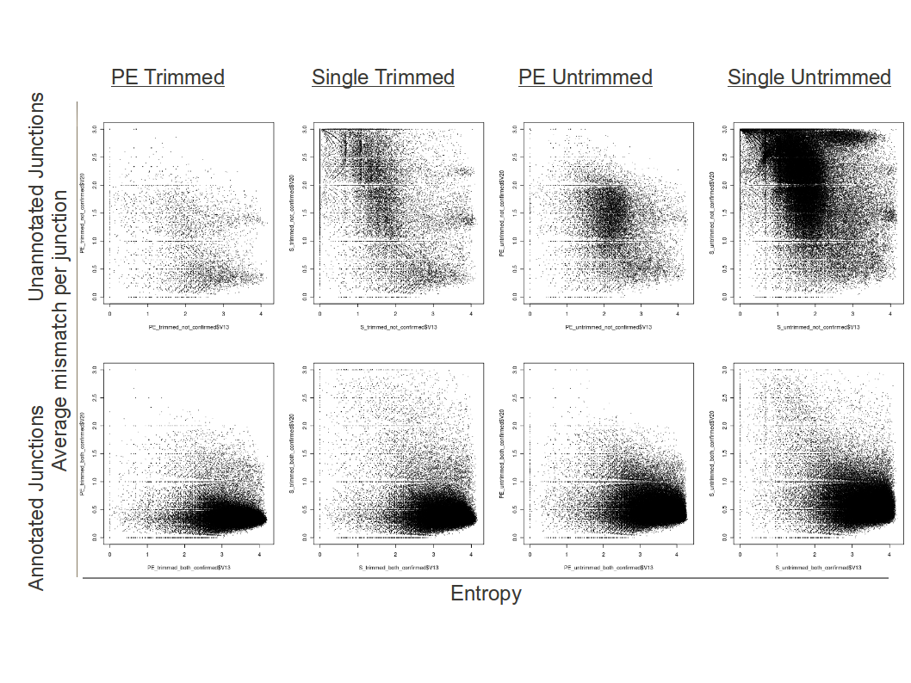
A view of alignment quality
Notes:
16
16
we show the effect of the preprocessing and postprocessing constraint on the output of mapsplice. These are scatterplots for the junctions that record on the horizontal axis the entropy of alignments that include the junctions and on the vertical axis the average mismatch of reads that include the junction. On the left we show the result with pre-processing (trimming) AND the paired end distance constraint. Going to the right we show just the preprocessing and the PE constraint respectively, and finally the result without either. Since we classify junctions according to the value on the horizontal axis, we like to see a dark cloud on the lower right, indicating that the highly supported junctions lead to high quality alignments. In the lower panel we can see that this is the case for a control group of “known” junctions. In the top panel we see that the two restrictions have the effect of improving the location of the cloud for the unknowns.

Slide 17
Performance
Dataset | # total reads | MapSplice 1.15 |  |  | MapSplice Parallel
 |  | Time | Mem | Disk | Time | Mem | Disk
Synthetic R1 | 80 Million | ~39 hours (bowtie with 8 threads) | 4 GB | 600 GB | ~4 hours with 8 threads | ~20 GB | 50 GB
Notes:
Finally, I turn to the performance of mapsplice. We have thus far focused exclusively on functionality so that mapsplice runs as a set of phases that read and write intermediate datasets. On large datasets this seriously bogs down. On the left is the running time and space for 1.15 on the synthetic R1 data set. MapSplice never uses very much memory making it suitable to run on many machines, but it uses external sorts whose performance really falls off a cliff when memory is limited and moreover writes an amazing amount of intermediate data. We have started work on a complete reimplementation of MapSplice that is fully parallelized in all phases of processing. Some preliminary results here show that we can get substantial performance improvements (factor of 10 or more depending on available concurrency). This is a shared-memory paralle implemntation that we expect to scale to 32 or more cores on modern servers with high performance memory systems. (so perhaps another factor of 4 improvement).

Slide 18
Transcript Quantification
RNA-seq alignments
Reference
Genome
Exon 1
Exon 2
Exon 3
5’
3’
Reference transcript isoforms
Isoform 1
Exon 1
Exon 2
Exon 3
Isoform 2
Exon 1
Exon 3
What is the relative abundance of each isoform?
Notes:
Now to perform abundance estimation, we start with a given set of transcripts. Because we have aligned all the reads, we can select just those reads that lie within the transcripts of interest. How can we find the relative abundance of each of these isoforms?

Slide 19
Exon-Centric Approach
Observed coverage on exons
4
4
2
Reference transcript isoforms
Isoform copy
Isoform 1
Exon 1
Exon 2
Exon 3
x
Isoform 2
Exon 1
Exon 3
y
Notes:
Suppose we have two transcripts that are related by alternative splicin. One skips exon 2, the other includes it.
We have some observed “coverage” on the exons, the average number of reads covering each nucleotide in the exon. Let x denote the number of copies we saw of Isoform 1, and y the number of copies of Isoform 2. Now we can solve some linear equations

Slide 20
Exon-Centric Approach
Observed coverage on exons
4
4
2
Reference transcript isoforms
Isoform copy
Isoform 1
Exon 1
Exon 2
Exon 3
x
Isoform 2
Exon 1
Exon 3
y
4 = x + y
2 = x
4 = x + y
Notes:
the following set of linear equations can be established on each exon, based on the idea that the observed coverage on each exon should equal to the aggregate expression of all the isoforms covering this exon.
It is not hard to solve this set of linear equations. We could get the estimation result that there are 2 copies of Isoform1 and 2 copies of Isoform2.

Slide 21
Exon-Centric Approach
Observed coverage on exons
4
4
2
Reference transcript isoforms
Isoform copy
Isoform 1
Exon 1
Exon 2
Exon 3
x=2
Isoform 2
Exon 1
Exon 3
y=2
4 = x + y
2 = x
4 = x + y
Notes:
the following set of linear equations can be established on each exon, based on the idea that the observed coverage on each exon should equal to the aggregate expression of all the isoforms covering this exon.
It is not hard to solve this set of linear equations. We could get the estimation result that there are 2 copies of Isoform1 and 2 copies of Isoform2.

Slide 22
Problem 1: underdetermined solutions
Observed coverage on exons
7
7
3
3
Reference transcript isoforms
# copies
True
P1
P2
Isoform 1
Exon 1
Exon 2
E 3
1
3
2
Isoform 2
Exon 1
E3
3
1
2
Isoform 3
Exon 1
Exon 2
E3
Exon 4
2
0
1
Isoform 4
Exon 1
E3
Exon 4
1
3
2
Notes:
Although the linear model set up on each exons works fine for many genes with 1 or 2 isoforms, when the structure of the gene model is complicated, there comes the problem.
Here is an example. Given the observed read coverage on each exon and provided with four reference transcripts, the same coverage on each exon could lead to different solutions of isoform quantities. As shown now, this is the true profile. However, the linear system may lead to other solutions, such as P1 and P2, but are not the correct answers.

Slide 23
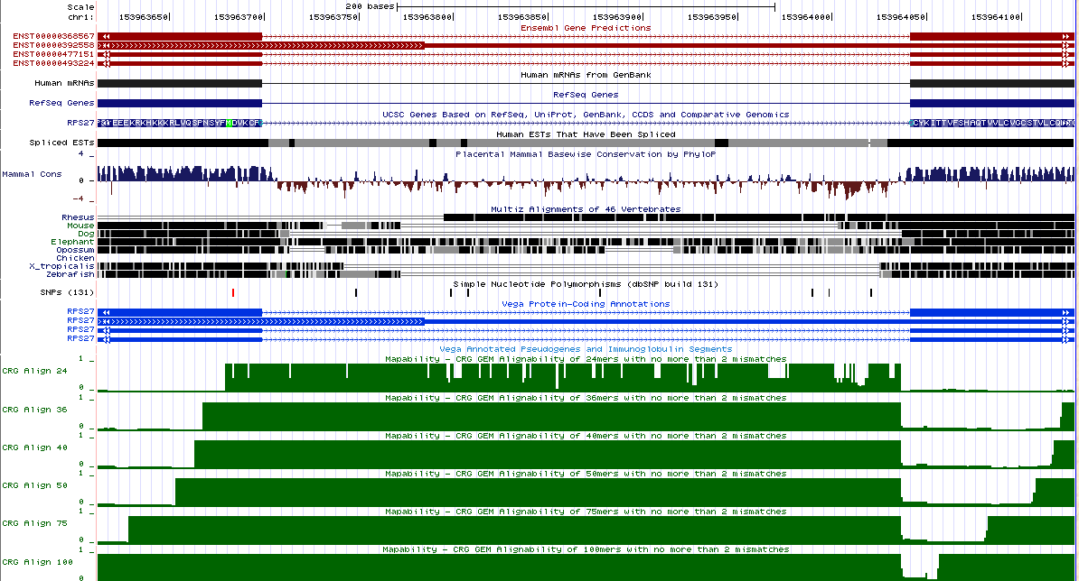
Problem 2: Mappability example of a “high” expressed junction
Mappability tracks
Notes:
23
23
Because MapSplice does not assume annotations, it may find many candidate alignments in regions of low complexity. These could be filtered, but this was not done because (??? It was not permitted or ??? We didn’t have time)

Slide 24
Abundance Estimation using EM
Li et al., RNA-Seq gene expression estimation with read mapping uncertainty, Bioinformatics, 26(4):493-500, 2010.
Probabilistic framework to estimate gene and isoform abundance from a model incorporating read bias
The general approach is to maximize the probability of observing the read alignments, given some expected isoform abundances.
Explicitly handles multimapped reads (reads mapped to multiple genes or isoforms)
In addition, 95% credibility intervals (CI) and posterior mean estimate (PME) are computed besides ML estimate.
RSEM appears to be most accurate
Cufflinks, IsoEM, and other methods follow a similar approach and agree to a large degree
We are currently developing an extension, Multisplice, that does this better!
Notes:
These two problems cause real complications. The best approach right now seems to be an expectation maximization method that works from a model describing read biases. We are asking given our observed coverages what are the most likely isoform abundances? Multimapped reads are legion, they come from shared exons. These methods try to accommodate them. The methods still encounter unidentifiable models that correspond tto the underdetermined solutions we saw before. Nevertheless these methods work pretty well with RSEM, developed at U wisc, working best among the alternatives.
For read-centric method, when it is impossible to precisely allocate a fragment to a unique transcript, Cufflinks, for example, simply disregards or randomly assigns the read, causing information loss or inaccurate quantification.

Slide 25
RNAseq
Parametric Models
edgeR
Deseq (NB)
Generalized Poisson ( λp)
GeneCounter (NBp)
RSEM (MLE, directed graph, various)
Non-parametric
(Li and Tibshirani)
Biswas et al in prep (hybrid)

Slide 26
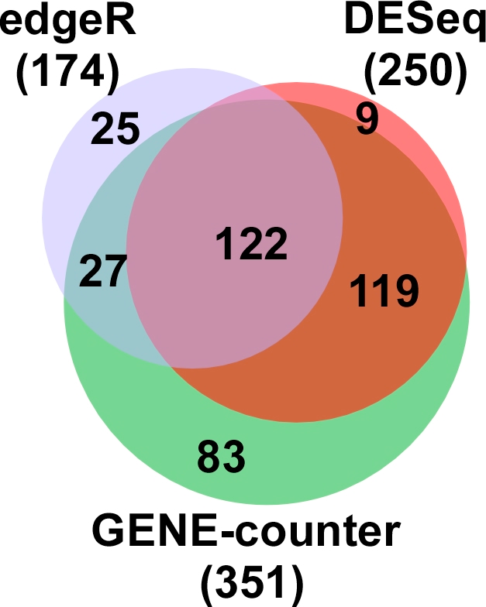
Comparison among methods

Slide 27
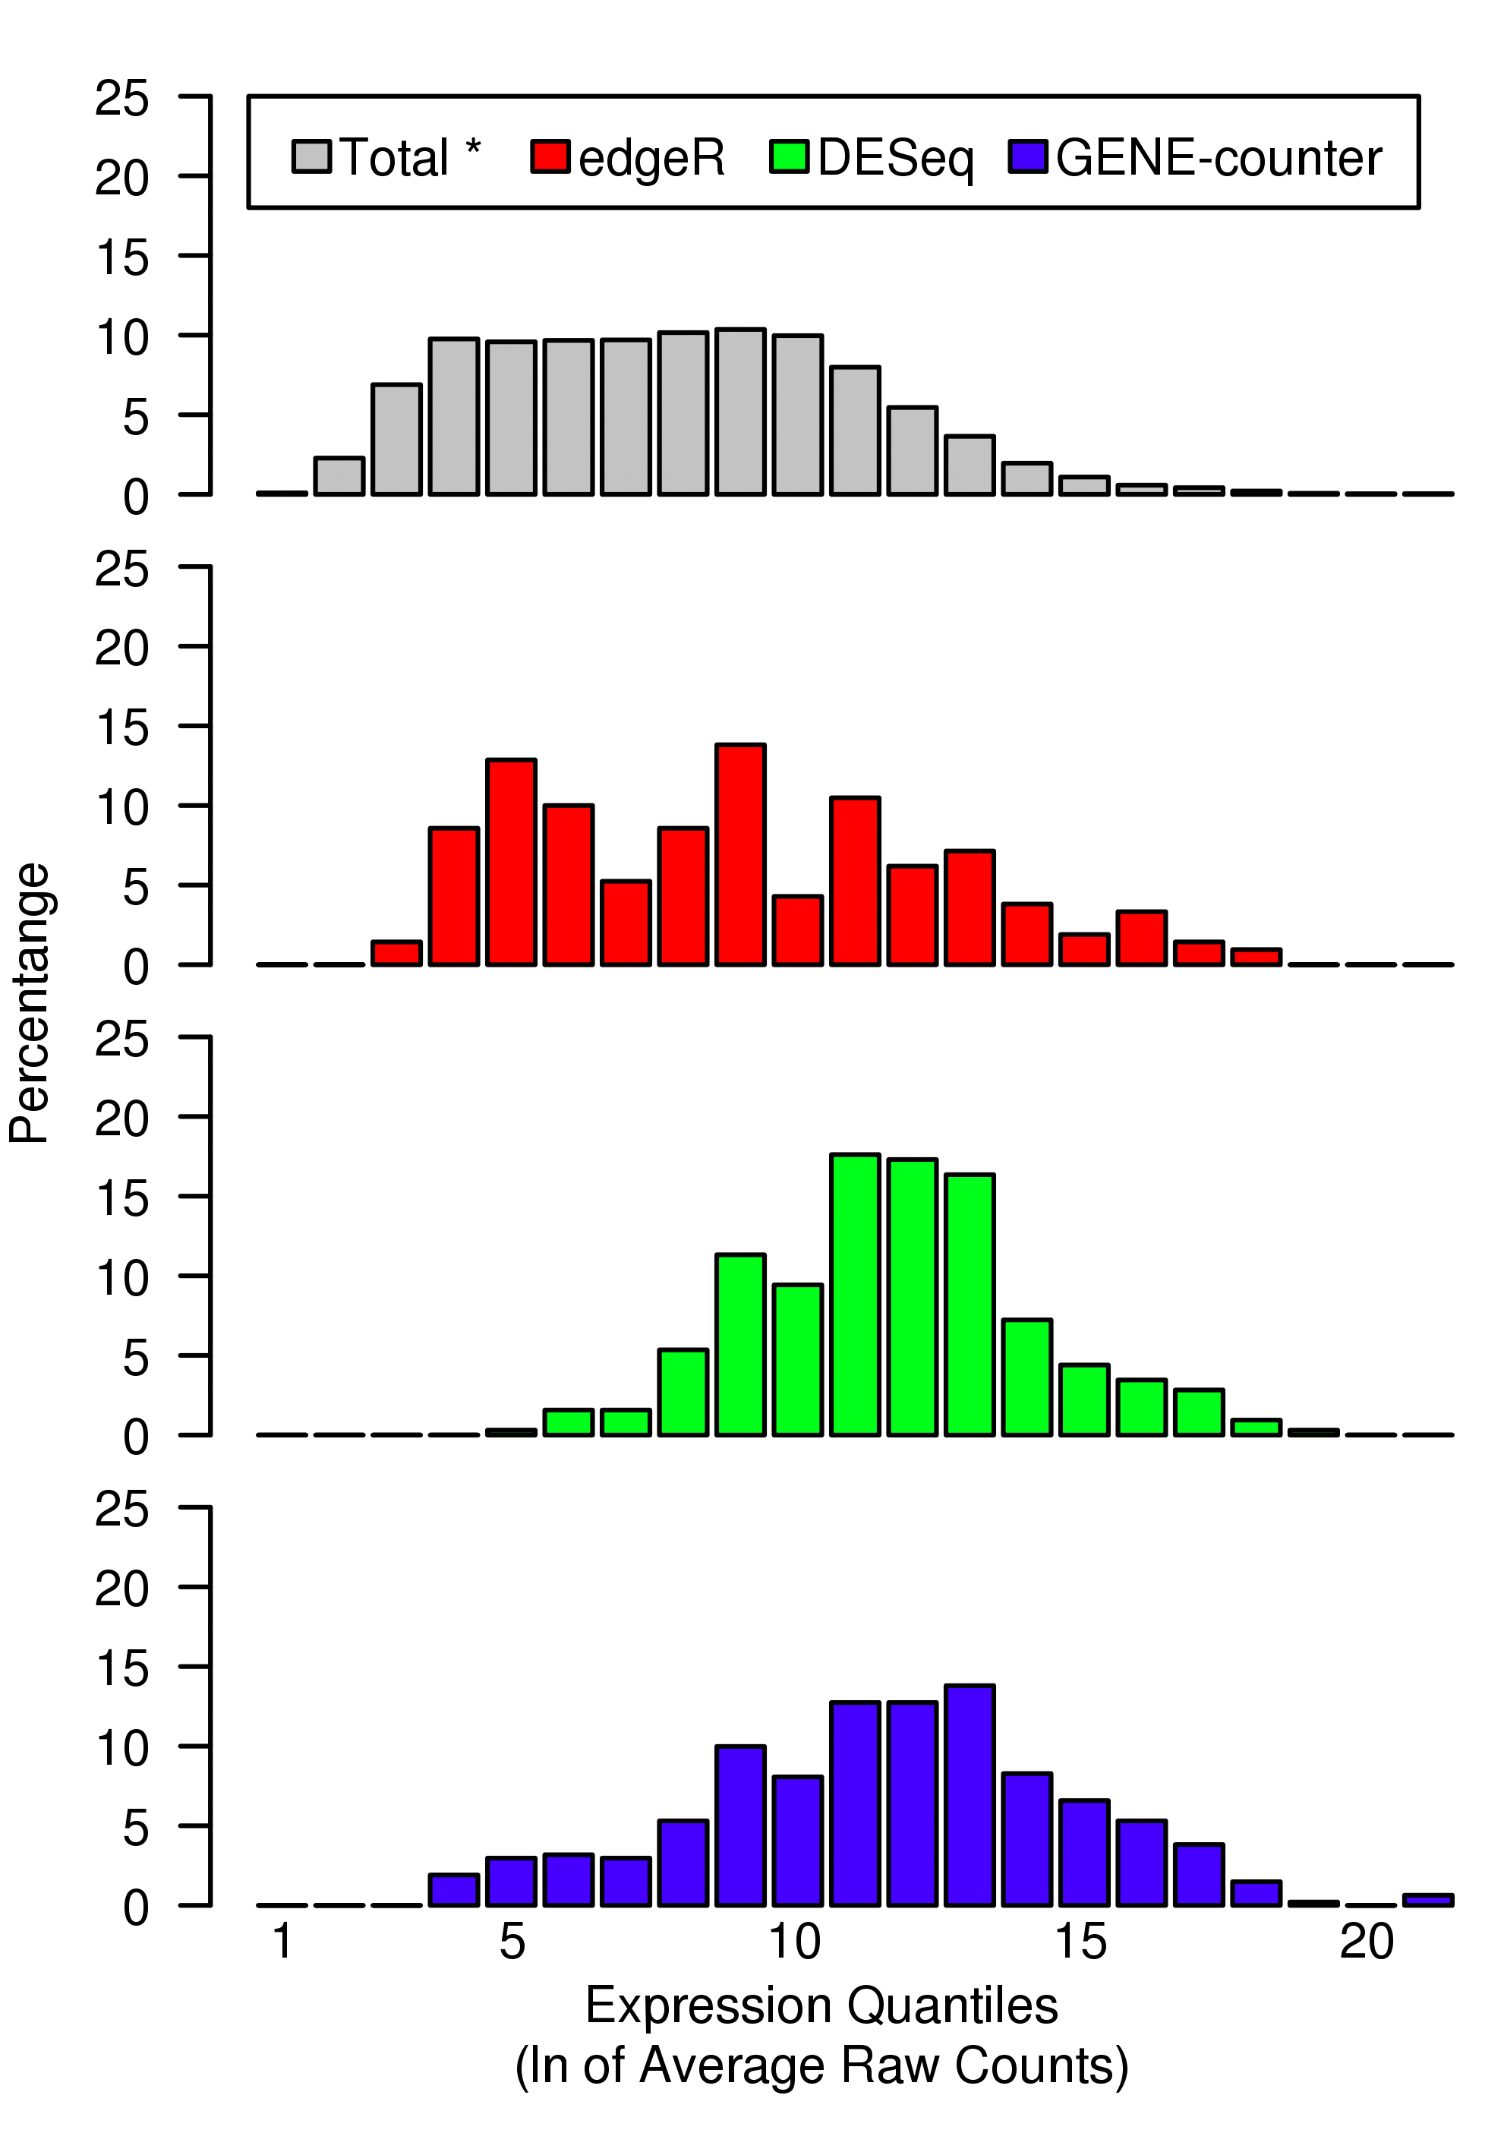
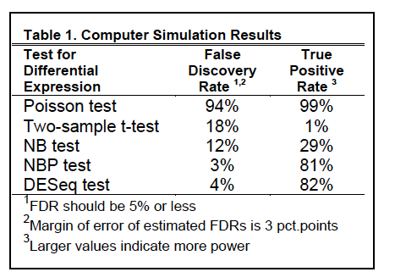
Histograms of Expression levels of significant genes

Slide 28
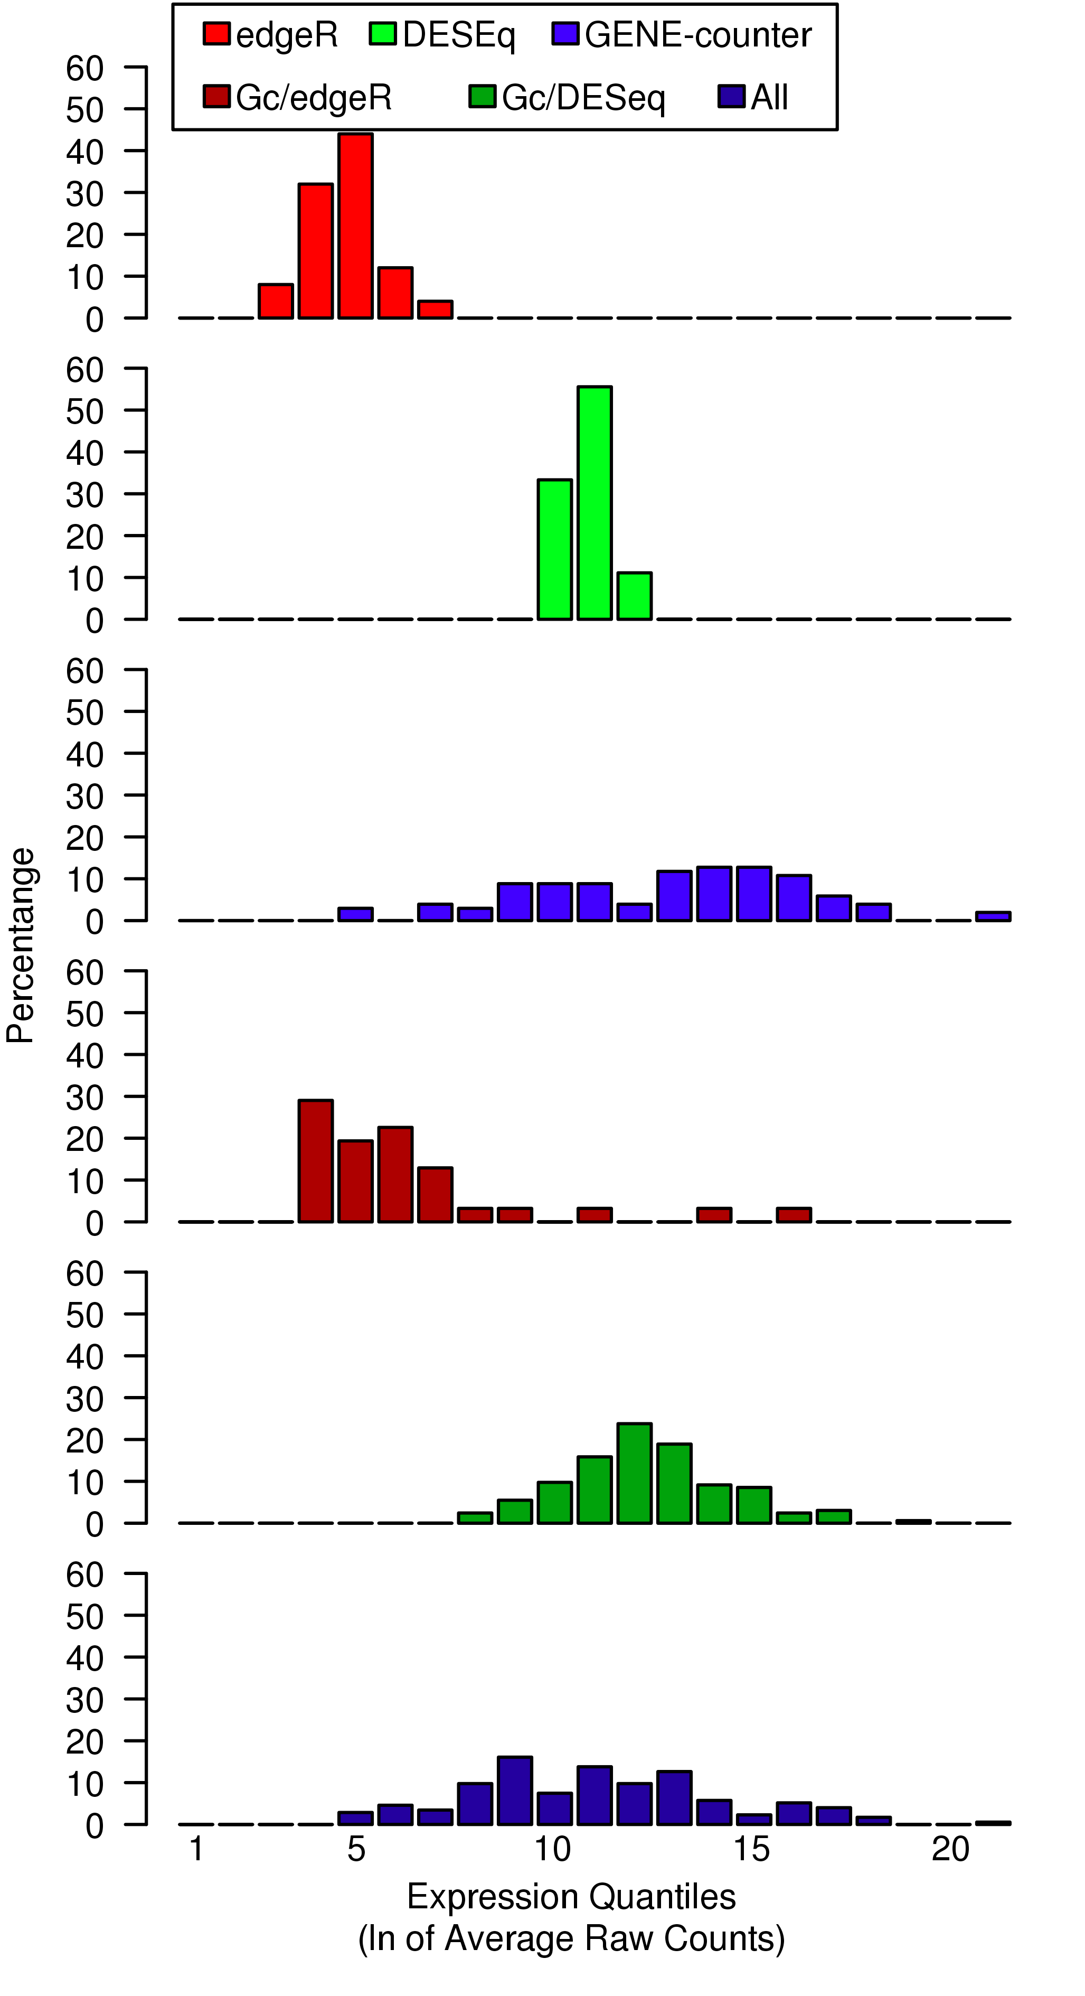
Bias..
Notes:
NBP appears less biased across
expression levels. Each panel is a histogram of
the expression levels as described in Fig 3 (xaxis)
for RNA-seq data. The panels 1-3 show
the range of expression values that correspond
to genes “unique” to a method. The panels 4-6
show the expression ranges of genes shared by
two methods. In contrast to other methods,
genes identified by the GENE-counter NBP
model and the microarray span the range of
expression quantiles. DESeq suppresses genes
at the extremes, whereas edgeR is biased
towards the low end of expression.

Slide 29
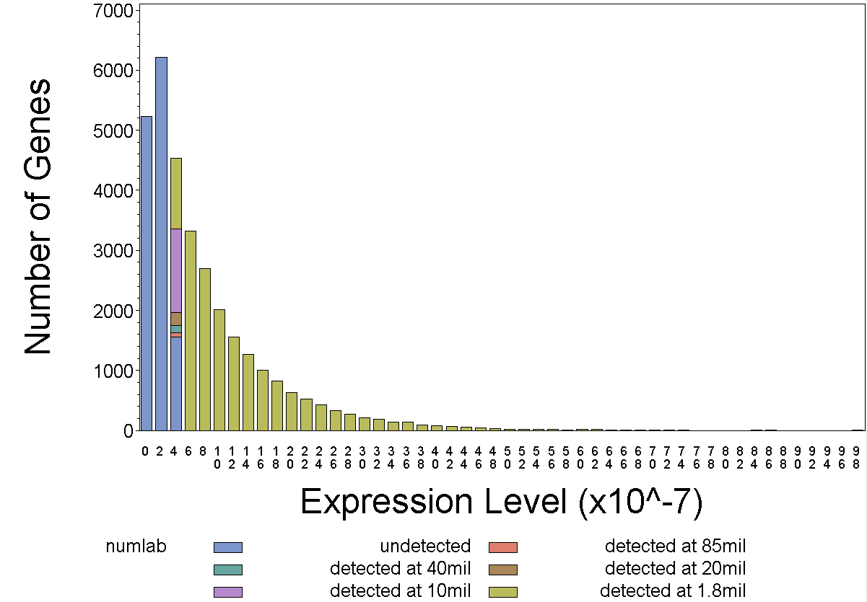
Notes:
Here are some Human simulation results. The vertical lines denote how many genes received less than one, ten and thirty counts. I simulated at the 10,20 and 40 million counts level and as you can see the more counts that get added the more genes get detected.
The area in between the lines is really a grey are of detection where you may or may not be able to see those genes. As we increase our counts this grey area gets smaller but you note our detection isnt getting a whole lot better. And this just goes to show that these highly expressed are going to absorb most of the new counts.
This simulation works well and can provide the data an investigator needs to determine the number of counts he needs in order to detect a certain number of genes. However the algorithm takes over 12 hours to run because of the large amount of data generated. So a more efficient way to estimate this number is needed.

