Slide 1
Introduction to mapping/alignment with short read sequence data
Ian Dworkin & Chris Chandler
KBS June 8th 2011

Slide 2
The book!!!!
Practical Computing for Biologists
Steven Haddock and Casey Dunn 2010
Sinauer

Slide 3
goals
Brief introduction to 2nd and 3rd generation sequencing platforms.
Discuss how “aligning” or mapping reads occurs.
Some basics of data structures needed.
Options.
Performance of gapped vs ungapped alignments. Paired end vs single end.

Slide 4
What makes these sequencing technologies “next”?
Large amount of sequencing possible, in a (relatively) short time and relatively cheaply.
Infrastructure for the technologies is quite different than Sanger.
Different chemistries.
Library based sequencing (instead of individual unique amplicons).
SCALING!
Shorter read lengths (for now).

Slide 5
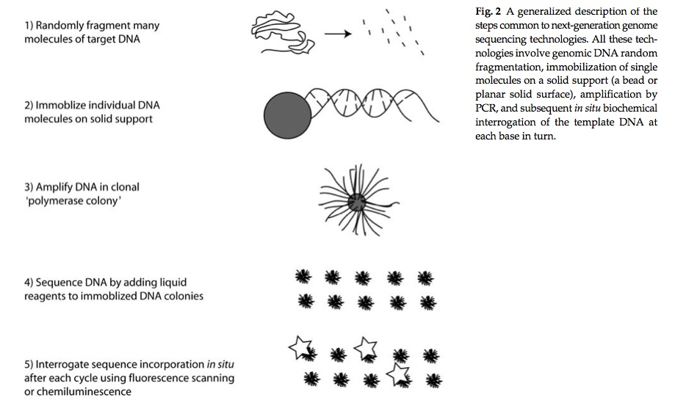
Some general principles (Illumina/Roche454/ABISolid)
Hudson 2008

Slide 6
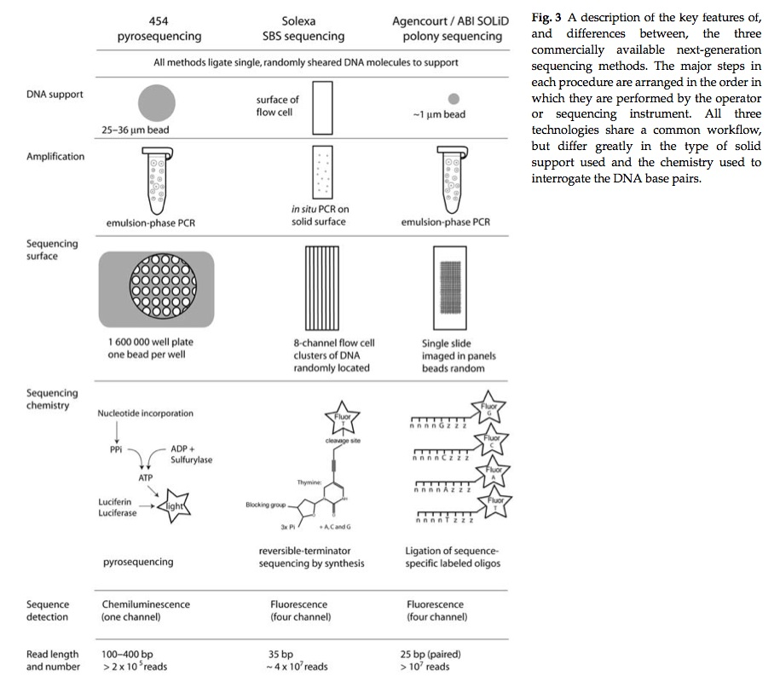
A few general differences..
Hudson 2008

Slide 7
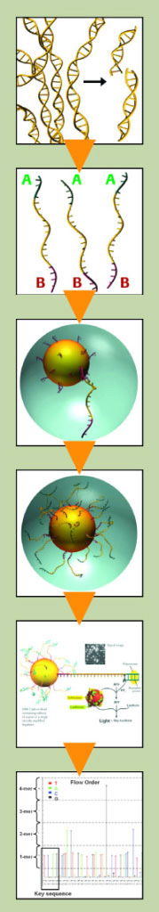
http://www.454.com/products-solutions/how-it-works/index.asp

Slide 8
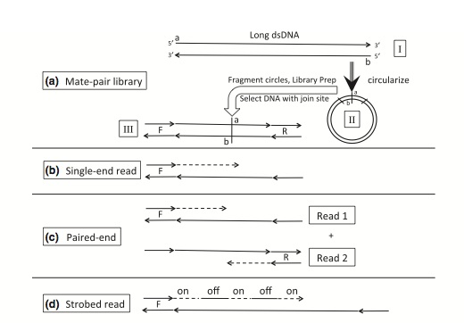
Among the many useful things these technologies allow is to “overcome” the short read length by doing multiple short reads from the same PCR amplicon.
Glenn 2011

Slide 9
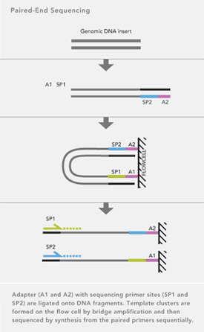
Illumina Paired end
Inserts on the order of 200-500bp
http://www.illumina.com/technology/paired_end_sequencing_assay.ilmn

Slide 10
The Roche454 FLX (or whatever version)…
The mate pairs allow for larger inserts of different sizes.
Currently ranging between 3-12kb (??).
However with this approach the actual length of the read from each side is effectively cut in half (not true for PE with Illumina).

Slide 11
The technologies are changing so fast..
We are all trying to keep up with latest developments.
The good news is everything is getting better and cheaper very quickly.
However it is still very important to pick the appropriate technology for your particular application (i.e. 454 for assembly, but Illumina for resequencing, chipSeq, RNAseq…).

Slide 12
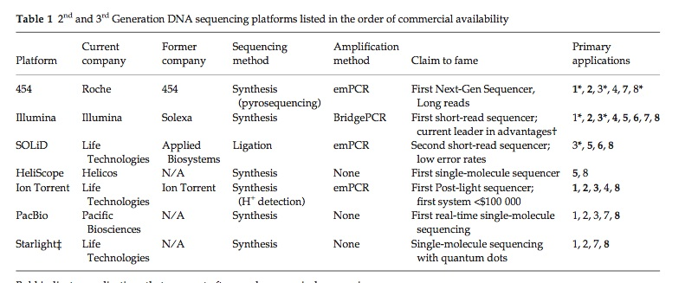
Comparison among platforms
Glenn 2011

Slide 13
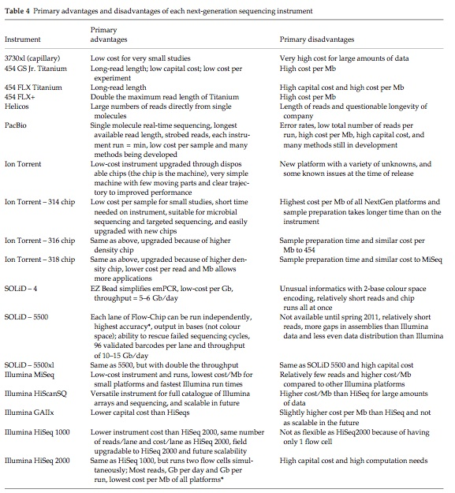
Comparisons among platforms
Glenn 2011

Slide 14
Ok… I now have 0.25Tb of sequence data… what do we do first
For most applications, the unique short reads by themselves are of little use.
In general most people try to “piece the data together” in some fashion.
In general this is either de-novo assembly, or syntenic assembly (i.e. aligning/mapping reads).
Hybrid approaches are becoming more common.

Slide 15
Syntenic assembly
Syntenic assembly assumes that you have some sort of reference genome that you can use as a scaffold to build your genome (or transcripts).
You make an assumption that the locations of your new sequence reads are syntenic with that of the reference genome?
How could this possibly go wrong?

Slide 16
Assumptions/issues with syntenic assembly?
Insertion/deletions (relative to reference genome).
High levels of sequence variation (relative to reference).
Low complexity DNA (repeats)
Recombination
Re-arrangements
Gene duplication
Quality of the reference genome
(reference is incomplete, and order may be incorrect).

Slide 17
So how do we map reads?
We can start where we left off yesterday..
As CTB described, Blast begins with a “seed” of length 11 (default).
Blast generates a database of the reference genome data (genomic DNA, transcripts etc) of 11bp sequences, and looks for exact (?) matches.
It then takes all matches (which is a small subset) and used the Smith-Waterman algorithm (CTB will explain later) to find the “best” matches.
This needs to be done as SMA and other approaches are slow.

Slide 18
Why not use Blast for NGS data?
Too Slow!
“homology” over short regions can be difficult for short reads.

Slide 19
NGS alignment/mapping
Most approaches still use this two step process of generating a subset of possible matches followed by a (slow) refinement step.
The major differences is how they go about doing this.

Slide 20
Hash tables
Some of software uses hash tables.
These are also called associative arrays, maps and in python dictionaries.
The basic idea is that instead of some sort of numerical indexing, the data structure (the hash table) uses a key-value pairing system.
You used one yesterday in python {}.
Pairs = {}

Slide 21
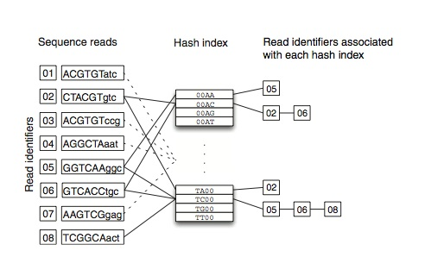
Hash table.
Flickey & Birney 2009

Slide 22
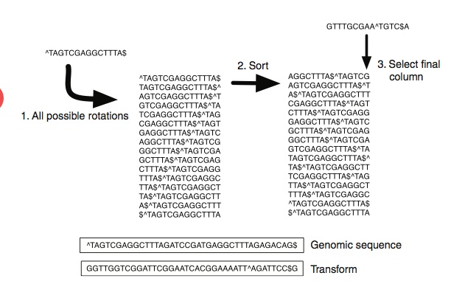
Burrows Wheeler.
Flickey & Birney 2009

Slide 23
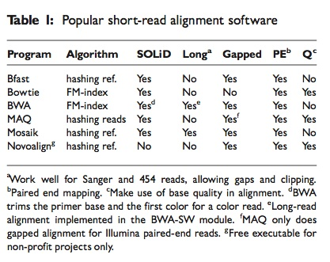
Among the many software options…
Li & homer 2011

Slide 24
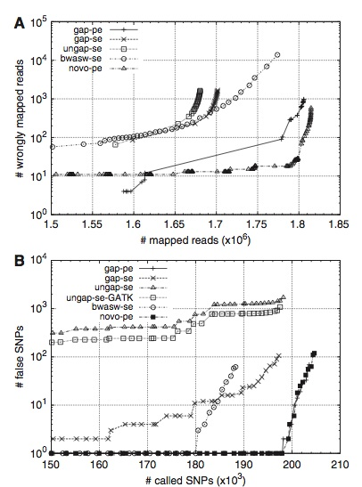
Some comparisons among gapped/ungapped & Single vs. Paired end (se/pe)
Li & homer 2011

Slide 25
How long a list?
http://seqanswers.com/forums/showthread.php?t=43
http://seqanswers.com/wiki/Software
http://seqanswers.com/wiki/Software/list
http://en.wikipedia.org/wiki/List_of_sequence_alignment_software

Slide 26
References
Flicek, P., & Birney, E. (2009). Sense from sequence reads: methods for alignment and assembly Nature Methods, 6(11 Suppl), S6–S12. doi:10.1038/nmeth.1376
Glenn, T. C. (2011). Field guide to next-generation DNA sequencers Molecular Ecology Resources. doi:10.1111/j.1755-0998.2011.03024.x
Hudson, M. E. (2008). Sequencing breakthroughs for genomic ecology and evolutionary biology Molecular Ecology Resources, 8(1), 3–17. doi:10.1111/j.1471-8286.2007.02019.x
Li, H., & Homer, N. (2010). A survey of sequence alignment algorithms for next-generation sequencing Briefings in bioinformatics, 11(5), 473–483. doi:10.1093/bib/bbq015

Slide 27
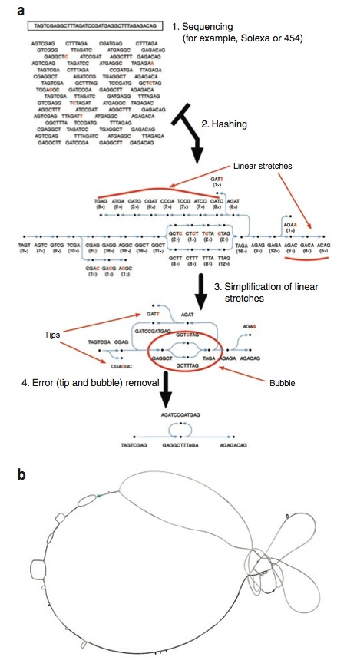
Flickey & Birney 2009

