Slide 1
De novo Assembly
Titus Brown
6/7/12

Slide 2
Assembly vs mapping
No reference needed, for assembly!
De novo genomes, transcriptomes…
But:
Scales poorly; need a much bigger computer.
Biology gets in the way (repeats!)
Need higher coverage
But but:
Often your reference isn’t that great, so assembly may actually be the best way to go.

Slide 3
Assembly
It was the best of times, it was the wor
, it was the worst of times, it was the
isdom, it was the age of foolishness
mes, it was the age of wisdom, it was th
It was the best of times, it was the worst of times, it was the age of wisdom, it was the age of foolishness
…but for lots and lots of fragments!

Slide 4
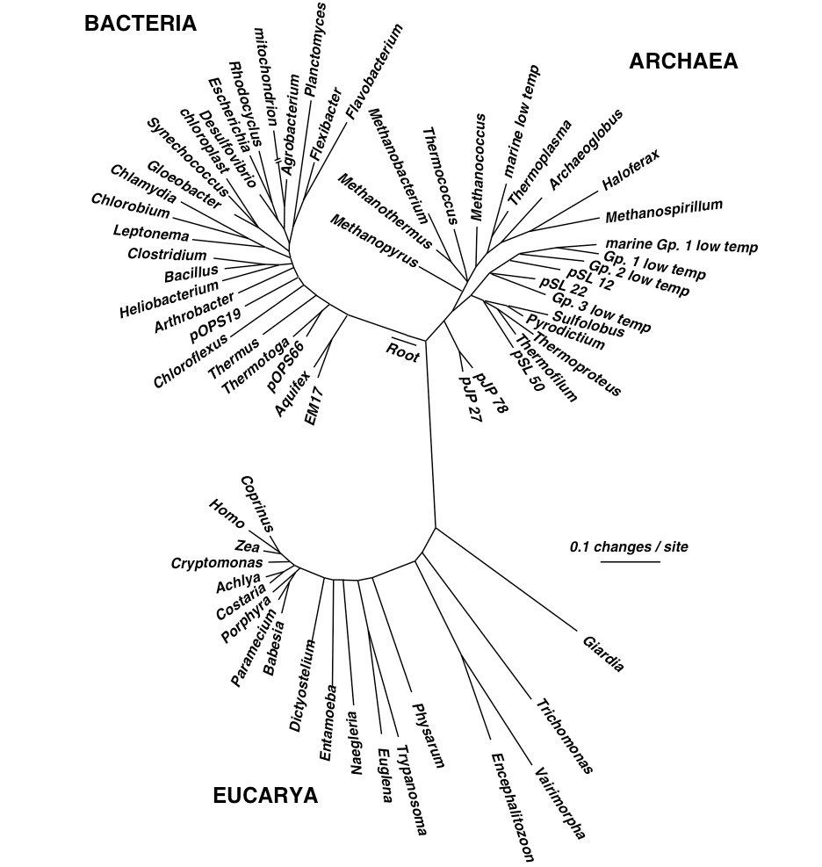

Slide 5
Assemble based on word overlaps:
the quick brown fox jumped
jumped over the lazy dog
the quick brown fox jumped over the lazy dog
Repeats do cause problems:
my chemical romance: na na na
na na na, batman!

Slide 6
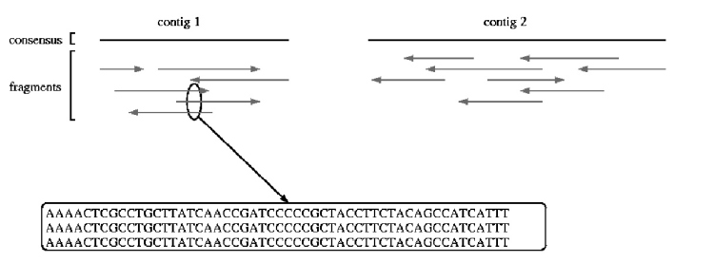
Shotgun sequencing & assembly
Randomly fragment & sequence from DNA;
reassemble computationally.
UMD assembly primer (cbcb.umd.edu)

Slide 7
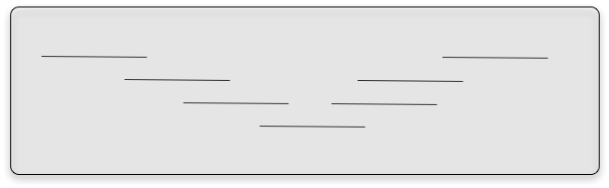
Assembly – no subdivision!
Assembly is inherently an all by all process. There is no good way to subdivide the reads without potentially missing a key connection

Slide 8
Short-read assembly
Short-read assembly is problematic
Relies on very deep coverage, ruthless read trimming, paired ends.
UMD assembly primer (cbcb.umd.edu)

Slide 9
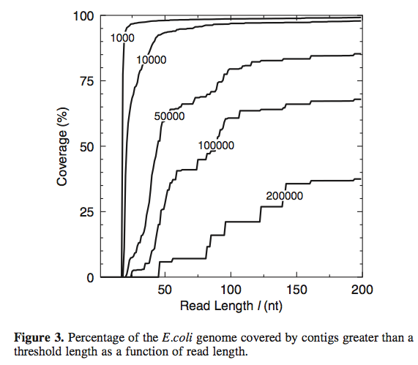
Short read lengths are hard.
Whiteford et al., Nuc. Acid Res, 2005

Slide 10
Short read lengths are hard.
Conclusion: even with
a read length of 200, the
E. coli genome cannot be
assembled completely.
Why?
Whiteford et al., Nuc. Acid Res, 2005

Slide 11
Short read lengths are hard.
Conclusion: even with
a read length of 200, the
E. coli genome cannot be
assembled completely.
Why? REPEATS.
This is why paired-end
sequencing is so important
for assembly.
Whiteford et al., Nuc. Acid Res, 2005

Slide 12
Four main challenges for de novo sequencing.
Repeats.
Low coverage.
Errors
These introduce breaks in the
construction of contigs.
Variation in coverage – transcriptomes and metagenomes, as well as amplified genomic.
This challenges the assembler to distinguish between erroneous connections (e.g. repeats) and real connections.

Slide 13
Repeats
Overlaps don’t place sequences uniquely when there are repeats present.
UMD assembly primer (cbcb.umd.edu)

Slide 14
Coverage
Easy calculation:
(# reads x avg read length) / genome size
So, for haploid human genome:
30m reads x 100 bp = 3 bn

Slide 15
Coverage
“1x” doesn’t mean every DNA sequence is read once.
It means that, if sampling were systematic, it would be.
Sampling isn’t systematic, it’s random!

Slide 16
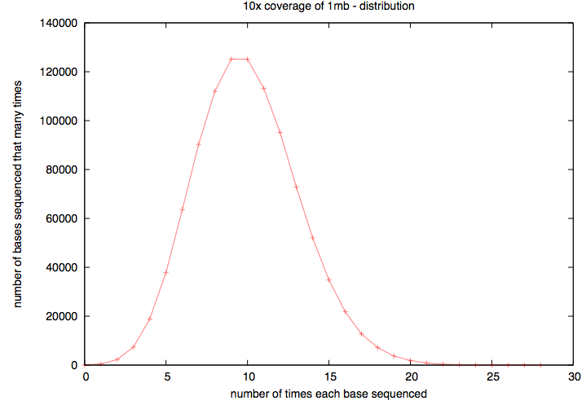
Actual coverage varies widely from the average, for low avg coverage
Notes:
High coverage is essential.

Slide 17
Two basic assembly approaches
Overlap/layout/consensus
De Bruijn k-mer graphs
The former is used for long reads, esp all Sanger-based assemblies. The latter is used because of memory efficiency.

Slide 18
Overlap/layout/consensus
Essentially,
Calculate all overlaps
Cluster based on overlap.
Do a multiple sequence alignment
UMD assembly primer (cbcb.umd.edu)

Slide 19
K-mers
Essentially, break reads (of any length) down into multiple overlapping words of fixed length k.
ATGGACCAGATGACAC (k=12) =>
ATGGACCAGATG
TGGACCAGATGA
GGACCAGATGAC
GACCAGATGACA
ACCAGATGACAC
Notes:
Note, no tolerance for indels

Slide 20
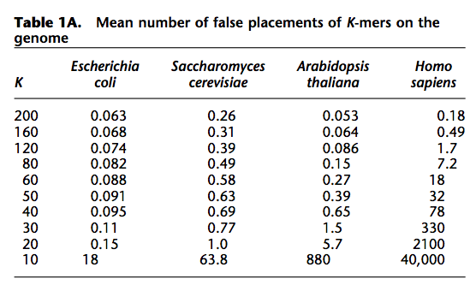
K-mers – what k to use?
Butler et al., Genome Res, 2009

Slide 21
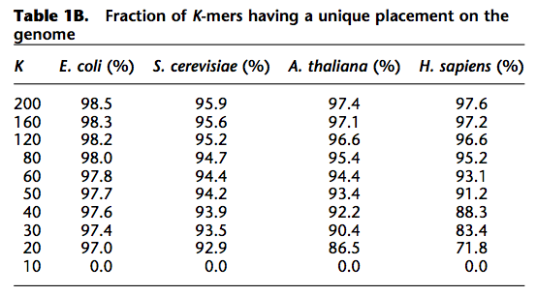
K-mers – what k to use?
Butler et al., Genome Res, 2009

Slide 22
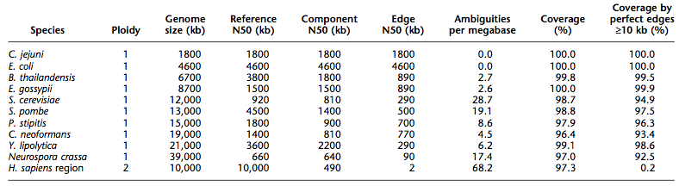
Big genomes are problematic
Butler et al., Genome Res, 2009

Slide 23
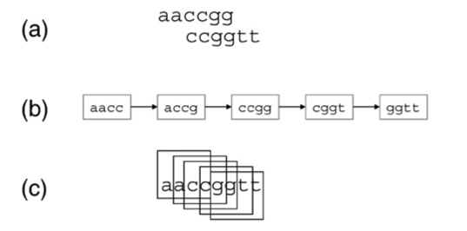
K-mer graphs - overlaps
J.R. Miller et al. / Genomics (2010)

Slide 24
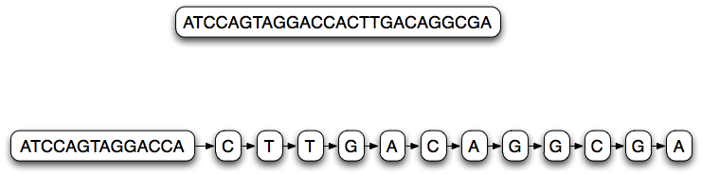
K-mer graph (k=14)
Each node represents a 14-mer;
Links between each node are 13-mer overlaps

Slide 25
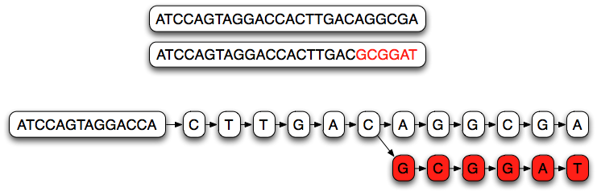
K-mer graph (k=14)
Branches in the graph represent partially overlapping sequences.

Slide 26
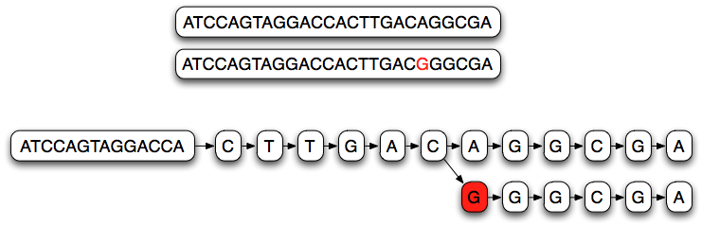
K-mer graph (k=14)
Single nucleotide variations cause long branches

Slide 27
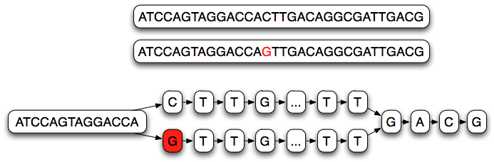
K-mer graph (k=14)
Single nucleotide variations cause long branches;
They don’t rejoin quickly.

Slide 28
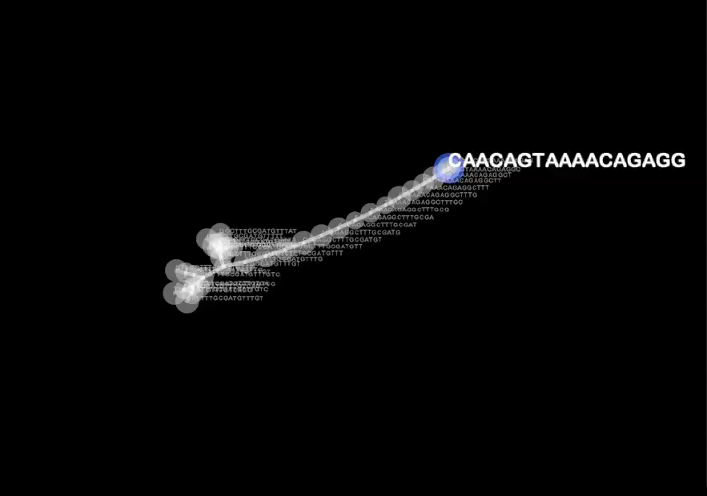
Groxel view of knot-like region / Arend Hintze

Slide 29
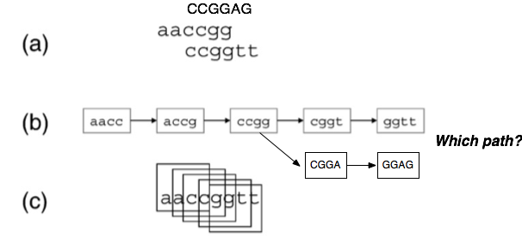
K-mer graphs - branching
For decisions about which paths etc, biology-based heuristics come into play as well.

Slide 30
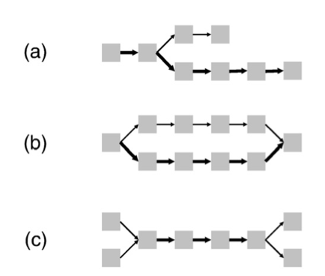
K-mer graph complexity - spur
(Short) dead-end in graph.
Can be caused by error at the end of some overlapping reads, or low coverage
J.R. Miller et al. / Genomics (2010)

Slide 31
K-mer graph complexity - bubble
Multiple parallel paths that diverge and join.
Caused by sequencing error and true polymorphism / polyploidy in sample.
J.R. Miller et al. / Genomics (2010)

Slide 32
K-mer graph complexity – “frayed rope”
Converging, then diverging paths.
Caused by repetitive sequences.
J.R. Miller et al. / Genomics (2010)

Slide 33
Resolving graph complexity
Primarily heuristic (approximate) approaches.
Detecting complex graph structures can generally not be done efficiently.
Much of the divergence in functionality of new assemblers comes from this.
Three examples:

Slide 34
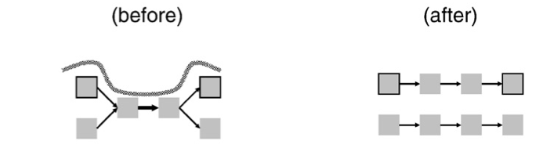
Read threading
Single read spans k-mer graph => extract the single-read path.
J.R. Miller et al. / Genomics (2010)

Slide 35
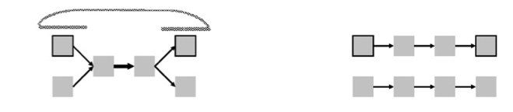
Mate threading
Resolve “frayed-rope” pattern caused by repeats, by separating paths based on mate-pair reads.
J.R. Miller et al. / Genomics (2010)

Slide 36
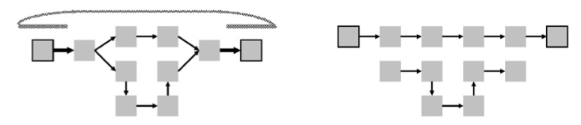
Path following
Reject inconsistent paths based on mate-pair reads and insert size.
J.R. Miller et al. / Genomics (2010)

Slide 37
More assembly issues
Many parameters to optimize!
RNAseq has variation in copy number; naïve assemblers can treat this as repetitive and eliminate it.
Assembly requires gobs of memory (4 lanes, 60m reads => ~ 150gb RAM)
How do we evaluate assemblies?
What’s the best assembler?

Slide 38
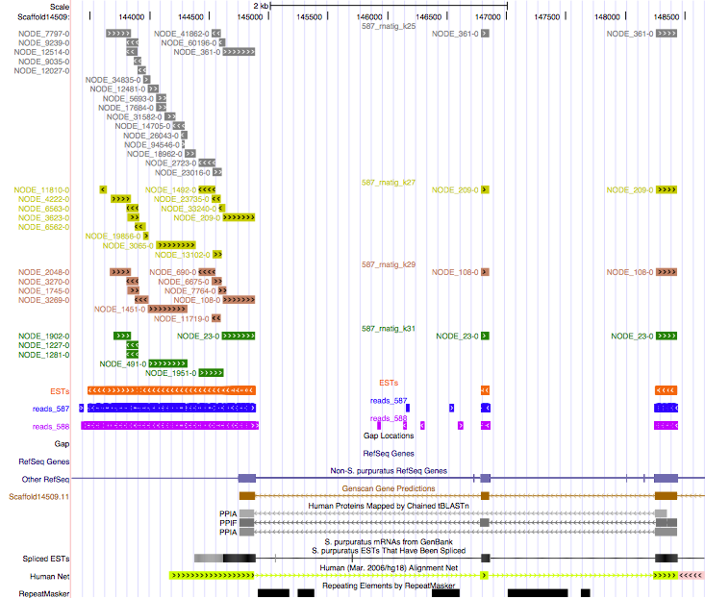
Hashlength = 25
Hashlength = 27
Hashlength = 29
Hashlength = 31

Slide 39
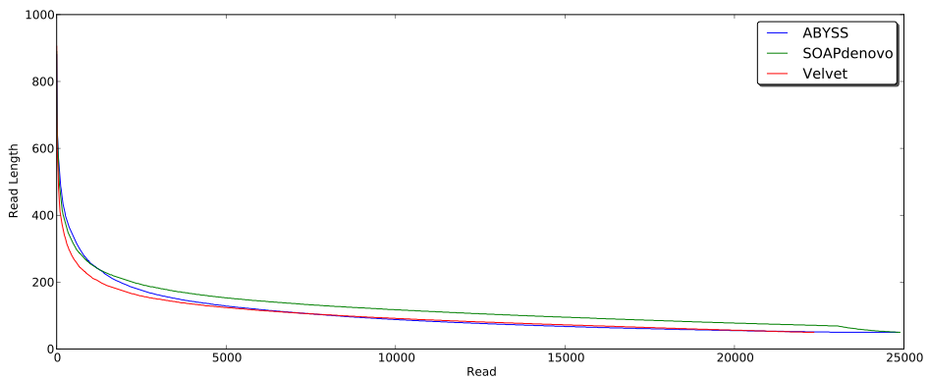
Trying out different assemblers
Notes:
Essentially no overlap in exact results @@

Slide 40
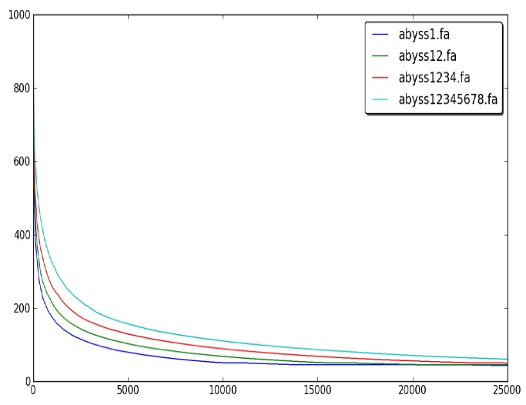
Adding more data starts to saturate

Slide 41
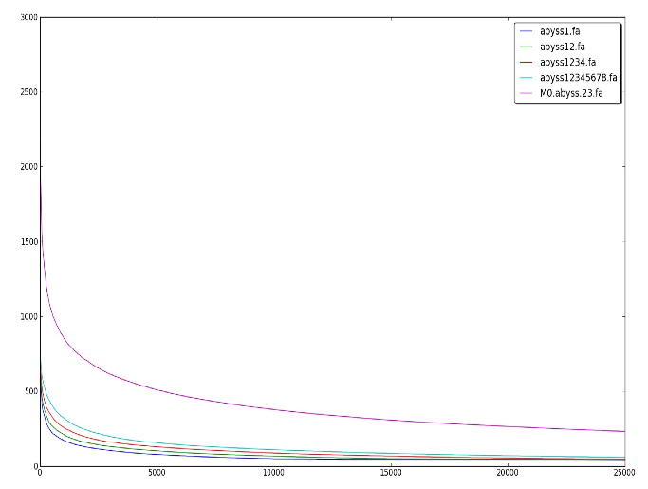
Longer reads help a lot… add 75bp
Notes:
Make point that depth here was less important than longer reads

Slide 42

…this matches simulations
Whiteford et al., Nuc. Acid Res, 2005

Slide 43
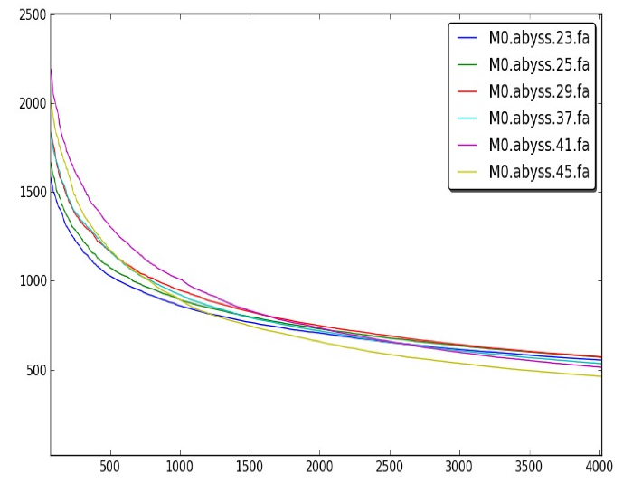
Different k values also matter.

Slide 44
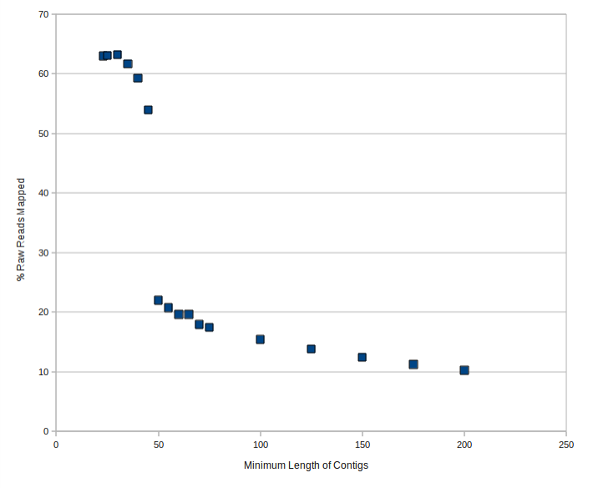
How useful is assembly, anyway?
Notes:
@@ jason’s stuff

Slide 45
Is your assembly good?
For genomes, N50 is an OK measure:
“50% or more of the genome is in contigs > this number”
That assumes your contigs are correct…!
What about mRNA and metagenomes??
Truly reference-free assembly is hard to evaluate.

Slide 46
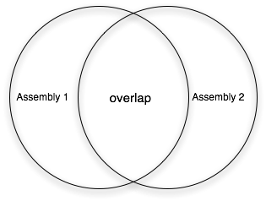
How do you compare assemblies?

Slide 47
K-mer comparison technique
Rank order contigs (shortest first)
Compare all contigs from two assemblies that are >= cutoff
Decompose contigs into k-mers
Look for k-mer overlap
This looks at composition of assemblies rather than structure; but if it reports differences, then those are minimum differences.

Slide 48
Comparison with small, clean data set
Conclusions:
CLC and Velvet are assembling quite a different set of contigs, even on a really simple, clean data set. !!

Slide 49
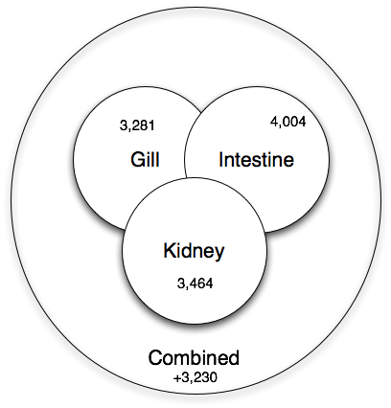
Co-assembly is important for sensitivity
Shared low-level transcripts may not reach the threshold for assembly.

Slide 50
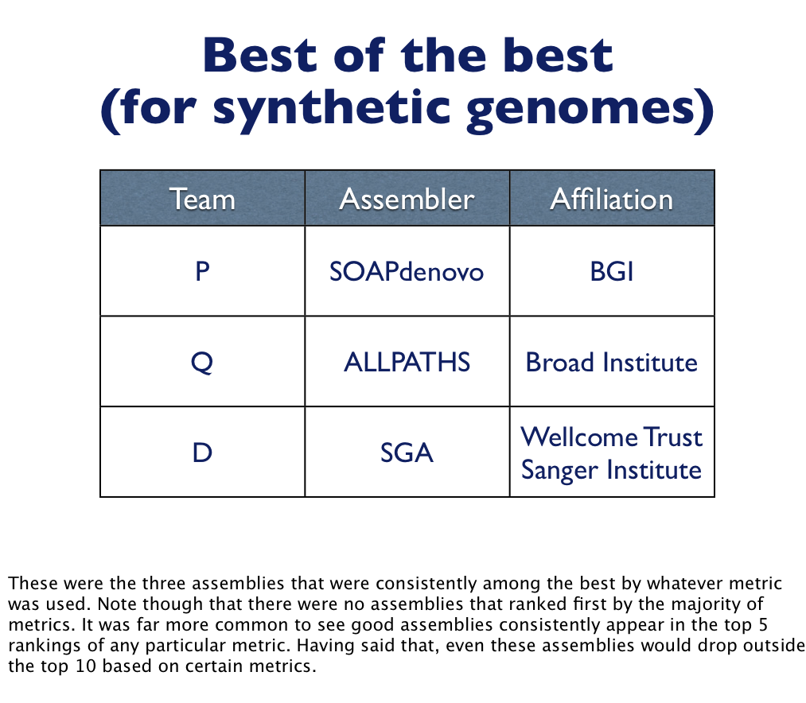

Slide 51
Practical issues
Do you have enough memory?
Trim vs use quality scores?
When is your assembly as good as it gets?
Paired-end vs longer reads?
More data is not necessarily better, if it introduces more errors.

Slide 52
Go forth! And map/assemble!
Assembly and mapping (and variations thereon) are the two basic approaches used to deal with next-gen sequencing data.
After the next few tutorials, you will be a truly dangerous bioinformatician!
Go forth & work with your own data, too!

