Slide 1
ChaiIntel
Forecasting Kenyan Tea Auction Prices
Methodology, implementation, validation & findings

Slide 2
Agenda
1. Problem & data
2. Methodology — candidate models, features, validation strategy
3. Model implementation
4. Model validation
5. Results
6. Findings & limitations
ChaiIntel — Kenya Tea Auction Forecasting

Slide 3
Section 1
Problem & data

Slide 4
Problem
• Forecast monthly auction prices (¢/kg) for five Kenyan tea grades — BP1, PF1, DUST1, FNGS 1/2, DUST 1/2.
• Produce a 12-month forecast per grade and quantify forecast uncertainty.
• Constraint: use ONE model uniformly across all grades for operational simplicity.
• Source: monthly Mombasa Tea Auction CSV.
• Dataset size: 8 monthly observations, covering May 2022 – May 2025.
ChaiIntel — Kenya Tea Auction Forecasting

Slide 5
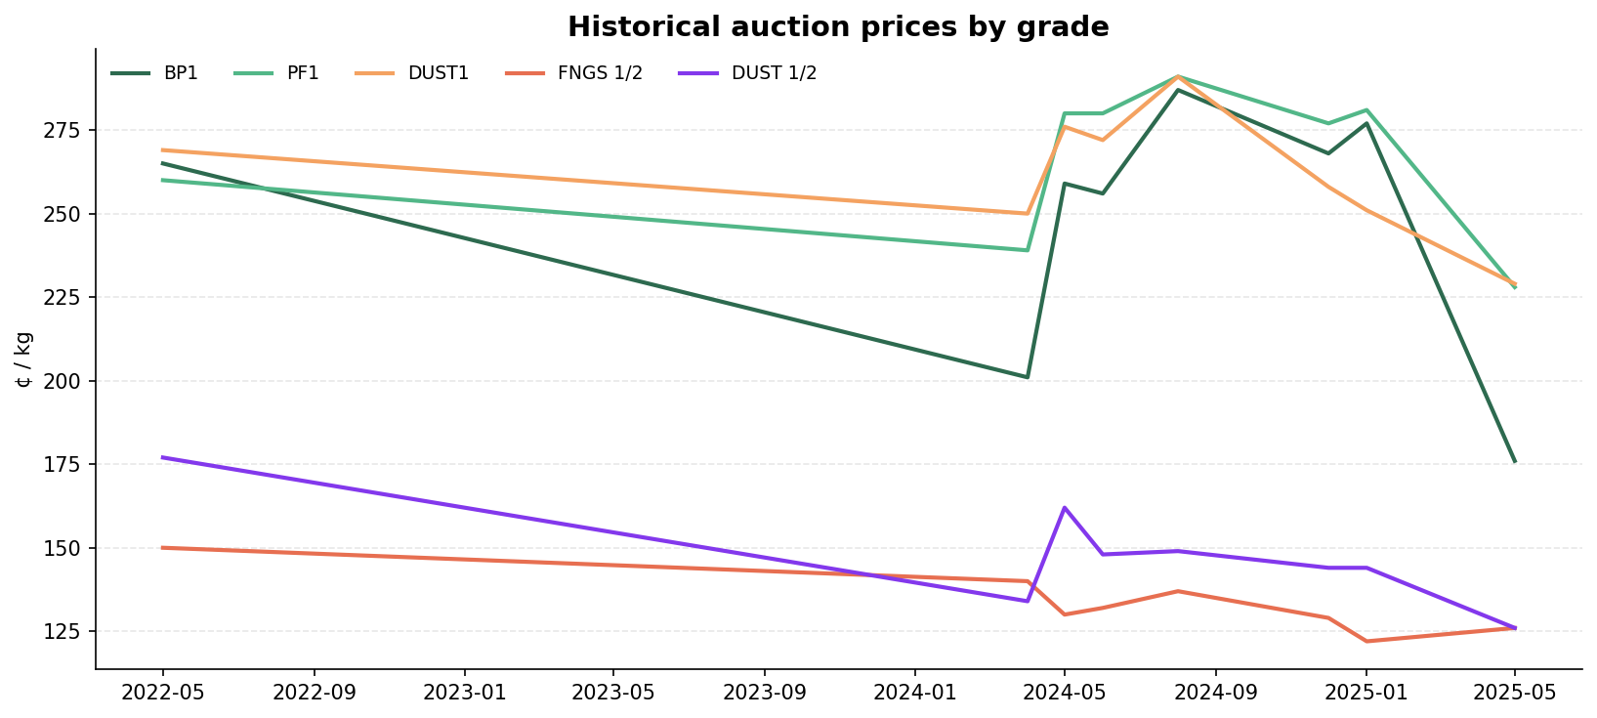
Historical prices
ChaiIntel — Kenya Tea Auction Forecasting

Slide 6
Section 2
Methodology

Slide 7
Candidate models
Model | Role | Why it's a candidate
Naïve (last-value) | Reference baseline | Any production model must beat this. Excluded from selection.
Linear Regression | Interpretable benchmark | Time-index, month/quarter, sin/cos, lags 1–3, rolling mean.
SARIMAX(1,1,1) | Classical time-series | Industry standard for univariate price series with trend.
Random Forest | Ensemble ML | Captures non-linear lag interactions without explicit modelling.
ChaiIntel — Kenya Tea Auction Forecasting

Slide 8
Feature engineering
Autoregressive / seasonal features (Linear Regression + Random Forest):
• time_idx — global trend
• month, quarter — calendar seasonality
• month_sin, month_cos — cyclical sin/cos transform of month
• lag_1, lag_2, lag_3 — recent autoregressive signal
• rolling_mean — 3-month rolling mean, shifted by 1 step (prevents leakage)
Exogenous regressors (Random Forest only):
• vol_lag_1 — previous month's sales volume (Pkgs), extracted from auction PDFs
• usd_kes — monthly USD→KES exchange rate
Rows with NaN lags are dropped before fitting.
ChaiIntel — Kenya Tea Auction Forecasting

Slide 9
How the global model is selected
1. Run 3-fold walk-forward TimeSeriesSplit cross-validation per grade.
2. Rank the eligible models per grade by MAPE (1 = best).
3. Average each model's rank across all five grades.
4. Lowest mean rank wins — tie-broken by mean MAPE, then mean RMSE.
Why ranks instead of raw MAPE? A grade with high absolute prices or high volatility could dominate a mean-MAPE comparison. Ranks are scale-free — every grade gets one equal vote.
ChaiIntel — Kenya Tea Auction Forecasting

Slide 10
Section 3
Model implementation

Slide 11
Implementation summary
Model | Key code module / class | Hyperparameters
Naïve | naive_forecast (rfutils.py) | —
Linear Regression | sklearn.linear_model.LinearRegression | default
SARIMAX | statsmodels.tsa.statespace.SARIMAX | order=(1,1,1), trend='c'
Random Forest | sklearn.ensemble.RandomForestRegressor | n_estimators=100, max_depth=4, min_samples_leaf=2, random_state=42
All four models share the same feature engineering pipeline (for LR / RF) and the same TimeSeriesSplit CV setup so that comparison is fair.
Forecasts use a recursive multi-step loop: predict step t, append to history, predict t+1, … For RF a small trend-damping term is applied at each step.
ChaiIntel — Kenya Tea Auction Forecasting

Slide 12
Section 4
Model validation

Slide 13
Validation methodology
Chronological 80/20 holdout per grade — strictly out-of-sample, independent of the CV used for selection.
For each grade:
1. Split the series chronologically: first 80% → train, last 20% → test.
2. Re-fit the chosen global model on the train partition only.
3. Forecast the held-out test horizon.
4. Run the naïve baseline on the same window for comparison.
ChaiIntel — Kenya Tea Auction Forecasting

Slide 14
Metrics reported
Metric | Formula (intuition) | Interpretation
MAE | mean( |y − ŷ| ) | Average error in ¢/kg.
RMSE | sqrt( mean((y − ŷ)²) ) | Penalises large errors more.
MAPE | mean( |y − ŷ| / y )·100 | Scale-free; comparable across grades.
Bias | mean( y − ŷ ) | + = under-forecast; − = over-forecast.
Directional accuracy | % sign(ŷₜ−yₜ₋₁) = sign(yₜ−yₜ₋₁) | Gets the up/down move right.
Improvement vs Naïve | (MAPE_naive − MAPE_model)/MAPE_naive | Justifies using the model.
ChaiIntel — Kenya Tea Auction Forecasting

Slide 15
Section 5
Results

Slide 16
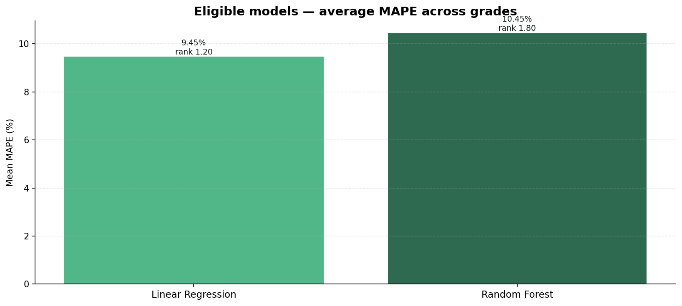
Selection — chosen model: Linear Regression
Chosen: Linear Regression
Mean rank: 1.20 / 2
Mean MAPE: 9.45%
Mean RMSE: 17.52
Naïve is kept as a reference baseline in the comparison tables but is excluded from selection.
ChaiIntel — Kenya Tea Auction Forecasting

Slide 17
Eligible models — global ranking
Model | Mean rank ↓ | Mean MAPE | Mean RMSE | Mean MAE
Linear Regression | 1.20 | 9.45% | 17.52 | 17.52
Random Forest | 1.80 | 10.45% | 20.04 | 20.04
Highlighted row = chosen global model.
Ranks averaged across all five grades; lower is better.
ChaiIntel — Kenya Tea Auction Forecasting

Slide 18
Per-grade cross-validation (all candidates)
Grade | Model | MAE | RMSE | MAPE | R² | Best/grade
BP1 | Naïve | 42.83 | 48.46 | 19.11% | —
BP1 | Linear Regression | 30.18 | 30.18 | 16.95% | — | ✓
BP1 | Random Forest | 35.23 | 35.23 | 19.31% | —
PF1 | Naïve | 24.83 | 27.94 | 9.51% | —
PF1 | Linear Regression | 19.66 | 19.66 | 8.32% | — | ✓
PF1 | Random Forest | 21.21 | 21.21 | 9.05% | —
DUST1 | Naïve | 19.50 | 20.62 | 7.49% | — | ✓
DUST1 | Linear Regression | 19.61 | 19.61 | 7.81% | —
DUST1 | Random Forest | 28.02 | 28.02 | 11.57% | —
FNGS 1/2 | Naïve | 6.00 | 6.19 | 4.64% | — | ✓
FNGS 1/2 | Linear Regression | 9.72 | 9.72 | 7.74% | —
FNGS 1/2 | Random Forest | 6.53 | 6.53 | 5.24% | —
DUST 1/2 | Naïve | 10.83 | 12.59 | 7.41% | —
DUST 1/2 | Linear Regression | 8.44 | 8.44 | 6.43% | — | ✓
DUST 1/2 | Random Forest | 9.22 | 9.22 | 7.07% | —
ChaiIntel — Kenya Tea Auction Forecasting

Slide 19
Holdout validation — per grade
Grade | MAPE | RMSE | Bias | Directional | Naïve MAPE | Δ vs Naïve
BP1 | 27.76% | 65.36 | -41.50 | 100.0% | 27.76% | +0.0%
PF1 | 11.46% | 34.76 | -22.50 | 100.0% | 11.46% | +0.0%
DUST1 | 7.73% | 21.10 | -18.00 | 0.0% | 7.73% | +0.0%
FNGS 1/2 | 4.06% | 5.39 | -5.00 | 100.0% | 4.06% | +0.0%
DUST 1/2 | 7.14% | 12.73 | -9.00 | 0.0% | 7.14% | +0.0%
Across all grades — mean MAPE: 11.63% · mean RMSE: 27.87 · mean bias: -19.20
Beats naïve baseline on 0 of 5 grades.
Directional accuracy: 60.0%.
ChaiIntel — Kenya Tea Auction Forecasting

Slide 20
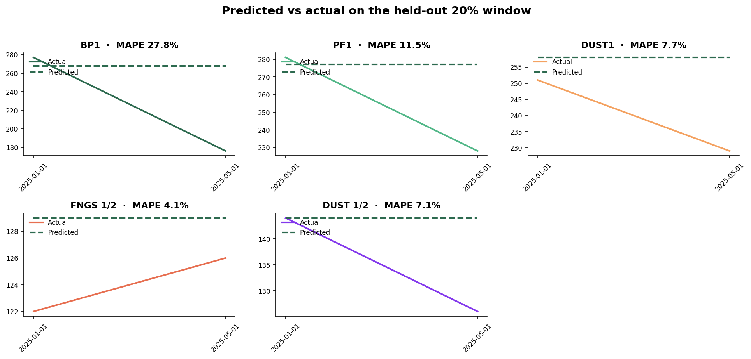
Predicted vs actual on the held-out window
ChaiIntel — Kenya Tea Auction Forecasting

Slide 21
Section 6
Findings

Slide 22
Findings
• The data-driven selection picked Linear Regression as the single model used for every grade.
• On the 80/20 holdout it beats naïve carry-forward on 0 of 5 grades — sufficient evidence for adoption over a passive baseline.
• Mean MAPE across grades is 11.63%; mean bias is -19.20 ¢/kg (systematic over-forecast).
• Directional accuracy averages 60.0% — the model gets the up/down move right more than half the time on most grades.
• Lag features dominate the Random Forest's importance ranking, confirming the autoregressive character of monthly tea prices.
• Seasonal sin/cos features carry secondary weight, consistent with annual harvest cycles.
ChaiIntel — Kenya Tea Auction Forecasting

Slide 23
Limitations & future work
• Monthly aggregation by mean discards within-month variability; weekly granularity is available.
• SARIMAX order is hard-coded to (1,1,1); auto_arima would likely improve its standing.
• Recursive RF forecasting damps long-horizon predictions toward the recent mean. A direct multi-output regressor per horizon would be more principled.
• Uncertainty bands shown on the dashboard are heuristic (μ ± 1.28·σ_hist), not statistical prediction intervals. Bootstrap residual intervals or SARIMAX's get_forecast().conf_int() are obvious next steps.
• Dashboard re-fits every model on each request. Caching by CSV mtime, or a nightly batch job writing to a ForecastRun table, would make the UI feel instant.
ChaiIntel — Kenya Tea Auction Forecasting

Slide 24
ChaiIntel
Thank you
Live dashboard, code & methodology write-up available at /

