Slide 1
Genrify Project
by
Henri Toussaint
Victor Saint Guilhem
Benoît Lafon

Slide 2
Task
Given a set of attributes characterizing a song from the Spotify platform, predict its genre.

Slide 3
Dataset
We collected 2000 tracks based on their genres. Genres was beforehand handpicked such that we had 20 genres.
Each track was characterized by 13 attributes each of them numerical.
Thus, our data was made of 2000 rows for 14 columns including the target variable.

Slide 4
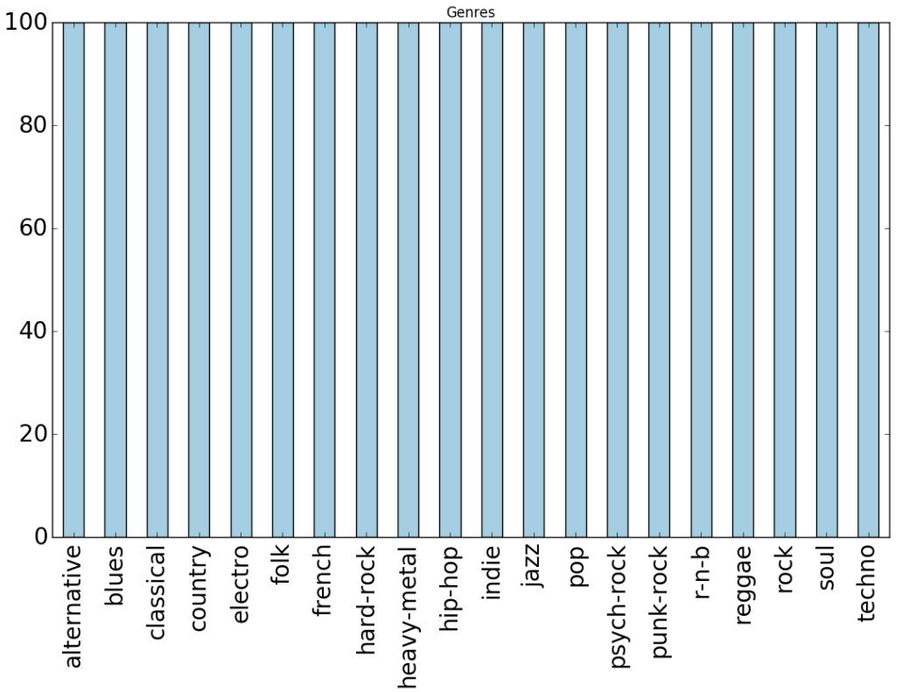
Visualization of the Class

Slide 5
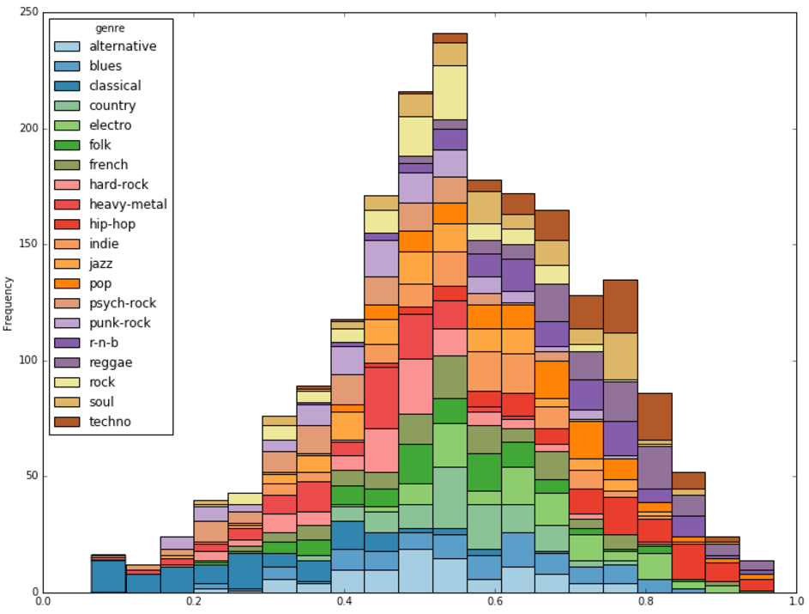
Visualization of one feature
Danceability attribute:
A value of 0 is least danceable and 1 is most danceable.
Overall statistics:
Mean: 0.556582
Std: 0.171023
Min: 0.064700
Max: 0.969000

Slide 6
Danceability exploitation
Based on the danceability by genre, we obtain the following results:
Techno, hip-hop and reggae have the highest average score of about 0.72-0.73
Classical has the lowest average score of about 0.29.

Slide 7
Model Selection Results
Since our data set was well balanced, we used accuracy as measure for each model
We plotted the confusion matrix for the best model to assess the classification distribution.
Models include Logistic Regression, Decision Tree, Naïve Bayes, Neural Network, SVM and Random Forest.
For each model, we performed 10-fold cross validation.
Results on the next slide are not exhaustive.

Slide 8
Model Selection Results
Model | Parameters | Performance
Baseline | majority class | 0.055
 | Predicting the majority class | 0.05
Logistic regression | penalty = l2, C=0.01 | 0.335
 | penalty = l2, C=40 | 0.37
 | penalty = l2, C = 170 | 0.371
Neural Network | Activation=identity, hid_layer=50, alpha=0.1 | 0.372
 | Activation=logistic, hid_layer=20, alpha=5 | 0.3725
SVM | Kernel=‘rbf ‘, C=1 | 0.346
 | Kernel=‘linear’, C=0.1 | 0.3665
Random Forest | Estimator = 70 | 0.361
Best model and parameter setting considering
efficiency AND speed was using Logistic Regression

Slide 9
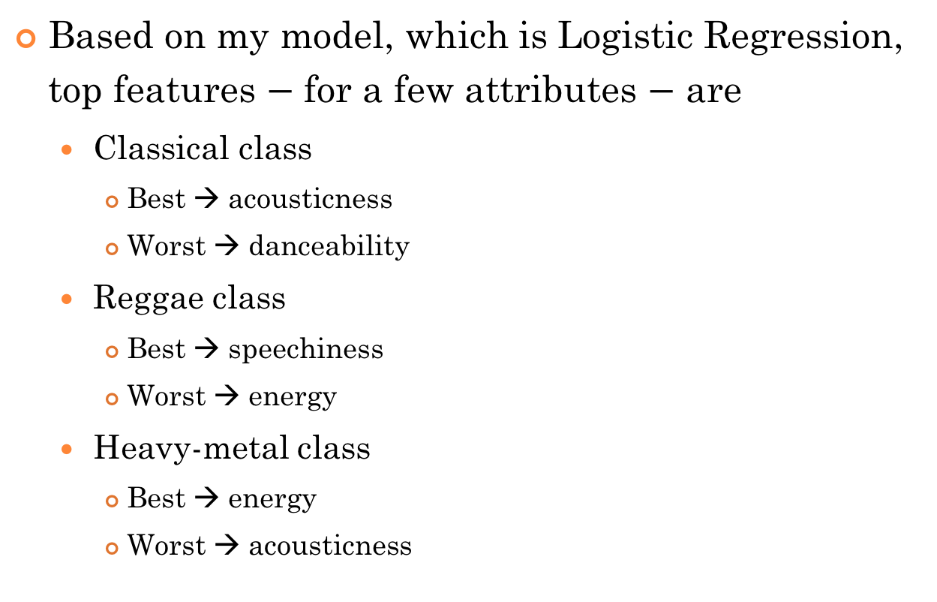
Top Features
Based on my model, which is Logistic Regression, top features $−$ for a few attributes $−$ are
Classical class
Best → acousticness
Worst → danceability
Reggae class
Best → speechiness
Worst → energy
Heavy-metal class
Best → energy
Worst → acousticness

Slide 10
Interesting/unexpected cases
While there were some genres that were easily predicted by our model, a majority of the genres were not accurately predicted, as seen on the confusion matrix
One of those genres is “Rock”, which got classified in a lot of other genres but only two times in the right class
However, when we look at some of its subgenres, like Punk-rock, Hard-rock or Heavy-metal, the classifier fares pretty well

Slide 11
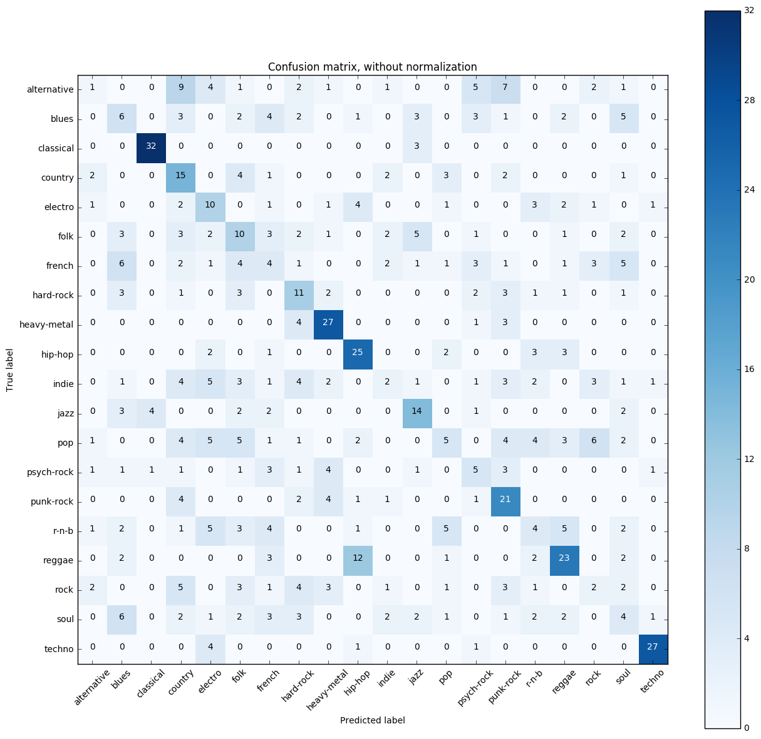

Slide 12
This phenomenon can easily be explained, as like for Pop, Indie or French, a lot of songs from a broad genre also belongs to a subgenre, and sometimes they can be described as having a bit of multiple genres (hence Pop-rock for example)
It can partly be verified by looking at the Rock row on our matrix: the songs are predicted mostly as either country (a lot of American rock bands have a country feeling to their songs), Hard-rock, Heavy-metal or Punk-rock

