Slide 1
MOLB7621 Project
Jeanne Benoit
May 10, 2016

Slide 2
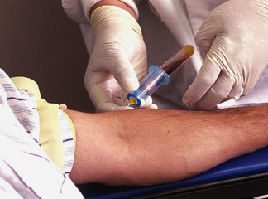
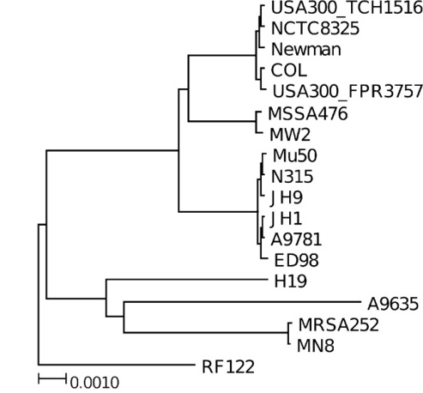
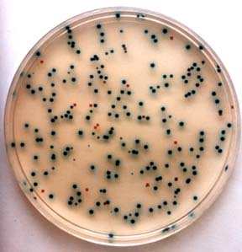
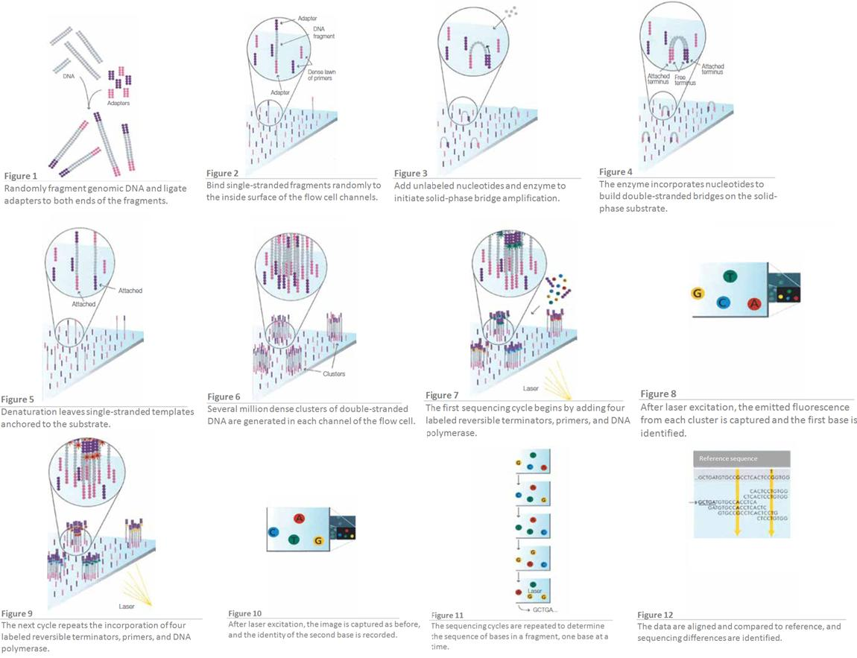
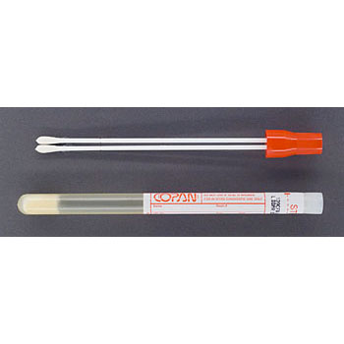
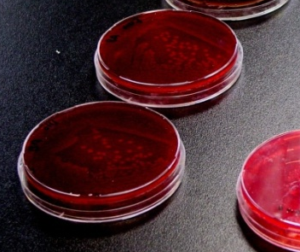
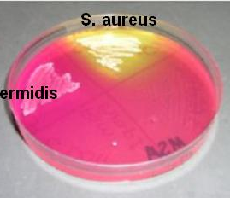
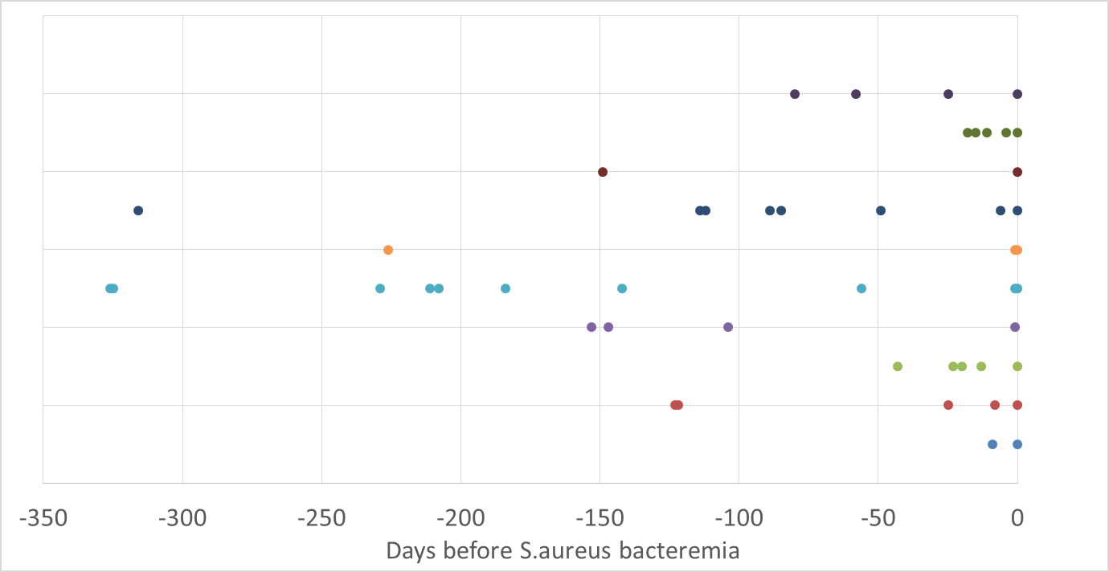
Research Objective
Objective: Determine whether SNPs in the genome of S. aureus during carriage in the nares results in strains that are more likely to cause bacteremia.
MRSA Isolates
Isolate via culturing
Whole Genome
Sequencing
cccmkc.edu.hk
m-techdiagnostics.ltd.uk
superfarmer.wordpress.com
isu.technion.ac.il
http://jb.asm.org/content/194/10/2630/F5.expansion.html
N112
N89
N49
N6
B0

Slide 3
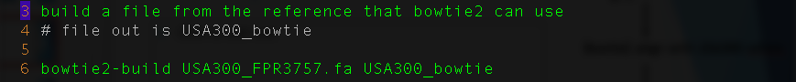
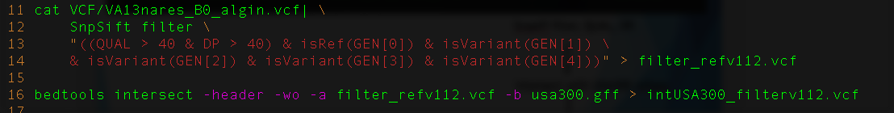
Data analysis workflow and code
Convert MiSeq fastq to fasta using python
Bowtie2 align with USA300 refseq
Freebayes variant calling
Snpeff filter, QUAL, DP,
Intersect with USA300 refseq
View on IGV

Slide 4
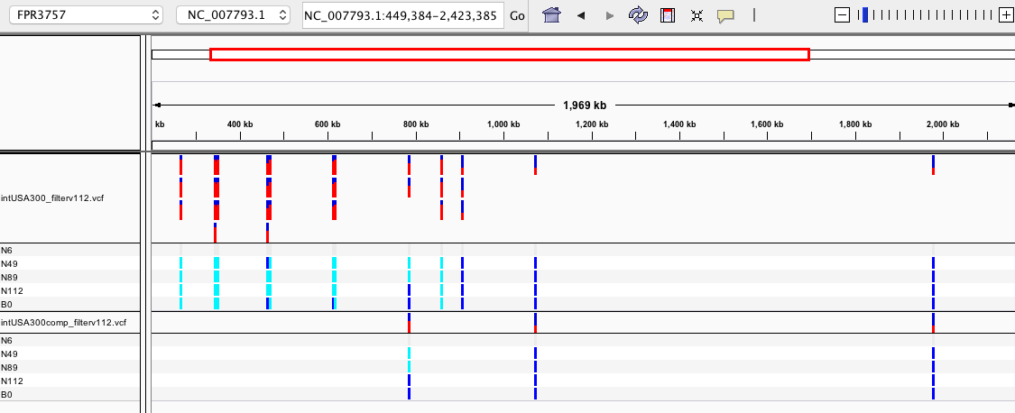
Results – IGV viewer
Intersection of VCF and RefSeq
Intersection of VCF and complement of RefSeq

Slide 5
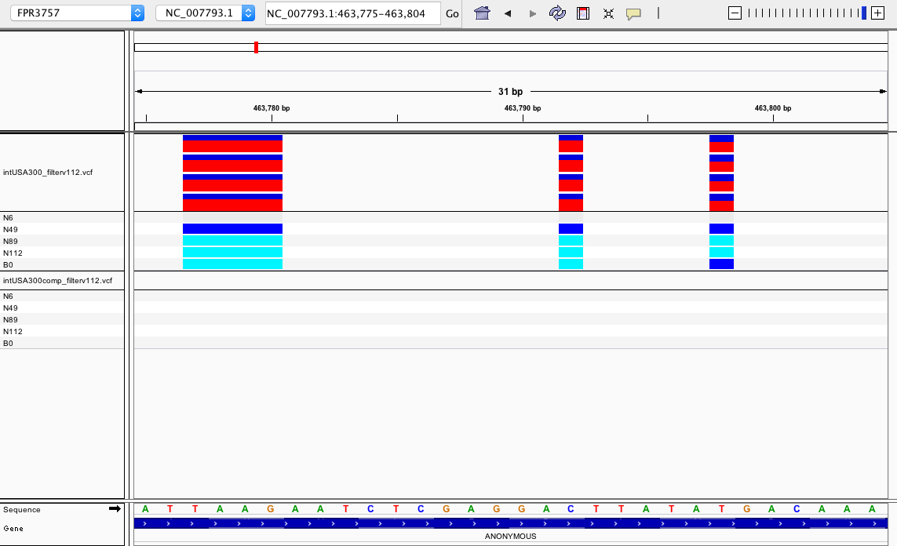
Results- IGV viewer zoomed-in
N6
N49
N89
N112
B0
Gene438- lipoprotein

