Slide 1

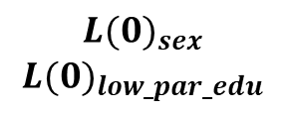

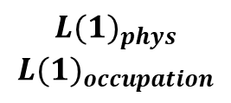

$${L(0)}_{sex}$$
$${L(0)}_{low_par_edu}$$
$${L(1)}_{phys}$$
$${L(1)}_{occupation}$$
$$Y$$
$$A_{edu}$$
$$M_{smoking}$$

Slide 2



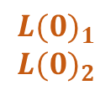




Visit 1
Visit 2
Visit 3
$${L(0)}_{1}$$
$${L(0)}_{2}$$
$$A(1)$$
$$M(2)$$
$$C(1)$$
$$C(2)$$
$$Y(1)$$
$$Y(2)$$
$$L(1)$$

