Slide 1

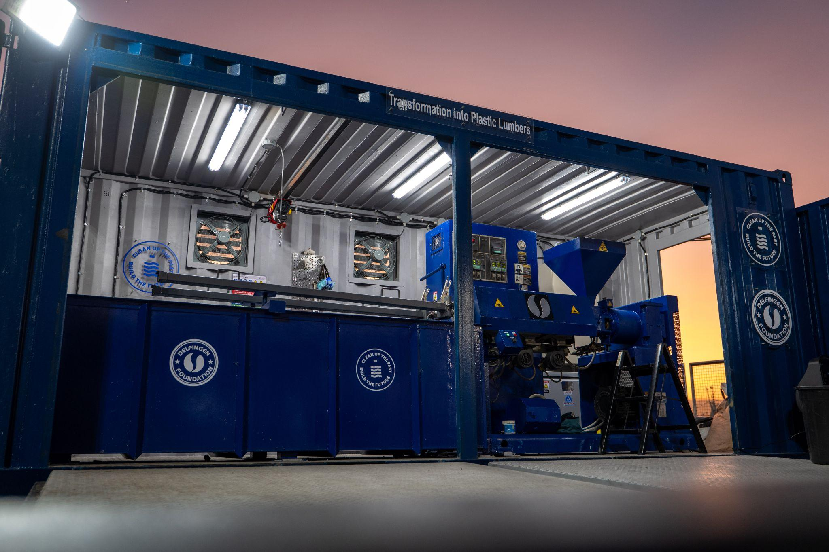

Charte graphique
et éléments de mise en page

Slide 2

THE PROBLEM
Rethink business & industrial models

Slide 3

THE PROBLEM
Rethink business & industrial models

Slide 4

Titre
Sous-titre

Slide 5
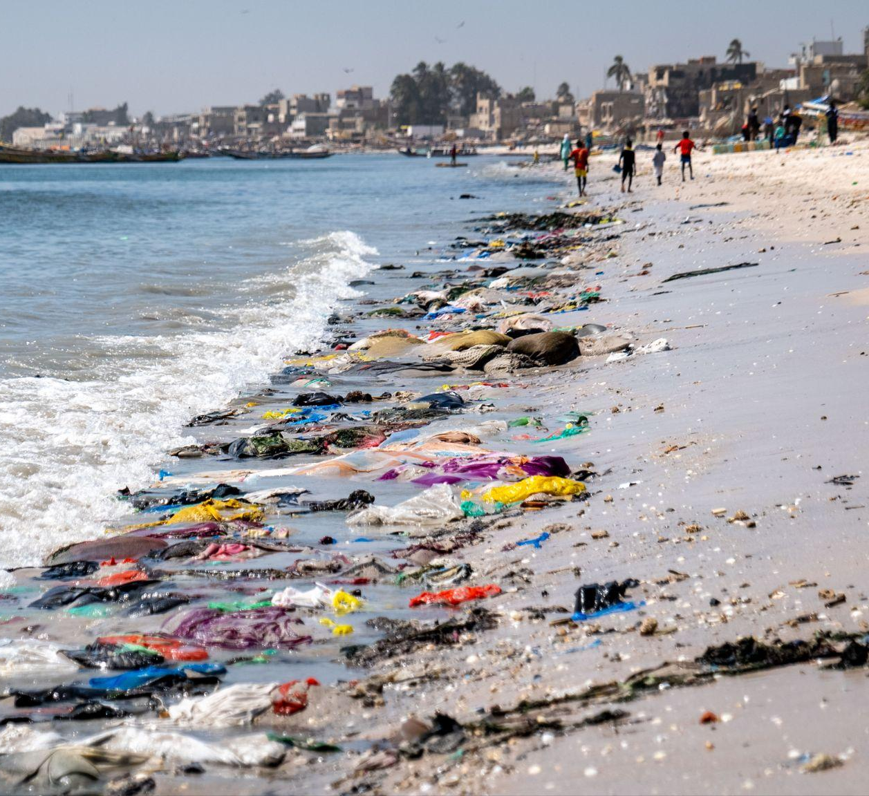
JE SUIS LE TITRE DE LA SLIDE
v
Je suis le sous-titre de la slide
6,5
x
growth in plastic use by 2060 in Low income countries
93
OF WASTE
%
openly dumped or burned
in low-income countries
These regions lack the collection and recycling infrastructure to handle current volumes, let alone future growth.

Slide 6



THE PROBLEM
Rethink business & industrial models
NGO/small-scale models struggle: Focused on machine provision, not business model or operations. No continuity. 42% of decentralized units in Indonesia failed within 2 years.*
Centralized infrastructure struggle: Feedstock mismatch in LMIC, political & currency risk, transport costs kill economics.**
*World Bank What a Waste 2.0 · GAIA 2023 · McKinsey 2022 · Global
**Infrastructure Hub · Guasch PPP studies · UNEP 2023
This is not a technology problem.
It is a business model problem.
The answer requires decentralization, local adaptation, integration with existing networks, and solid industrial partnerships.

