Slide 1

Teaching an Old Cache New Tricks: Learning Better Caching Policies Online
Nathan Beckmann, CMU
ML for Systems @ISCA2019

Slide 2
Learning better caching policies online
Caching matters: Caches are everywhere & often determine systems’ end-to-end performance.
Caching is hard: Deciding what to keep in the cache is hard. Workloads vary too much & the cache has ~no control over its input trace.
Caching practice is expensive & fragile: Most caches use hand-tuned heuristics
We’ll discuss caching policies that learn online to tune themselves w/o heuristics
Vanilla reinforcement learning does not work!
Option #1: Cache modeling + Bayesian inference
Option #2: Learn to imitate optimal

Slide 3

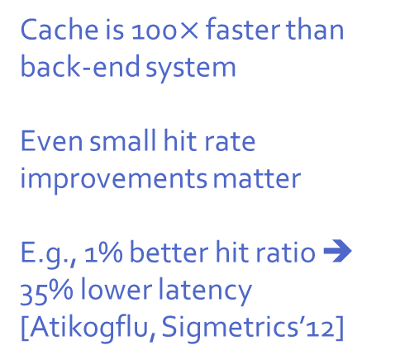
Caching matters!
Cache is 100$×$ faster than back-end system
Even small hit rate improvements matter
E.g., 1% better hit ratio ➔ 35% lower latency
[Atikogflu, Sigmetrics’12]
Web Server
10 ms
100 µs

Slide 4

Think smarter, not larger
Empirically, hit ratio follows log-linear law: $2×$ larger cache ➔ $+Δ$ hit ratio
Miss ratio
Lower is better
Better caching policy
Cache size

Slide 5
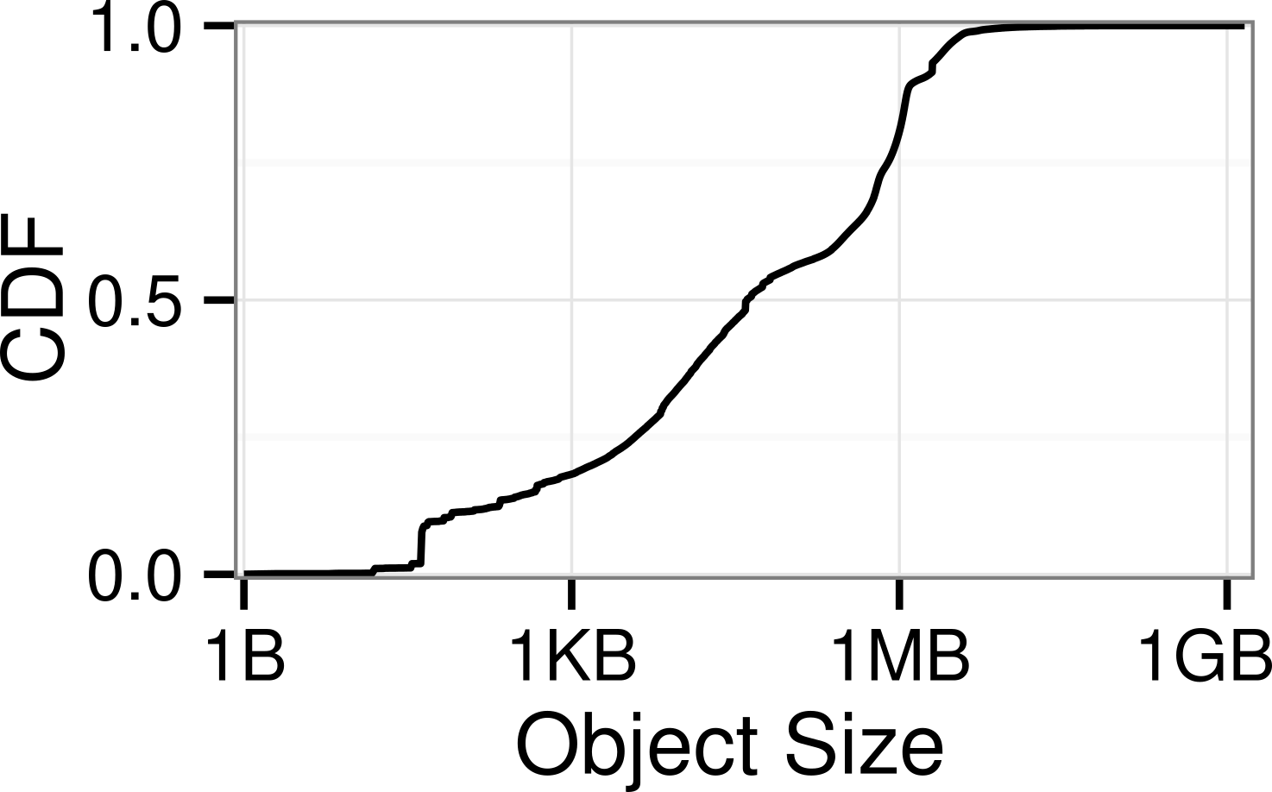
Finding a good eviction policy is hard
Web caching: Object sizes vary by 9 orders of magnitude [Berger+, NSDI’17]
Applications vary a lot
Access objects in different patterns
Objects have different sizes
Prior policies use heuristics that combine recency and frequency
No theoretical foundation
Require hand-tuning ➔ fragile to workload changes
No single policy works for all workloads

Slide 6
Theme: Learning alone is not Enough! ➔ combine learning w/ cache theory

Slide 7
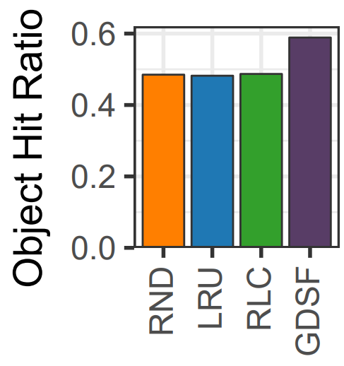
Reinforcement learning struggles in caching
“Harvesting randomness to optimize distributed systems” [Lecuyer+, HotNets’17]
Caching heuristics beat reinforcement learning

Slide 8
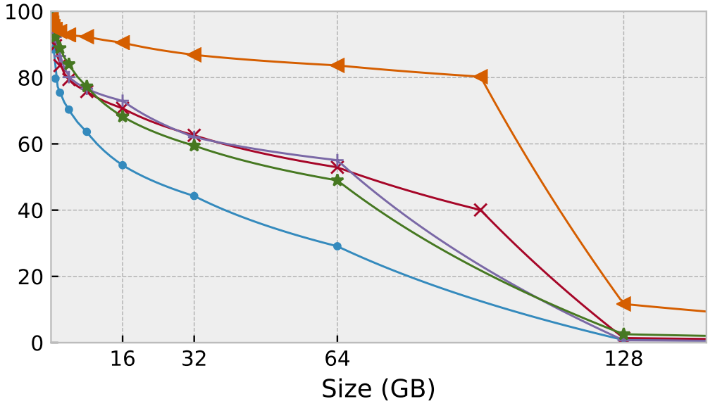

Learning online ➔ Much better cache performance!
MSR “src1_0” storage workload
[Beckmann+, NSDI’18]

Slide 9
Cache Theory + Bayesian Inference
Maximizing Cache Performance Under Uncertainty Nathan Beckmann, Daniel Sanchez – HPCA’17
LHD: Improving Cache Hit Rate by Maximizing Hit Density Nathan Beckmann, Haoxian Chen, and Asaf Cidon – NSDI’18

Slide 10
Q: What’s the “Right” metric for caching policies?

Slide 11
Caching theory: The “big picture”
Goal: Maximize cache hit rate
Constraint: Limited cache space
Uncertainty: In practice, don’t know what is accessed when

Slide 12


Where does cache space go?
Time $⇒$
Let’s see what happens on a short trace…
… A B B A C B A B D A B C D A B C B …
A
A
A
A
A
A
B
B
B
B
B
B
B
C
Hit! ☺
Space $⇒$
…
Eviction! ☹
Y
Y
Y
Y
Y
X
X
X
X
X

Slide 13


Where does cache space go?
Time $⇒$
Green box = 1 hit
Red box = 0 hits
➔ Want to fit as many green boxes as possible
Each box costs resources = area
➔ Cost proportional to size & time spent in cache
… A B B A C B A B D A B C D A B C B …
A
A
A
A
C
C
B
B
B
C
B
B
B
Hit! ☺
Space $⇒$
…
Eviction! ☹
A
B
B
Y
D
D
X

Slide 14
The Key Idea: Hit Density

Slide 15

Our metric: Hit density (HD)
Hit density combines hit probability and expected cost
Least hit density (LHD) policy: Evict object with smallest hit density
But how do we predict these quantities?
$$Hit density=\frac{{Object}^{′}s hit probability}{{Object}^{′}s size×Object^{′}s expected lifetime}$$

Slide 16
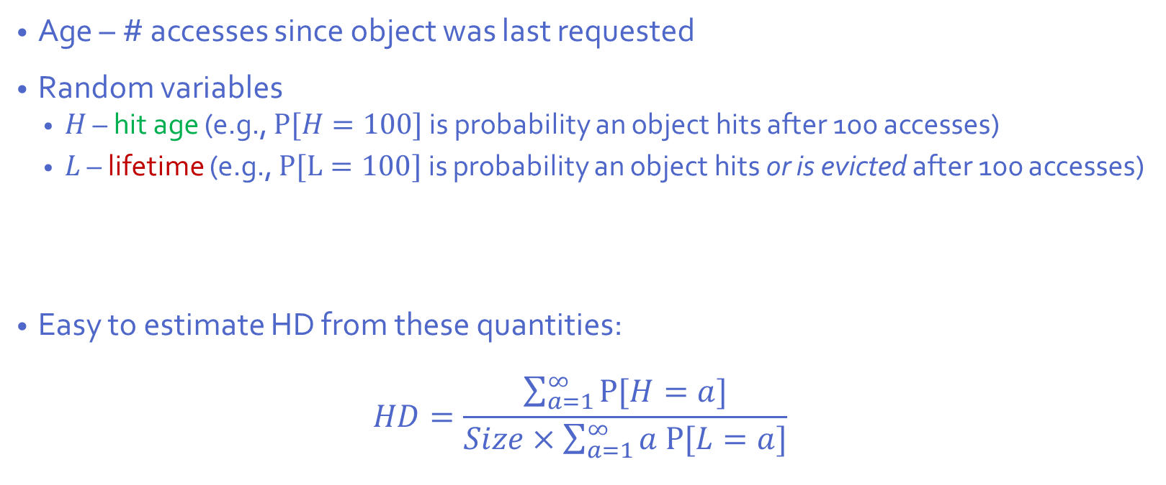


Estimating hit density (HD) via probability
Age – # accesses since object was last requested
Random variables
$H$ – hit age (e.g., $P[H=100]$ is probability an object hits after 100 accesses)
$L$ – lifetime (e.g., $P[L=100]$ is probability an object hits or is evicted after 100 accesses)
Easy to estimate HD from these quantities:
$$HD=\frac{\sum_{a=1}^{∞}{P[H=a]}}{Size×\sum_{a=1}^{∞}{a P[L=a]}}$$
$$hit probability$$
$$expected lifetime$$

Slide 17
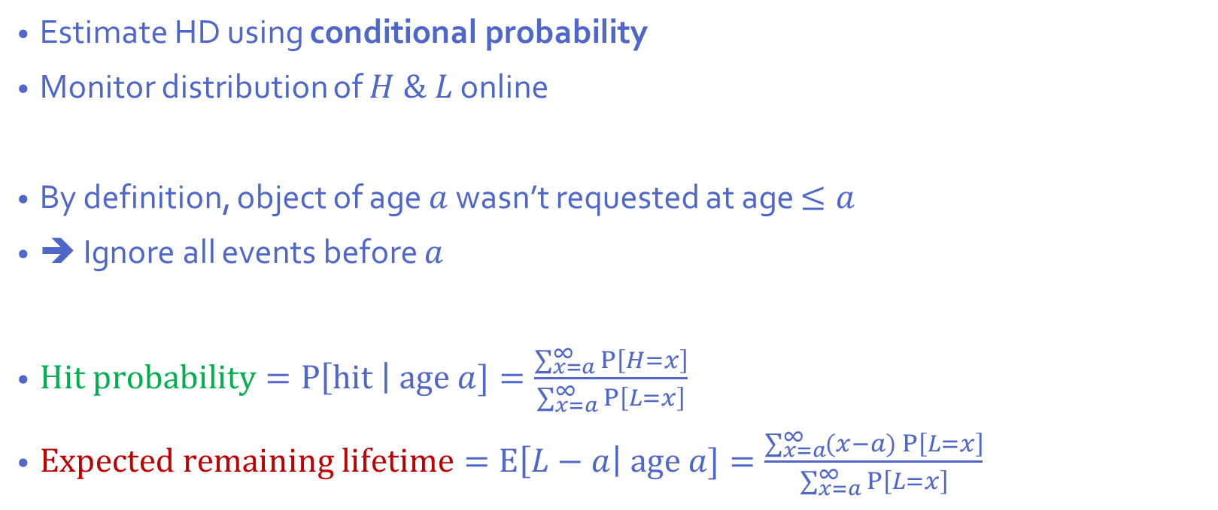

Bayesian inference from an object’s age
Estimate HD using conditional probability
Monitor distribution of $H \& L$ online
By definition, object of age $a$ wasn’t requested at age $≤a$
➔ Ignore all events before $a$
$Hit probability=P\left[hit \right| age a]=\frac{\sum_{x=a}^{∞}{P\left[H=x\right]}}{\sum_{x=a}^{∞}{P\left[L=x\right]}}$
$Expected remaining lifetime=E\left[L−a\right| age a]=\frac{\sum_{x=a}^{∞}{(x−a) P\left[L=x\right]}}{\sum_{x=a}^{∞}{P\left[L=x\right]}}$
Hit probability
Age
Candidate age $a$

Slide 18
LHD by example
Users ask repeatedly for common objects and some user-specific objects
More popular
Less popular
Common
User-specific
Best hand-tuned policy for this app: Cache common media + as much user-specific as fits

Slide 19
Probability of referencing object again
Common object modeled as scan, user-specific object modeled as Zipf

Slide 20
LHD by example: what’s the hit density?
Hit density large & increasing
Hit density small & decreasing
High hit probability
Older objs closer to peak ➔ expected lifetime decreases with age
Older objects are probably unpopular ➔ expected lifetime increases with age
Low hit probability

Slide 21
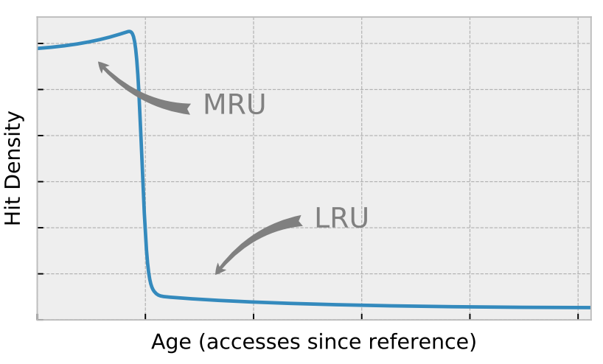
LHD by example: policy summary
Hit density large & increasing
Hit density small & decreasing
LHD automatically implements the best hand-tuned policy: First, protect the common media, then cache most popular user content

Slide 22
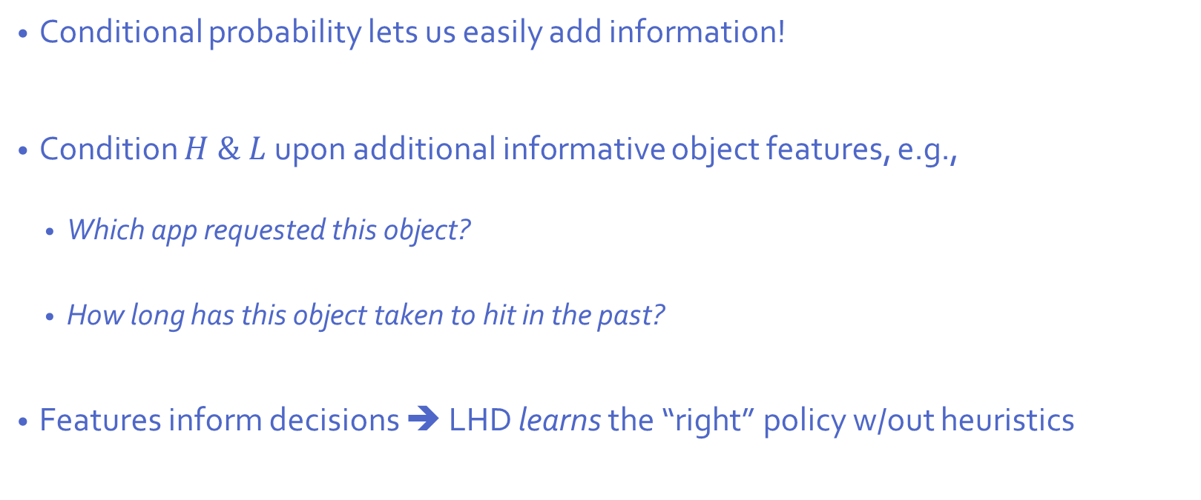
Improving LHD using additional object features
Conditional probability lets us easily add information!
Condition $H \& L$upon additional informative object features, e.g.,
Which app requested this object?
How long has this object taken to hit in the past?
Features inform decisions ➔ LHD learns the “right” policy w/out heuristics

Slide 23
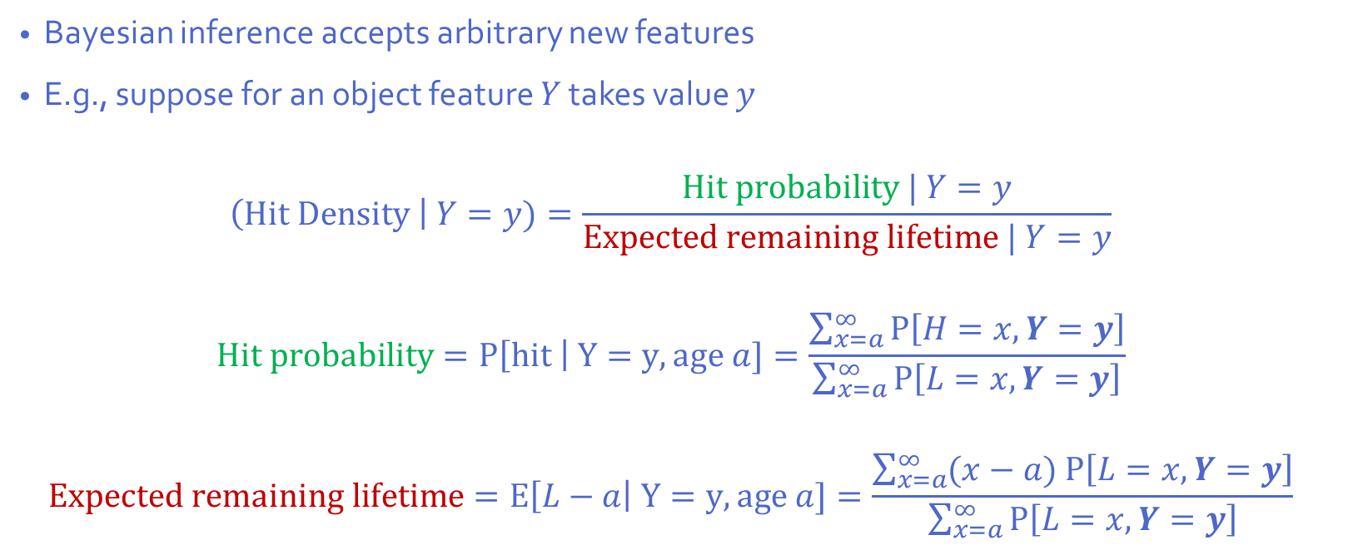
Inferring HD from add’l object features
Bayesian inference accepts arbitrary new features
E.g., suppose for an object feature $Y$ takes value $y$
$$\left(Hit Density \right| Y=y)=\frac{Hit probability | Y=y}{Expected remaining lifetime | Y=y}$$
$$Hit probability=P\left[hit \right| Y=y, age a]=\frac{\sum_{x=a}^{∞}{P\left[H=x,Y=y\right]}}{\sum_{x=a}^{∞}{P\left[L=x,Y=y\right]}}$$
$$Expected remaining lifetime=E\left[L−a\right| Y=y, age a]=\frac{\sum_{x=a}^{∞}{(x−a) P\left[L=x,Y=y\right]}}{\sum_{x=a}^{∞}{P\left[L=x,Y=y\right]}}$$
Features added w/ minimal changes to policy & no hand-tuning

Slide 24
LHD gets more hits than prior policies
Lower is better!

Slide 25
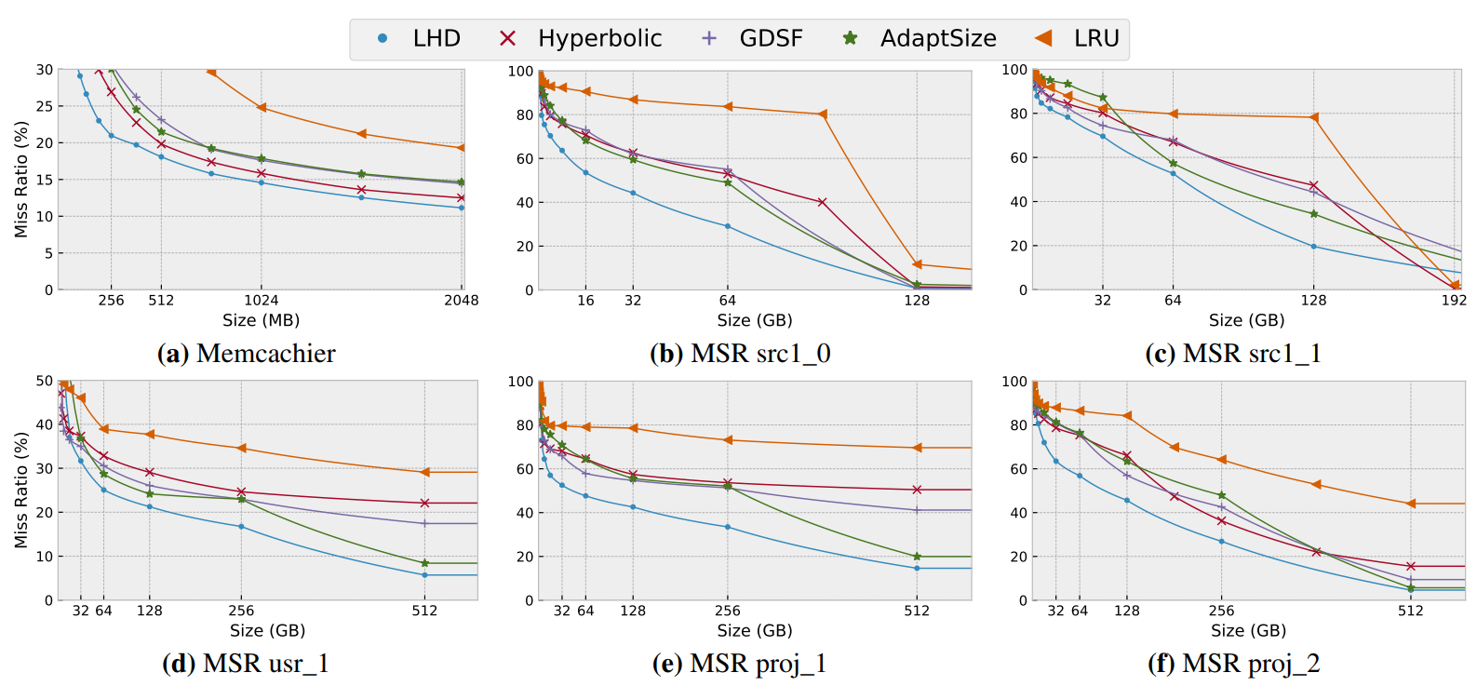
LHD gets more hits across many traces

Slide 26
Translating Theory to Practice

Slide 27
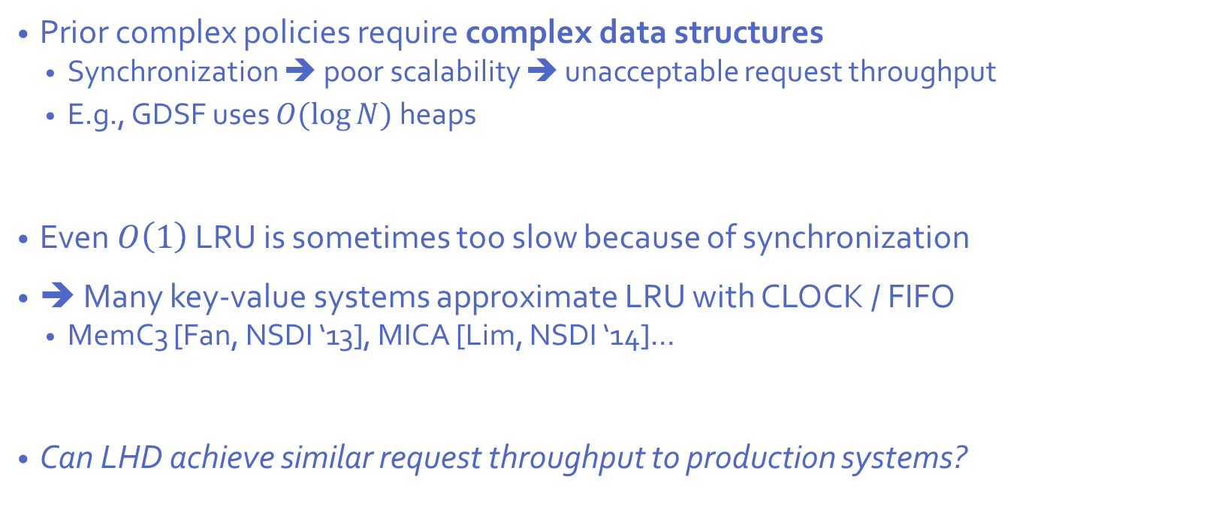
Good hit ratio ⬄ Poor throughput?
Prior complex policies require complex data structures
Synchronization ➔ poor scalability ➔ unacceptable request throughput
E.g., GDSF uses $O(\log{N})$ heaps
Even $O\left(1\right)$ LRU is sometimes too slow because of synchronization
➔ Many key-value systems approximate LRU with CLOCK / FIFO
MemC3 [Fan, NSDI ‘13], MICA [Lim, NSDI ‘14]…
Can LHD achieve similar request throughput to production systems?
YES!

Slide 28



LHD implementation sketch (time view)
Compute estimated hit density for different object features (age, app id, etc)
Training
Time
…
Operation
Rank objects by pre-computing hit density (Indexed by object age, …)
Few thousand requests
Count when hits & evictions happen (i.e., object age)

Slide 29


LHD implementation sketch (structures)
Key, …
Cache
Metadata
Objects
Timestamp
Hit/eviction event counters
Global timestamp
Bayesian estimation of hit density
Ages, features
Hit density

Slide 30


Fast evictions in LHD
No global synchronization ➔ Great scalability! (Even better than CLOCK/FIFO!)
A
Sample objects
Lookup hit density (pre-computed)
B
Miss!
A
C
C
Evict E
D
F
E
E
F
G
Repeat if race detected

Slide 31
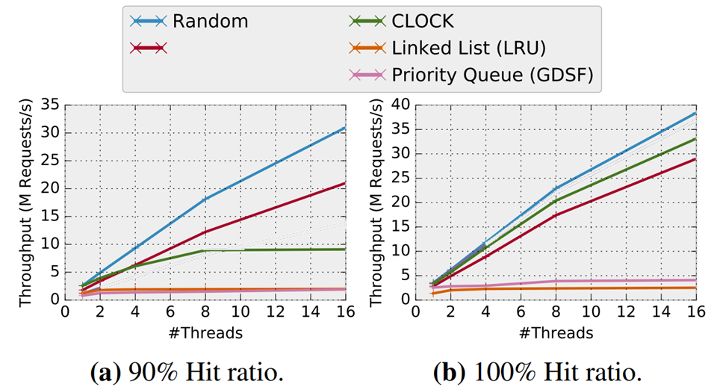
LHD gets best throughput
LHD
GDSF & LRU don’t scale!
CLOCK doesn’t scale when there are even a few misses!
LHD scales well with or without misses!

Slide 32
Future directions in Bayesian caching
Machine learning: Learn which features matter
Many possible features (age, app id, size, frequency, burstiness, etc.)
Only a few features can be used (sample quality, runtime & memory overhead)
Caching systems should learn which features are important for a given workload online
Systems: Real systems care about more than object hit ratio
Dynamic latency / bandwidth optimization
Optimizing end-to-end response latency (multi-object requests) [Berger+, OSDI’18]
Full system modeling (write endurance in FLASH/NVM, replicas in a distributed system)

Slide 33
Can we do better? Learning from optimal
Work by many others…
Back to the Future: Leveraging Belady’s Algorithm for Improved Cache Replacement [Jain and Lin, ISCA’16]
Ongoing work by [Song, Berger, Li, Lloyd]

Slide 34
Reinforcement learning struggles in caching
Caching is a chaotic, input-driven environment
Little to no control over input
Weak signal between decision (eviction) and reward (later hits / evictions)
RL often struggles in input-driven environments [Mao+, ICLR’19]
Need to reduce noise & enhance reward response
Can avoid these problems by learning to imitate OPT

Slide 35
Learning the optimal caching policy
Trace: a b c b d a c d a b c d ...
HawkEye learns to mimic Belady replacement for CPU caches [Jain & Lin, ISCA’16]
Load PC is a good predictor for caching policies [Khan+, MICRO’10][Wu+, MICRO’11]
HawkEye realizes that load PC also correlates strongly with OPT’s decisions
➔ Simple hardware can learn OPT very effectively
Solve for OPT
Deploy model
Train a model
Object features (size, age, etc)
Would OPT cache this object?
OPT: ✓ ✗ ✗ ✓✓✗✗✗✓✓✓✗ …
OPT predictor

Slide 36
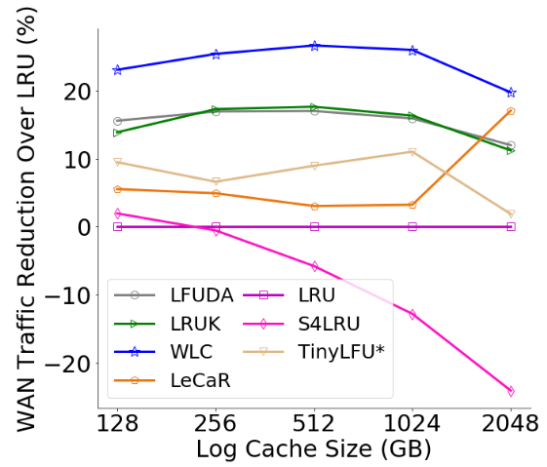
Comparing learning approaches
[Song+; ongoing work] learns to imitate OPT using various object features (age, size, etc.)
[Vietri+, HotStorage’18] tunes parameters w/ RL
➔ Imitating OPT is more effective!
(Pure RL is very bad, off bottom of figure)
[Song+; ongoing work]
[Vietri+; HotStorage’18]

Slide 37
Computing the optimal policy
Practical Bounds on Optimal Caching with Variable Object Sizes Daniel Berger, Nathan Beckmann, and Mor Harchol-Balter SIGMETRICS’18

Slide 38
How much better can we do?
Computing optimal can be easy or hard, depending on caching problem
Easy: Objects are the same size & cost ➔ Belady (i.e., evict max. next-use distance)
Less easy: Objects have different costs ➔ Network flow methods
Hard: Objects have different sizes ➔ Strongly NP-hard!
Hard: Writes cost more than reads ➔ MaxSNP-hard! [McGuffey+, SPAA’19 BA]
Web caching: Object sizes vary by 9 orders of magnitude
Today’s focus

Slide 39
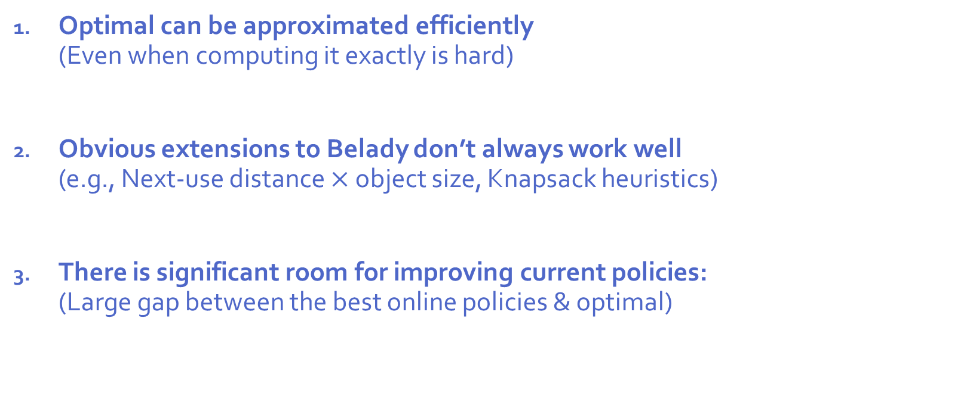
Three lessons from this work:
Optimal can be approximated efficiently (Even when computing it exactly is hard)
Obvious extensions to Belady don’t always work well (e.g., Next-use distance $×$ object size, Knapsack heuristics)
There is significant room for improving current policies: (Large gap between the best online policies & optimal)

Slide 40

Prior OPT approximations
Technique | Time Complexity | Approximation Guarantee
OFMA [STOC’97] | O(N²) | O(log cache size)
LP rounding [SODA’99] | O(N⁵) | O(log (max_{size}/min_{size}))
LocalRatio [JACM’01] | O(N³) | 4
State-of-the-art 4-approximation not useful
$O(N^{3})$ is too slow anyway

Slide 41

Computing OPT efficiently on real traces
Insight: Traces are not adversarial in practice
Idea: Map OPT to min-cost flow problem ➔ $O(N^{2}\log^{2}{N)}$ solution
We prove that FOO introduces negligible error on real traces (specifically, under IRM)
We design efficient algorithms to compute upper/lower bounds on OPT
a | b | c | b | d | a | c | d | a | b | c | d
FOO:
Flow-based Offline Optimal
a
b
c
b
d
a
c
d
a
b
c
d

Slide 42
FOO is accurate & efficient
Technique | Time Complexity | Approximation Guarantee
OFMA [STOC’97] | O(N²) | O(log cache size)
LP rounding [SODA’99] | O(N⁵) | O(log (max_{size}/min_{size}))
LocalRatio [JACM’01] | O(N³) | 4
FOO* | $$O\left(N^{2}\log^{2}{N}\right)$$ | 1
* On non-adversarial traces seen in practice.

Slide 43
FOO is accurate & efficient
Technique | Time Complexity | Approximation Guarantee
OFMA [STOC’97] | O(N²) | O(log cache size)
LP rounding [SODA’99] | O(N⁵) | O(log (max_{size}/min_{size}))
LocalRatio [JACM’01] | O(N³) | 4
FOO | $$O\left(N^{2}\log^{2}{N}\right)$$ | 1*
PFOO | $$O(N\log{N})$$ | $≈$1.06**
* On non-adversarial traces seen in practice.
** On storage traces where IRM assumption does not hold.

Slide 44
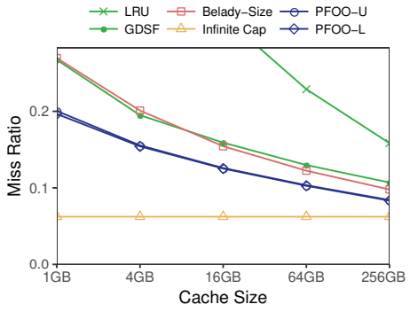
FOO is accurate across different domains
CDN Trace
1. PFOO gives tight bounds on OPT (blue lines)
2. There is significant room to improve online policies (green vs blue)
3. Prior heuristics are bad OPT bounds ➔ false conclusions (green vs red)

Slide 45
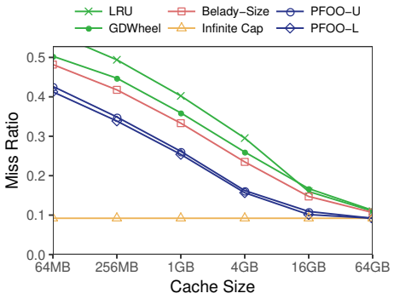
FOO is accurate across different domains
Web App Trace
1. PFOO gives tight bounds on OPT (blue lines)
2. There is significant room to improve online policies (green vs blue)
3. Prior heuristics are bad OPT bounds ➔ false conclusions (green vs red)

Slide 46
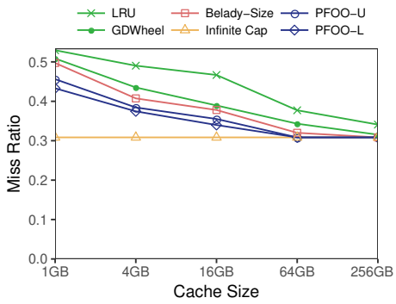
FOO is accurate across different domains
Storage Trace
1. PFOO gives tight bounds on OPT (blue lines)
2. There is significant room to improve online policies (green vs blue)
3. Prior heuristics are bad OPT bounds ➔ false conclusions (green vs red)

Slide 47
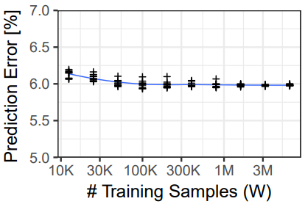
OPT is predictable!
Boosted decision trees achieve 93% accuracy [Berger, HotNets’19]
Features: Object size, object retrieval cost, inter-request gap
Classifier must be updated frequently
Big drop in accuracy when updating every few M requests
➔ Online training is a must ➔ Training & computing OPT must be fast!
Fortunately, we can learn OPT quickly
Converges within a few 10K requests
(Comparable to LHD)

Slide 48
Summary
Caching policies that learn & adapt online are effective & address longstanding problems
Caching has a ton of structure that should be exploited
Object hit density ⬄ Cache hit rate
Offline optimal ⬄ Min-cost flow
There is ample opportunity to improve cache performance further

Slide 49
Thank you!

