Slide 1

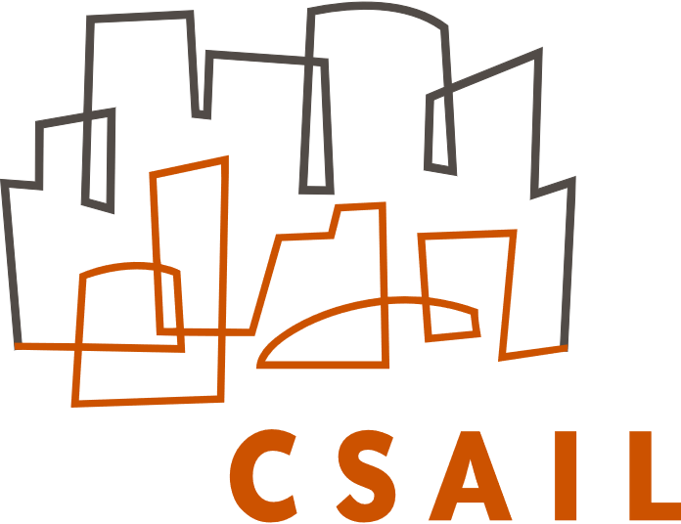

Learning Automatic Schedulers through Projective Reparameterization
Ajay Jain
Saman Amarasinghe

Slide 2
Challenges in ML for Systems
Learning automatic schedulers through projective reparameterization
Ajay Jain
Notes:
Use greedy list scheduling heuristic to select topological sort Often done at the IR level, before and after register allocation

Slide 3
Challenges in ML for Systems
Discrete search spaces
Learning automatic schedulers through projective reparameterization
Ajay Jain
Notes:
Use greedy list scheduling heuristic to select topological sort Often done at the IR level, before and after register allocation

Slide 4
Challenges in ML for Systems
Discrete search spaces
Large, combinatorial search spaces
Learning automatic schedulers through projective reparameterization
Ajay Jain
Notes:
Use greedy list scheduling heuristic to select topological sort Often done at the IR level, before and after register allocation

Slide 5
Challenges in ML for Systems
Discrete search spaces
Large, combinatorial search spaces
Highly constrained feasible sets
Challenging for supervised learning!
Learning automatic schedulers through projective reparameterization
Ajay Jain
Notes:
Use greedy list scheduling heuristic to select topological sort Often done at the IR level, before and after register allocation

Slide 6
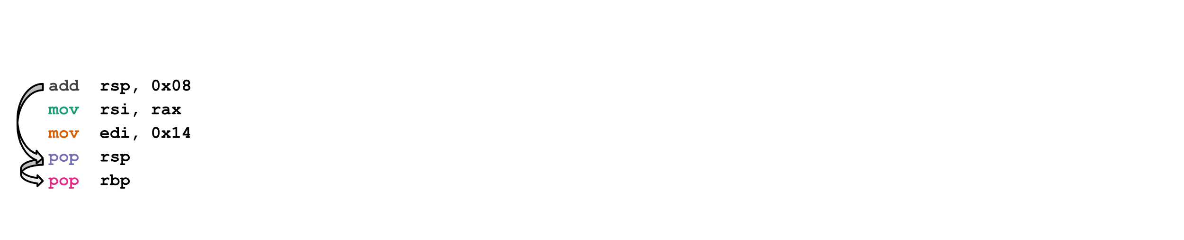
Motivating application: Instruction Scheduling
N! POSSIBLE
SCHEDULES
FEASIBLE
SCHEDULES
EFFICIENT SCHEDULES
Learning automatic schedulers through projective reparameterization
Ajay Jain
Notes:
Use greedy list scheduling heuristic to select topological sort Often done at the IR level, before and after register allocation

Slide 7
Motivating application: Instruction Scheduling
List scheduling with heuristics
Stochastic search & superoptimization
Integer linear programming
Reinforcement learning
Challenging for supervised learning!
Baseline: Sinkhorn iteration from ranking literature
→ 16% of schedules are invalid
Learning automatic schedulers through projective reparameterization
Ajay Jain
Notes:
Use greedy list scheduling heuristic to select topological sort Often done at the IR level, before and after register allocation

Slide 8
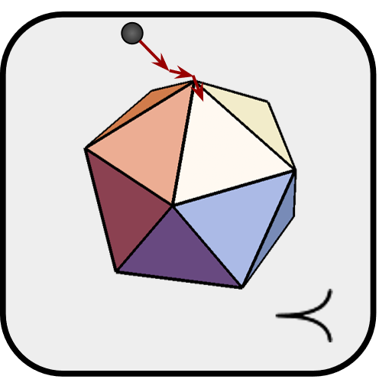
This work
Introduce EPOCS operator
General approach for learning under dynamic constraints
Formulate instruction scheduling as relaxed integer program
Imitate GCC compiler instruction schedules
Learning automatic schedulers through projective reparameterization
Ajay Jain
Notes:
Use greedy list scheduling heuristic to select topological sort Often done at the IR level, before and after register allocation

Slide 9
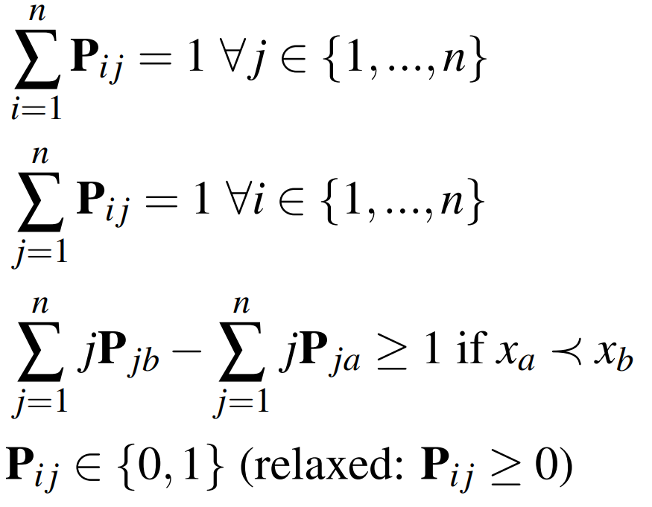
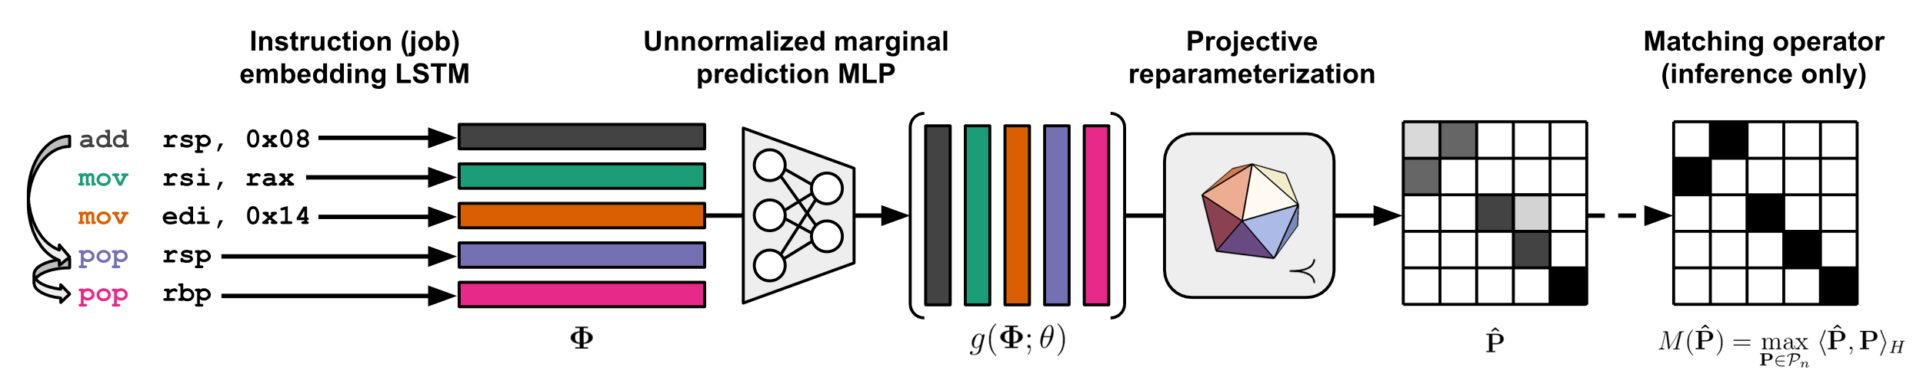
Permutation matrix representation
0 1 2 3 4
1 0 2 3 4
Fixed constraints
Input dependent partial order constraints
ranking, scheduling, packet switching, matching…
Learning automatic schedulers through projective reparameterization
Ajay Jain

Slide 10
Learning automatic schedulers through projective reparameterization
Ajay Jain

Slide 11
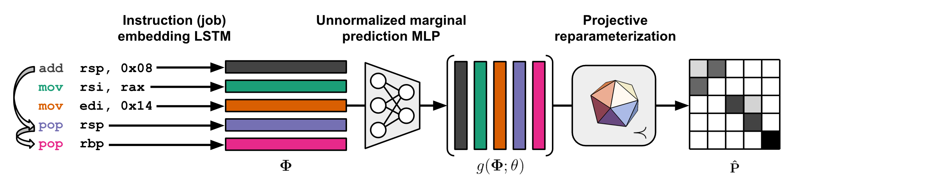
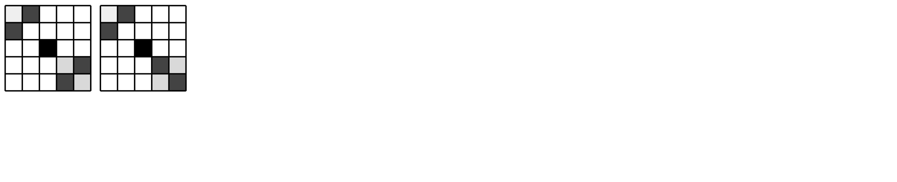
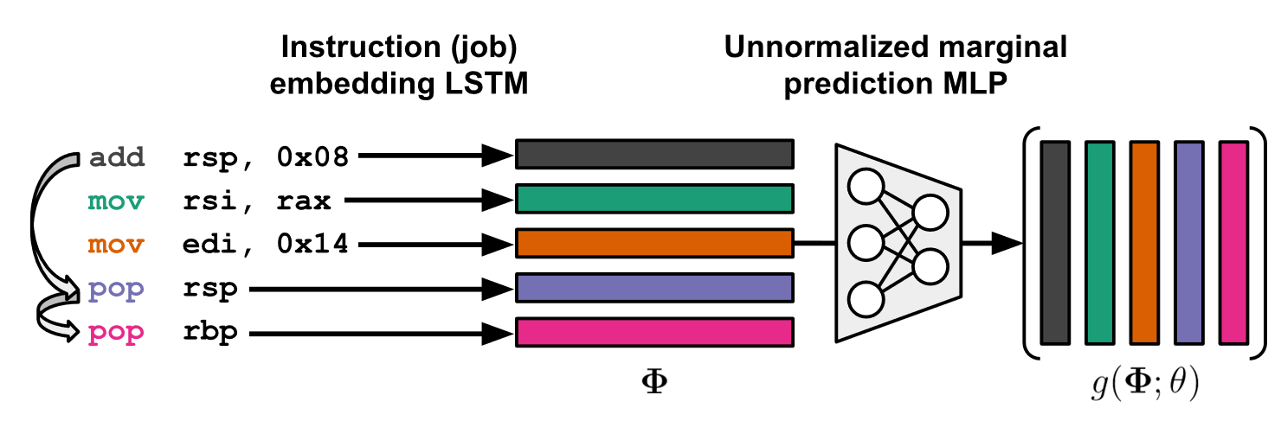
EPOCS operator
✅ Fixed constraints
✅ Dynamic constraints
Sinkhorn iteration
✅ Fixed constraints
❎ Dynamic constraints
Learning automatic schedulers through projective reparameterization
Ajay Jain

Slide 12
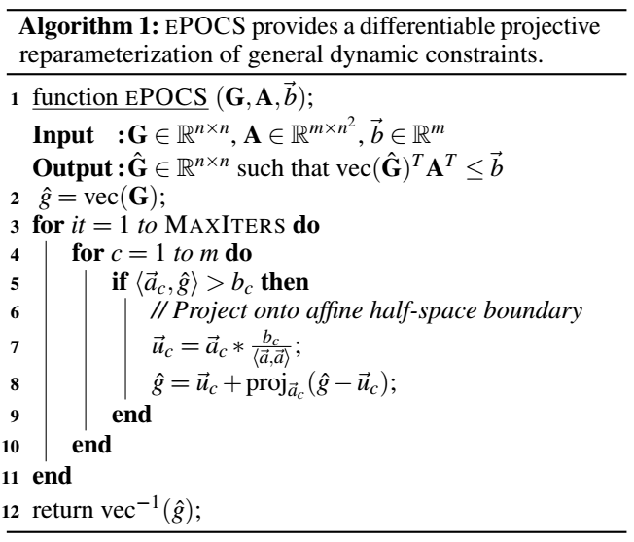
One iteration of EPOCS for scheduling
1) Normalize*
2) Normalize*
3) ReLU
4) Project
Learning automatic schedulers through projective reparameterization
Ajay Jain
Notes:
EPOCS operator

Slide 13

Correct the relaxation with matching
(Hungarian algorithm)
Learning automatic schedulers through projective reparameterization
Ajay Jain

Slide 14
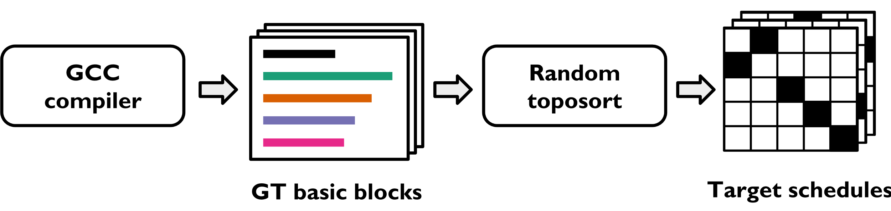
Evaluation
Train POCSNet to imitate GCC 4.9.4 schedules
77,202 basic blocks from SPEC2006, SPEC2017 [Mendis et al 2019]
Evaluate data dependency violations, accuracy
Baseline: Sinkhorn iteration
Learning automatic schedulers through projective reparameterization
Ajay Jain
Notes:
Use greedy list scheduling heuristic to select topological sort Often done at the IR level, before and after register allocation

Slide 15
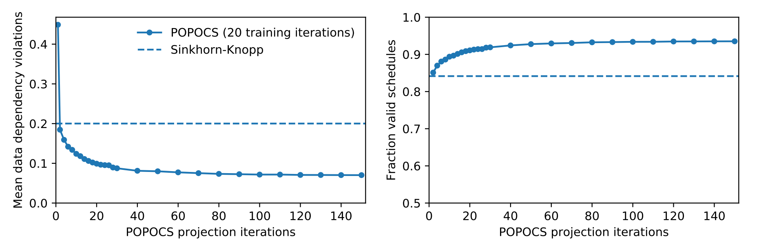
+ Dynamic constraints with EPOCS/POPOCS
Fixed constraints only
16% of predicted schedules are infeasible
Imposing dynamic constraints reduces data dependency violations
Learning automatic schedulers through projective reparameterization
Ajay Jain
Notes:
Use greedy list scheduling heuristic to select topological sort Often done at the IR level, before and after register allocation

Slide 16
 | Fixed constraints Sinkhorn iteration | Dynamic constraints EPOCS/POPOCS
Accuracy | 35.6% | 39.7%
Kendall tau distance | 0.238 | 0.222
Fixed constraints
Sinkhorn iteration
Dynamic constraints
EPOCS/POPOCS
Imposing constraints improves accuracy (+4%)
POCSNet schedule latencies are on par with GCC latencies
Learning automatic schedulers through projective reparameterization
Ajay Jain
Notes:
Use greedy list scheduling heuristic to select topological sort Often done at the IR level, before and after register allocation

Slide 17
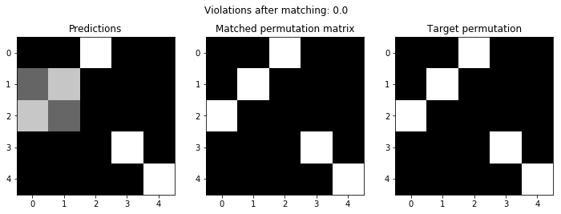
mov rdi, rbp
mov rsi, rbx
add rsp, 0x18
pop rbx
pop rbp
Shuffled input block
add rsp, 0x18
mov rsi, rbx
mov rdi, rbp
pop rbx
pop rbp
POCSNet scheduled block
Learning automatic schedulers through projective reparameterization
Ajay Jain
Notes:
Use greedy list scheduling heuristic to select topological sort Often done at the IR level, before and after register allocation

Slide 18
Takeaways
EPOCS: General purpose op for dynamic constraints on NNs
One application: Job scheduling problems
A step toward correct-by-construction ML for Systems: Enforce known constraints end-to-end for accuracy boost + guarantees
Contact: ajayj@berkeley.edu
Learning automatic schedulers through projective reparameterization
Ajay Jain
Notes:
Use greedy list scheduling heuristic to select topological sort Often done at the IR level, before and after register allocation

Slide 19
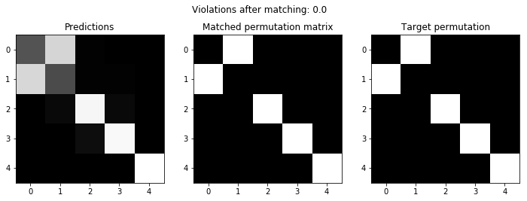
movsd xmm3, qword ptr [r13+0xa0]
movsd xmm5, qword ptr [rsp+0x20]
subsd xmm3, xmm5
divsd xmm3, xmm8
ucomisd xmm2, xmm3
Shuffled input block
movsd xmm5, qword ptr [rsp+0x20]
movsd xmm3, qword ptr [r13+0xa0]
subsd xmm3, xmm5
divsd xmm3, xmm8
ucomisd xmm2, xmm3
POCSNet scheduled block
Learning automatic schedulers through projective reparameterization
Ajay Jain
Notes:
Use greedy list scheduling heuristic to select topological sort Often done at the IR level, before and after register allocation

Slide 20
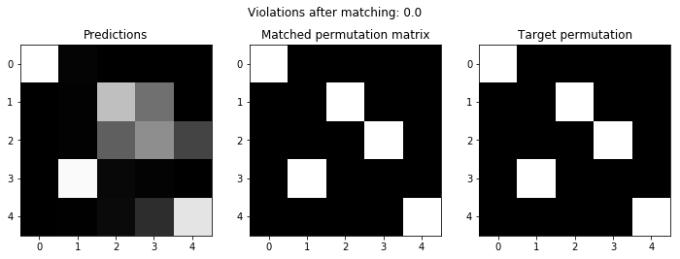
movsxd rdx, dword ptr [rsp+0x0c]
cmovnz rax, rdx
mov rax, 0xffffffff
test edx, edx
mov r15, rax
Shuffled input block
movsxd rdx, dword ptr [rsp+0x0c]
mov rax, 0xffffffff
test edx, edx
cmovnz rax, rdx
mov r15, rax
POCSNet scheduled block
Learning automatic schedulers through projective reparameterization
Ajay Jain
Notes:
Use greedy list scheduling heuristic to select topological sort Often done at the IR level, before and after register allocation

Slide 21
Fixed constraints
Sinkhorn iteration
Dynamic constraints
EPOCS/POPOCS
Fixed constraints
Sinkhorn iteration
Dynamic constraints
EPOCS/POPOCS
Enforcing constraints improves accuracy
POCSNet schedule latencies are on par with GCC latencies
Learning automatic schedulers through projective reparameterization
Ajay Jain
Notes:
Use greedy list scheduling heuristic to select topological sort Often done at the IR level, before and after register allocation

