Slide 1




Optimal Learning-Based Network Protocol Selection
Xiaoxi Zhang¹, Siqi Chen², Youngbin Im²,
Maria Gorlatoga³, Sangtae Ha², Carlee Joe-Wong¹
Workshop on ML for Systems @ISCA 2019

Slide 2



Network needs are heterogeneous
Augmented Reality
Video Streaming
Internet of Things

Slide 3
Today’s network management..
Relies on static pre-configurations
E.g., pre-specifying routing algorithms used to determine flow paths
Or provides more flexible configurations but still requires manual intervention
E.g., NFV and Radio access network Intelligence Controller

Slide 4

An alternative solution: automated network management via learning the optimal policy/protocol configuration in real-time

Slide 5
Why automated protocol selection
A pre-set policy/protocol can’t cover all possible scenarios
Existing policies/protocols can be utilized
Automated and dynamic approaches better adapt to changing environments

Slide 6
Problem model
Flows arrive in a network online
Each flow has a fixed size (the amount of data to transfer) and a pre-determined path
Flows can share one or more links at any given time
S₁
D₁
Flow 1
Flow 2
S₂
D₂
Network node

Slide 7
Problem model
Our decisions: choose one out of M pre-defined protocols to use on each link for each flow
Protocols can be changed over time
TCP Reno
UDP
S₁
D₁
Wireless
link
Flow 1
Flow 2
S₂
D₂
Network node
TCP Cubic, TCP Vegas

Slide 8
Problem model
Our goal: minimize the total flow completion time
Completion time of a flow ≈ transmission delay on the bottleneck link
TCP Reno
UDP
S₁
D₁
Wireless
link
Flow 1
Flow 2
S₂
D₂
Network node
TCP Cubic, TCP Vegas

Slide 9
Unknown information
Bandwidth capacity on each link at each time
Flow interactions under different protocols
TCP Reno
UDP
S₁
D₁
Wireless
link
Flow 1
Flow 2
S₂
D₂
Network node
TCP Cubic, TCP Vegas

Slide 10
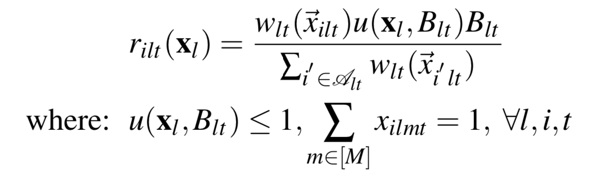
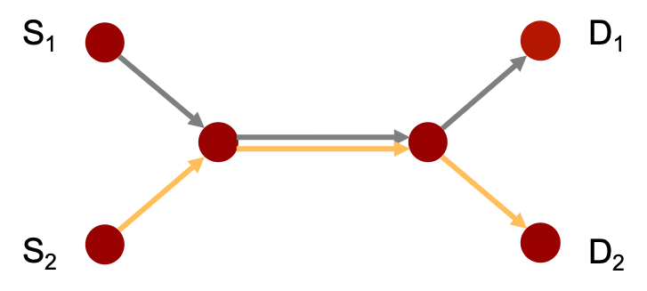
Stochastic flow interactions
For each flow i, on each link l, at each time t:
Transmission rate
Bandwidth
partition weight
Total bandwidth utilization
Bandwidth
capacity
on each link l
at each time t
Binary decision variable: protocol chosen for each flow

Slide 11
Stochastic flow interactions
I.i.d. assumption on each parameter
Transmission rate
Bandwidth
partition weight
Total bandwidth utilization
Bandwidth
capacity
on each link l
at each time t
Binary decision variable: protocol chosen for each flow

Slide 12

Multi-armed bandits (MAB)
Bandit “arms” (unknown reward probabilities)
Arm 1
Arm 2
Arm 3
Arm 4
Sequentially pull arms to maximize expected total reward

Slide 13
Learning rate distributions
Transmission rate dependent with the protocol combination used for all co-existing flows
Problem: the number of possible protocol combinations exponential with the network size and number of co-existing flows
Protocol combination

Slide 14
Sketch of our algorithm
On each link, at each time slot, independently do:
Use the MAB-based algorithm to learn the dominant throughput (or weight for uniform total bandwidth utilization) of each pair of protocols, which is the transmission rate per flow achieved by flows using the better protocol in any protocol pair
Select the protocol pair with the highest dominant throughput over all protocol pairs
Select the better protocol from the chosen protocol pair for the flow with the shortest remaining size and the worse protocol in the chosen pair for other co-existing flows
(This strategy shares the spirit with Shortest Remaining Time First)

Slide 15
Theoretical guarantees
If the flows have the same bottleneck link and the total bandwidth utilization is uniform over all protocol combinations:
Our strategy is optimal if the predictions of protocols are accurate
The expected gap of the incurred completion time per flow between our algorithm and the optimum converges to zero

Slide 16
Experiment set-up
Hop-by-hop transport layer protocol selection
Each node deployed on an Amazon EC2 instance, equipped with a TCP proxy; 50 Mbps capacity per link
Protocol choices: TCP CUBIC, Vegas, Reno, Westwood
50 Flows arriving in five batches spaced 3 seconds apart
Flow sizes uniformly drawn from [10, 20] Mb

Slide 17
Performance comparison
Our algorithm OPSBC decreases the flow completion time by:
66.18% compared with randomly selecting a protocol for each flow on each link (per-flow-random)
43.27% compared with randomly selecting a protocol on each link for all flows to use (per-link-random)

Slide 18
Thank you!
xiaoxiz2@andrew.cmu.edu
https://www.andrew.cmu.edu/user/xiaoxiz2/

