Slide 1

AutoRank: Automated Rank Selection for Effective Neural Network Customization
Mohammad Samragh
Mojan Javaheripi
Farinaz Koushanfar
University of California, San Diego
June 23 2019

Slide 2











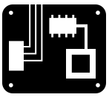



Intelligence at the Edge
Compress
Neural
Network
Modern AI workloads require:
High accuracy
Intensive computations
Real-time execution
Platform constraints:
+
Power (hundred watts to milliwatt regime)
Model Customization
+
=
-
x
=
Memory
Computational Resources
?

Slide 3
Compression VS Customization
Compression methods to reduce execution overhead
Tensor Decomposition
Pruning
Quantization
Binarization
Nonlinear Encoding
Compression methods should be configured per layer
Compression
Customization
Has a theoretical objective
Memory
FLOPs
Often oblivious to hardware
Has a physical performance objective
Runtime
Power
Hardware-aware compression

Slide 4
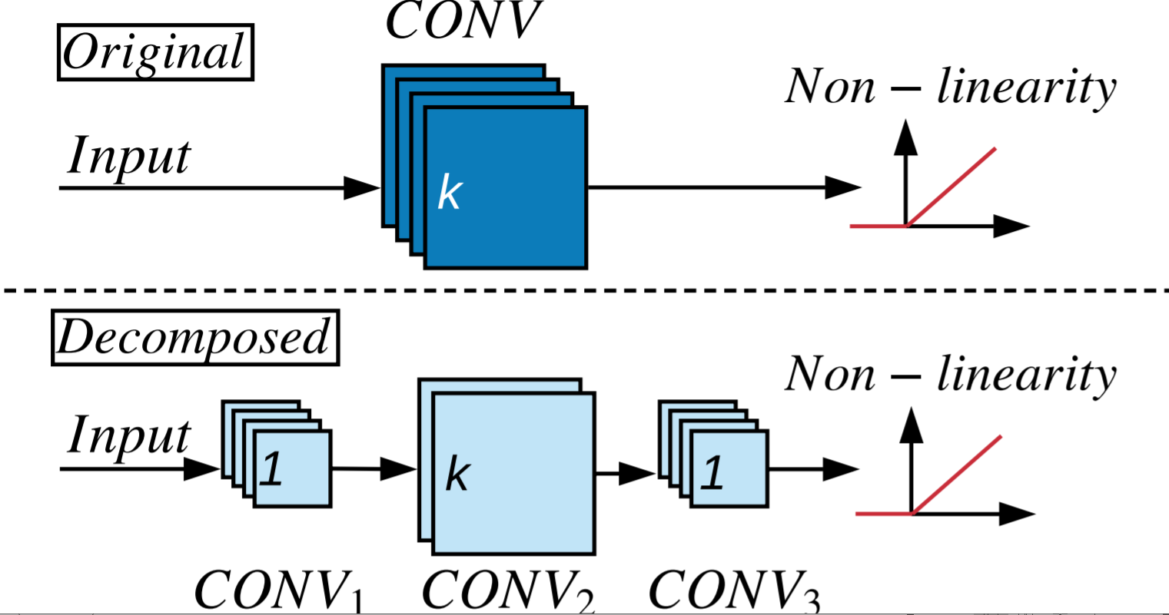
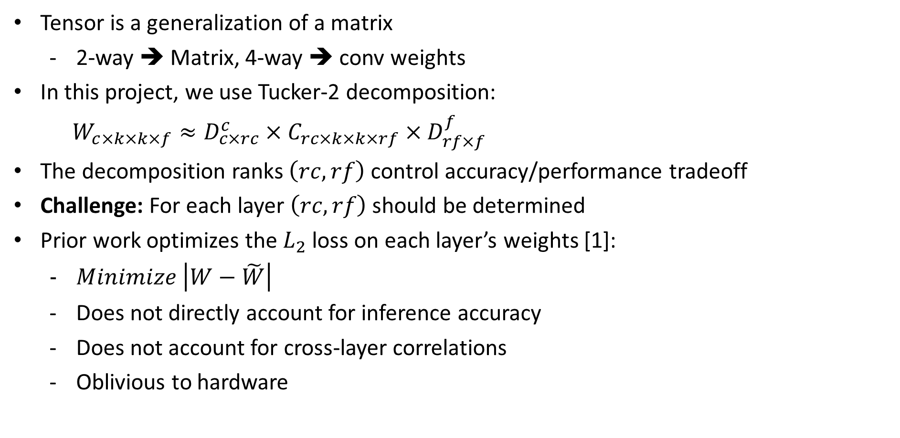
Tensor Decomposition
Tensor is a generalization of a matrix
2-way ➔ Matrix, 4-way ➔ conv weights
In this project, we use Tucker-2 decomposition:
$W_{c×k×k×f}≈D_{c×rc}^{c}×C_{rc×k×k×rf}×$ $D_{rf×f}^{f}$
The decomposition ranks $\left(rc,rf\right)$control accuracy/performance tradeoff
Challenge: For each layer $\left(rc,rf\right)$ should be determined
Prior work optimizes the $L_{2}$ loss on each layer’s weights [1]:
$Minimize \left|W−\tilde{W}\right|$
Does not directly account for inference accuracy
Does not account for cross-layer correlations
Oblivious to hardware
[1] Kim, Yong-Deok, et al. "Compression of deep convolutional neural networks for fast and low power mobile applications." arXiv preprint arXiv:1511.06530 (2015).

Slide 5
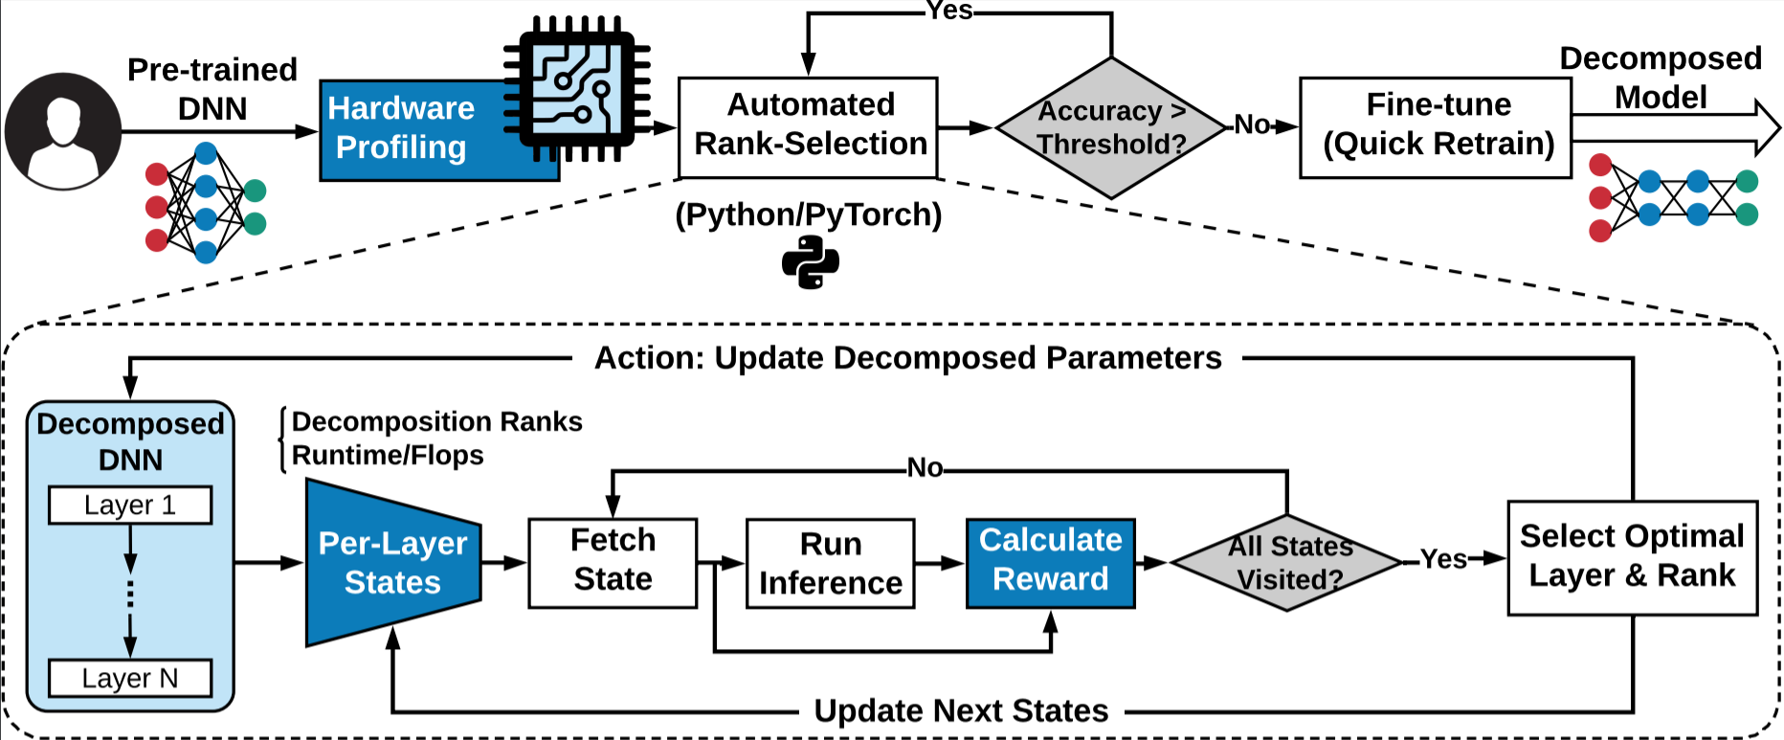
Methodology: Overview

Slide 6
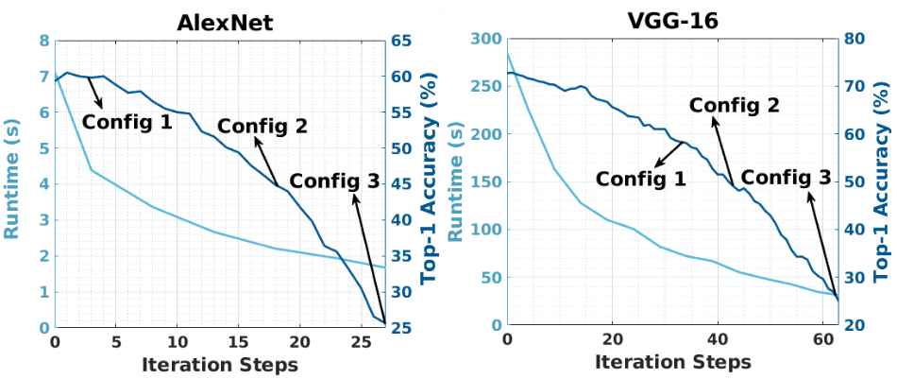
Pareto-curve extraction
Runtimes are measured on embedded ARM-A57 processor.

Slide 7
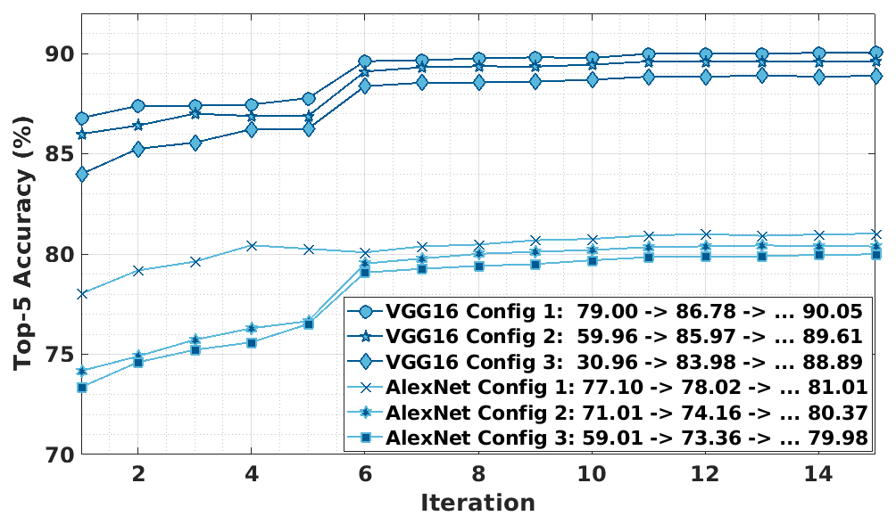
Model Re-training

Slide 8
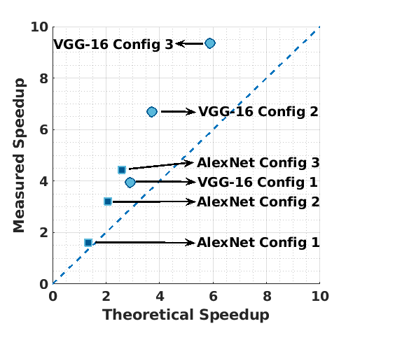
Hardware-aware rank selection
Runtimes are measured on embedded ARM-A57 processor.

Slide 9
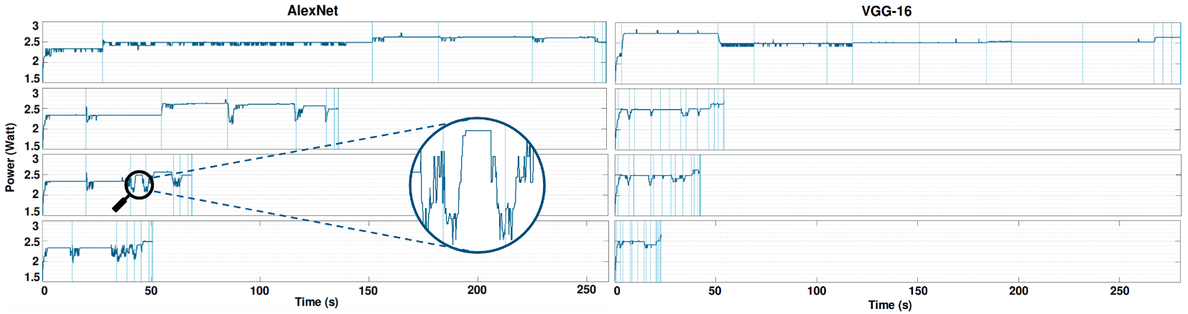
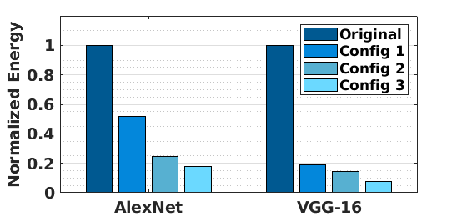
Power and Energy Improvement
Measurements obtained from embedded ARM-A57 processor.

Slide 10
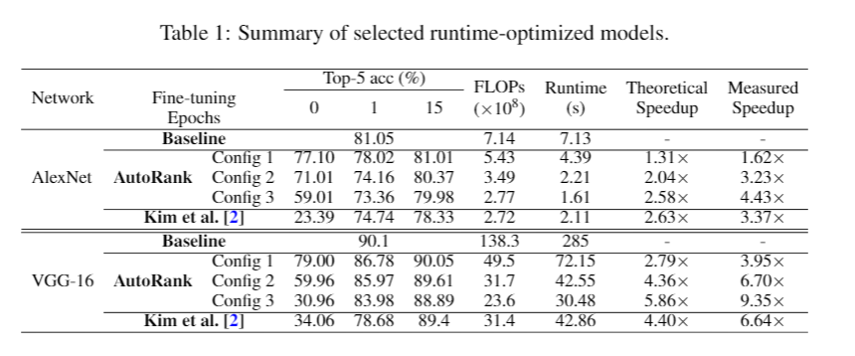
Comparison with Prior Art
Measurements obtained from embedded ARM-A57 processor.
[2] Kim, Yong-Deok, et al. "Compression of deep convolutional neural networks for fast and low power mobile applications." arXiv preprint arXiv:1511.06530 (2015).

Slide 11
Summary
Tensor decomposition is an effective novel model for efficient DNN inference.
We propose AutoRank, a hardware-aware rank selection methodology.
Unlike prior work, our method:
Directly maximizes inference accuracy
Is hardware-aware
Is automated
Accounts for cross-layer correlations
AutoRank eliminates the engineering cost associated with tensor decomposition
AutoRank better pareto curves than the state-of-the-art rank-selection method

Slide 12

Thank you, Questions?

