Slide 1



Coda: An End-to-End Neural Program Decompiler
Cheng Fu¹, Huili Chen¹, Haolan Liu¹, Xinyun Chen³,
Yuandong Tian², Farinaz Koushanfar¹, Jishen Zhao¹,
¹UC San Diego, ²Facebook AI Research, ³UC Berkeley
Coda is the abbreviation for CodeAttack

Slide 2
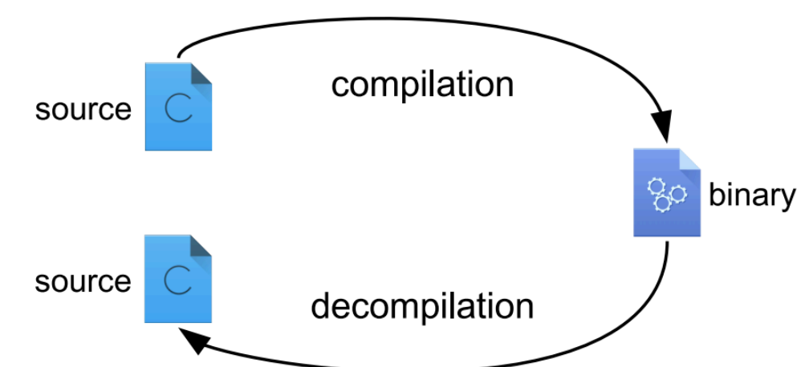
Background: Decompilation
Goal of Decompilation:
Binary executables to High-level programming language
Decompilation for SW defense:
Malware analysis
Vulnerability detection and fixing
Binary comparison/verification
Decompilation for SW attacking:
Reverse engineering software binary with copyright protection for illegal usage.

Slide 3
Challenges
Prior decompilers (e.g. Hex-rey [1], RetDec [2]…) focus on reverse engineering the functionality of binary executables:
Semantics not guaranteed
Many hardware architectures (ISA): x86, MIPS, ARM
Many Programming Languages (PL)
Extra Human effort to extend to the new version of the hardware architectures or programming languages
Our goals:
Maintain both the functionality and semantics of the binary executables
Make the design process end-to-end to easily generalized to various ISAs and PLs
[1] HexRey, 2018, https://www.hex-rays.com/products/decompiler/
[2] RetDec, 2019, https://retdec.com/
Notes:
How can we close the gap

Slide 4
Coda Design Leverage both syntax and dynamic information
Iteratively correct the candidates towards perfect match
Find good candidates
Stage 1
Code
Sketch Generation
Stage 2
iterative
Error
Correction
Low-level code
High level program
End-to-End Framework
Notes:
The answer is yes!! We believe that a holistic on-device attestation solution shall simultaneously optimize the Alg, SW, and HW.
Such co-design is the core of DA framework

Slide 5
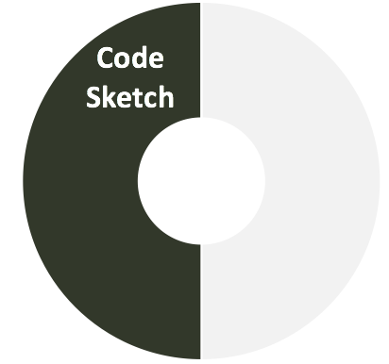
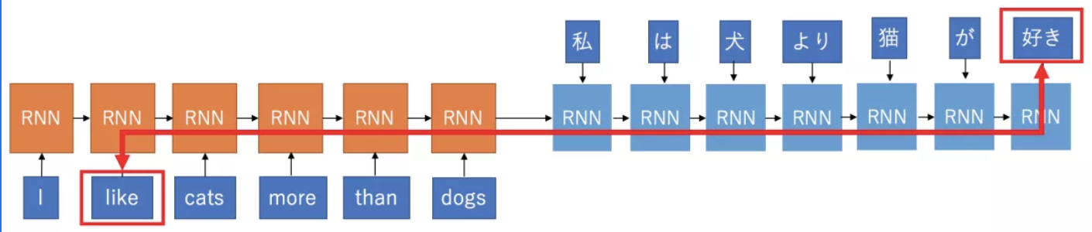
Stage 1: Code Sketch Generation
Intuitively, decompilation is translation problem and can be solved using auto-encoder for machine translation:
However, a naïve sequence-to-sequence model is hard to capture the meaning of low-level code and learn the grammar of high-level PL.
Encoder Recurrent Neural Network (RNN)
Decoder Recurrent Neural Network (RNN)
Notes:
Various hardware platforms such as application-specific accelerators and neuromorphic chips have been designed for efficient DNN execution.

Slide 6
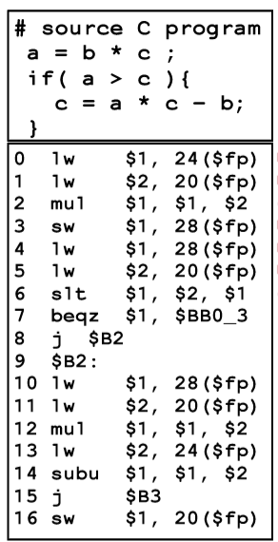
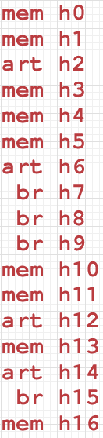
Stage 1: Code Sketch Generation
Instruction-aware Encoder :
Coda leverages N-ary Tree Encoder [3] to capture inter and intra dependencies of the low-level code.
Opcode and its operands are encoded together.
Different encoders are used for encoding different instruction types, namely, memory (mem), branch (br) and arithmetic (art).
[3] Tai, Kai Sheng, Richard Socher, and Christopher D. Manning.
"Improved semantic representations from tree-structured long short-term memory networks."
arXiv preprint arXiv:1503.00075 (2015).
Notes:
Various hardware platforms such as application-specific accelerators and neuromorphic chips have been designed for efficient DNN execution.

Slide 7
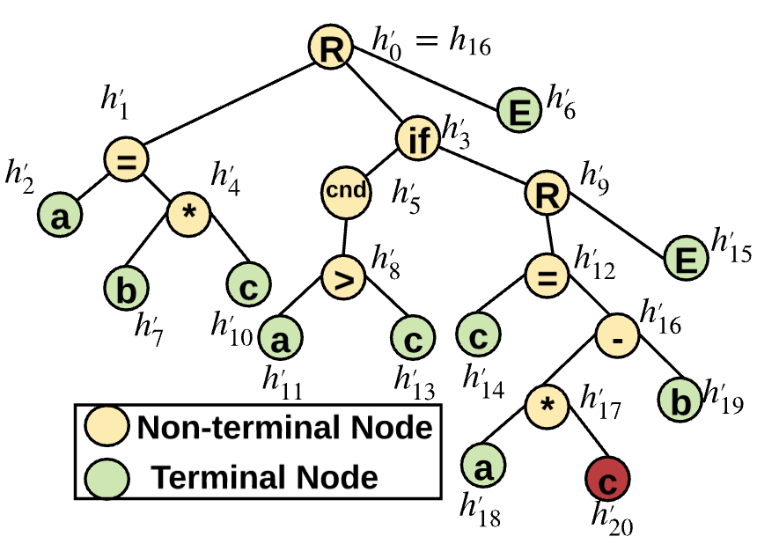
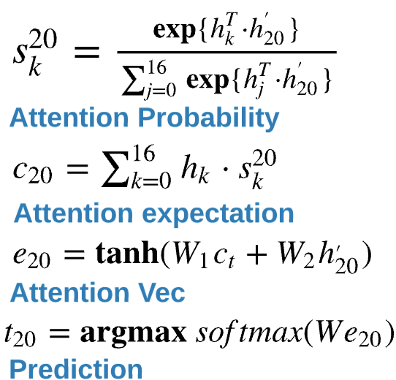
Stage 1: Code Sketch Generation
Tree decoder for Abstract Syntax Tree (AST) generation:
AST can be equivalently translated into its corresponding high level Program
Advantages:
Prevent error propagation/ Preserve node dependency / easy to capture PL grammar
Boundaries are more explicit (terminal nodes)
Parent and input attention feeding mechanism
Notes:
Various hardware platforms such as application-specific accelerators and neuromorphic chips have been designed for efficient DNN execution.

Slide 8
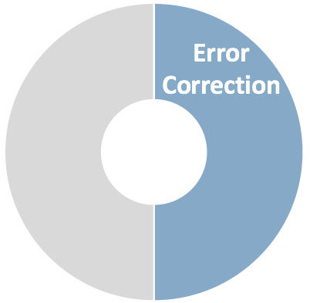
Stage 2: Iterative Error Correction
The sketch generated in Stage 1 may contain errors:
mispredicted tokens, missing lines, redundant lines
Correct the error using an Error Correction machine (EC machine) guided by the Error Predictor (EP).
Optimization techniques:
Prevent the false alarm by recompile the updated sketch code and check its Levenshtein edit loss from the golden input.
Ensemble multiple error predictors to cover more potential errors for updates.
Golden program
If( a > c ) {
a = b + c * a;
b = a – c ;
}
Mispredicted
If( a > b ) {
a = b + c * a;
b = a - b;
}
Missing lines
If( a > c ) {
a = b + c * a;
}
Redundant lines
If( a > c ) {
a = b + c * a;
b = a;
b = a;
}
Notes:
Various hardware platforms such as application-specific accelerators and neuromorphic chips have been designed for efficient DNN execution.

Slide 9
Experimental Setup
Compiler configuration : clang –O0 ( disabled optimization )
Benchmarks:
Synthetic programs:
Karel library (Karel) – only function calls
Math library (Math) – function calls with arguments
Normal expressions (NE) – (^,&,*,-,<<,>>,|,% ….)
Math library + Normal expressions (Math+NE) – replaces the variables in NE with a return value of math function.
Metrics:
Token Accuracy : The percentage of predicted tokens that match with the ground-truth ones.
Program Accuracy: The percentage of programs that yields 100% Token accuracy.

Slide 10
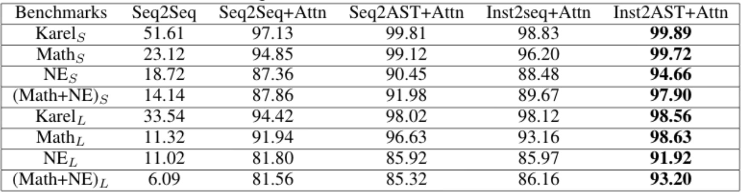
Results – Stage 1 Performance
Token accuracy across benchmarks
Coda yields the highest token accuracy across all benchmarks (96.8% on average) compared to all the other methods.
Coda engenders 10.1% and 80.9% margin over a naive Seq2Seq model with and without attention.
More tolerant to the growth of program length.
Baseline
Ours
X_{S} short programs, X_{L} long programs

Slide 11
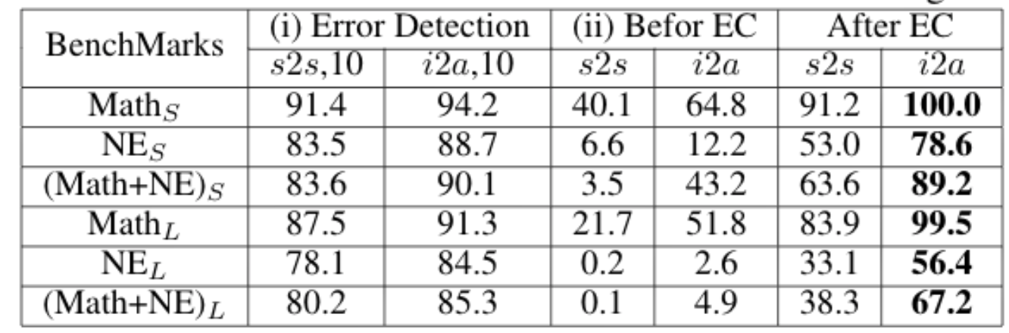
Results – Stage 2 Performance
Part (i): By ensemble 10 EP, Coda achieves 90.8% error detection rate.
Part (ii): Coda’s EC machine increases the program accuracy from 30% to 82% on average for Inst2AST-based code sketch generation, respectively.
Baseline
Coda
s2s = sequence-to-sequence with attention
I2a = instruction encoder to AST decoder with attention

Slide 12
Results -- Overall
Coda vs. traditional decompiler (RetDec)
Lines of code: ~10K vs. ~500K -- 50x reduction
Toolkit size: ~10MB Neural network size vs. ~5GB toolkit size -- 500x reduction
Program accuracy: 82% vs. no semantics guarantee
Summary of Coda
The first neural-based decompilation framework, which preserves both the semantics and the functionality of the high-level program
Decomposes the decompilation task into of two key phases -- code sketch generation and iterative errors correction
Significantly outperforms the Seq2Seq model and traditional decompilers
Notes:
In conclusion

Slide 13
Coda: An End-to-End Neural Program Decompiler
Cheng Fu¹, Huili Chen¹, Haolan Liu¹, Xinyun Chen³,
Yuandong Tian², Farinaz Koushanfar¹, Jishen Zhao¹,
¹UC San Diego, ²Facebook AI Research, ³UC Berkeley
Coda is the abbreviation for CodeAttack

Slide 14
Backup

Slide 15


Coda: An End-to-End Neural Program Decompiler
Cheng Fu¹, Huili Chen¹, Haolan Liu¹, Xinyun Chen³, Yuandong Tian², Farinaz Koushanfar¹, Jishen Zhao¹,
¹UC San Diego, ²Facebook AI Research, ³UC Berkeley
Coda is the abbreviation for CodeAttack

Slide 16
Two-stage framework which leverages both syntax and dynamic information
Code
Sketch
Error
Correction
Low-level code
High level program
Code Sketch Generation:
Find good approximate candidate
Iterative Error Correction:
Iteratively correct the candidate towards perfect
End-to-End framework
Notes:
The answer is yes!! We believe that a holistic on-device attestation solution shall simultaneously optimize the Alg, SW, and HW.
Such co-design is the core of DA framework

Slide 17
Results
Performance of Stage 1: Token accuracy across benchmarks
Summary:
Coda yields the highest token accuracy across all benchmarks (96.8% on average) compared to all the other methods.
Coda engenders 10.1% and 80.9% margin over a naive Seq2Seq model with and without attention.
More tolerant to the growth of program length.
Baseline
Ours
X_{S} short programs, X_{L} long programs

Slide 18
Results
Traditional decompiler (RetDec) vs Coda:
~500K lines of code vs ~10K lines of code. -- 50x more coding workloads
~5GB toolkit size vs ~10MB Neural network size – 500x reduce in toolkit size
0% program accuracy of traditional decompiler vs 82% program accuracy of coda.
Conclusions
In this work, we present the first neural-based decompilation framework which preserves both the semantics and the functionality of the high-level program.
Coda decomposes the decompilation task into of two key phases, namely, code sketch generation and iterative errors correction.
Coda outperforms the Seq2Seq model and traditional decompilers by a large margin.
Notes:
In conclusion

