Slide 1
Virginia Beach Neighborhood Clustering

Slide 2
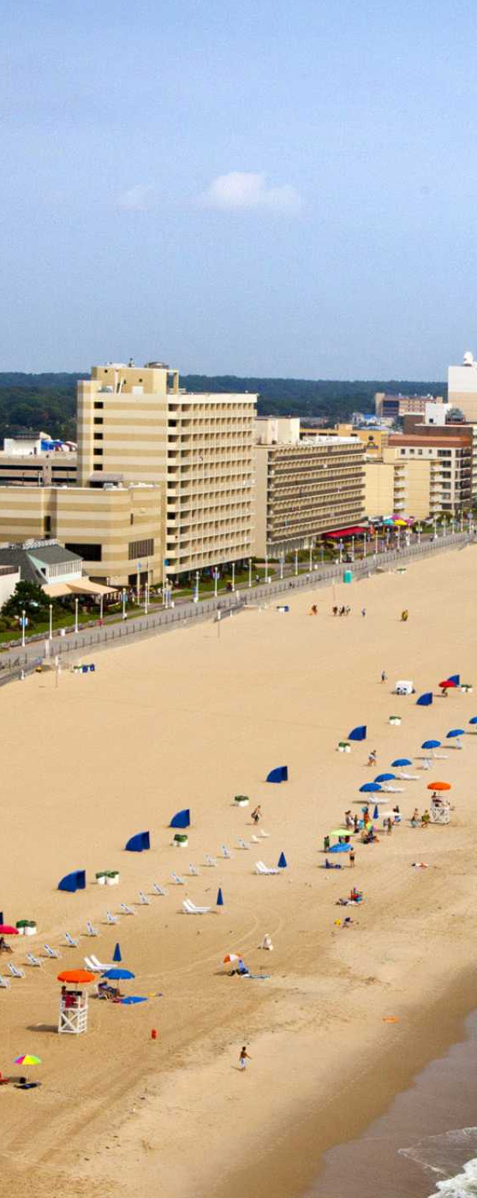
Virginia Beach, VA
Virginia Beach is an independent city located on the southeastern coast of the Commonwealth of Virginia in the United States. It is the most populous city in Virginia and the 44th most populous city in the nation. Located on the Atlantic Ocean at the mouth of the Chesapeake Bay, Virginia Beach is included in the Hampton Roads metropolitan area. This area, known as "America's First Region", also includes the independent cities of Chesapeake, Hampton, Newport News, Norfolk, Portsmouth, and Suffolk, as well as other smaller cities, counties, and towns of Hampton Roads.
Virginia Beach is a resort city with miles of beaches and hundreds of hotels, motels, and restaurants along its oceanfront. A 3-mile boardwalk stretches along its beach-lined oceanfront. The bayside First Landing State Park marks the 1607 arrival of the Jamestown colonists from England. The Virginia Aquarium & Marine Science Center exhibits ocean life including sharks, rays and sea turtles in globally themed habitats

Slide 3
Neighborhood clustering
Neighborhood clustering is an important process by which the different neighborhoods in a city are grouped together based on various parameters
This helps people who are moving into the city or looking to buy a home in the city to understand the city in detail and the livability of each neighborhoods in the city
Once the neighborhoods are classified based on features people will be able to make informed decisions about which neighborhood to choose based on their priorities
Budget will be a crucial factor for some while availability of good schools will be a detrimental factor for some others

Slide 4
Data for clustering
Neighborhood Clustering for the city of Virginia Beach, VA in this project is done based on below parameters -
Home value index(HVI - property price ranges)
Source – Zillow.com(https://www.zillow.com/research/data/)
Safety(number of crime related incidents reported to local law enforcement)
Source – Virginia Beach city electronic police reports online - https://eprodmz.vbgov.com/MainUI/Crimes/CrimeSearch.aspx
Availability of schools
Source - Foursquare
Availability of health care(hospitals, urgent care, Doctor’s office etc)
Source - Foursquare
Category and frequency of different venues in and around neighborhood(category of venues include parks, restaurants, supermarkets, grocery stores etc.)
Source - Foursquare

Slide 5
Clustering Process
Extract and cleanse Zillow neighborhood home value index data
Extract and cleanse neighborhood and zip code data from Virginia Beach city property sales data
Map Zillow neighborhood to matching zip code from property sales data
Extract and summarize crime count from VB police reports at a neighborhood level
Map Zillow neighborhoods with the total crime counts
Using Foursquare obtain school, healthcare access and venue data
Merge Home value, crime, school, healthcare and venue data
Apply K-Means Clustering algorithm on merged data

Slide 6
Clustering Algorithm
K Means clustering algorithm was used to do the clustering of neighborhoods in city of VA beach
A combined data frame which had all the weighted average values for venues, school and healthcare access, Home Value Index(HVI) and crime count was used as input the clustering algorithm
K value was assigned 5 initially and the algorithm ran changing it till 9
Each time an increment of 1 was made and results reviewed
Finally, 8 was the value which gave most accurate results and hence 8 was fixed as value of K
A map was plot using the clustered data to indicate the cluster locations

Slide 7
Clustered Data Snapshot
Below is a snapshot of clustered data with a selected set of columns displayed.
Cluster | Neighborhood | Elementary School | High School | Doctor's Office | Hospital | HVI | Crime Count | 1st Most Common Venue
0 | Oceana | 0.6875 | 0 | 0 | 0.821429 | 231062 | 2686 | Discount Store
0 | Salem | 0.545455 | 0.090909 | 0 | 0.785714 | 299268 | 2631 | Golf Course
0 | Thalia | 0.730769 | 0.115385 | 0.02381 | 0.738095 | 258412 | 2706 | Convenience Store
1 | Bay Colony | 0.666667 | 0.166667 | 0 | 0.75 | 892192 | 158 | Seafood Restaurant
1 | Broad Bay Colony | 0.666667 | 0.166667 | 0 | 0.75 | 840671 | 44 | Seafood Restaurant
1 | Cape Story by the Sea | 0.666667 | 0.166667 | 0 | 0.75 | 696546 | 64 | Seafood Restaurant
1 | Croatan Beach | 0.666667 | 0.166667 | 0 | 0.75 | 870809 | 79 | Seafood Restaurant
4 | Green Run | 0.722222 | 0.166667 | 0 | 0.68 | 227791 | 4807 | Gym / Fitness Center
4 | Kempsville | 0.676471 | 0.176471 | 0.027027 | 0.702703 | 256486 | 4833 | American Restaurant
4 | Princess Anne | 0.730769 | 0.115385 | 0.02381 | 0.738095 | 369781 | 4941 | Convenience Store

Slide 8
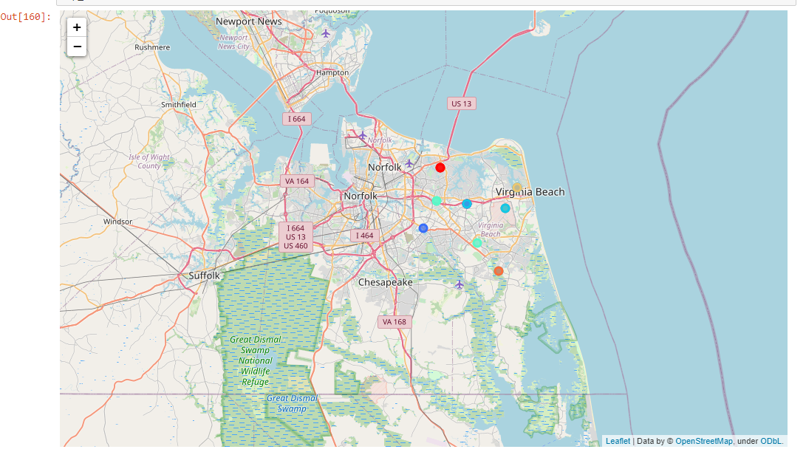
Map after Clustering

